Slide 1
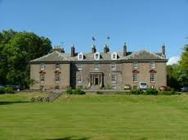
Lockerbie Manor
Primary 7
7th – 11th October 2019

Slide 2
About Lockerbie Manor
Established in 1991
Largest independent operator
Safe and secure location
95% re-booking levels
https://www.manoradventure.com/lockerbie-manor.php

Slide 3
Why Lockerbie Manor?
Sixth trip for Our Lady of the Missions
Tailor made programme
19 outdoor pursuits per week (Mon – Fri)

Slide 4
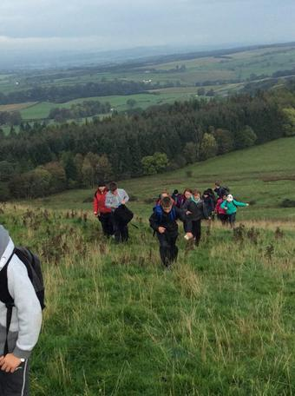
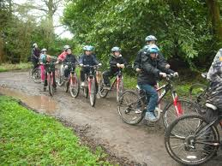
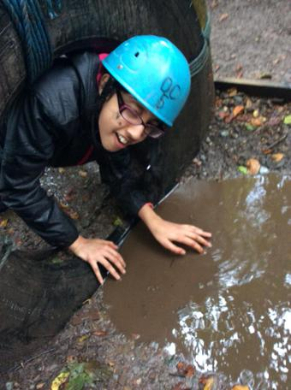
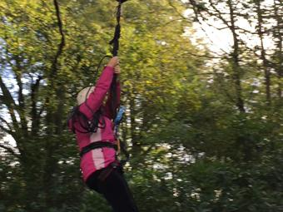
Activities
Abseiling
Archery
Bivouac Building
Blind Trail
Camp craft skills
Canoes/Kayaking
Climbing
Compass work
Crate stacking
Evening walk
Fencing
Film studies/video
High Ropes
Hill Walk
Initiative Exercises
Low Ropes
Manor Olympics
Mountain Biking
Nature Walk

Slide 5
And there’s more…
Obstacle Course
Orienteering
Overnight Camp
Paddle Boarding
Rifle Shooting
Scavenger Hunt
Stand up Paddle Boarding
Survival Skills
Team Games
Volleyball
Wide Games
Zip Wire

Slide 6
Health and Safety
Approved centre status
AALA licence
Regularly inspected by Health and Safety Executive
Conforms to all Governing Body Guidelines
Each outdoor pursuit risk assessed
Pursuits, equipment and instructors continually monitored and assessed

Slide 7
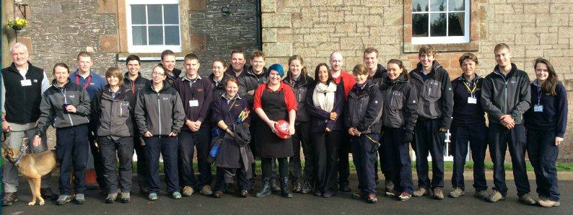
Instructors
Rigorous recruitment and training programme
NGB qualifications (outdoor pursuits)
First aid trained
Fire Marshall trained
Emergency procedures

Slide 8
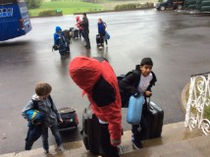
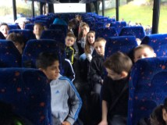
Programme
Arrive around 2.30pm
Children shown to dormitories, fire drill
1st outdoor pursuit at 3.30pm
Each outdoor pursuit lasts 1.5 hours
2nd outdoor pursuit at 7.15pm
Bedtime around 9pm

Slide 9
Accommodation - Pod Villages
2 POD Villages
Luxury camping with heating & electricity
4 bedded pods
Toilet and shower blocks are part of the POD village
Pupils eat in the Manor House

Slide 10
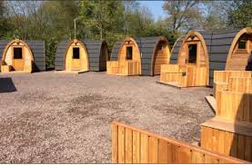
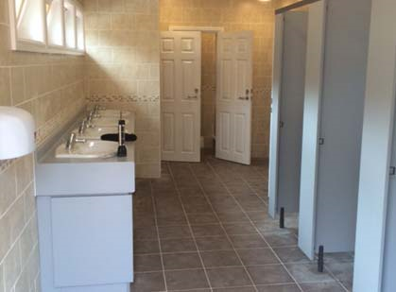
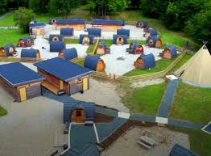
POD Villages

Slide 11
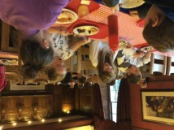
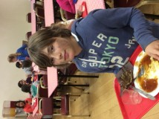
Child friendly and nutritious food
Cooked breakfast
Substantial lunch
Cooked dinner
Plenty of choice
Vegetarian, Vegan, Halal and special diets catered for

Slide 12
General Time Table:
07.30 - Rise & Shine
08.00 - Breakfast
09.00 – 10.30 - Outdoor Pursuit Session 1
10.30 – 10.50 - Break Time
10.50 – 12.20 - Outdoor Pursuit Session 2
12.20 – 13.40 - Lunch Time
13.40 – 15.10 - Outdoor Pursuit Session 3
15.10 – 15.30 - Break Time
15.30 – 17.00 - Outdoor Pursuit Session 4
17.15 – 19.00 - Evening Meal / Free time
19.00 – 20.30 - Outdoor Pursuit Session 5
Bedtime - At the discretion of the school

Slide 13
What to bring?
Sleeping bag
Cagoule and waterproof trousers
Kit List - Old clothes
EVERYTHING MUST BE LABELLED
NO MOBILE TELEPHONES OR ELECTRONIC APPLIANCES

Slide 14
What do the children think?

Slide 15
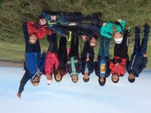
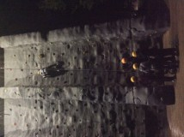
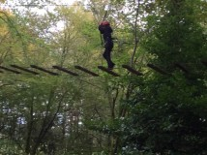
Exciting
I made loads of new friends in different classes.
Erin D P7
2018/19
Lockerbie was amazing. I loved all of the activites, food and spending time with my friends.
Amelia P7
2018/19

Slide 16
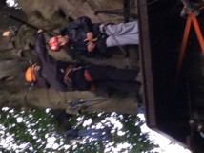
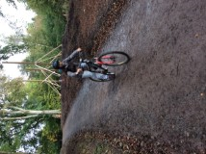
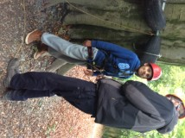
Demanding
The food was really good and so were all of the activities.
Conor P7
2018/19
I really enjoyed meeting all of the instructors because they were all very kind.
Niamh P7
2018/19

Slide 17
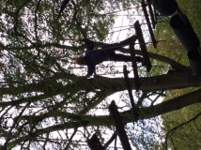
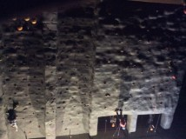
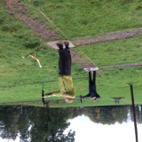
Unnerving
It is a great experience and you have fun with your friends.
Michael P7
2018/19
I think the whole experience was good because it gives us independence and it let us do things we might not do everyday.
Liam P7
2018/19
Lockerbie Manor was the best experience I have ever had. You will regret if you don’t go.
Isla P7
2018/19

Slide 18
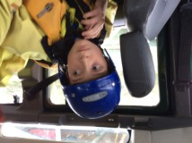
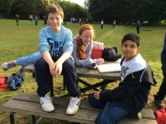
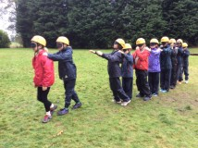
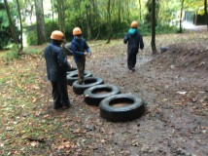
Experience the unknown
It helps us get into a routine of getting up early. The food is great.
Charlie P7
2018/19
It is an amazing experience. There are amazing but challenging activities. The food is really good.
Marissa P7
2018/19
Lockerbie is a great opportunity to hang out with friends and learn new skills.
Eleanor P7
2018/19

Slide 19
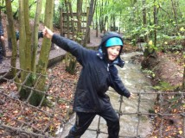
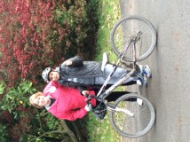
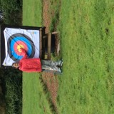
Personal Achievement
Lockerbie is a great experience and I would have been disappointed to have missed out.
Aaron P7
2018/19
Lockerbie is an amazing experience with tons of new and exciting activities. It helps make new friends and grow in confidence.
Mairead P7
2018/19

Slide 20
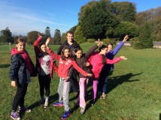
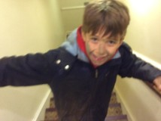
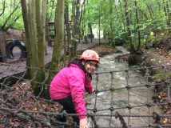
Inner confidence and self-esteem
You get to know new friends and get to do loads of great activities.
Max P7
2018/19

Slide 21
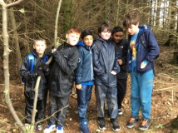
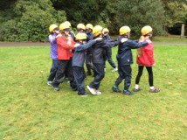
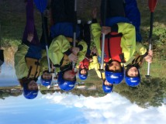
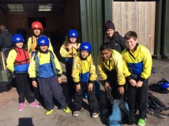
Team building
I loved the breakfast as it fills you up for the day!
Kieran P7
2018/19
Lockerbie is a great experience to make new friends and learn new skills.
Cael P7
2018/19

Slide 22
Serious, structured, safe…. …challenging and rewarding….

Slide 23
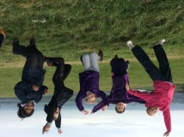
…and it is also great fun!

