Slide 1
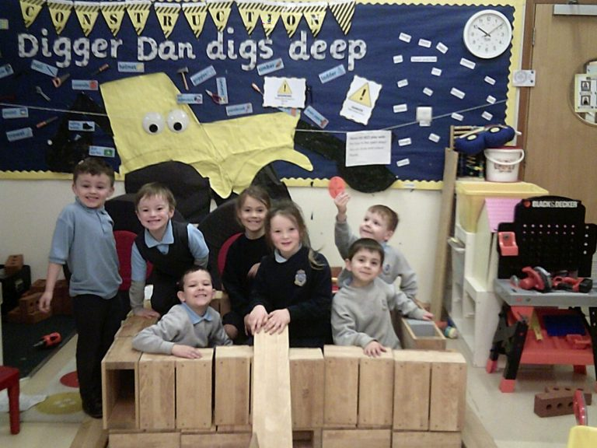
Our Lady of the Missions Primary P1 Induction may 2019

Slide 2
Welcome
Mrs Dillon-Ruddy/ Father Stephen
P1 Information
Mrs Duns
PC/PSA
Marketplace
School Admin
ERC Catering Services
Uniforms
Out of School Provision
Pupil Representatives
Children will return to the hall one class at a time.

Slide 3
Curriculum Rationale

Slide 4
Inspection Report
Gospel values and positive relationships permeate the daily life and work of this community of faith and learning.
The highly articulate, confident and ambitious children. Their knowledge and influence in decision making in relevant contexts about the school, wider community, national and global issues is strong.
They receive high quality feedback to support their understanding of progress within literacy and numeracy.

Slide 5
Inspection Report
•
• Children’s progress is carefully tracked; commendably involving the associated early learning and childcare setting and secondary school.
• The very high levels of children’s attainment in literacy, numeracy and science through a whole school approach ensuring excellence and equity of opportunity for all children.
• Highly effective leadership of all staff and their team work which focuses on improving outcomes for children.
• The leadership of the headteacher and senior management team in quality assuring the work of the school and the focus on high quality learning and teaching.

Slide 6
Inspection Report
Teachers plan lessons well to include differentiated tasks and activities for groups and individuals to meet their needs.
Planning for children with additional barriers to learning is highly effective.
Creative approaches in the use of digital technologies to extend learning giving children experiences that would not normally be accessible.
Children have a very good understanding about the skills they are developing through the 10 ‘Children on a Mission: We’re Reaching for the Stars’ framework.

Slide 7
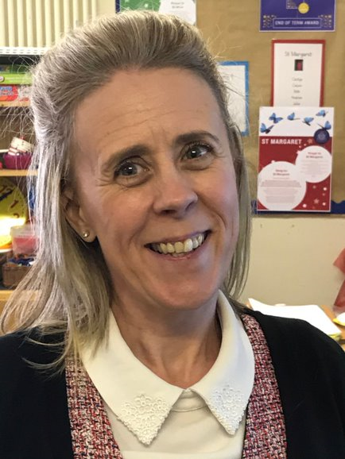
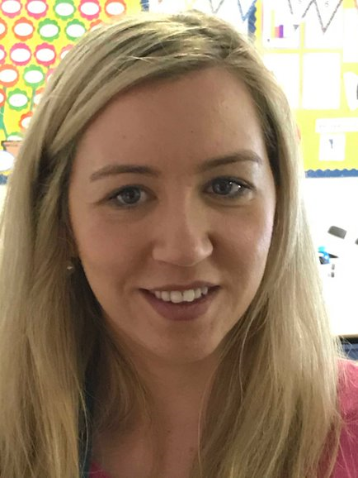
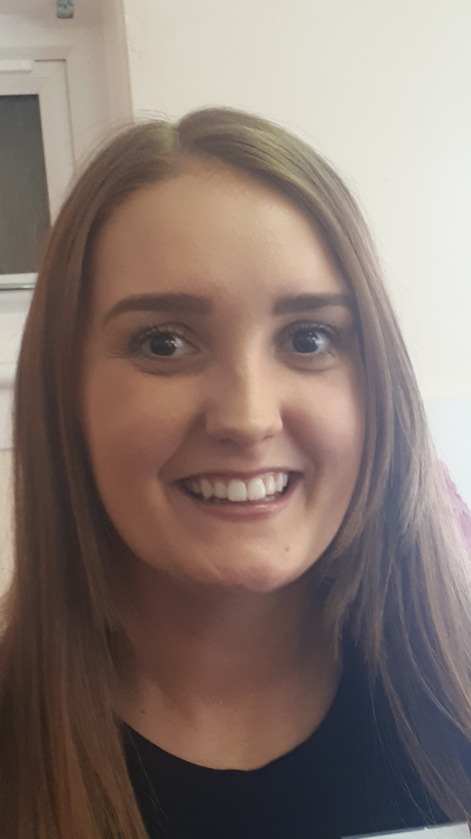
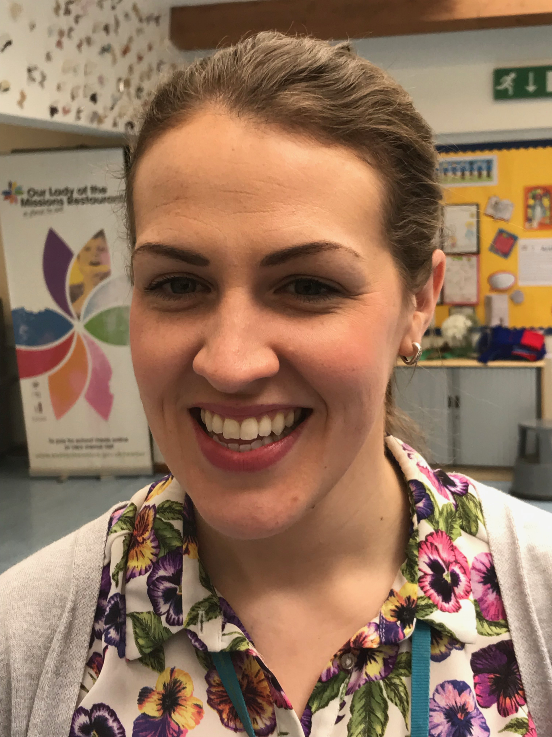
Teachers
P1a Mrs Taylor
P1b Miss Quinn
P1c Miss McRobb and Mrs Burke PT

Slide 8
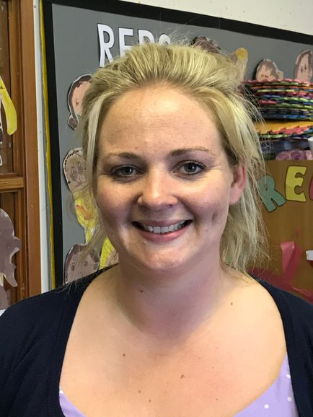
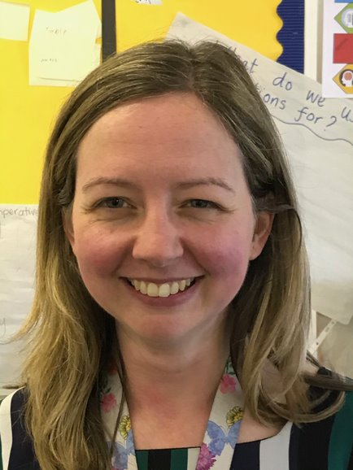
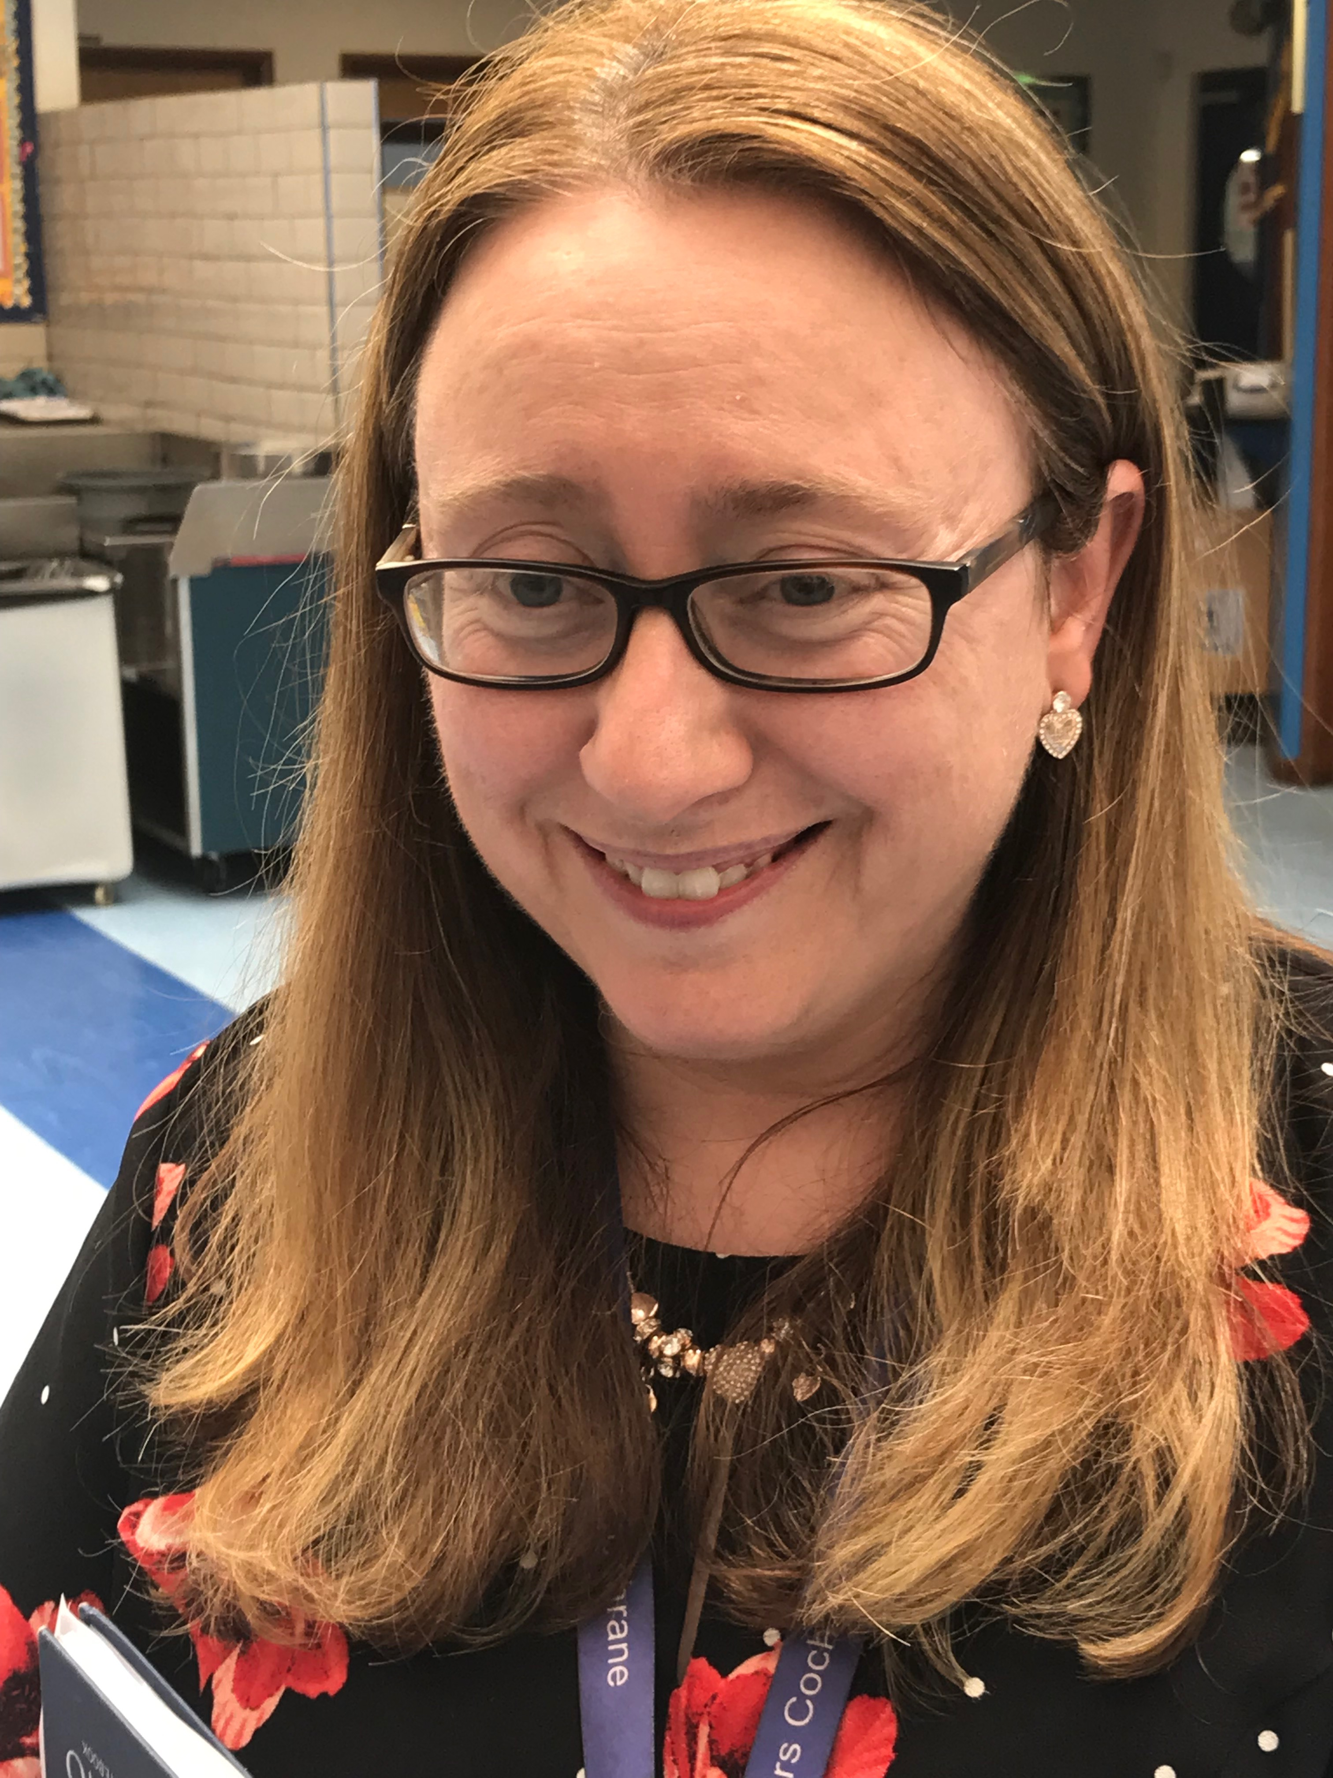
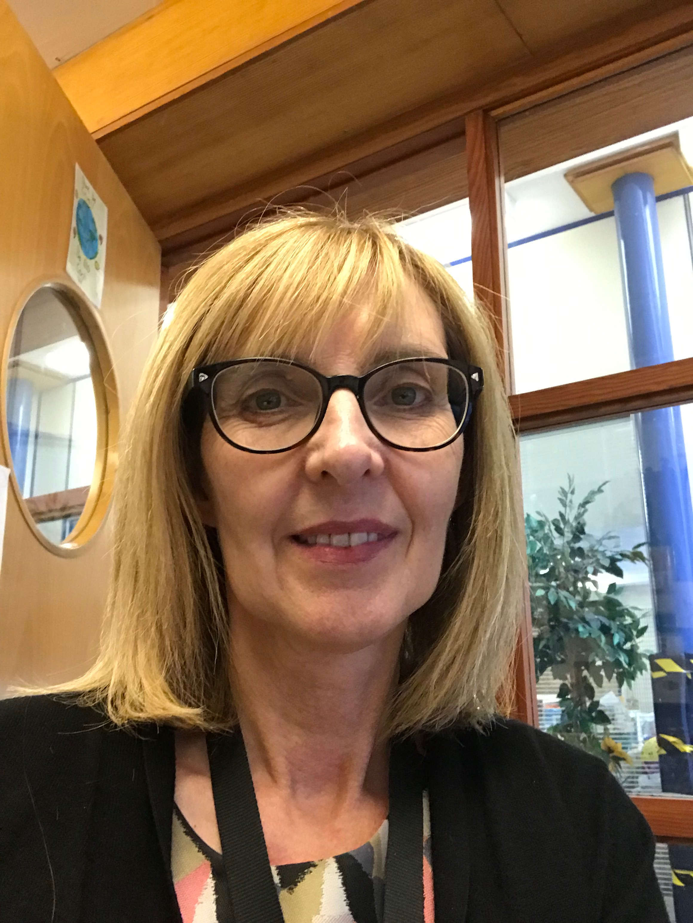
Teachers
P1d Miss Scott
P1e Mrs Milmore
Mrs Cochrane (support for learning)
Mrs Duns DHT

Slide 9
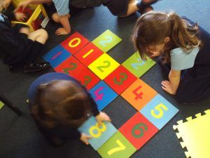
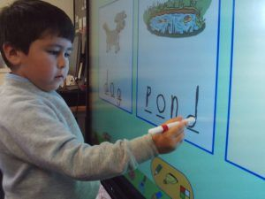
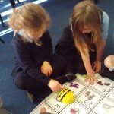
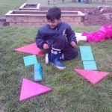
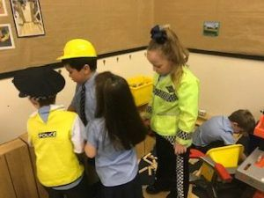
A Day in the Life of P1
Literacy/ Digital
Numeracy
Independent Learning/ Play

Slide 10
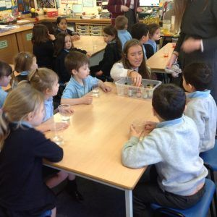
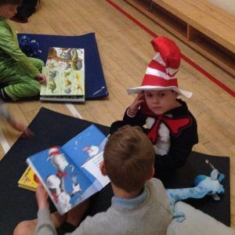
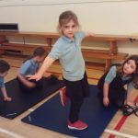
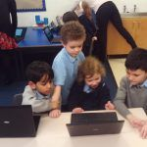
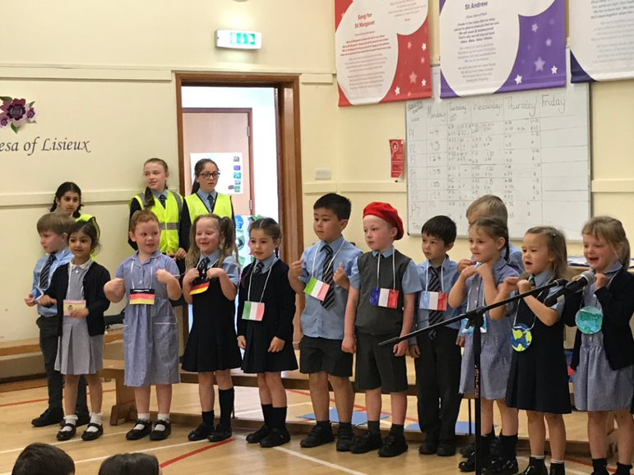
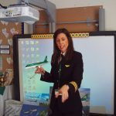
A Day in the Life of P1
STEM
Buddies
Health and Wellbeing
Social Studies/ DYW
Assembly
Digital

Slide 11
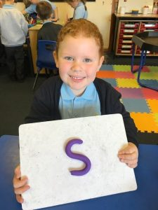
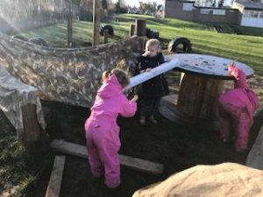
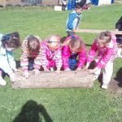
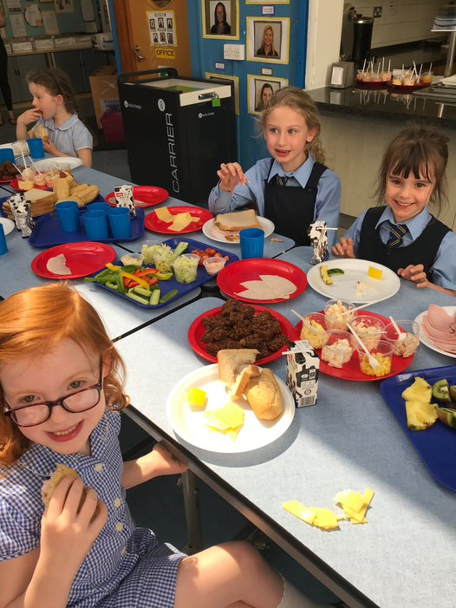
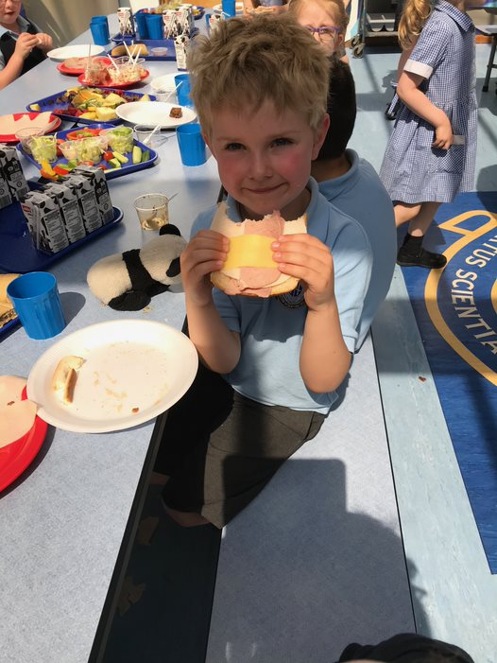
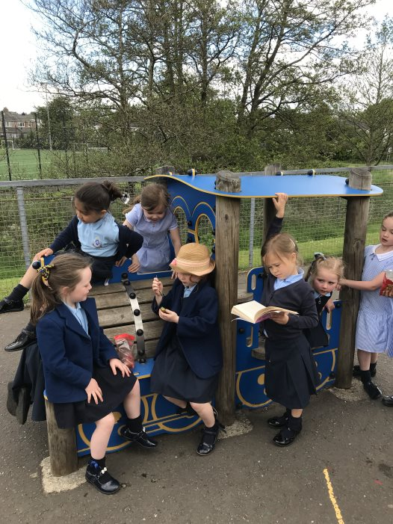
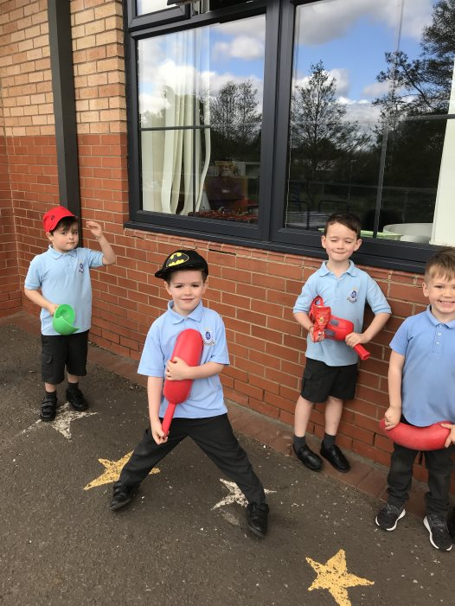
A Day in the Life of P1
Developing social skills
Independence
Team working
Lunchtime
Playtime

Slide 12
Preparing for School
• Talk to your child positively about school
• Discuss the school day – what to expect
• Encourage independence – changing clothes, shoes and
coats, packing and carrying bags, toilet, cutlery, tidying up
• Practise turn taking, sharing, focussing on a game or task
• Literacy and Numeracy - share books, rhymes, numbers and letters in the environment, pencil grip
• Visit P1 class blog, Information page and P1 video
• Put name tags on all clothing and shoes

Slide 13
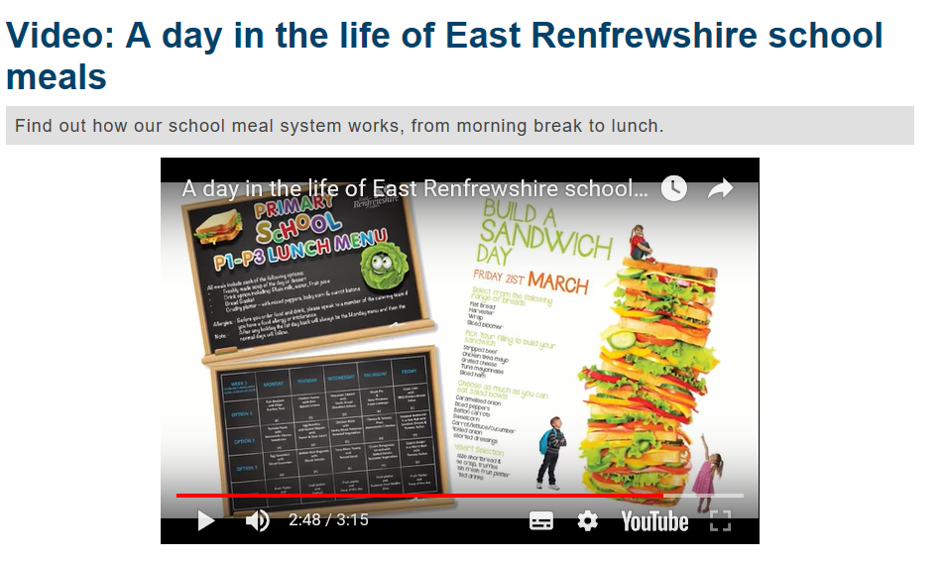
School Lunches
Forms for pupils choosing halal options can be completed and handed in today.

Slide 14
First Days – Timetable
Date | Time | What | Where
First Day of Term Monday 19th August 2019 | 9.10am | P1d, P1e Gather at cones in P1 playground. Entry via P1 doors. | Accompany children to classes. Leave class by 9.20. Exit via main entrance.
First Day of Term Monday 19th August 2019 | 9.20am | Gather at cones in P1 playground. P1a, P1b, P1c Entry via P1 doors. | Accompany children to classes. Leave class by 9.30. Exit via main entrance.
End of first school day for first week | 2.50 pm Thereafter 3.10pm | Pupils are dismissed by class teacher. P1a/ P1b/ P1c will come to the bottom of the ramp. P1d/ P1e come down the stairs. Please keep the exit clear and wave to your child so that the teacher can see who is collecting them. Pupils who leave on school buses will be escorted to their buses separately. Please inform school office of bus arrangements. | P1 entrance.
All term days thereafter | 8.50 -9.00 | Pupils say goodbye to parent/care and line up at cones in playground. Pupils who arrive on school buses will be supervised from the bus to the P1 doors and escorted to the buses at the end of the day. | P1 playground. Class lines.
P1 Lunch Experience | P1a 27th Aug P1b 28th Aug P1c 29th Aug P1d 3rd Sept P13 4th Sept | Parents/carers will be invited to join their child for lunch. Please join your child as they line up for lunch. They will demonstrate how they get their lunch, eat and clear. Please then say goodbye to them in the lunch hall. They will return to their classes. | MENSA 12 noon

Slide 15
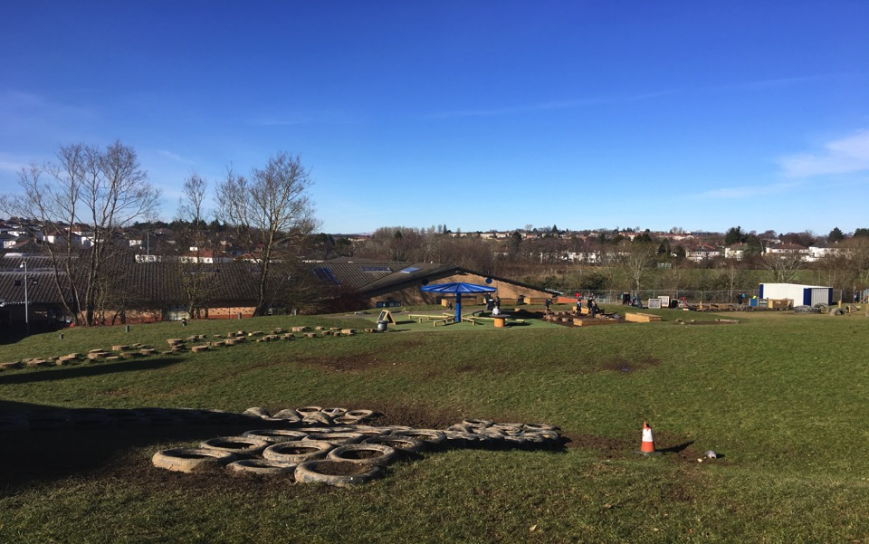
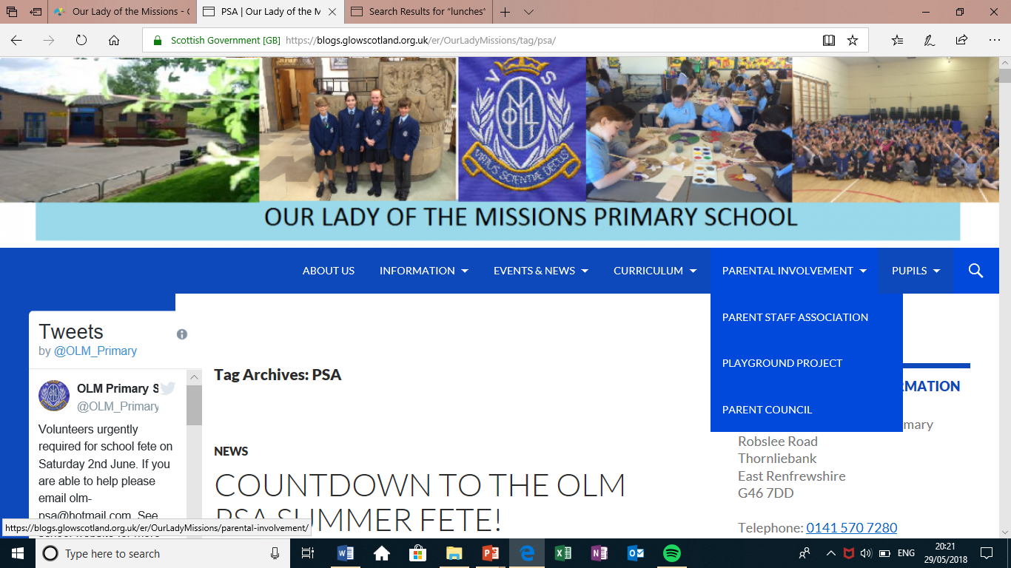
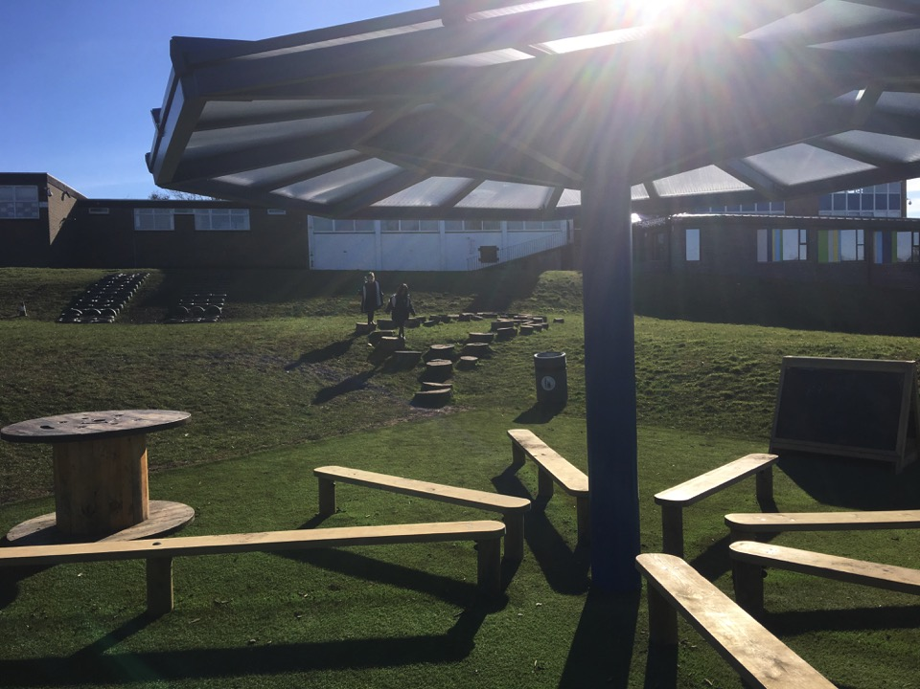
Parent Council and Parent Staff Association
Chairperson of the Parent Council: Christopher McLaughlin Vice Chairperson of the Parent Council: Lorna McIntosh
PSA - PSA Co-Chairs: Christine Devine and Caroline Kelly
P1 Advice booklet for parents by parents

Slide 16
OLM Parents – welcome
60th Anniversary Summer Fayre
Holmwood House Saturday 1st June

Slide 17
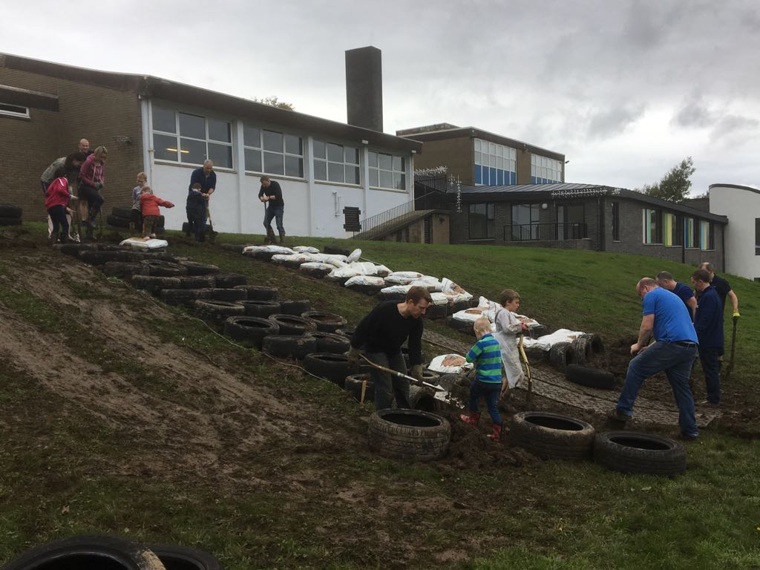
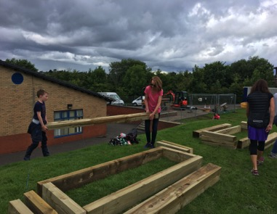
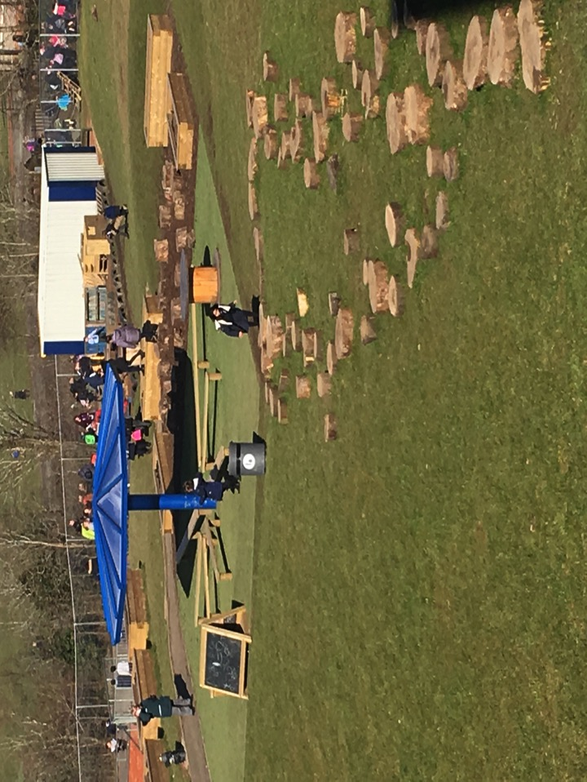
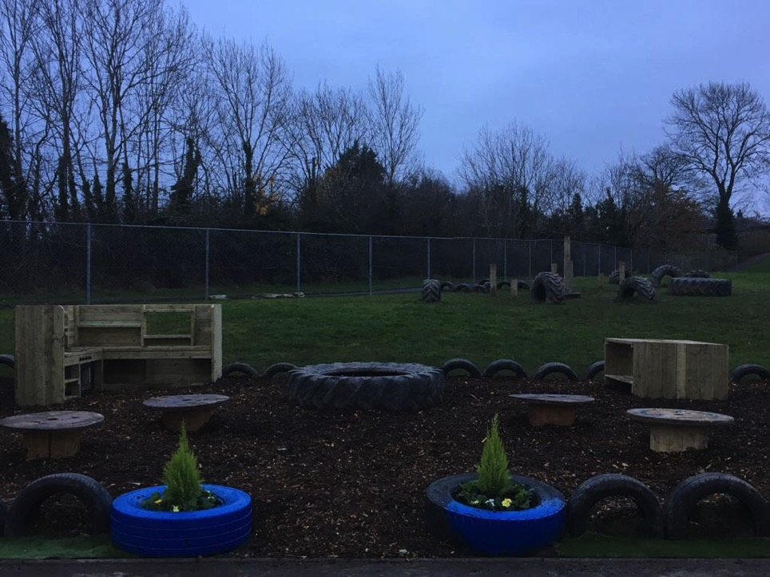
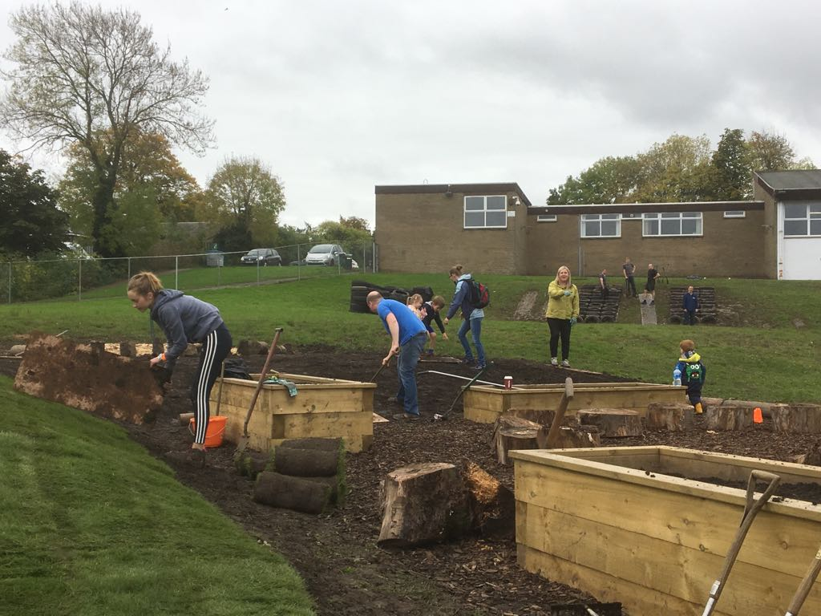
OLM Parents – get involved

Slide 18
OLM Parents – get involved

Slide 19
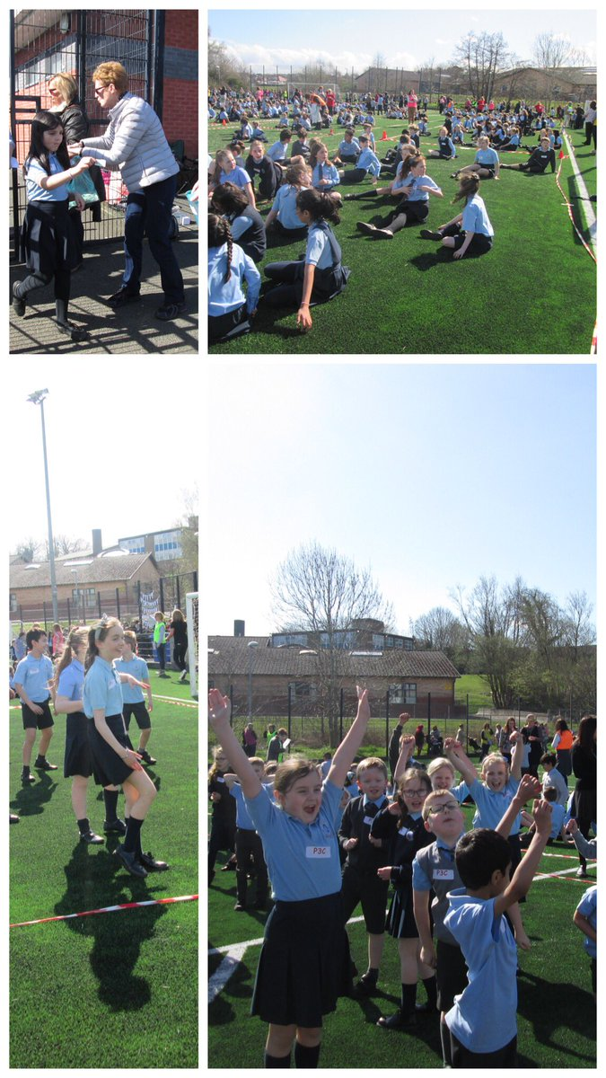
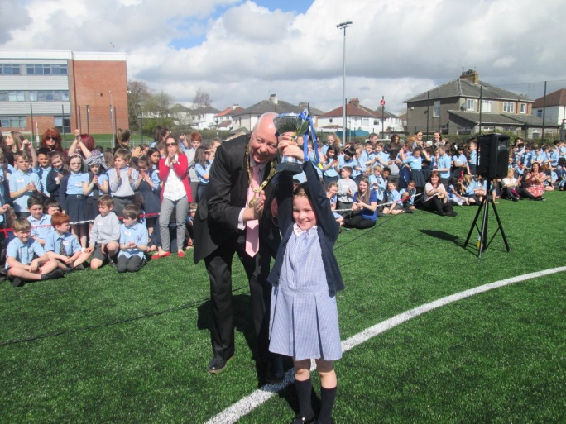
OLM Parents – get involved

Slide 20
Contacts/ Information
Class Teacher Communication Diary
Telephone – 0141 570 7280
Email – office@ourladymissions.e-Renfrew.sch.uk
Website - https://blogs.glowscotland.org.uk/er/OurLadyMissions/
Twitter - https://twitter.com/OLM_Primary
Transition Info- https://blogs.glowscotland.org.uk/er/OurLadyMissions/preparing-for-school/transition/
Monthly newsletter on Sway

Slide 21
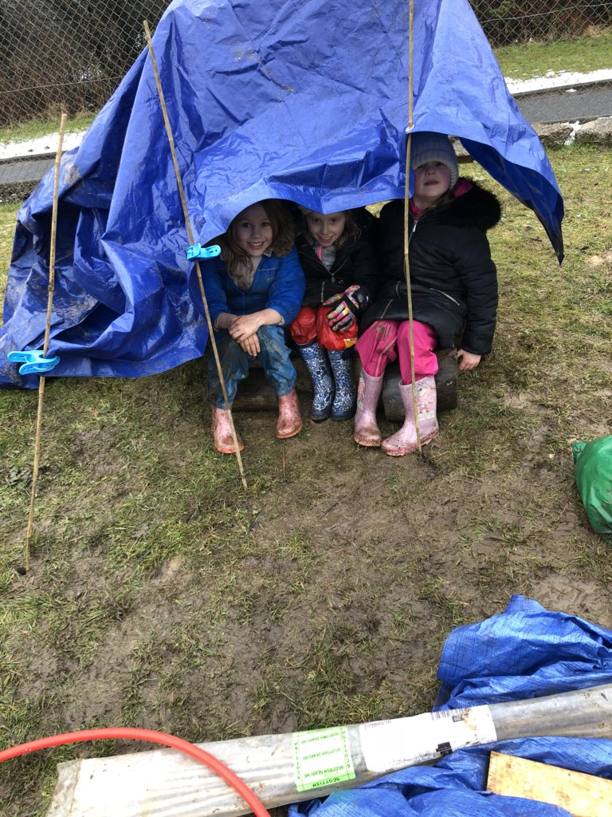
Welcome to Our Lady of the Missions
We are
Children on a Mission
and
we’re reaching for the stars

