Slide 1
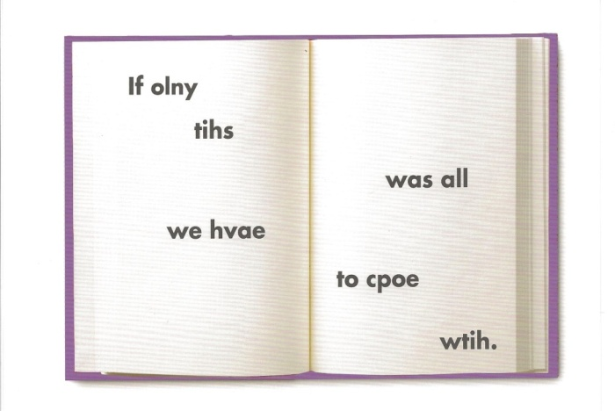
Dyslexia Scotland Glasgow East Ren
GLASGOW DYSLEXIA SUPPORT SERVICE
Presents
Support for Dyslexic Learners with the new SQA
Assessments
MONDAY 15th September 2014,
7.15pm-8.15pm
Williamwood High School, Newton Mearns
Parents and Pupils
Are welcome to our
OPEN MEETING
Our New Email Address is dyslexiascotland.er@gmail.com

