Slide 1
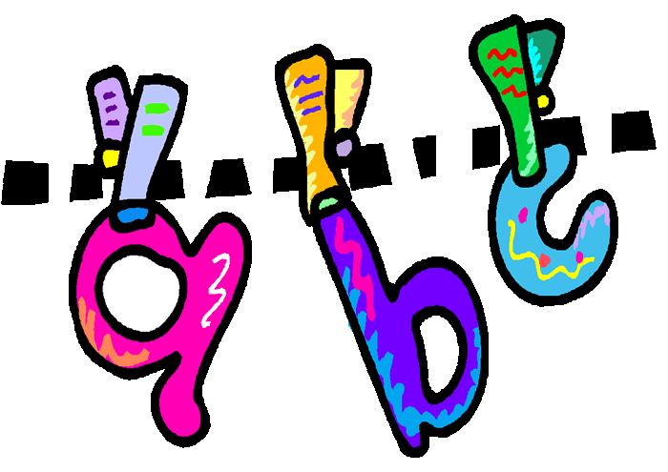
Spelling Guidance for Parents

Slide 2
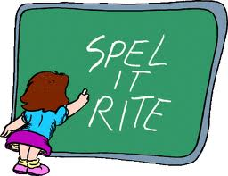
Helping your child with spelling
The English spelling system is hard. However, about 85% of it follows rules and patterns, so learning about spelling is useful and will make a difference. The most helpful thing you can do to help your child is to stay positive. Some children will spell accurately with seemingly very little effort. Most will experience some degree of struggle. Some will find it very tricky. The degree of difficulty they experience is not linked to intelligence. The ability to use memory strategies will emerge and improve, if well supported. Our aim might be to produce accurate spellers, but the journey to this is to nurture spellers with good self-esteem, who have explored a range of self-help strategies and begin to find out which ones work best for them.

Slide 3
How to support writing
Always ask your child to have a go. What do you know about the word?
What is the first sound?
Can we break it down into sounds or syllables?
Which part of the word is most difficult?
Do we know any other words like this?
If there is an error in your child’s attempt – talk about why this part of the word is tricky, and how it could be remembered. Come back to spelling this word – or words like it – at other times in the day.
cat-er-pill-ar

Slide 4
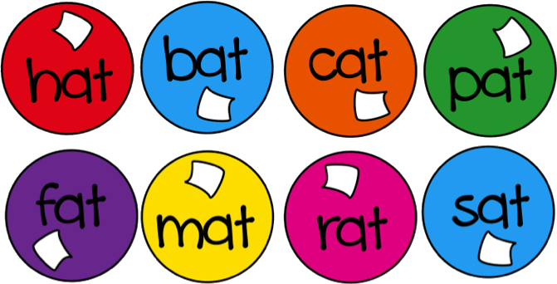
Finding the write right strategy
Top tips to learn how to spell:
Break it into sounds (p-i-c-n-i-c)
Break it into syllables (re-mem-ber)
Break it into root words and affixes (un-break-able)
Use a mnemonic (necessary – one collar and two sleeves)
Use your knowledge of word roots (two is a number like twelve and twenty)
Use word families (would, could, should)
See words within words (friend until the end)
Use spelling rules (writing, written)
By sight - learn the shape of the word – look, say, cover, write, check
By movement – get used to writing the word (with your finger, with a pen, in the air, on the keyboard)

Slide 5
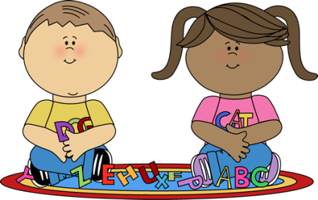
Using games and play to spell
Notice language around you, e.g. making up words from letters on number plates, noticing words that are deliberately (or otherwise!) misspelled by newspapers, advertisers and shop keepers (e.g. Krispy Kreme)
Play hangman, crosswords, word searches, jumbled words and anagrams.
Play commercial games like Scrabble, Boggle, Pass the bomb, Lexicon.
Be interested in etymology (word derivations). Find out where oddly spelt words come from (e.g. where did the ‘ph’ sound come from? So what kinds of words use these letters?)

