Slide 1
Achievements
Friday 9th September 2016

Slide 2
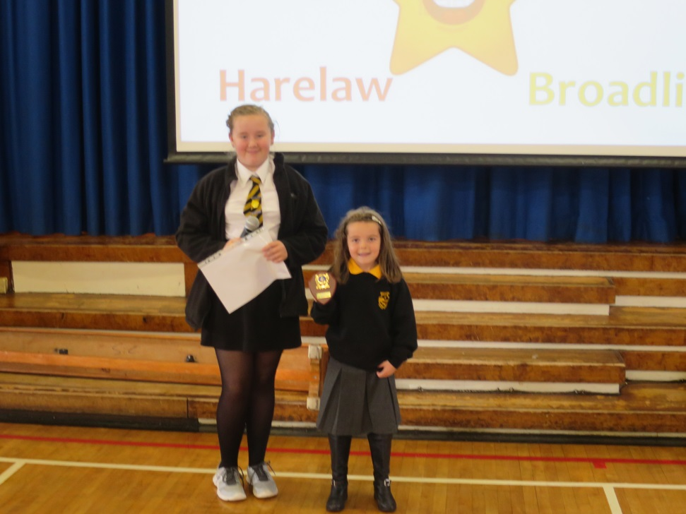
Broadlie
Olivia was presented with a Roseball trophy at Girl’s Brigade,

Slide 3
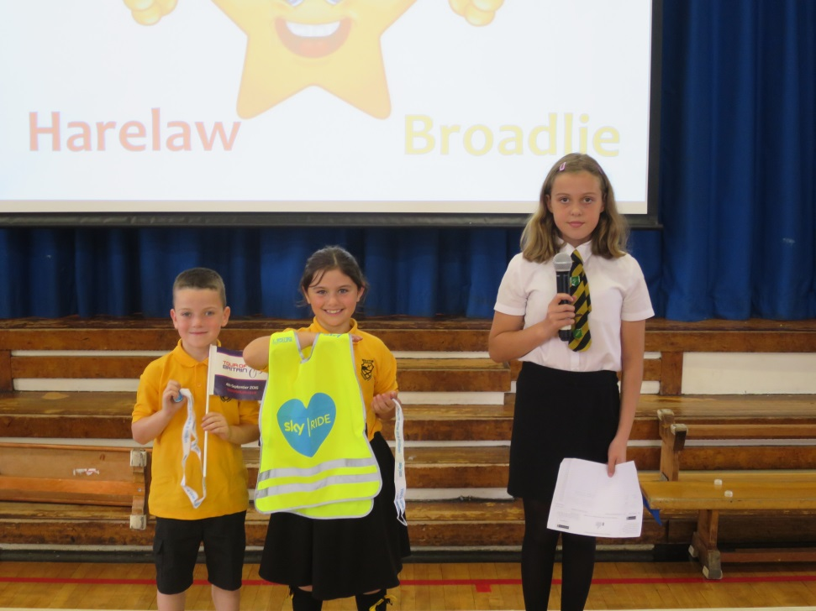
Kingston
Andrew and Beth both took part in the Sky Ride cycle through Glasgow.

Slide 4
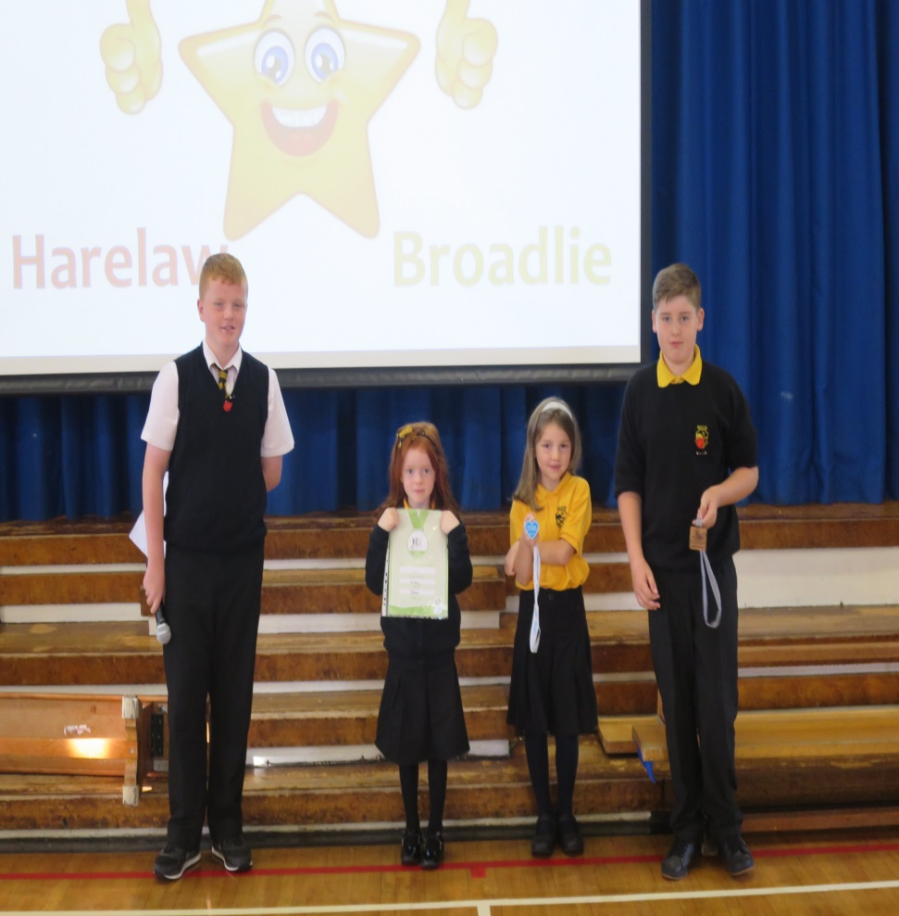
Harelaw
Ruby received a certificate for fencing and archery.
Jenna was given a medal for cycling.
Kyle took part in go-karting and won a medal.

Slide 5
Caldwell
No achievements for Caldwell this week.
Keep trying hard for next week!

