Slide 1
Achievements
Friday 6th January 2017

Slide 2
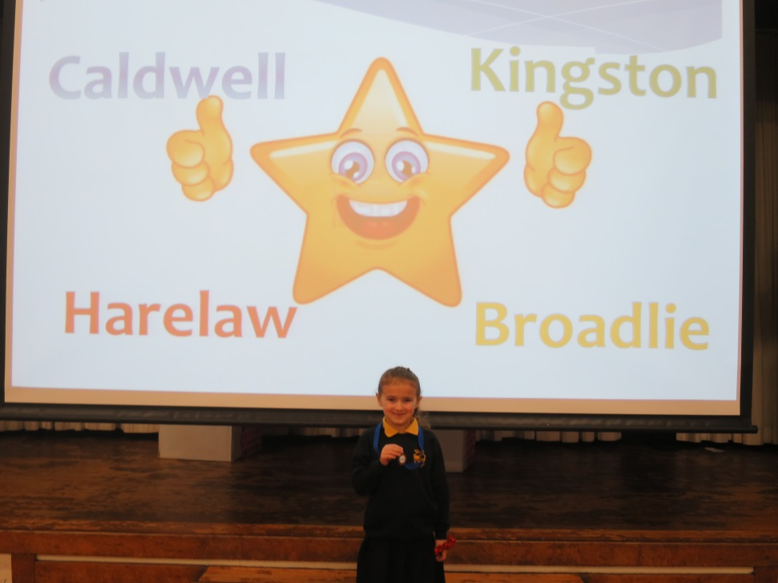
Broadlie
Rosie has received a gymnastics medal.

Slide 3
Kingston
Deacon was given a medal for best performance at football.

Slide 4
Harelaw
No achievements this week.

Slide 5
Caldwell
No achievements this week.

