Slide 1
Achievements
Friday 9th September 2016

Slide 2
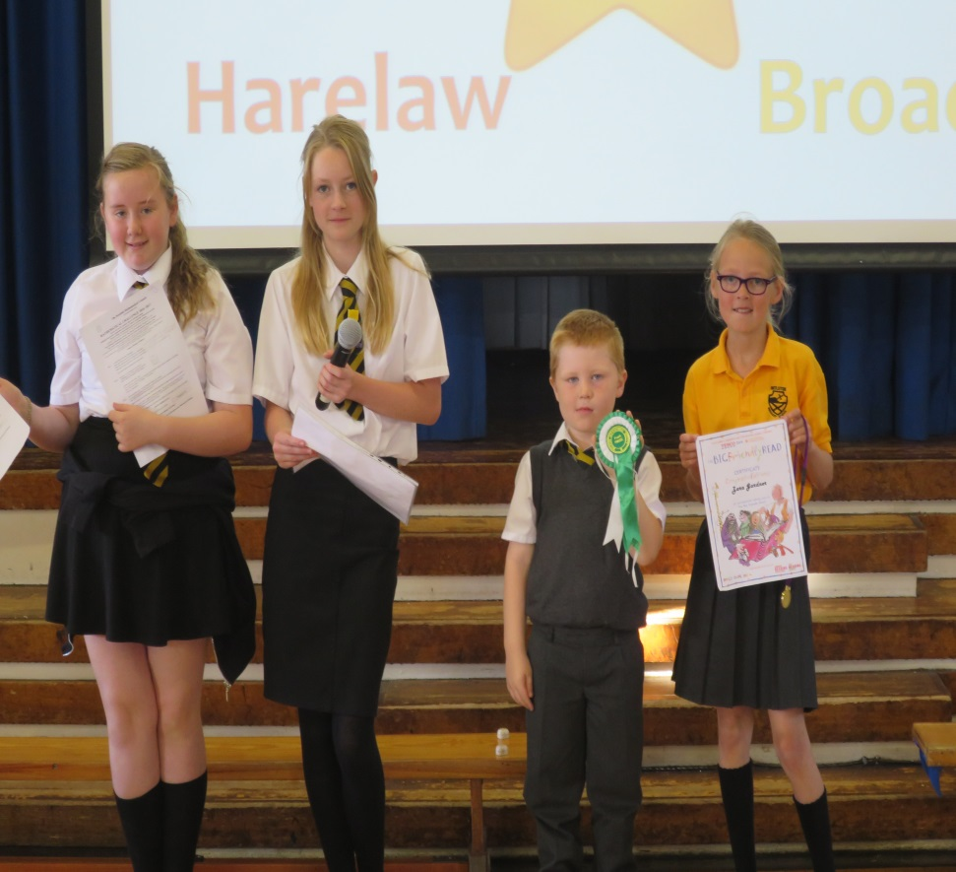
Broadlie
Zara completed the summer reading challenge.
Ollie’s dog got 4th place in the cattle show.
Katy, Niamh & Callum took part in the Scottish Maths Challenge.

Slide 3
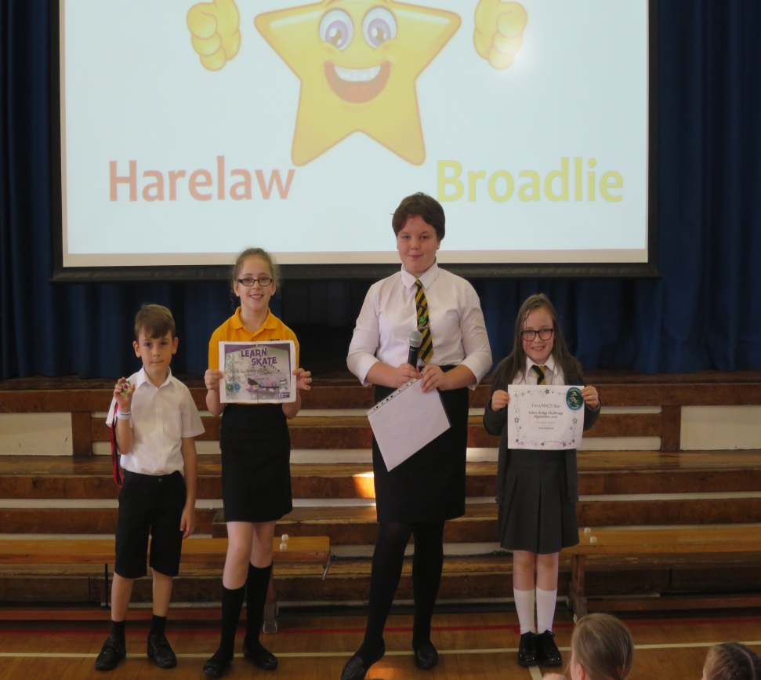
Kingston
Austin got a running medal.
Hannah has an Ice Skating certificate.
Erin received a MACS badge.

Slide 4
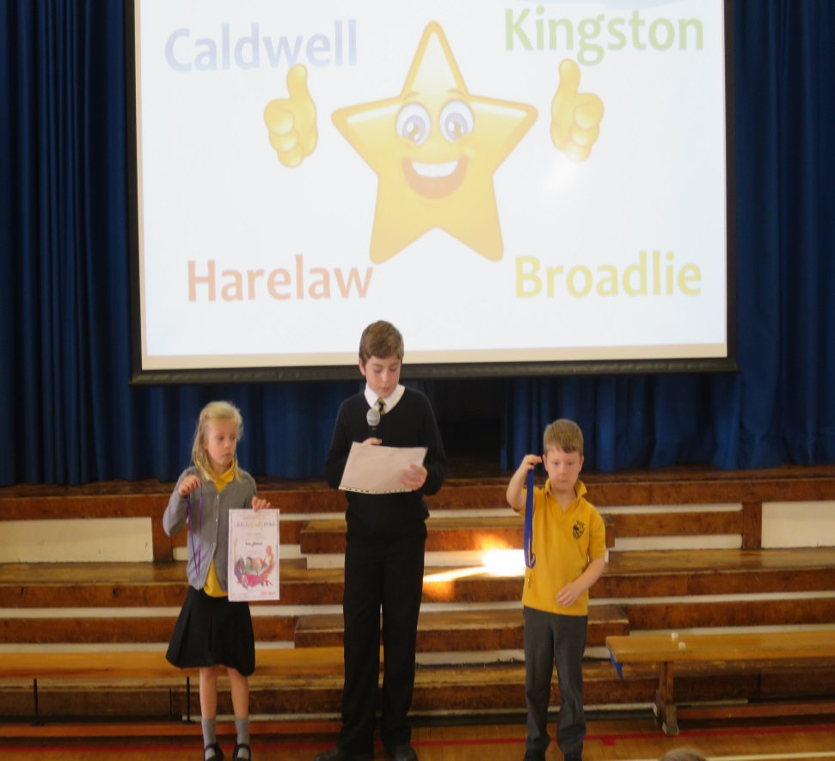
Harelaw
Isla has a certificate for completing the summer reading challenge.
Aaron has a swimming medal.

Slide 5
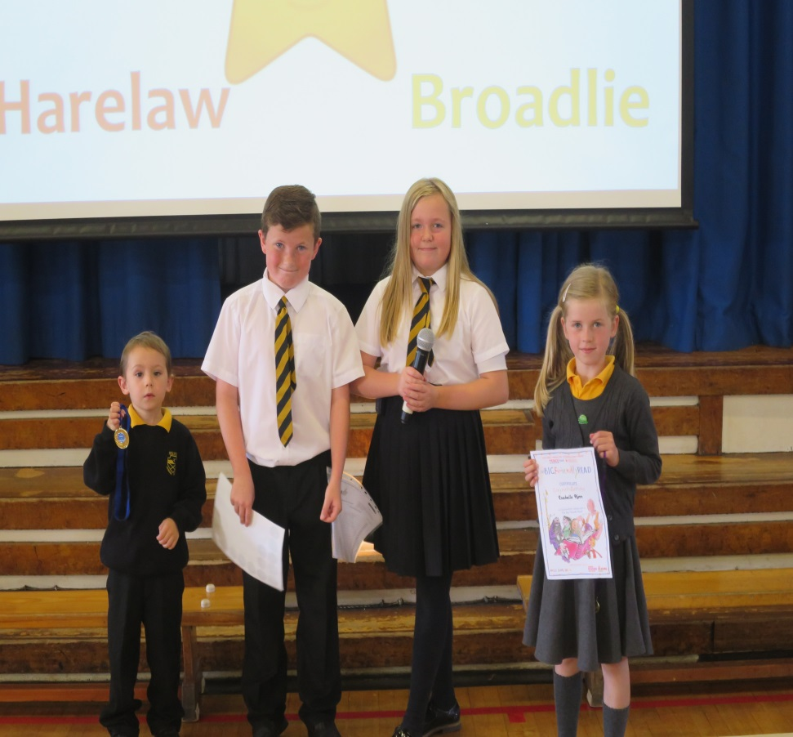
Caldwell
Isabella completed the summer reading challenge.
Ollie swam 10 metres.

