Slide 1
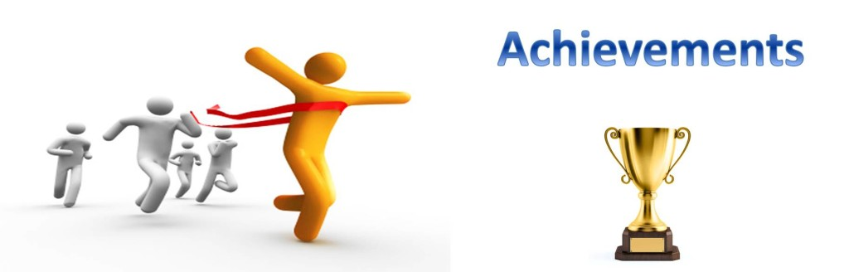
Achievements
Friday 10th March 2017

Slide 2
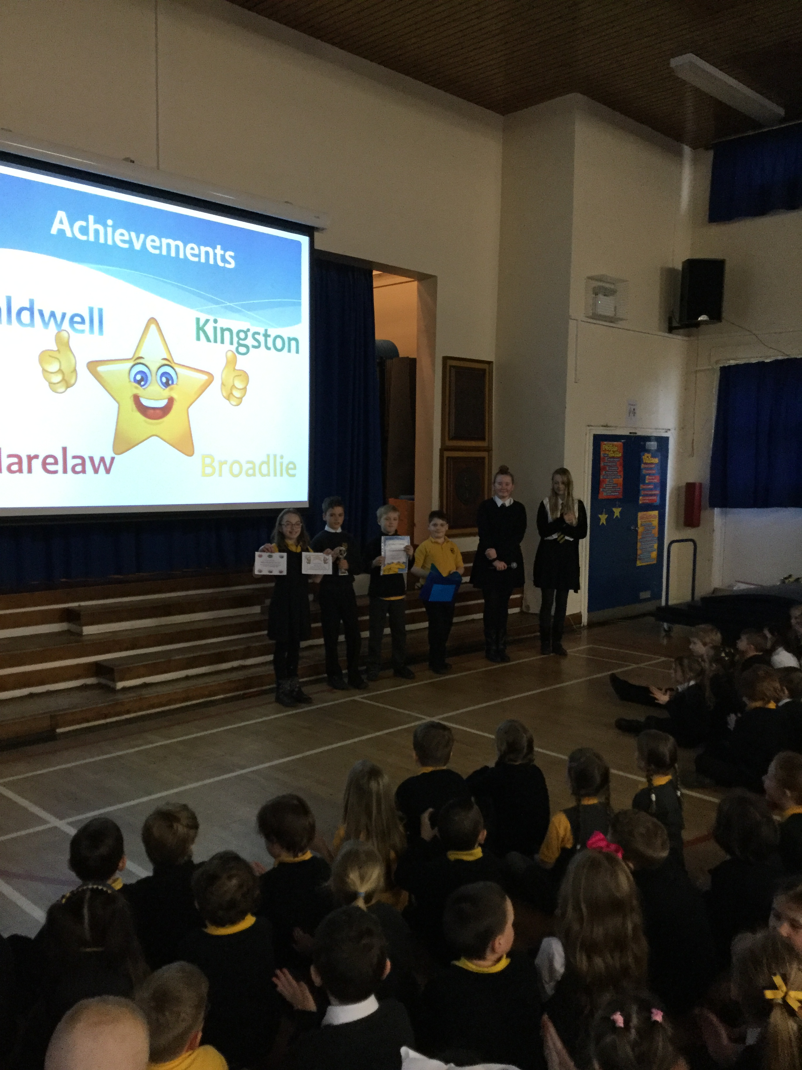
Broadlie
Jamie won a medal at Irish Dancing
Alexander swan 400 metres
Ben won a medal at football
Tyeghan received 2 certificates at Girl Guides

Slide 3
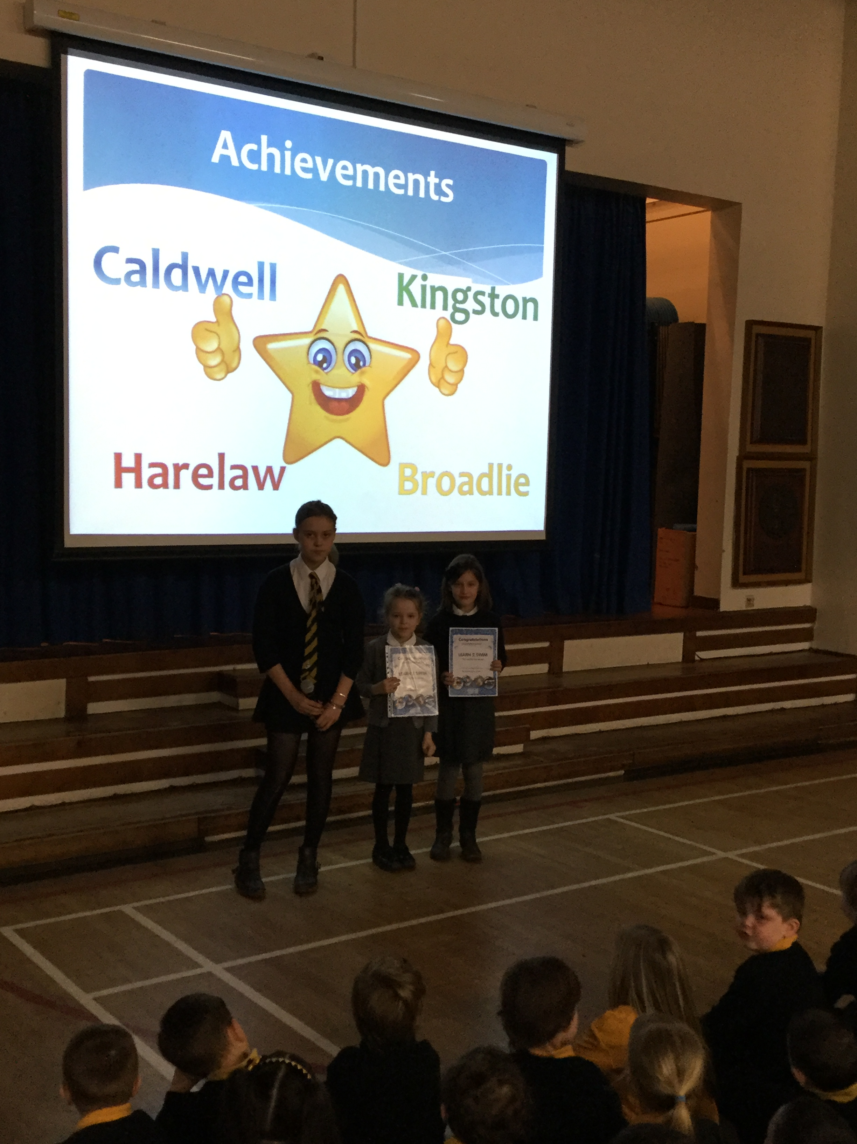
Kingston
Iona received her level 2 swimming award
Molly received her level 4 swimming award

Slide 4
Harelaw
No achievements this week

Slide 5
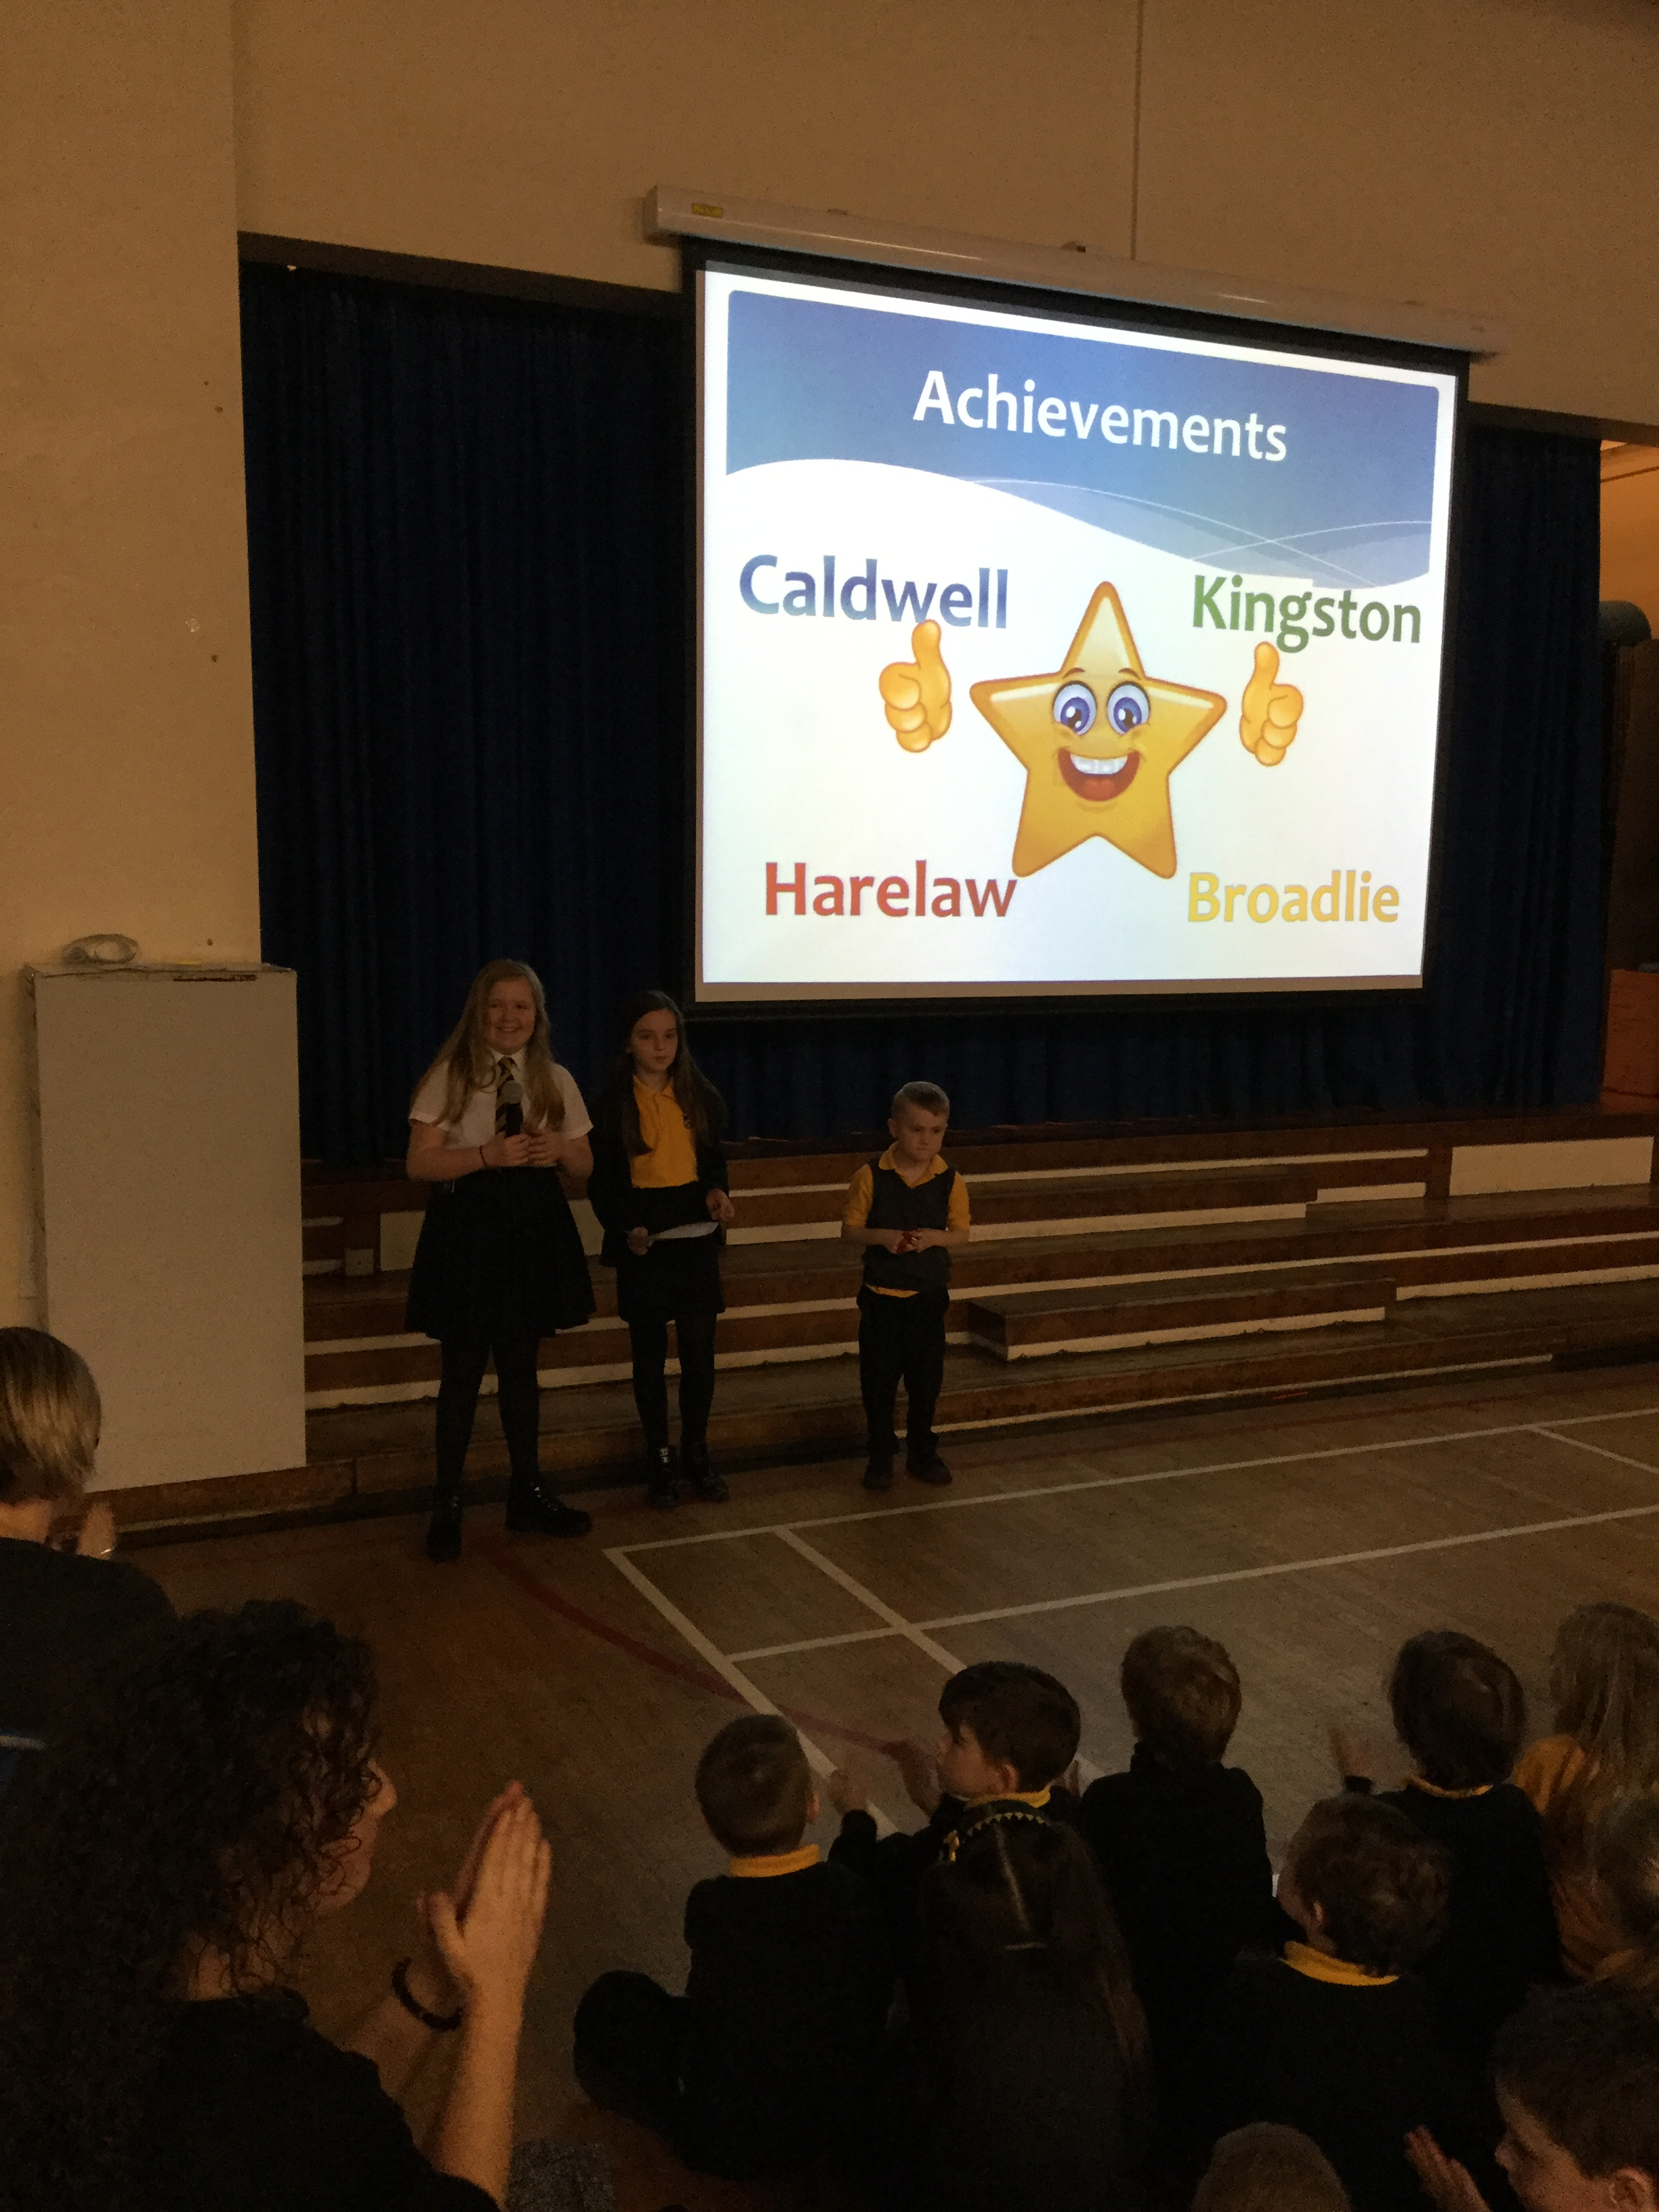
Caldwell
Katelyn passed her dancing exams
Scott won a medal for ?

