Slide 1

Welcome to
Neilston Primary School

Slide 2
Vision, Values & Aims
The staff and pupils are very proud of our school and constantly strive to work together to provide a happy and safe environment where our pupils are encouraged to fulfil their potential.
The partnership between home and school is vital to our aims and we would encourage you to involve yourself with the school taking an active role in your child’s education.

Slide 3
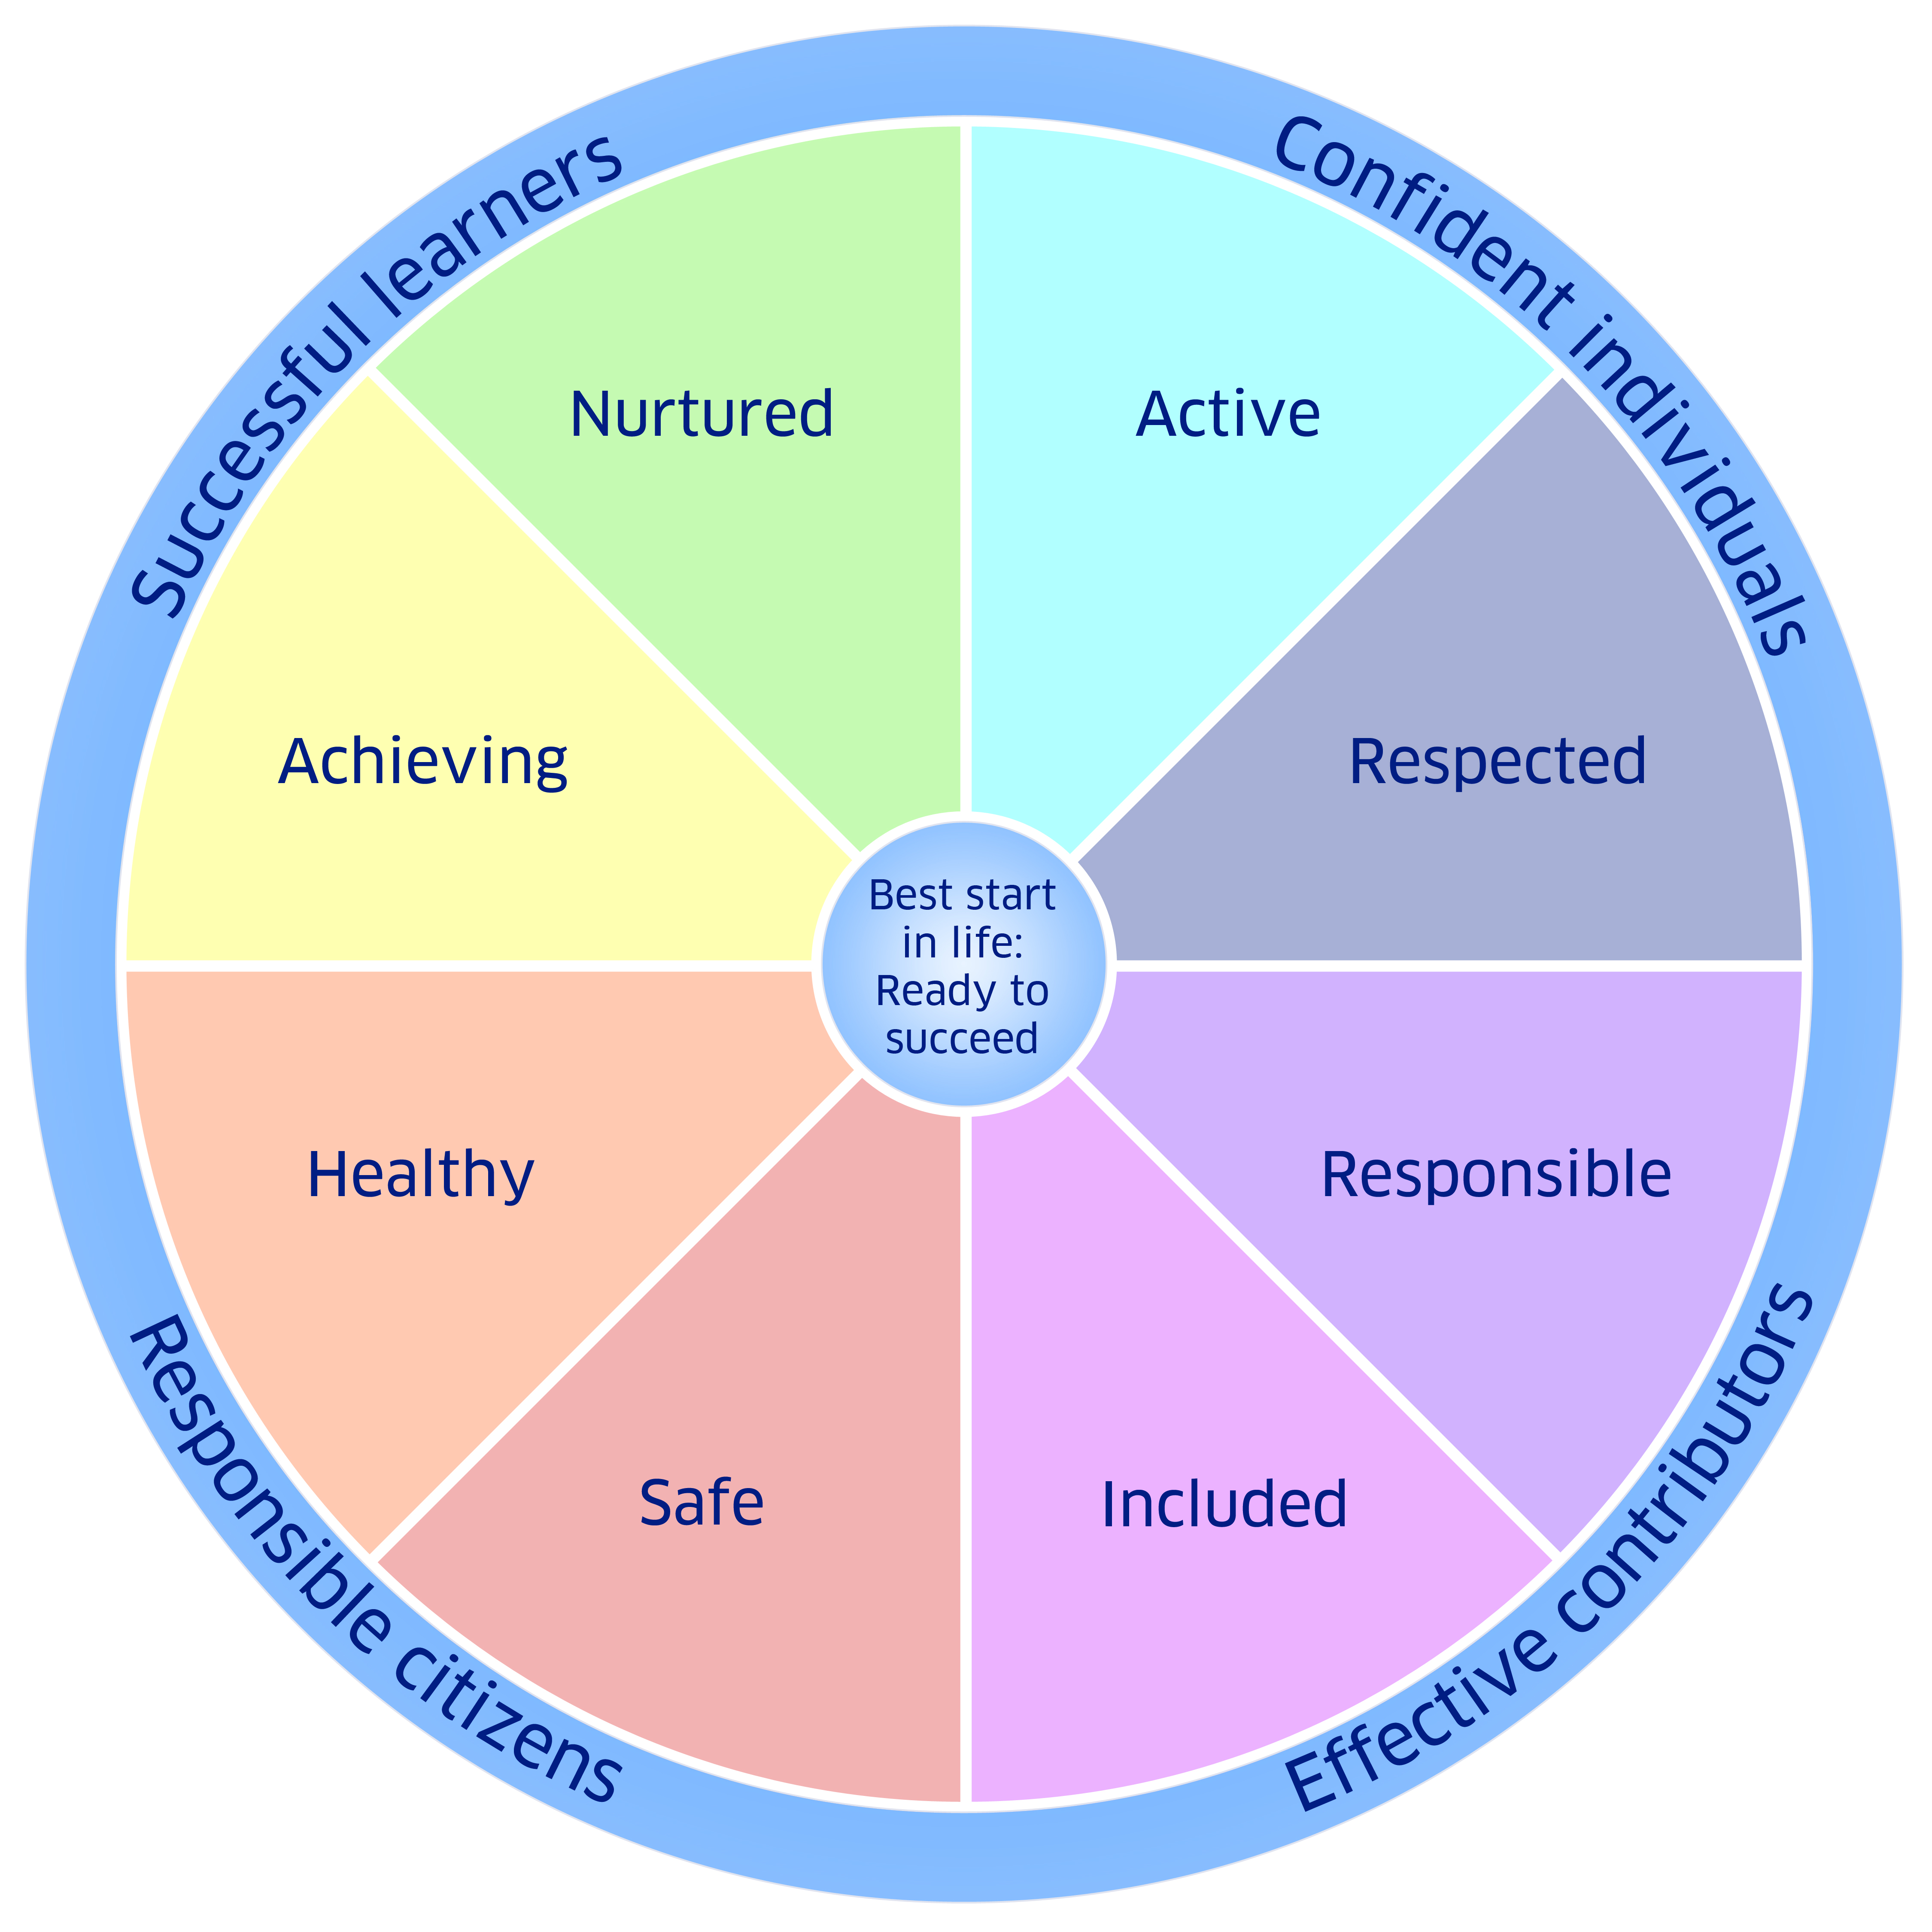
Getting It Right For Every Child (GIRFEC)
Eight well-being indicators
Safe
Healthy
Achieving
Nurtured
Active
Respected
Responsible
Included

Slide 4
Safe
Staff – (Management Team,Teachers,PSA, Office and Janitorial)
The School Day
Informal Entry – 8.50a.m.
Morning Interval – 10.40
Lunch-12.35-1.35
School finishes – 3.15p.m. (P1 pupils must be collected by an adult)

Slide 5
Safe
Attendance
Notify the school of any absence
Office staff will call parents if there is no call to the school 9.30a.m.
Data/Emergency contacts – let school know of any changes
Consent forms – annual consent form for
local excursions

Slide 6
Healthy
During Class
Primary 1 pupils are given water bottles
Trips to the toilet
Tooth brushing Programme
Health and Wellbeing Programme -Emotional, social and physical

Slide 7
Achieving
Early Days
Build on Nursery experiences
Transition Programme
Information from the Nursery
Baseline Assessment
Developmental Milestones
Curriculum for Excellence – own level

Slide 8

Achieving
Homework
Start almost immediately
Sounds, reading, handwriting, maths
Family activities
Meet the teacher - early in the session

Slide 9

Active
PE
2 hours each week
PE kit: shorts, school polo shirt, no jewellery, soft black sand shoes/trainers
Outdoor play

Slide 10
Nurtured
School Community
Class Teachers – Mrs Brooksbank Mrs Connor Pupil Support Staff
Primary 1 Buddy Programme
A Nurturing School
Learning Centre

Slide 11
Respected
Pupil and Parent Voice
Assembly programme encourages pupil participation
Open afternoons
Parent Council
SOS Group
Teacher/pupil dialogue
Views/questionnaires
Involved in decisions about them

Slide 12
Responsible
Pupil Forum – Pupil Council
Sub Committees
Eco
Rights Respecting School
Junior Road Safety Officer
Peer Mentoring
Playzone leaders

Slide 13

Included
Additional Support Needs
We all need a little help from time to time
Mrs McDermott (Principal Teacher)
Pupil Support Assistants
Joint Support Team
Staged Intervention Plans (STINT)

Slide 14





Included
House System
Kingston
Harelaw
Caldwell
Broadlie

Slide 15
Active
Active Schools
Gordon Philips is our coordinator
Afterschool clubs
Lunch clubs
P7 playzone buddies

Slide 16

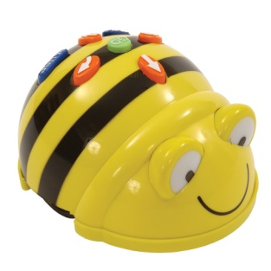




Internet safety
Intranet
ICT
Graphics
Research
Word Processing

Slide 17







Our Successes

Slide 18
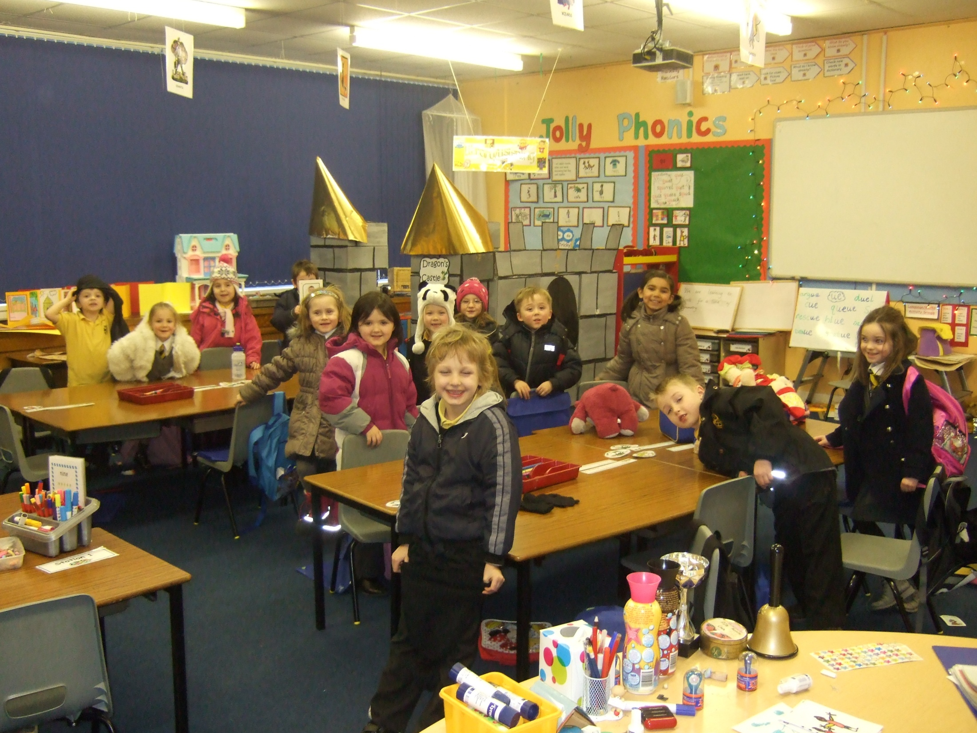


Up and Coming Events
Sports Day
Friday 10/6/16
1.45pm
Come and Lunch with Us
Thursday 2/6/16
11.45am-12.30pm

