Slide 1

Mearns Castle High School
Welcome
S6 Curriculum Information Evening
September 2020
Mrs. Janice Mitchell DHT

Slide 2
S6 Curriculum Evening
Introduction
Insight into the move from S5 to S6
Challenges of S6
College and University application advice
Scholar

Slide 3
Subject Choices
3 timetabled subjects (based on advice)
N5 to Adv. Higher subjects available
Vocational Programme
Monitoring Attendance
Notes:
Each S6 pupil should now be undertaking a minimum of three subjects – the pattern may vary between three in school and one/two in school and a vocational option. Please note some pupils do not yet have the required number of subjects they must ensure they speak with Mrs Mitchell immediately.
In addition to the three academic courses all pupils are expected to take on some level of volunteering/community involvement. There has been a great response this year so far. This is also something that enhances an application too.
Attendance is key to success and we will continue to monitor pupil attendance at their timetabled classes. Pupil Support staff will review this regularly.

Slide 4
Challenges of S6
“Reduced timetable”
Juggling academic subjects with other various commitments
Maintaining the level of focus and studying demonstrated in S5
Committing to school to the end of S6
Notes:
Sometimes with less subjects we allow bad habits to creep in – ‘I can do that in my study period tomorrow…’ etc. Pupils still need to manage their time efficiently and commit to both regular classwork and homework but also time for review and consolidation. This is their final year, they want it to count and most importantly add to the qualifications already achieved.
Pupils are hopefully with us until the end of S6. Some do leave after receiving unconditional University offers or drop subjects based on conditional offers. Before making any changes following accepting an offer, pupils should check with University. It has been known for offers to be withdrawn if pupils change what they are doing despite it not seeming to be part of an offer/condition.

Slide 5
Challenges of S6
“Being trusted and mature . . .”
“A lot of independent learning”
“Meeting conditions for university, college or employers”
“Leading others and being a role model”
Notes:
I expect S6 to be role models for younger pupils. I want them to take on responsibility around the school and share their talents and abilities in departments. They are a popular year group with staff and I want them to be remembered in that way once they have moved on. They have a lot to offer the school and in these particularly difficult circumstances I hope they ‘step up’ and show themselves to be the pupils I know they are both in and out of the classroom.

Slide 6
And the positives?
“Not being babied anymore!”
“Buddying and working with the younger year groups.”
“Being trusted with completing tasks and building different relationships with the teaching staff.”
“Community Involvement.”
Notes:
Opportunities to work on developing/ enhancing other skills
Other platforms to work within the school other than your timetabled classroom
Working with staff in different ways, taking on greater responsibility within the school

Slide 7

So what’s different about S6?
Opportunities!
Pupil Leadership
24 House Captains
Over 100 S6 Involved Community Involvement
Subject Ambassadors
Successful Academic Family
Most S1 pupils have a Buddy
Still recruiting!
Community Involvement
Buddies

Slide 8



So what’s different about S6?
Prom
Charities
Over 60 Pupils involved
Year Book
Notes:
This year is going to be very different, but we are going to try to retain as many of the traditions as possible, in some format.
The year group have already organised committees for Prom, the yearbook, Charities Week and for their Leavers Hoodies. These groups are chaired by our Pupil Leadership Team who are Ailsa Finlay, Ryan Bruce, Katie Little and Fraser Hyde. Work is already underway in all four groups. Well done.

Slide 9
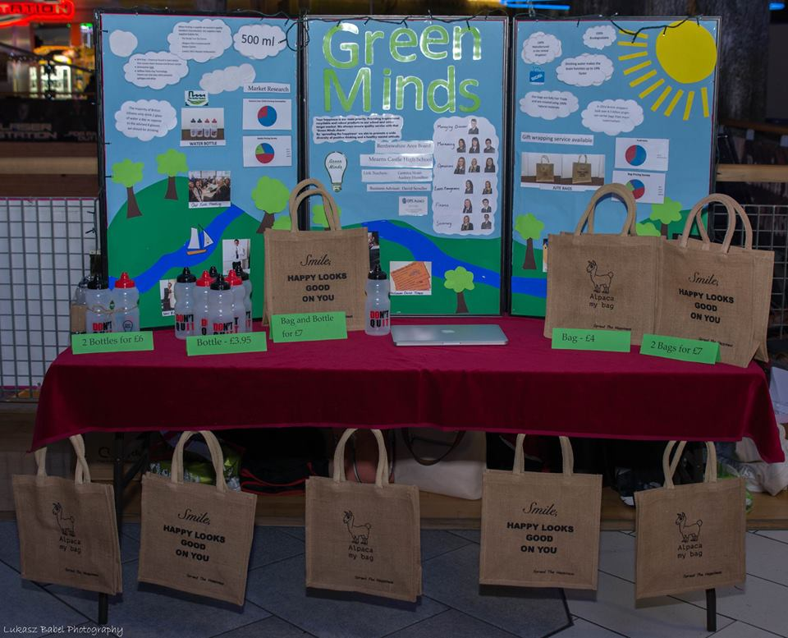
So what’s different about S6?
School Photographs
Young Enterprise Awards
Young Enterprise
Notes:
Our Young Enterprise group would normally organise a Halloween Disco but this will not be possible this year. They are looking at alternative ways to raise funds for their project. They will continue with other roles in the school. For example, they organised the rota and managed the school photographs earlier this week.

Slide 10
HOME LEARNING
Notes:
Continues to be very important.

Slide 11




SCHOLAR
scholarprogramme
@SCHOLARuk

Slide 12
SCHOLAR USE
24/7 access anywhere
Comprehensive notes
Targeted assessments
Record of assessment performances
Interactivities
Online tutorials
Revision planner
Log in through GLOW

Slide 13
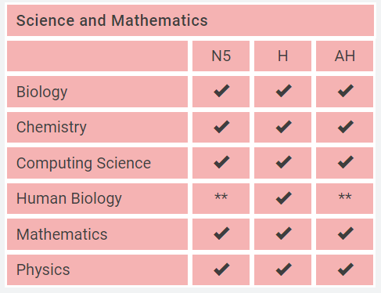
COURSES AVAILABLE

Slide 14
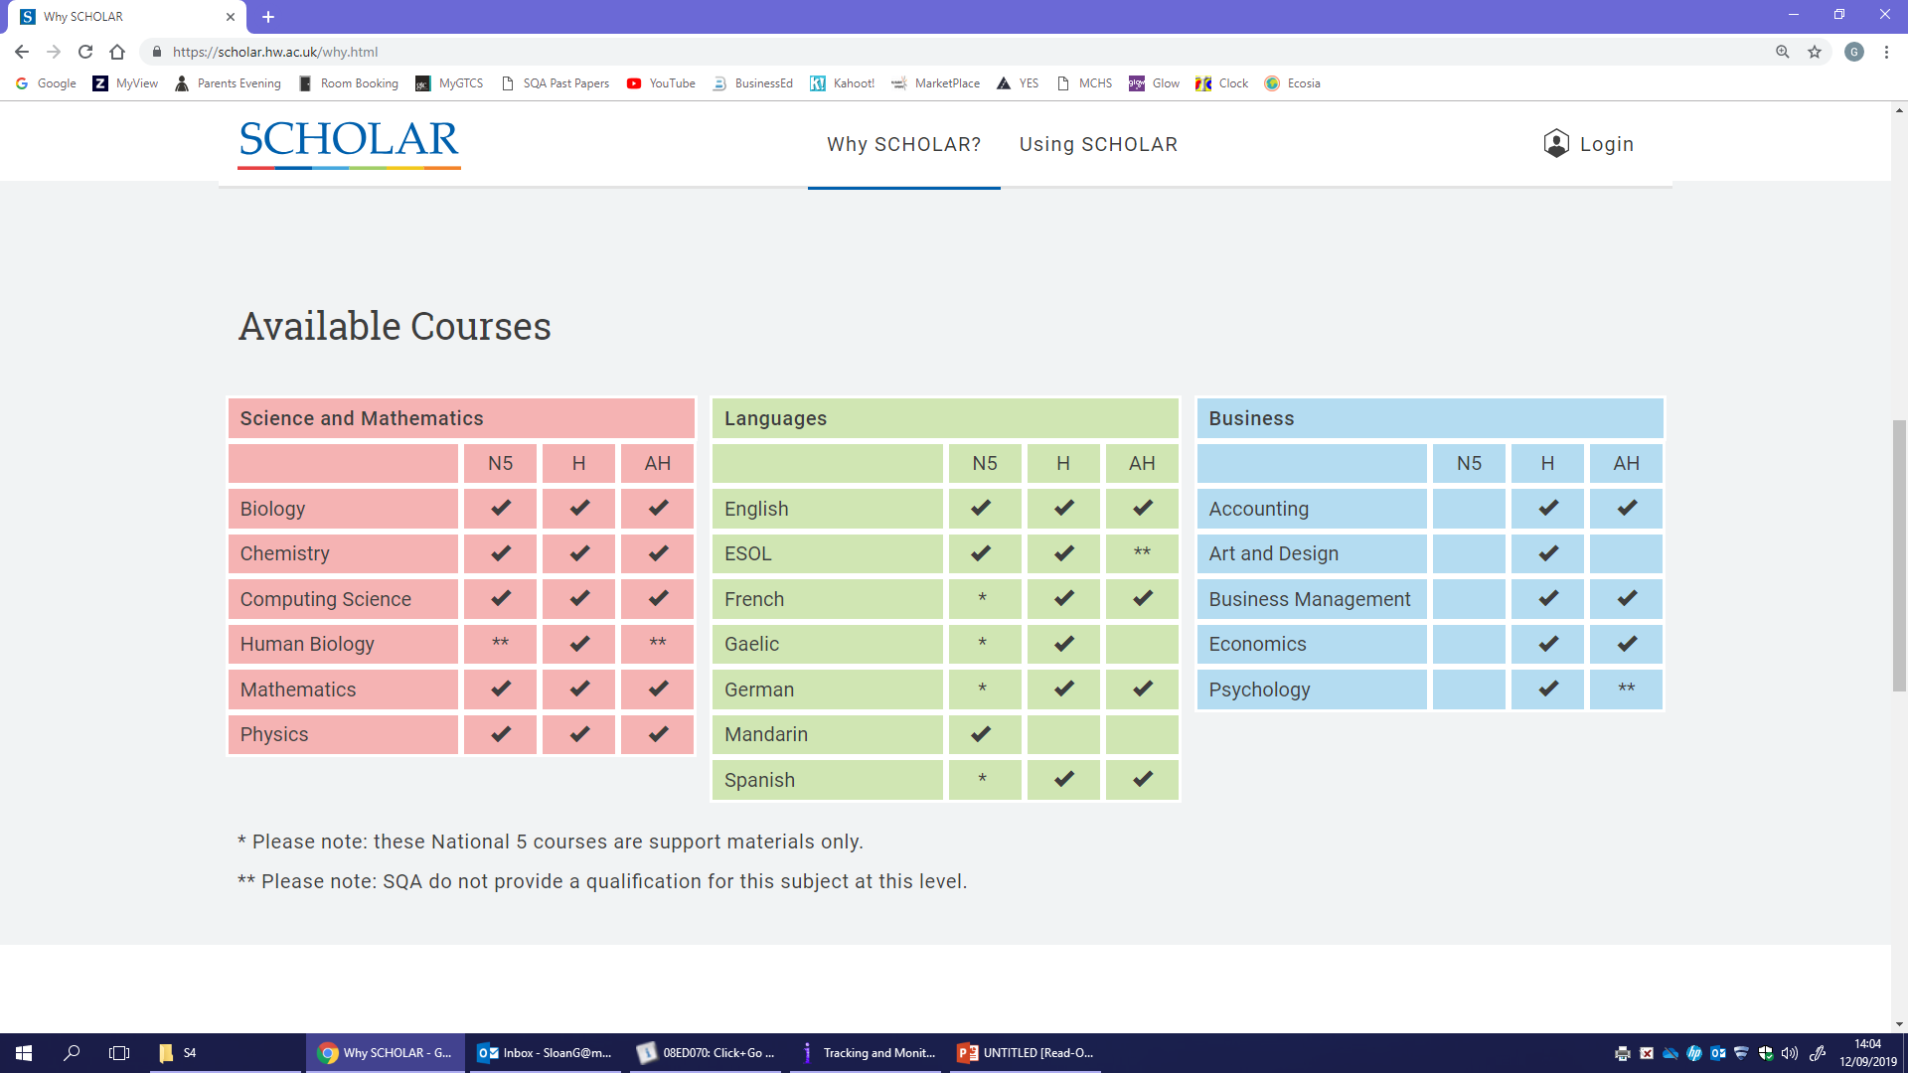
COURSES AVAILABLE

Slide 15
COURSES AVAILABLE

Slide 16
ADDITIONAL RESOURCES
Other resources online through GLOW
Various Department resources
Preparing for next stage of learning

Slide 17
University/College/Employment
Harry Cairney
Principal Teacher Pupil Support
UCAS Coordinator

Slide 18
Quick Quiz
1. In 2015, what % of school leavers nationally entered a positive destination after leaving school?
A 78.1%
B 83.5%
C 92.9%
D 96.2%

Slide 19
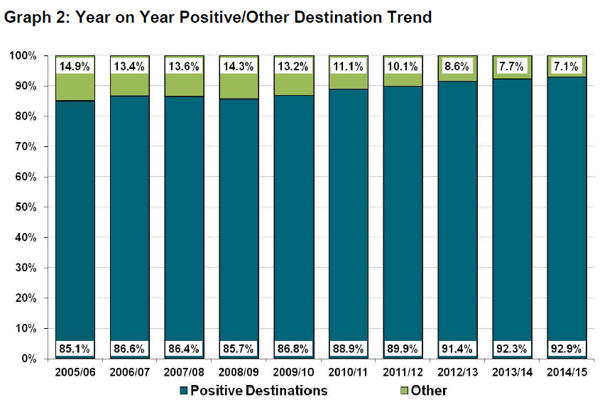

Slide 20
2. In 2015, what % of school leavers nationally went directly into employment as their first destination?
3. What was the % in the 1970s?
A 5%
B 20%
C 40%
D 70%

Slide 21
40 years ago, 7 out of 10 young people went straight into jobs
1976










2015
Now it’s
2 out of 10
  Source: Wolf, A. (2011) Review of Vocational Education - The Wolf Report, Department for Education

Slide 22
4. What feature do employers value most when employing school leavers?
5. What do young people think employers value most?
A Qualifications
B Attitude
C Work Experience
D Literacy/numeracy

Slide 23
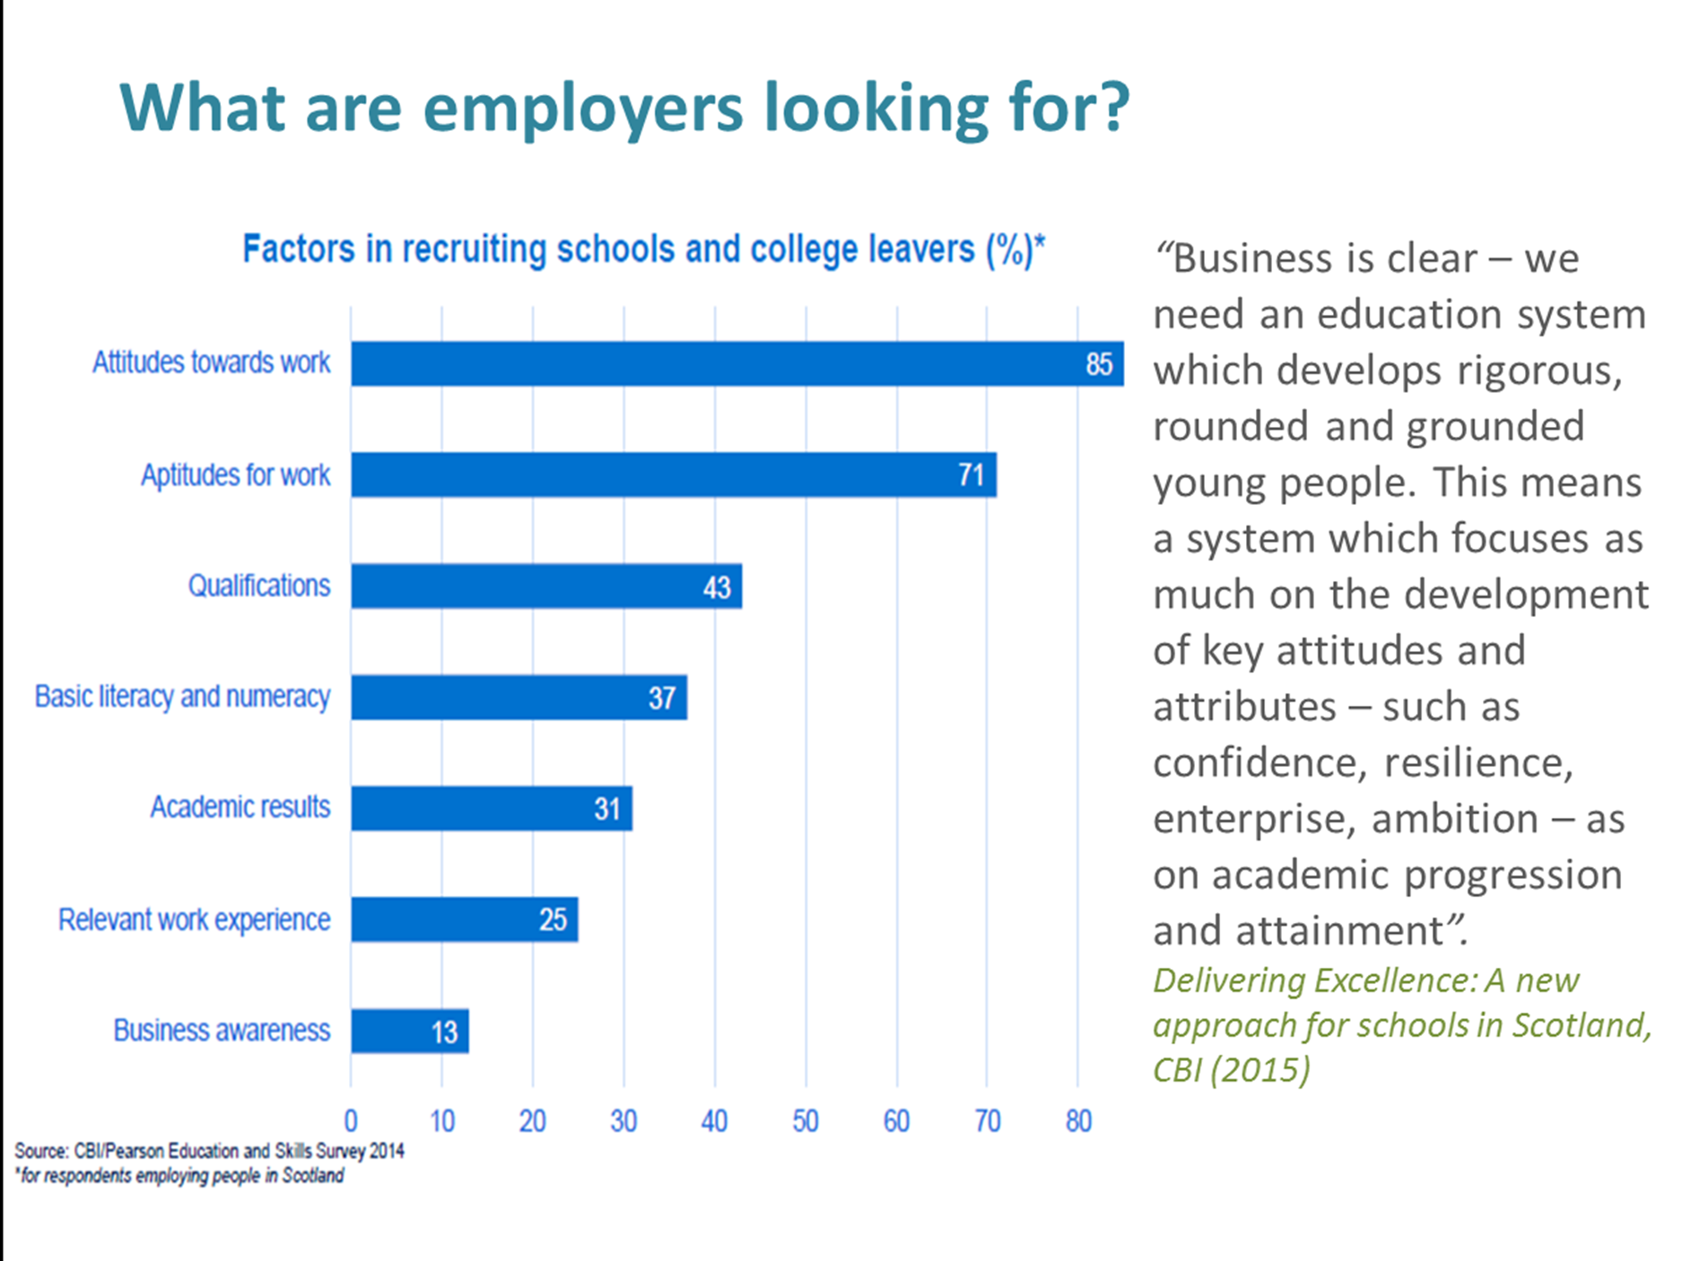

Slide 24
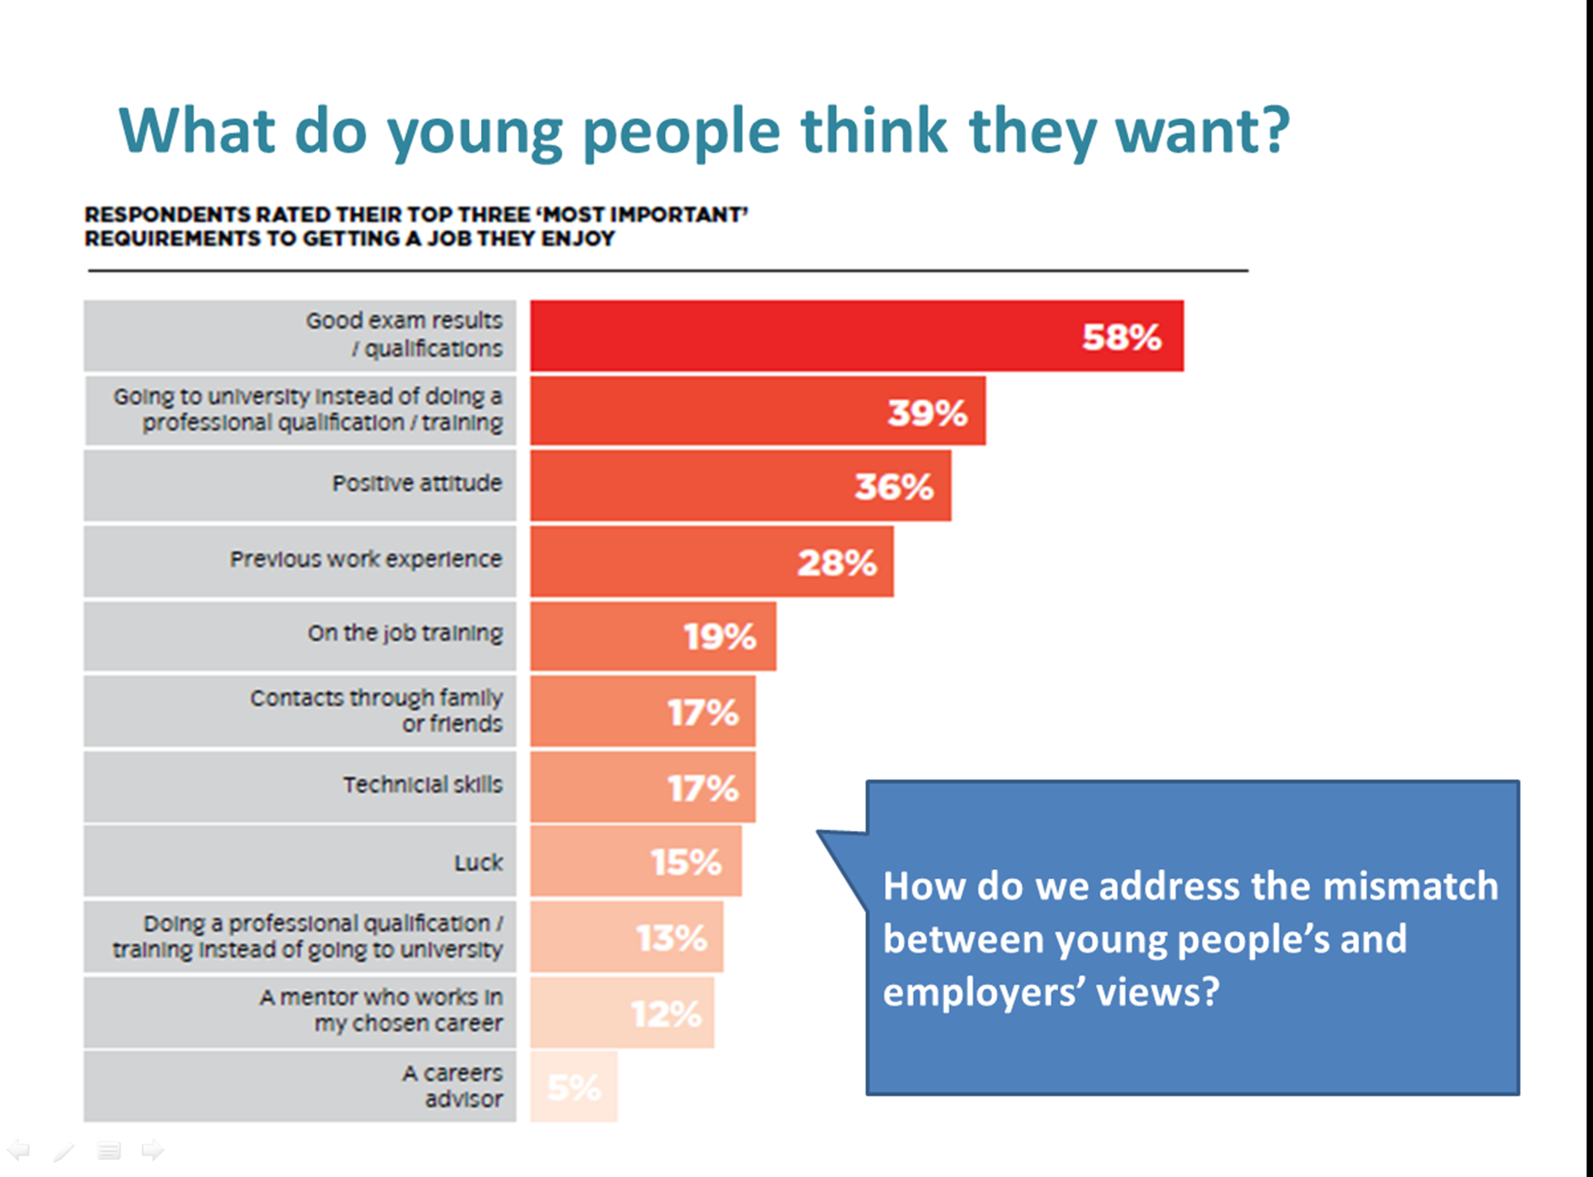

Slide 25
6. In 2022, what % of jobs are predicted to be at graduate level?
7. In 2015, what % of young people expressed a preference for attending university?
A 18
B 30
C 50
D 68

Slide 26

“... there is a widespread belief that studying for a degree will lead to a well-paid job and fulfilling professional career and whilst in many cases this is true it isn’t always the case”.
Great Expectations, City and Guilds 2015

Slide 27
Update
Training and registration for UCAS Apply has now been completed.
Presentations (virtual) from colleges and universities during PSE (Sept/Oct).
Webinars and other virtual opportunities will be published via the Microsoft Teams UCAS group.
Personal statement sessions in PSE.
Personal statement help booklets given to students.

Slide 28
Application Process
Personal research
Registration (online application)
Check for any relevant Admission Tests
Apply for up to 5 courses
Application checked by PT Pupil Support / DHT
Payment made online (1 course £13, 2-5 £24)
Application sent to referee (PT PS/DHT)
Referee attaches school reference
Referee sends completed form to UCAS
Mock interview if appropriate

Slide 29
Personal Statement
Very important part of application - major factor.
It should reflect who your child is & why he/she wants to do a particular course
Include interests, experiences and abilities, details of jobs, experiences, work experience, voluntary work and achievements
Mention any positions of responsibility and any attributes which make him/her interesting or unique.

Slide 30
Parental Involvement
Get involved in the process.
Support your child.
Ensure deadlines are met.
Be aware of course choices. (Do they have the minimum requirements?)
Ensure your son/daughter applies for funding through SAAS.
www.ucas.com

Slide 31
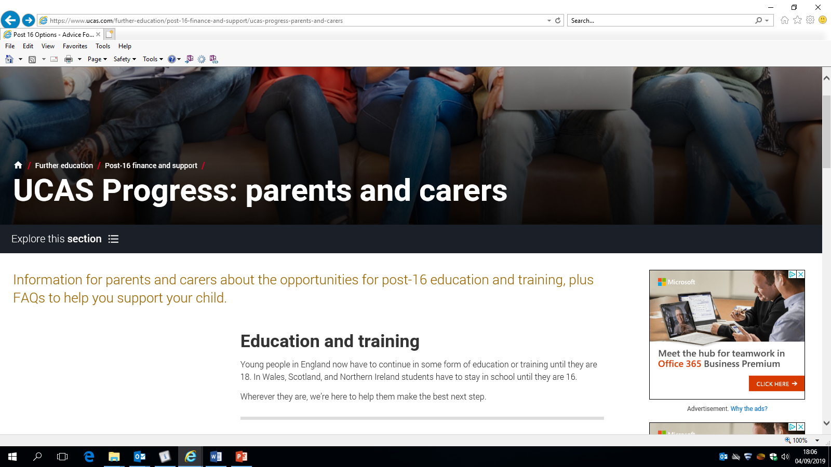

Slide 32
Mearns Castle Deadlines
EARLY APPLICANTS :
Medicine
Dentistry
Oxford
Cambridge
Vet Medicine
Vet Science
CURS and Referee forms : Friday 11th September 2020
Personal Statements : Friday 18th September 2020
Forms completed and fees paid : Wednesday 30th September 2020

Slide 33
Mearns Castle Deadlines
ALL OTHER APPLICANTS :
CURS (Peach Form) and REFEREE (pink) form to Pupil Support Adviser – Monday 5th October 2020
Personal Statements – Monday 19th October 2020 (FIRST DRAFT)
Personal Statements FINAL deadline – Monday 2nd November 2020
Forms completed and fees paid – Monday 16th November 2020

Slide 34
Mearns Castle Deadlines
ART AND DESIGN APPLICANTS :
ALL Art and Design students will recruit through the main UCAS scheme, allowing applicants five simultaneous choices with no order of preference.
Forms completed and fees paid – Monday 16th November 2020

Slide 35
Decision Process
Pupils can track application electronically
May be invited for interview if applicable
Mock interviews available in school
Offers/Rejections made by universities/colleges
A BACK UP PLAN IS ESSENTIAL

Slide 36
Back Up Options
It is really important for your sons and daughters to have more than one choice when making their decisions.
UCAS Statistics
  St Andrews University received 12,000 applications for 1,100 places
  Edinburgh University received 47,000 applications for 3,802 places
Your children should apply to more than one course at university and/or college.
They should keep their options open.

Slide 37
Alternatives
If your Son/Daughter does not wish to go to university: http://www.notgoingtouni.co.uk/
Apprenticeships
Gap years
Distance learning
Jobs
College
Notes:
Even if your child is already quite determined about what they want to do and have firm ideas about their next steps, I would still encourage them to explore all the options that might be available to them.

Slide 38
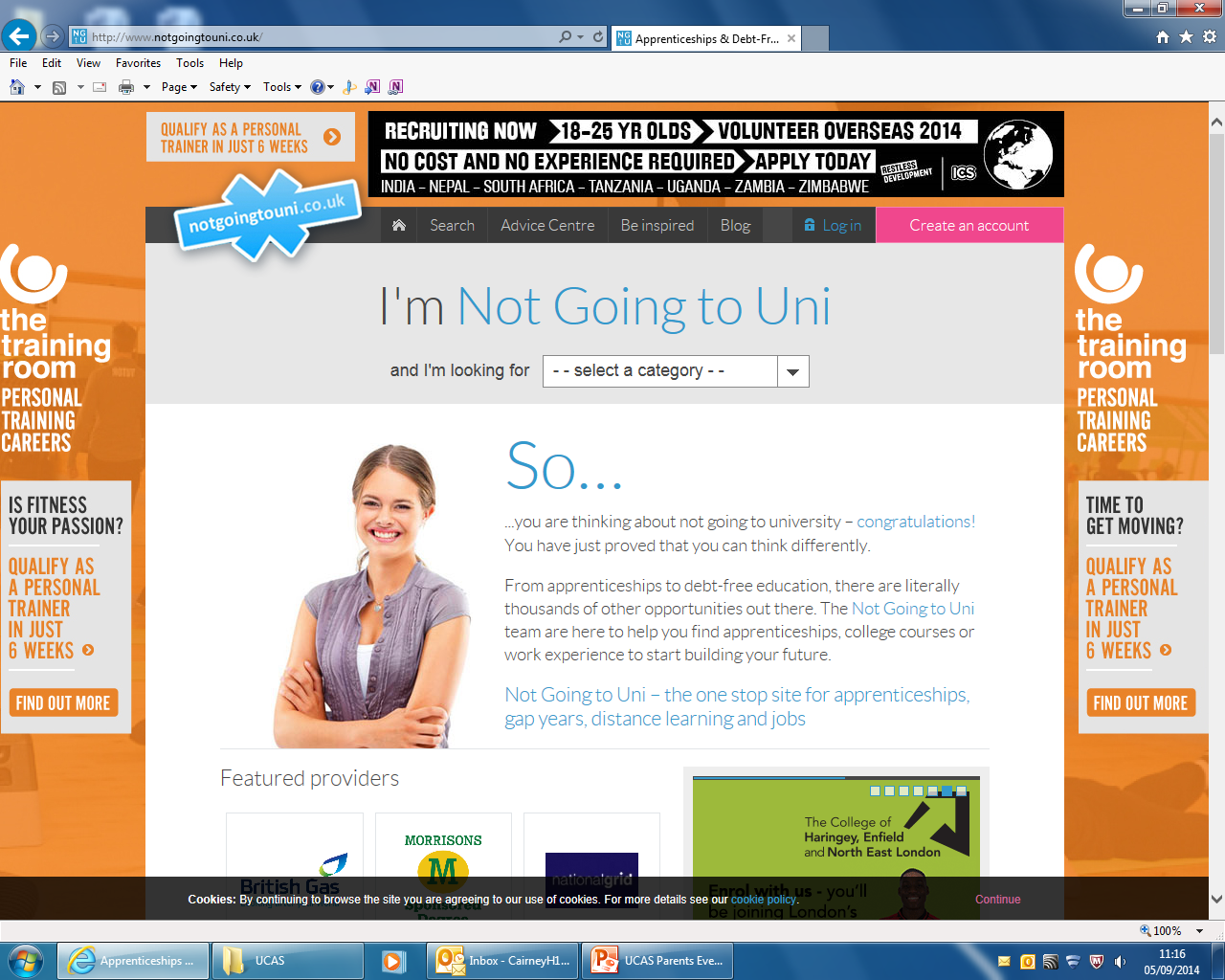
http://www.notgoingtouni.co.uk/

Slide 39
College
Workshops available in MCHS:
College presentation
Careers fair in MCHS Wed 21st Oct 2020 (tbc)
Careers officer involvement
Help with college applications
Can apply directly to several colleges
Usually 2 courses per application form
Student will be invited for interview
Mock interviews available in school

Slide 40
College
Higher National Diploma HND 2 / 3 Highers
Higher National Certificate HNC 1 / 2 Highers
National Certificate / Qualification NC/NQ Nat4/Nat 5
Why consider College?
Wide diversity of college courses and qualification levels on offer.
There are PROGRESSION ROUTES on to University.
Applications open from January onwards.
  Many courses are very popular therefore is it important that applications are made early and MORE THAN ONE CHOICE MADE.
Encourage your children to go to College Open Days

Slide 41
Local Colleges
City of Glasgow College
College of Nautical Studies, Glasgow Metropolitan,
Central of College Commerce
Glasgow Clyde College
Langside, Cardonald, Anniesland
West College Scotland
Clydebank, James Watt, Reid Kerr
Glasgow Kelvin
Stow, John Wheatley, North Glasgow
South Lanarkshire

Slide 42
Useful Websites
www.ucas.com
http://www.ucas.tv
www.planitplus.net
www.prospects.ac.uk - Degree choice related to school subjects and labour market
www.studential.com - sample personal statements
www.unistats.com
www.ukcoursefinder.com - includes questions to generate degree suggestions

Slide 43
My World of Work
Students register to create own account and access various help sections:
My Strengths
My CV – use information from My Strengths
Career A to Z – research your ideas
Featured Articles
Job vacancies
Course search
www.myworldofwork.co.uk

Slide 44
Funding their University/College Fees
Student Awards Agency for Scotland (SAAS)
Gyleview House, 3 Redheughs Rigg, Edinburgh, EH12 9HH. Tel: 0845 111 1711
www.saas.gov.uk/
Students Loans Company (SLC)
100 Bothwell Street, Glasgow, G2 7JD. Tel:0800 405010
www.slc.co.uk

Slide 45
#NoWrongPath
#NoWrongPath is a social media movement which aims to provide inspiration and reassurance to young people moving on from school.
#NoWrongPath aims to show young people the options that are available to them and that exams results are not necessarily the key to unlocking future success.
Notes:
We recognise that some of our young people may be disheartened by their exam results this year particularly in the midst of the Covid-19 pandemic and the disruption that has been caused. #NoWrongPath aims to demonstrate to young people that many people in interesting job roles across Scotland may not have taken a straight, obvious or traditional path to get there. This has always been the case when we have talked about different routes of progression on the qualifications ladder, but this site also just demonstrates that peoples’ lives take different turns and where young people believe they want to be right now might not necessarily be where they end up and that there is no definitive route to achieving anyone’s ambition.

Slide 46
Mearns Castle 2018
School Leaver Destinations
Higher Education 75.8%
Further Education 5.02%
Training 0.46%
Employment 16.89%
Unemployed Seeking 0.46%
Unemployed Not Seeking 0.91%
Not Known 0%
Total Leavers
Positive Destination 98.63%
Other 1.37%
This is pattern of positive pathways for our you people

Slide 47
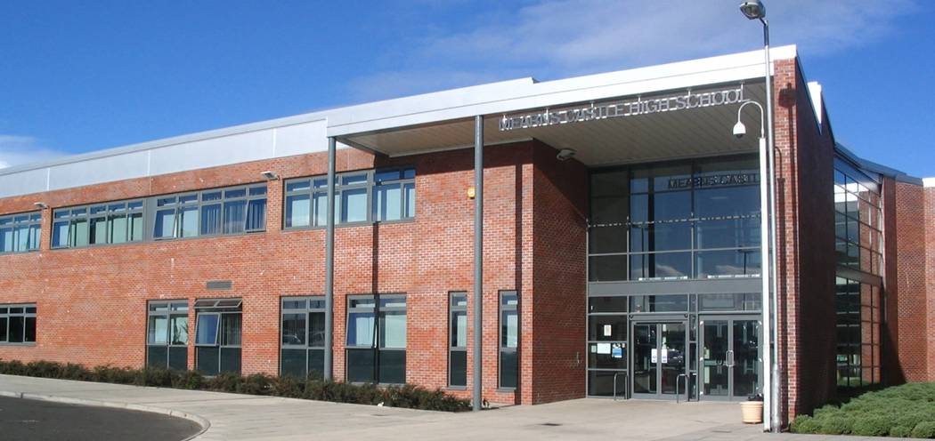
Importance of Communication

Slide 48
Important Dates – (dates subject to change)
Monday 2nd November 2020 | S5/6 Tracking Report 1
Thursday 3rd December 2020 | S5/6 Parents Consultation
Monday 11th January 2021 | S5/6 Tracking Report 2
21st January – 4th Feb 2021 | Prelims
Monday 1st March 2021 | S5/6 full report
Thursday 22nd April 2021 | Leavers Ceremony
26th April 2021 | SQA Exams
Notes:
Please note we are not currently able to invite parents into school, therefore you will receive a report in lieu of this meeting with the possibility of a conversation with some staff being available online.

Slide 49
Any Questions?
Please contact your child’s Pupil Support Teacher who will be working with them and supporting them throughout the coming months

