Slide 1
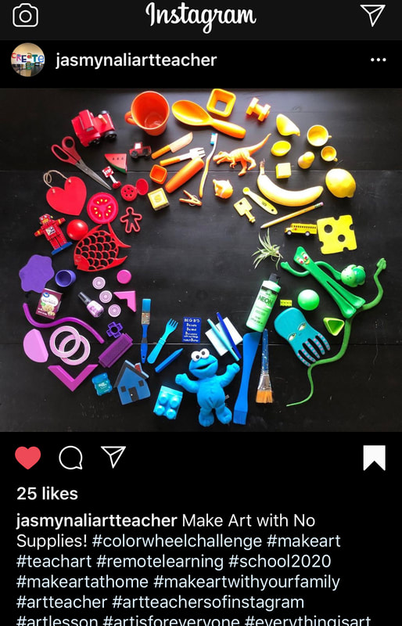
Faculty of Design
Colour Challenge

Slide 2
Faculty of Design
We would like to welcome you to the Faculty of Design.
Our departments deliver the following subjects. You will develop many skills within each one:
Art & Design
Photography
Design & Manufacture
Graphic Communication
Practical Metalwork
Practical Woodwork

Slide 3
Colour Wheel Challenge
Watch the BBC Bitesize Colour Video
https://www.bbc.co.uk/bitesize/guides/z3bqycw
TASK 1:
Find as many objects as you can from either your home and/ or garden that can be used to make your own colour wheel.
Photograph your objects arranged like a colour wheel.
Upload your photograph to slide 4

Slide 4
TASK 1:
Colour Wheel Challenge

Slide 5
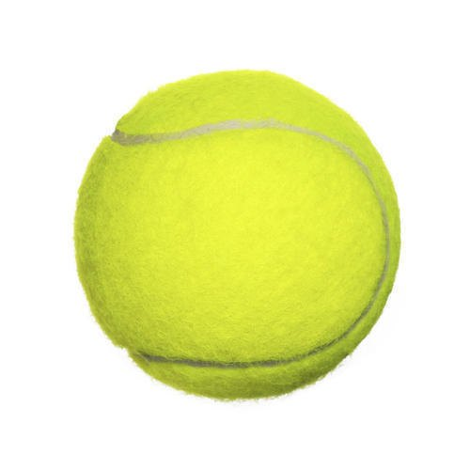
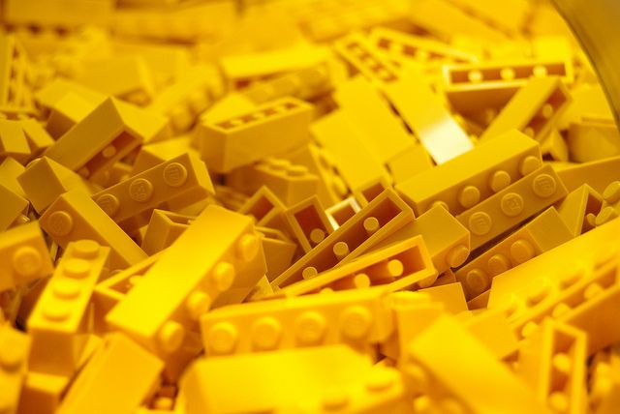
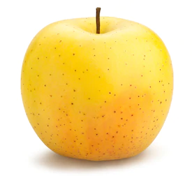
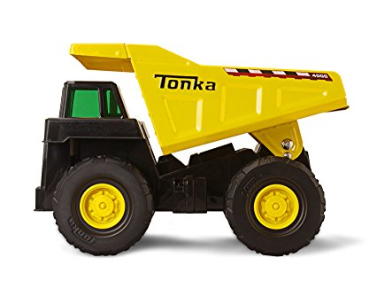
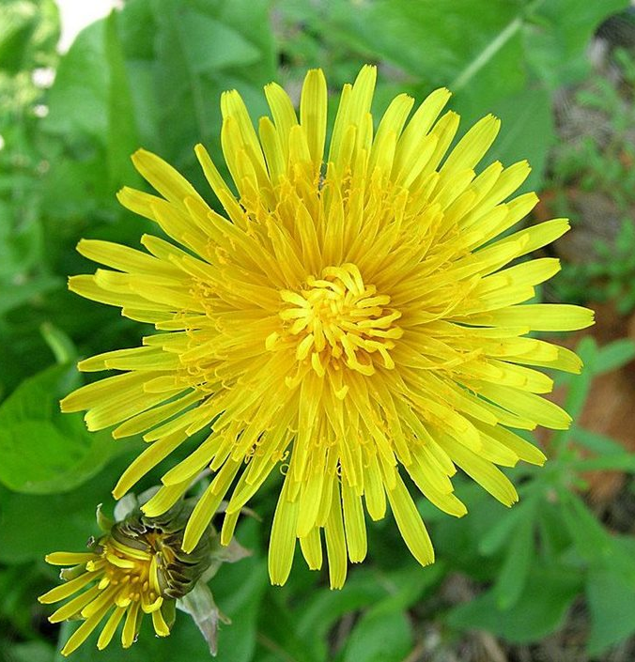
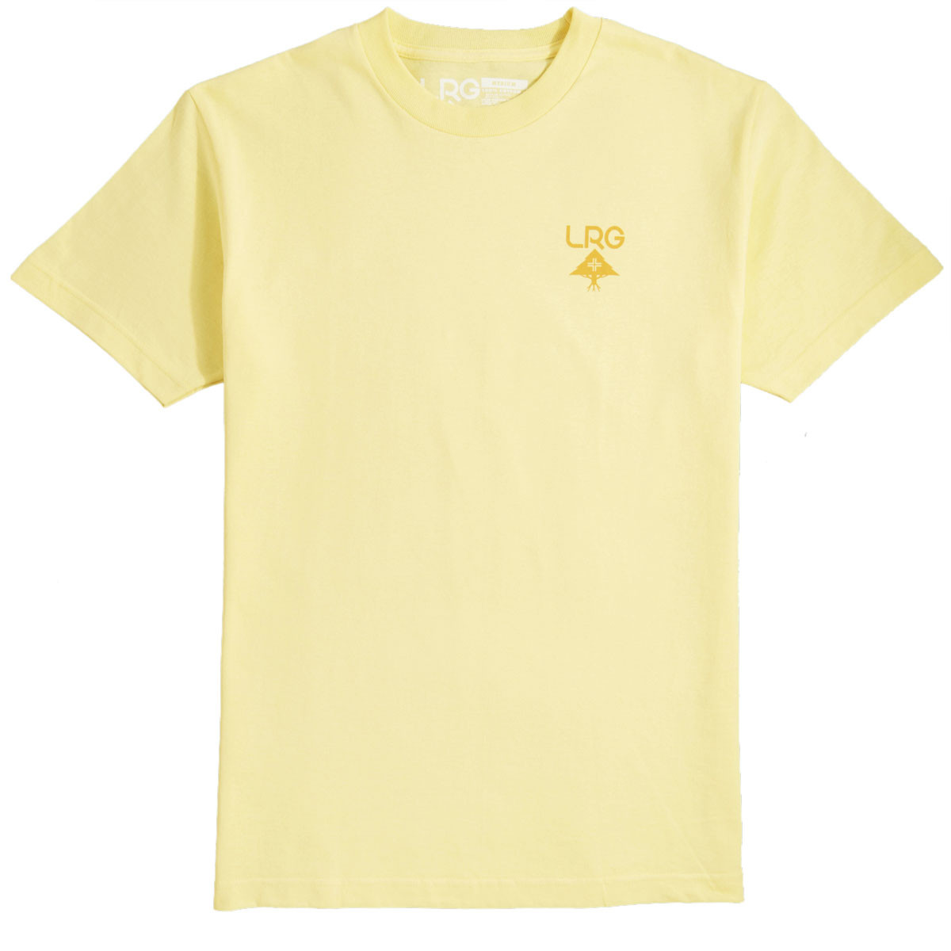
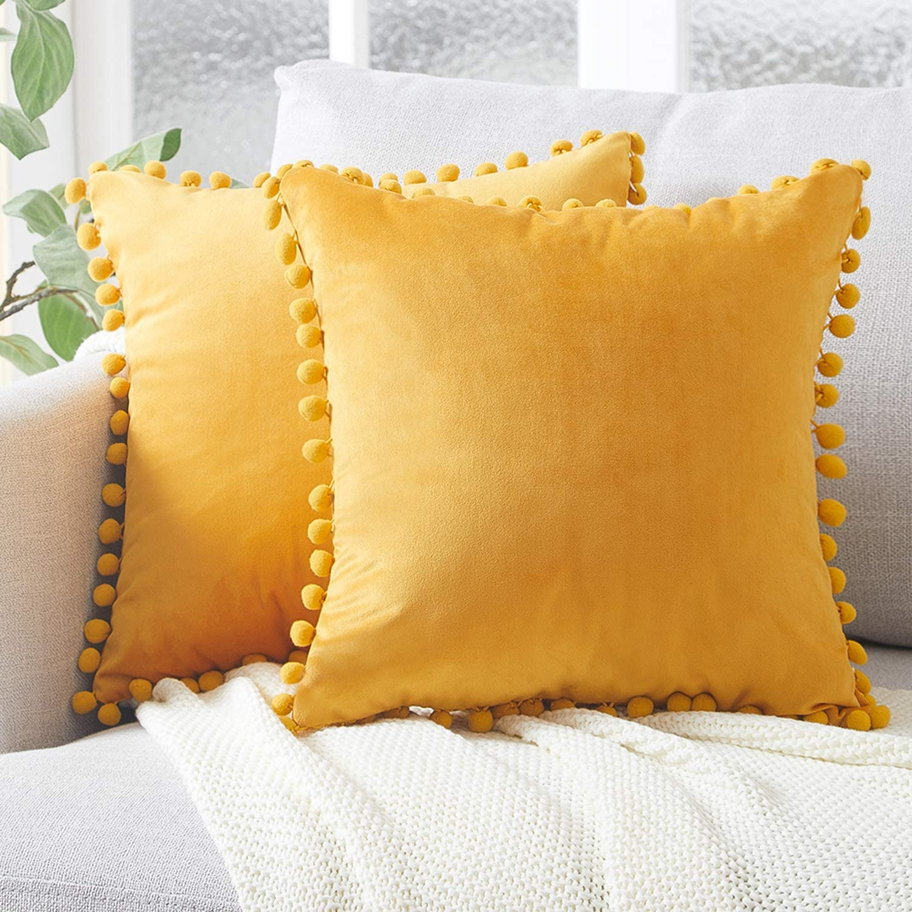
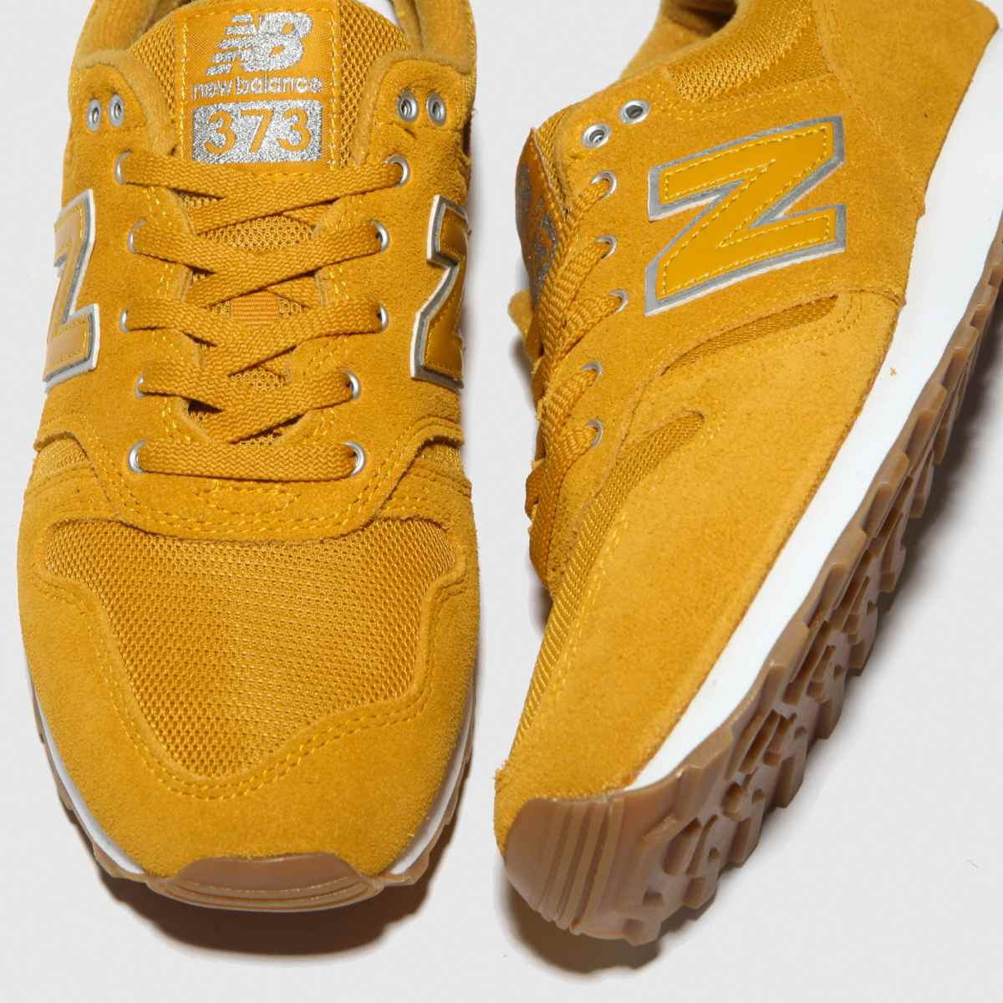
Describing Colour Challenge
1. Neon yellow
2. Golden yellow
TASK 2:
Select your favourite colour
Find 5 items in your home or garden that is that colour.
Now describe the colour using one descriptive word.
Upload your photograph to slide 6
EXAMPLE:
3. Bright Yellow
4. Pastel yellow
5. Mustard Yellow

Slide 6
TASK 2:
Describing Colour Challenge

Slide 7
Colour Terminology Challenge
TASK 3:
Find objects to represent the following colour terms.
Take a photo of the object or objects that you have found to represent each colour term.
Indicate which object goes with which term.
Upload your photograph to slide 8
TOP TIP:
If you are stuck about the meaning of any term, use the internet and google the term.
Primary
Secondary
Tertiary
Harmonious
Complementary
Neutral
Pastel
Natural
Neon
Monochromatic

Slide 8
TASK 3: Colour Terminology Challenge
Primary
Secondary
Tertiary
Harmonious/ Analogous
Complementary
Neutral
Pastel
Natural
Neon
Monochromatic

