Slide 1
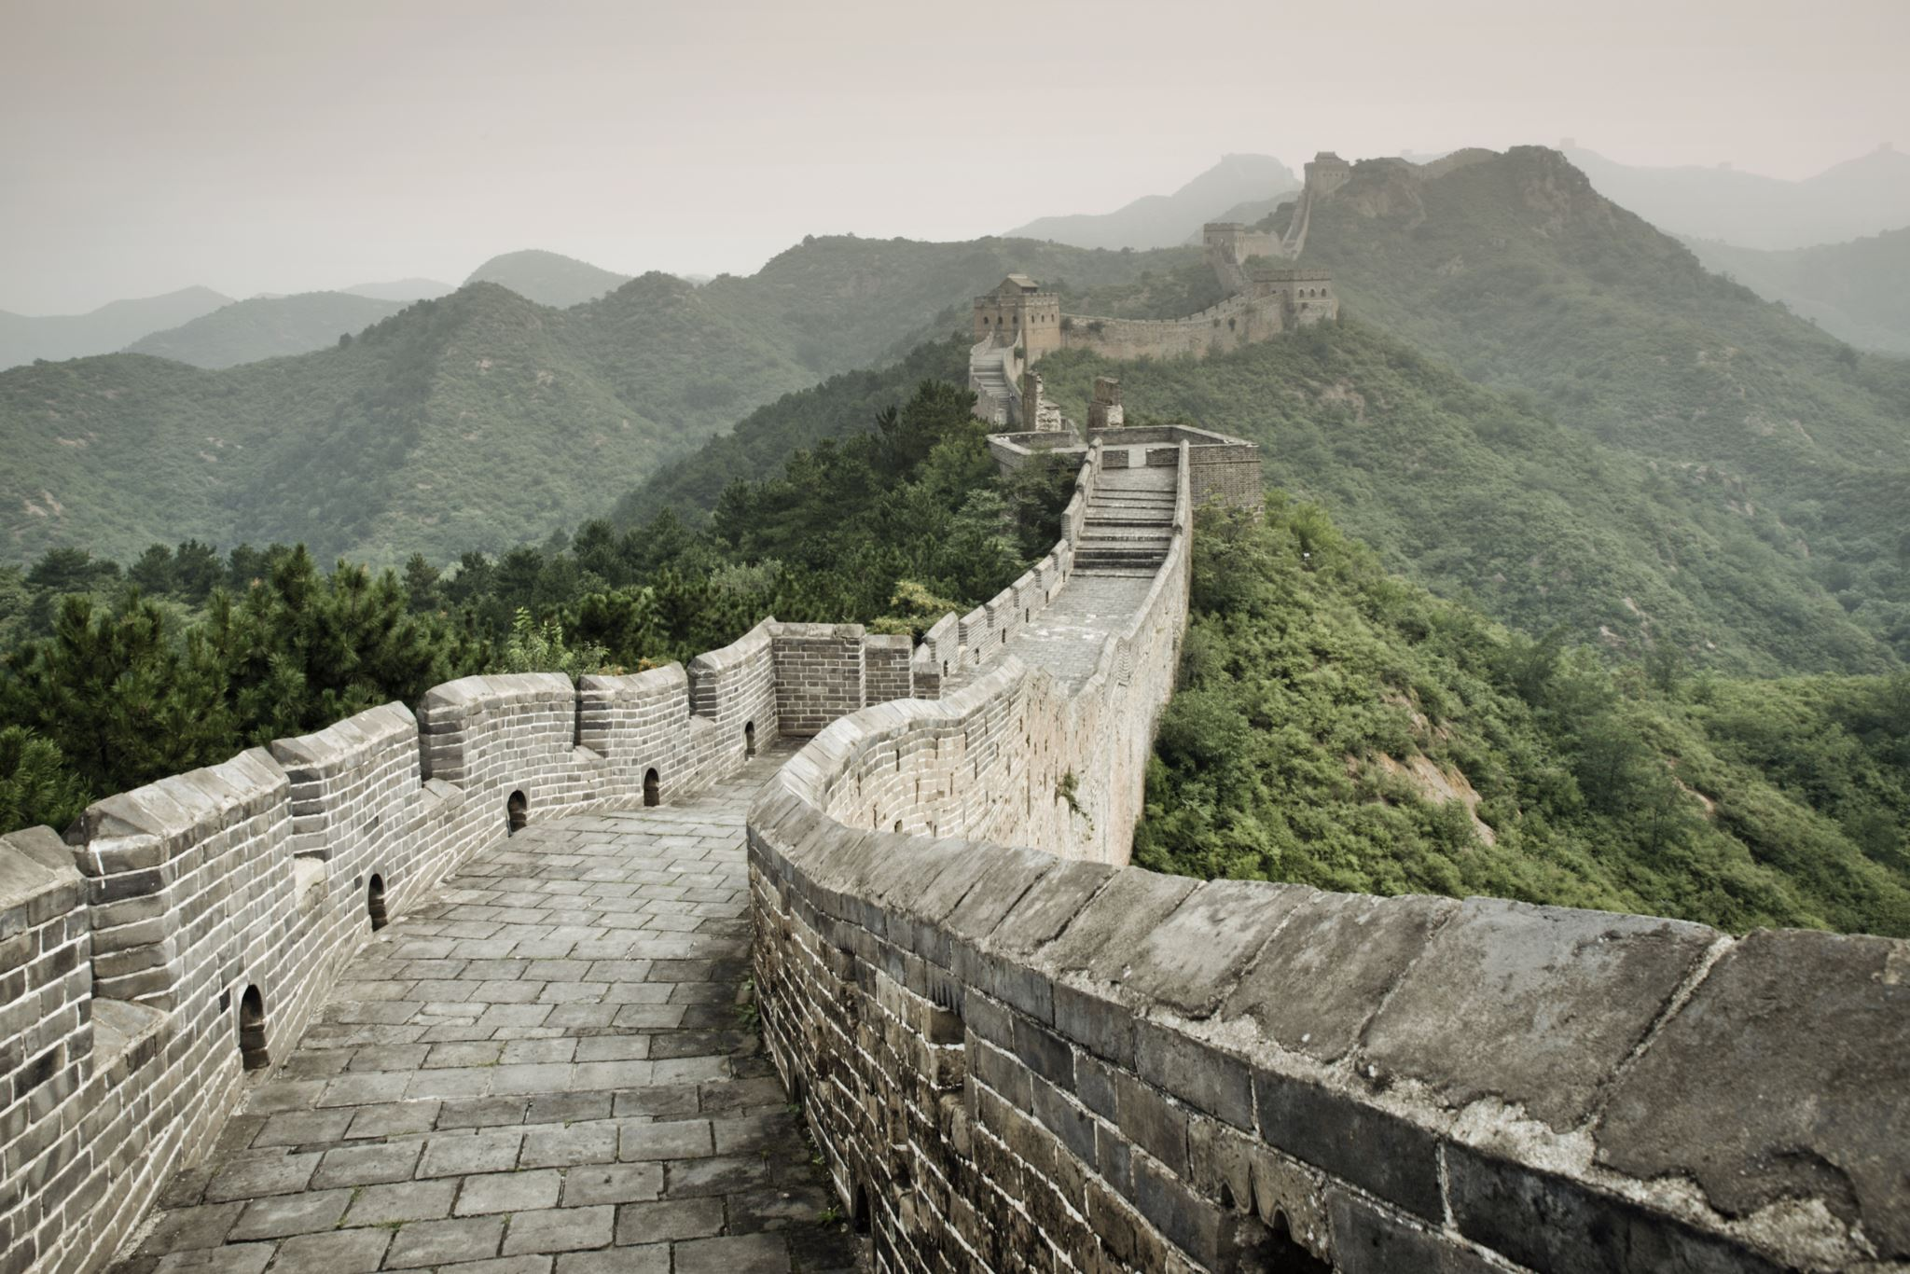
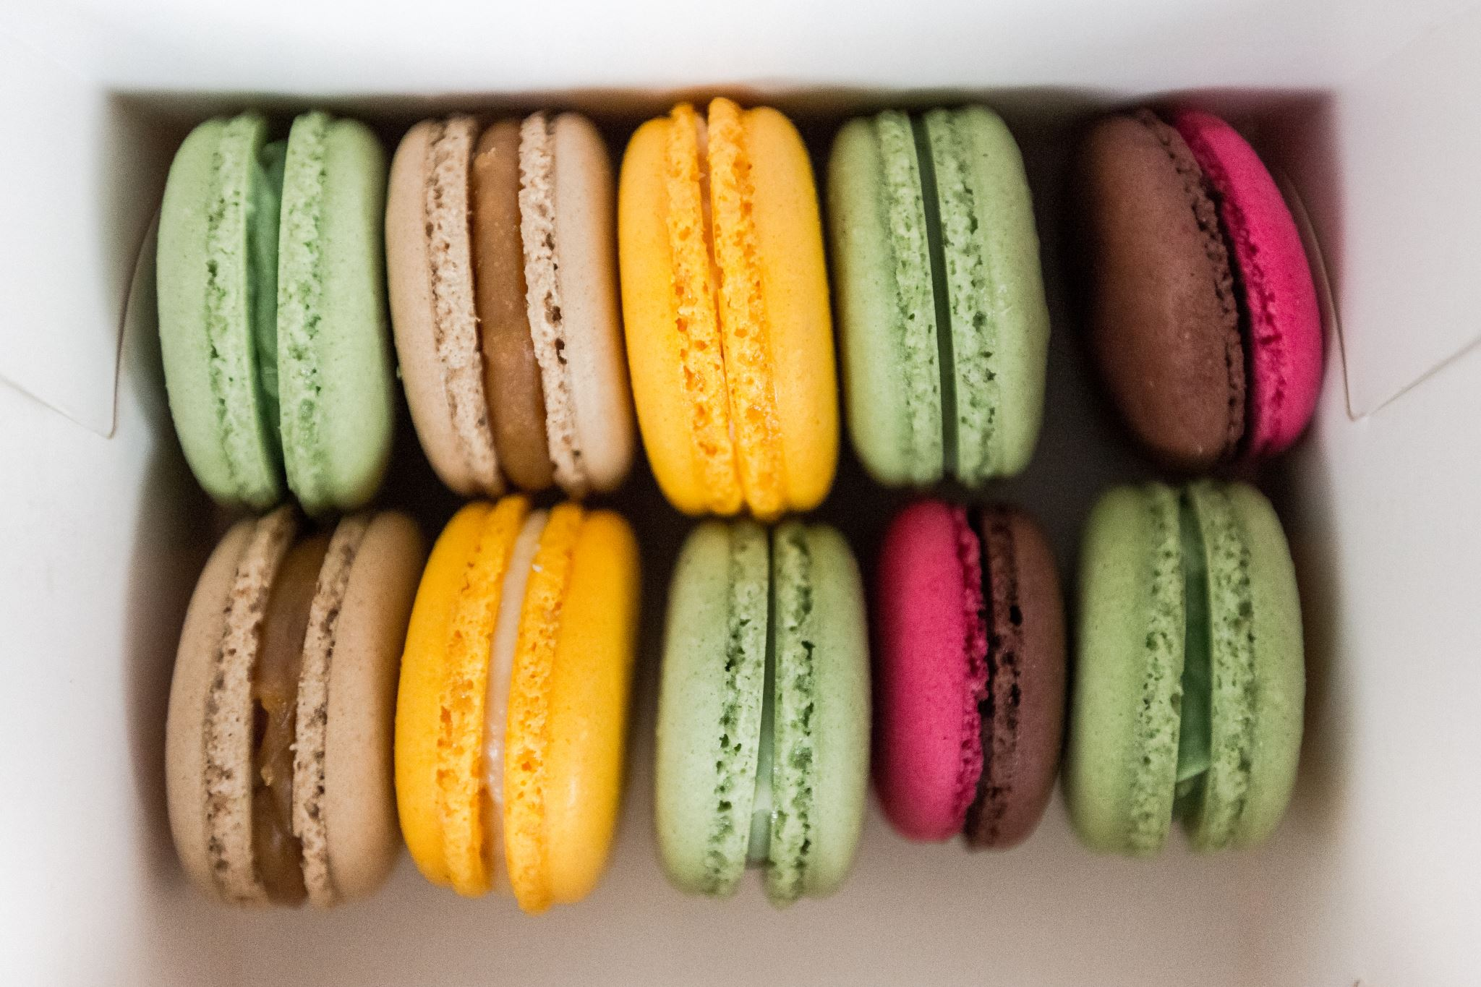
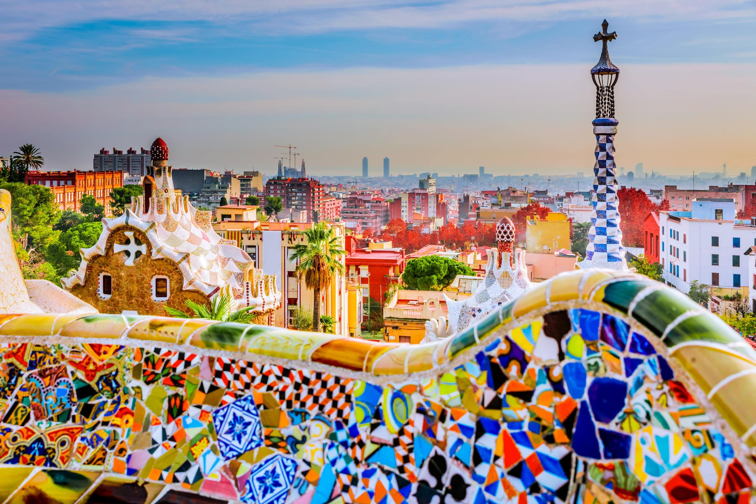
Meet the Modern Languages Department! video
There are a couple of questions during the vid. Answers are on the next slide.

Slide 2
Meet the Modern Languages Department! Here are the answers to our questions:
Mme Nicklin described her cat as small(petit)
Sra Ross's favourite city is Madrid.
Mme Crilley has four children
Monty is Mme McDiarmid's little dog.
Mme Wright can play the violin and the piano
WELL DONE IF YOU GOT ANY OF THOSE!

Slide 3
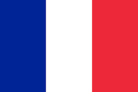
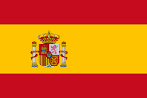
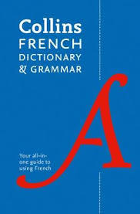
“Being honest, French was my most hated subject going into high school. But if there is one thing I can narrow it down to that changed my opinion on the subject, it would be the Kahoots we would have, a close contender would be the reading tasks. I hope these are both continued in the following years.”
“I enjoyed doing the Mandarin and Spanish taster sessions. You get to try new languages.”
“My favourite part of s1 was the Spanish taster”
What our S1 enjoyed this year in the Languages Department!
“I have enjoyed all the fun games of kahoot and learning about all the different languages.”
“I enjoyed learning about languages in S1, especially the opportunity to learn Spanish along with French. I enjoyed learning in the varied ways we were taught, like the mix between solo and group work. I also enjoyed playing the small games in French that we played to help us learn about school subjects and other things.”
“What I enjoyed the most was learning how to use our dictionary in the library”

Slide 4
https://m.youtube.com/watch?v=_nRosw-sY8s

Slide 5
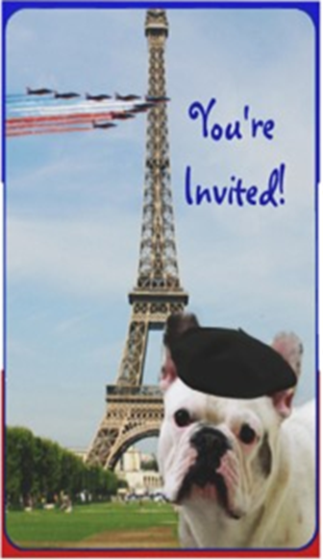
A quiz to test your knowledge!

Slide 6
1. Which of these colours does NOT appear on the French flag?
A) white
B) green
C) red
D) blue

Slide 7
2. The French territory is bigger than the UK one. By how many times?
A) twice
B) five times
C) ten times
D) twenty times

Slide 8
3. Which of these countries does NOT share a border with France?
a) Spain
B) Switzerland
C) Austria
D) Germany

Slide 9
4. Which of these cheeses is a French cheese?
A) cheddar
B) feta
C) gouda
D) camembert

Slide 10
5. Which of these French towns holds a very famous film festival every year?
A) Paris
B) Cannes
C) Lyon
D) Nice

Slide 11
6. What river goes through Paris?
A) the Loire
B) the Seine
C) the Danube
D) The Rhône

Slide 12
7. Which of these islands is French?
A) Guernsey
B) Malta
C) Australia
D) Corsica

Slide 13
8. Which of the following is NOT a French football team?
A) PSG
B) Auxerre
C) Ajax
D) Olympique Marseille

Slide 14
9. Which of the following composers is French?
A) Debussy
B) Beethoven
C) Mozart
D) Verdi

Slide 15
10. Which famous sporting event in France involves the wearing of a yellow shirt?
A) Roland Garros
B) The tour de France
C) The TT races
D) Le Mans 24 hours race

Slide 16
11. Which of these ranges of mountains can you find on the French territory?
A) the Pyrénées
B) the Pennines
C) the Dolomites
D) the Himalayas

Slide 17
12. Which of these countries does not have French as an official language?
A) Canada
B) Germany
C) Haiti
D) Sénégal

Slide 18
13. Which of these painters is French?
A) Monet
B) Picasso
C) Turner
D) Van Gogh

Slide 19
14. Which of the following fashion designers is not French?
A) Chanel
B) Armani
C) Lacroix
D) Dior

Slide 20
15. Which of these tourist attractions is NOT located in Paris?
A) La Tour Eiffel
B) Le Mont St Michel
C) Le Louvre
D) L’Arc de Triomphe

Slide 21
Answers
Question 1: B. There is no green on the French flag.
Question 2: A. France is twice as big as the UK.
Question 3: C. Austria doesn’t have any border in common with France.
Question 4: D. The camembert is French.
Question 5: B. Cannes.
Question 6: B. The Seine crosses Paris.
Question 7: D. Corsica is a French region.
Question 8: C. Ajax is a football club from Amsterdam (Netherlands).
Question 9: A. Debussy was a French composer. His Clair de Lune is quite famous in France.
Question 10: B. The tour de France. The yellow shirt is awarded to the winner of the race.

Slide 22
Answers
Question 11: A. The Pyrénées are mountains in the south of France. They mark the border with Spain.
Question 12: B. Germany. The other countries mentioned are former French colonies and still use the language today.
Question 13: A. Claude Monet created the painting style of Impressionism with his painting Impression soleil levant.
Question 14: B. Georgio Armani is an Italian designer.
Question 15: B Mont Saint Michel is in Normandy, NW France

