Slide 1
FRIENDSHIP BRACELET

Slide 2
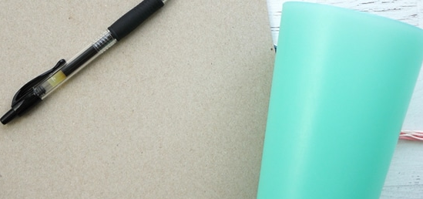

Slide 4
