Slide 1
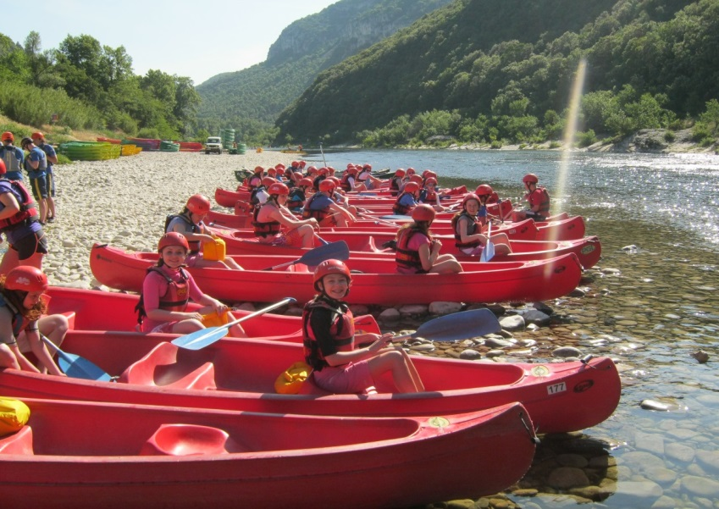
Water Sports Trip 2020 Parent Meeting

Slide 2
Welcome
Thank you for attending this meeting. There is a lot of information to get through so please be patient.
Forms will be collected in at the front
There will be an opportunity to ask questions at the end.
If you want to speak to a member of staff confidentially then please wait behind at the end of the meeting.

Slide 3
Staff
Mr Cairney
Miss Dooris
Mr Wilson
Mr Weston
Miss Roberts

Slide 4
Departure
Meeting at the school for 4am on Friday 29th May 2020
Pupils should bring the following items with them on the bus in their hand luggage:
Sleeping bag and pillow
Wear school hoodie
Change of clothes
Packed lunch and dinner or money to buy lunch at services and dinner on the ferry…NO ENERGY DRINKS AND NO CANS OF JUICE.
Toothbrush and toothpaste
DVDs/ games
Pupils will not have access to their main luggage until we arrive at the campsite in France
Notes:
I will issue a letter with the final details prior to the trip and also a reminder of what to bring in their hand luggage.

Slide 5
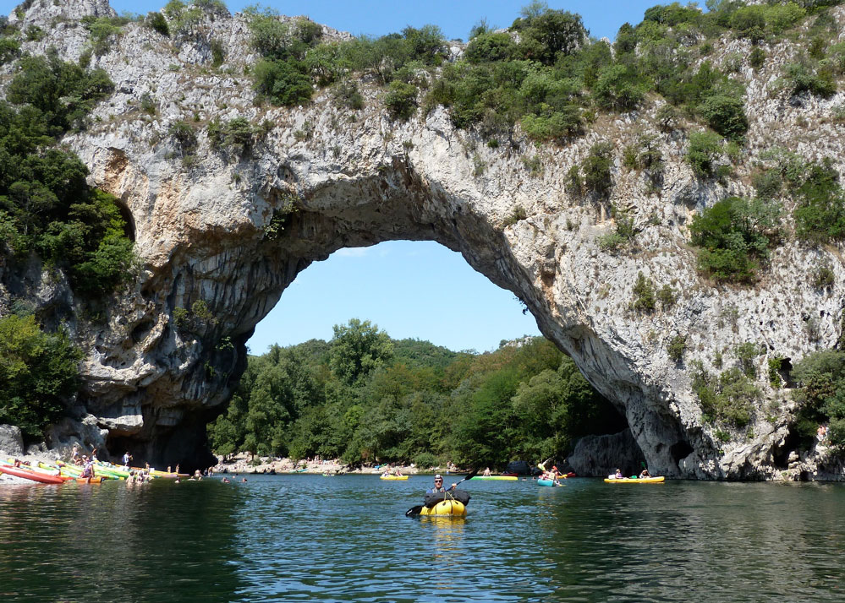
Domaine de Segries
We should arrive at the Ardeche around 7.30am on Saturday 30th May
The pupils will participate in two and half days of canoeing down the Ardeche gorge.

Slide 6
Domaine de Segries
Contact Details and Address
Domaine de Segries, 07150 Vagnas, France
0333 321 2100

Slide 7
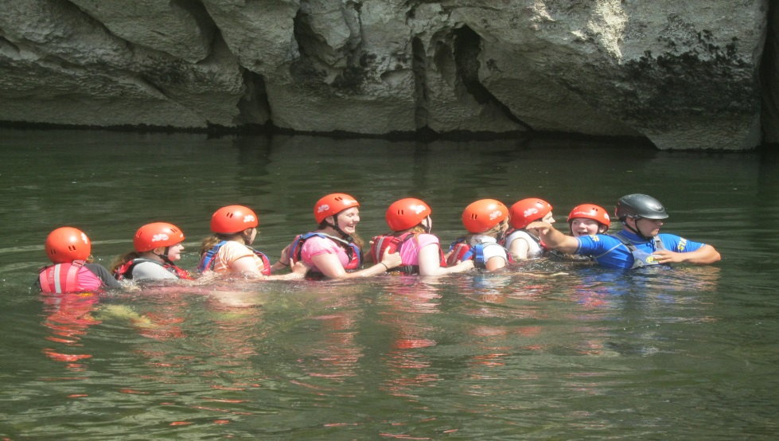
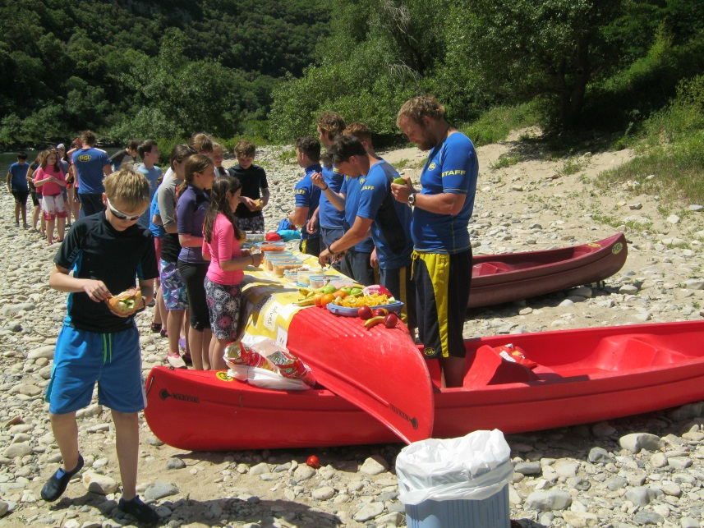
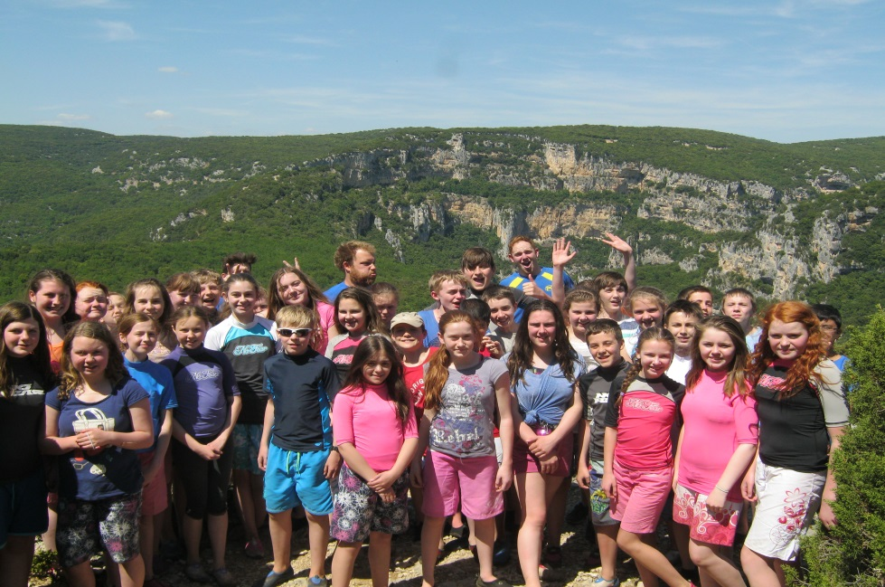
Domaine de Segries

Slide 8
Itinerary
Date | Morning | Afternoon | Evening
Fri 29th May | Meet @MCHS | Dover to Calais | Coach to Ardeche
Sat 30th May | Arrive @ Ardeche | Open Canoe | Generation Game
Sun 31st May | Open Canoe | Open Canoe | Disco
Mon 1st June | Open Canoe | Open Canoe | Fun Games
Tues 2nd June | Leave Ardeche | Arrive @ Mimosa Beach Activity | Music Quiz
Wed 3rd June | Body Boarding | Funboats | Beach Olympics
Thurs 4th June | Windsurfing/Raft building | Picos | Talent Show
Fri 5th June | Catamarans/Sit on Kayaks | Ocean Rider | Depart Mimosa
Sat 6th June | Morning Ferry To Dover | Coach travel to school | Home @ 9.30pm
*These activities are subject change due to weather, but the pupils are always kept active and busy.

Slide 9
Mimosa…The Beach!
We will leave the Ardeche on Tuesday 2nd June and travel down to the beach at PGL Mimosa.
We participate in 3 and a half days of beach activities, these activities are subject to change dependent on the weather.
We depart Mimosa after dinner on Friday to arrive in time for the Saturday morning ferry from Calais to Dover.

Slide 10
Mimosa
Contact Details and Address
Chemin des Montilles, 34350 Grau de Vendres, France
0333 321 2100

Slide 11
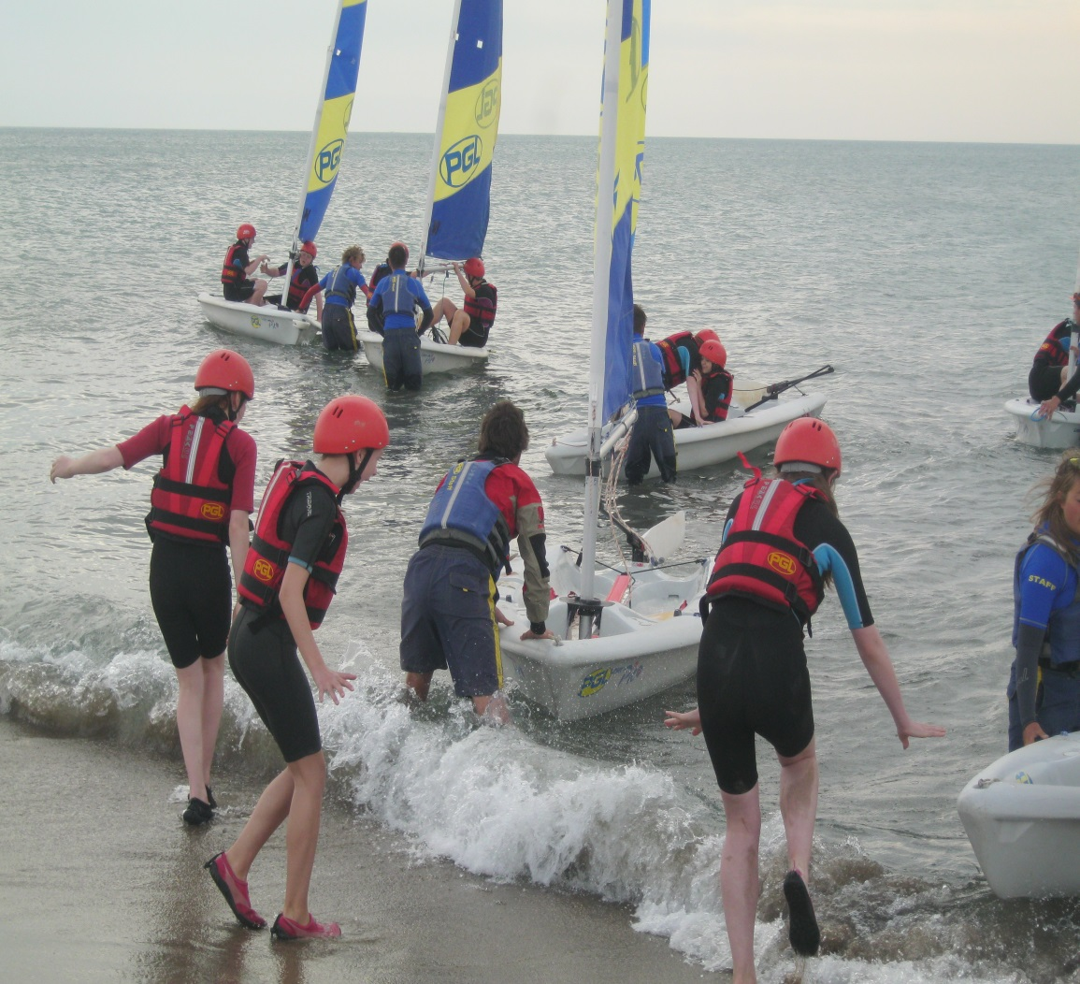
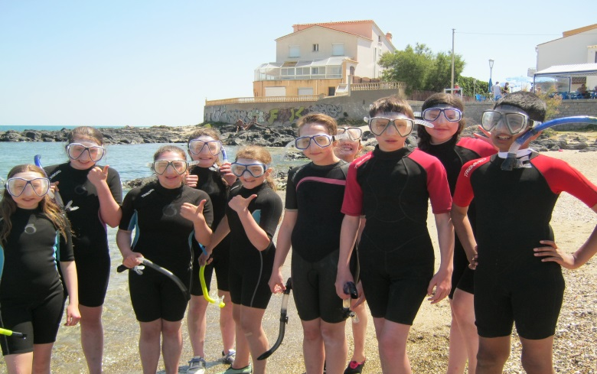
Mimosa Beach Activities

Slide 12
SLEEPING ARRANGEMENTS
Chalets/Tents will sleep 4 or 5 people
Pupils will have chance to select who they would like to share with closer to the time

Slide 13
Kit List 1
Sleeping bag
(used on the bus and after the ferry)
Single sheet
(optional)
Pillow
2 towels
Clothes pegs
Night clothes
(warm clothing)
Sun hat
Shorts
(longer are better, really short ones rub in the salt water and legs can get burned in the canoes)
Several T-shirts
Socks
Trainers
Notes:
Everything must be clearly marked with the pupil’s name – not initials

Slide 14
Kit List 2
Several changes of underwear
Dry Bag
(Sports direct for £5, small bag for sun cream, water and camera in the canoes)
Rash Top
(to wear under the life vest which will protect them from the sun. Sports direct £5-10)
Shoes for water sports activities
(no crocs. Old trainers or water shoes only)
Swimming costume/Shorts
(no bikinis, tankinis or swimming costume only)
Casual Wear (school hoodie to travel in plus one hoodie as it can be cold at night. Bring one outfit for the disco)
Labelled strong plastic bags (bin liners) for wet and spare clothes
Factor 50 waterproof suntan lotion
Factor 50 Lip salve
Insect repellent

Slide 15
Passport/Money/Health insurance card
Can you please return in an envelop to the school office on Monday 20th April the following items below:
Passport (must have 6 months still in date)
Health Insurance card (must be valid)
Euros(drinks/sweets/ice cream in France)
Sterling (service stations on the way there and back)
Can you write on the outside of the envelop your son/daughters name along with ‘FAO Miss Roberts in PE’.

Slide 16
Mobile Phones
We encourage pupils not to bring expensive phones with them (pupils will have access to the school phone if they need to contact home)
There will be regular updates on the school twitter feed.
There are no charging facilities in the tents
Valuables: there are no locks on doors/tents so please don’t bring anything valuable with you (e.g. jewellery etc)
No tablets, phones or iPads are to be brought on the trip.

Slide 17
Ms Roberts - 10 | Ms Dooris - 10
Massie Ling Grace Love Milla McGonigle Sophie Parry Sophie Pearce Masie Quinn Sophia Quinn Olivia Walker Lucy Wilson Zaynab Hussain | Emelia Brown Juliette Carter Imogen McKever Brooke Murphy Abigail Sabba Ava Scott Molly Stephen Sarah Stevenson Katie Stuart Abigail Dee
Mr Wilson - 10 | Mr Weston – 10
Nathan Davidson Matthew Halpin George Hashagen Adam Hyde Kieran McAneny Andrew McBride Ben McCroskie Findlay McDougall Alec Tough Sandy Wilson | Douglas Buchanan Blair Farquhar John Gardiner Issak Meulemans Lewis Nairn Ross Nisbet Murray Olliver Paul O’Neill Blake Orr Murray Souter

Slide 18
Questions
If you don’t have any questions please hand the completed paper work to a member of staff on your way out. If you have not done so already.
Otherwise, we will be happy to answer any questions you may have.
If you want to speak to a staff member confidentially then please wait behind at the end.
Thank you for coming.

