Slide 1
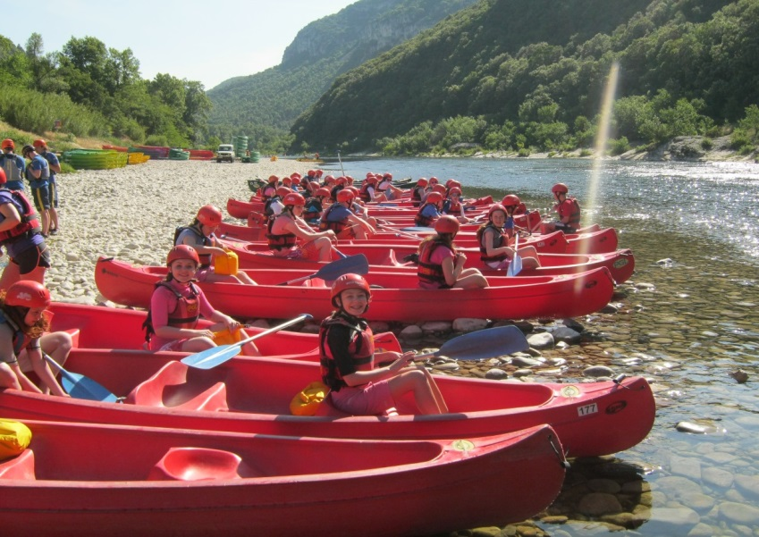
Water Sports Trip 2019 Parent Meeting

Slide 2
Welcome
Water Sports Trip 2019 Parent Meeting
Thank you for attending this meeting. There is a lot of information to get through so please be patient.
Forms will be collected in at the end.
There will be an opportunity to ask questions at the end.
If you want to speak to a member of staff confidentially then please wait behind at the end of the meeting.

Slide 3
Departure
Water Sports Trip 2019 Parent Meeting
Meet at the school at 5.30am and the bus will leave at 6.00am – I will confirm this nearer the time by letter.
Pupils should bring the following items with them on the bus in their hand luggage:
Sleeping bag and pillow
Wear school hoodie
Change of clothes
Packed lunch and dinner or money to buy lunch at services and dinner on the ferry…NO ENERGY DRINKS AND NO CANS OF JUICE.
Toothbrush and toothpaste
DVDs/ games
Pupils will not have access to their main luggage until we arrive at the campsite in France.
Notes:
I will issue a letter with the final details prior to the trip and also a reminder of what to bring in their hand luggage.

Slide 4
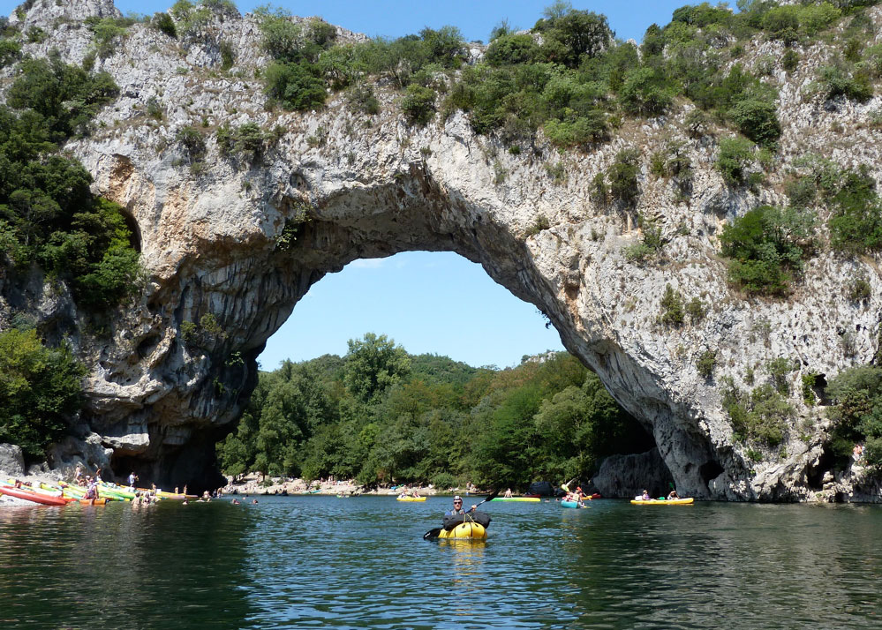
Domaine de Segries
Water Sports Trip 2019 Parent Meeting
We should arrive at the Ardeche around 8/8.30am on Saturday 1st June.
The pupils will participate in two and half days of canoeing down the Ardeche gorge.

Slide 5
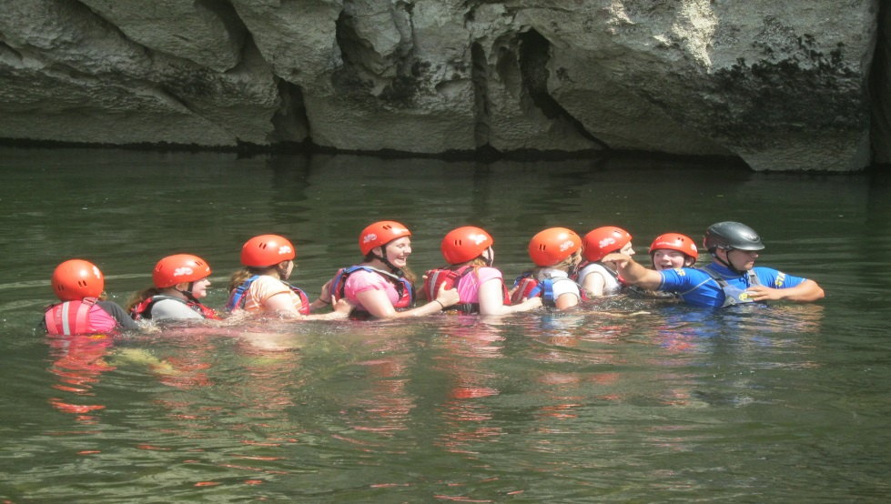
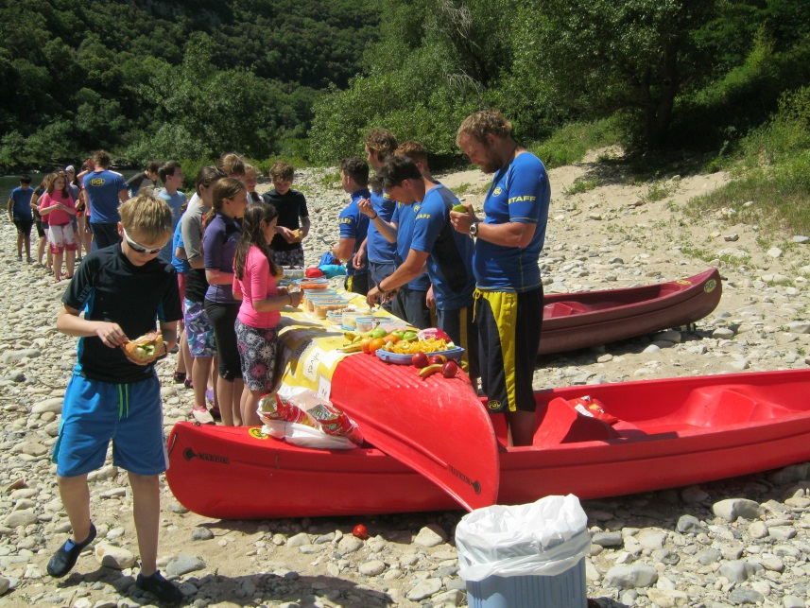
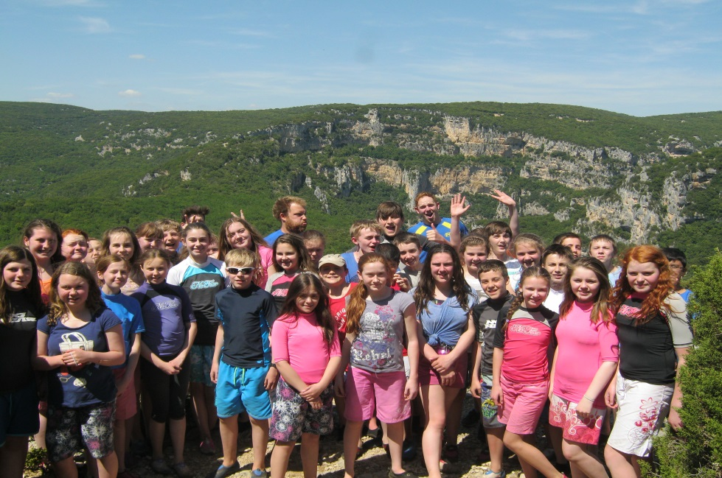
Domaine de Segries
Water Sports Trip 2019 Parent Meeting

Slide 6
Itinerary
Water Sports Trip 2019 Parent Meeting
Date | Morning | Afternoon | Evening
Fri 31st May | Meet @MCHS | Dover to Calais | Coach to Ardeche
Sat 1st June | Arrive @ Ardeche | Open Canoe | Generation Game
Sun 2nd June | Open Canoe | Open Canoe | Disco
Mon 3rd June | Open Canoe | Open Canoe | Fun Games
Tues 4th June | Leave Ardeche | Arrive @ Mimosa Beach Activity | Music Quiz
Wed 5th June | Body Boarding | Funboats | Beach Olympics
Thurs 6th June | Windsurfing/Raft building | Picos | Talent Show
Fri 7th June | Catamarans/Sit on Kayaks | Ocean Rider | Depart Mimosa
Sat 8th June | Morning Ferry To Dover | Coach travel to school | Home @ 9.30pm
Notes:
These activities are subject change due to weather, but the pupils are always kept active and busy.

Slide 7
Mimosa…The Beach!
Water Sports Trip 2019 Parent Meeting
We will leave the Ardeche on Tuesday 4th June and travel down to the beach at PGL Mimosa.
We participate in 3 and a half days of beach activities, these activities are subject to change dependent on the weather.
We depart Mimosa after dinner on Friday to arrive in time for the Saturday morning ferry from Calais to Dover.

Slide 8
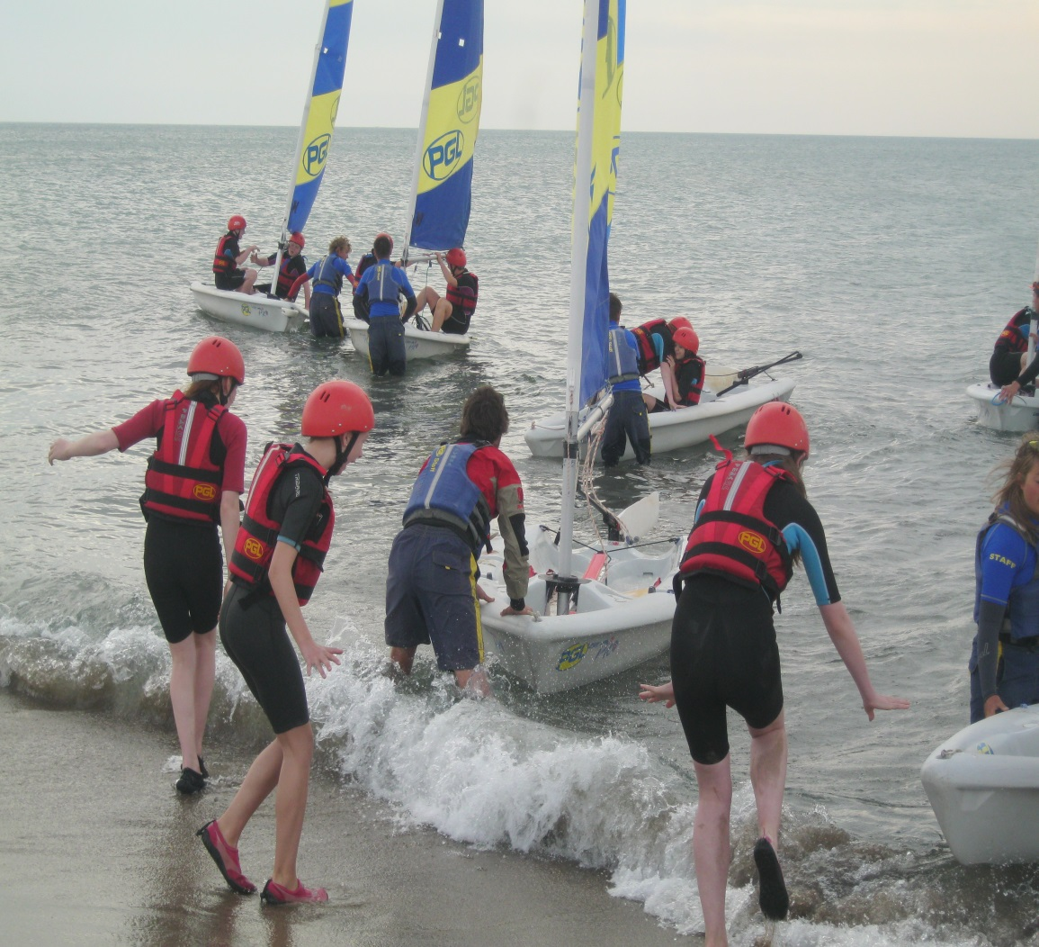
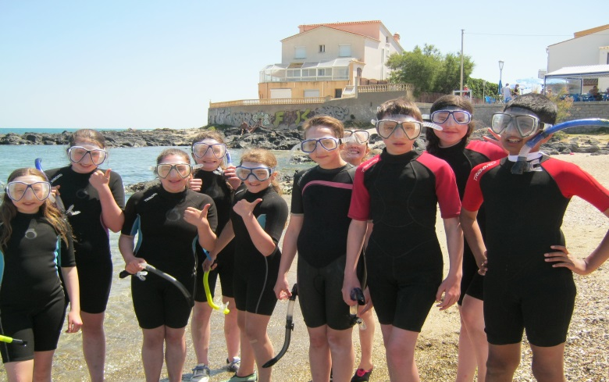
Mimosa Beach Activities
Water Sports Trip 2019 Parent Meeting

Slide 9
Forms
Water Sports Trip 2019 Parent Meeting
I will collect all forms in at the end.
If any forms are missing or you need other copies please let me know at the end.
Notes:
Yellow – please make sure all numbers are correct and available for all times of day
Pink – We will carry emergency paracetamol/ anti histamine with us there is no need to hand any in.
Dietry requirements: fantastic food and choice, any concerns please highlight this to a member of staff
Green – Nil return is required. If you circumstances change before the trip just let us know and we can issue a new form.
Please hand any medication in a with your child’s name clearly labelled to the staff member the morning of the trip.
Please note the only medication a child should carry is their travel sick medication. If your child has never been on a long coach trip it is a good idea to be proactive.
Purple – Check list for young person. Pupils will be given a card with the school’s mobile number, both PGL centre numbers on it once we are on the road. They are expected to have this with them at all times they are off site.
Blue – Check list for parents any questions please ask at the end

Slide 10
Kit List
Water Sports Trip 2019 Pupil Meeting
Sleeping bag
Single sheet - optional
Pillow
2 towels
Clothes pegs
Night clothes
Several changes of underwear
Casual Wear – Disco
Dry Bag
Rash Top
Shoes for water sports activities
Swimming costume
Sun hat
Shorts
Several T-shirts
Socks
Trainers
Labelled strong plastic bags (bin liners) for wet and spare clothes
Factor 50 waterproof suntan lotion
Factor 50 Lip salve
Insect repellent
You should have received a copy of this in your packs, however I have spare copies if needed.
Notes:
Sleeping bag and pillow will be used on the bus after the ferry.
Casual wear – school hoodie expected to be worn to travel in for easy identification plus one other hoodie as it can be chilly at night time.
Dry Bag – Sports Direct approx £5 just a small one for sun cream, water and camera in the canoes,
Rash Top – To wear under life vest which will protect them from the sun. Sports Direct (£5-£10 approx)
or you can buy them from PGL at the campsite for about 8-10 euros.
Shoes – NO CROCS, old trainers or the water shoes (£5)
Swimming costume/ tankini – NO BIKINIS
Shorts – longer are better, really short ones rub in the salt water, also legs get burnt in the canoes.
Everything must be clearly marked with the pupil’s name – not initials

Slide 11
Passport/Money
Water Sports Trip 2019 Parent Meeting
Everyone has been issued with an envelope in the pack.
Passport
Health Insurance card
Euros and Sterling- Smaller notes
Please ensure this is handed to the school office on Monday 20th May at the start of the day.
Campsite shops for pupils to buy drinks/sweets/ice cream. We may also visit a small market town one evening.
Notes:
Envelopes should have pupil names on them? If not, please put this onto the envelope.
Passport – 6 months still in date, make sure it is the right one ☺
Euros for campsites and same market town we visit one evening.
Sterling for journey back.
Importance of it being handed in on time.
Pupils should carry their own sterling for the journey down, they will be given access to their euros each night.

Slide 12
Mobile Phones
Water Sports Trip 2019 Parent Meeting
We encourage pupils not to bring expensive phones with them.
There will be regular updates on the school twitter feed.
There are no charging facilities in the tents
Misuse of phone/ camera
No tablets or IPads are to be brought on the trip.
Notes:
There aren’t locks on the pupils door and tents so please don’t bring anything valuable with you (jewellery etc)
Great opportunity for pupils to interact fully instead of being on their phones.

Slide 13
Questions
Water Sports Trip 2019 Parent Meeting
If you don’t have any questions please hand the completed paper work to a member of staff on your way out.
Otherwise, we will be happy to answer any questions you may have.
If you want to speak to a staff member confidentially then please wait behind at the end.
Thank you for coming.

