Slide 1
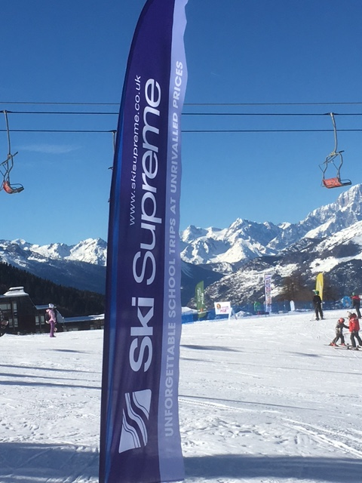
Mearns Castle
PILA 2019

Slide 2
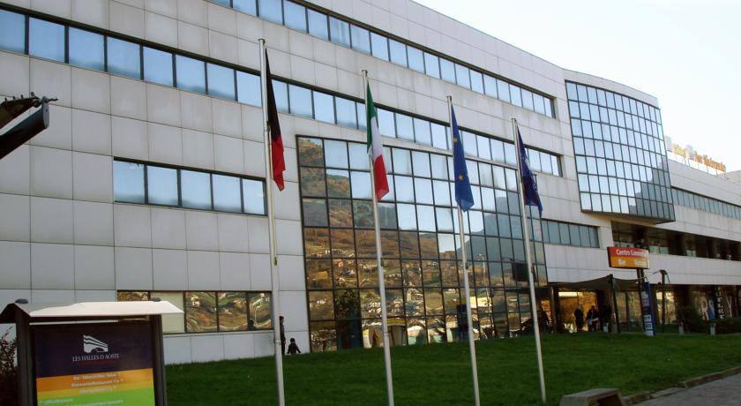
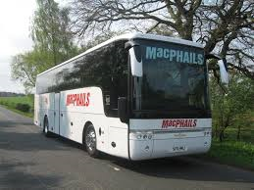
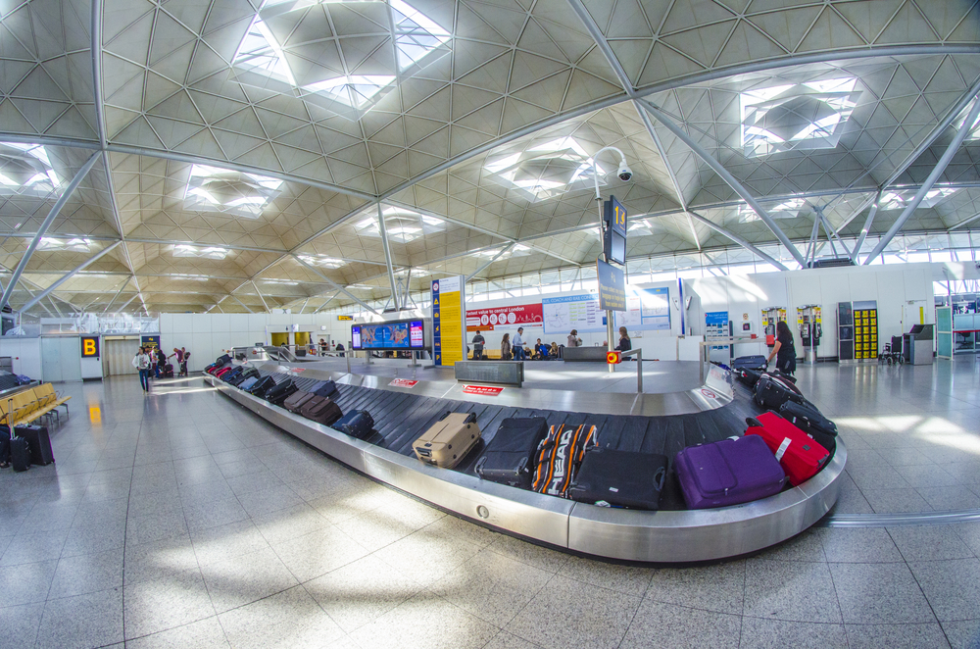
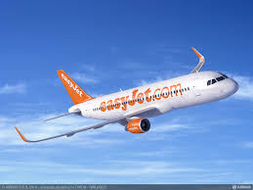
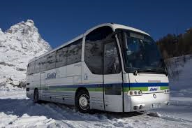
DEPARTURE DAY 1
SATURDAY 12TH JANUARY
13:30 Depart school travel to Glasgow Airport
16:40 Easyjet flight departure
23 kg Baggage Allowance
19:55 Arrive Geneva
20:45 Transfer coach to hotel
22:30 Arrive Express Hotel
Allocate Rooms & settle in

Slide 4
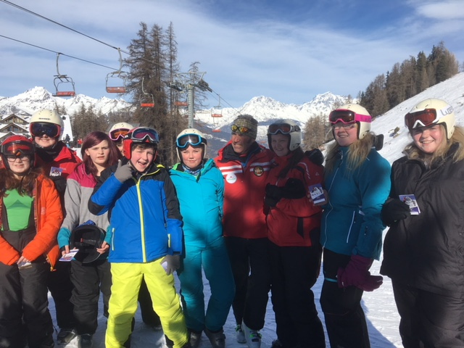
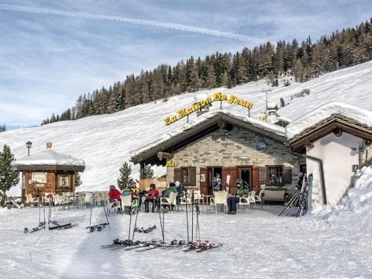
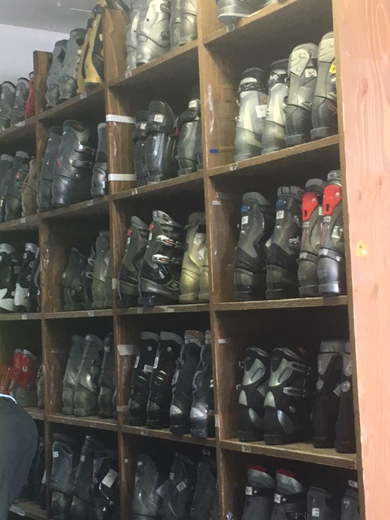
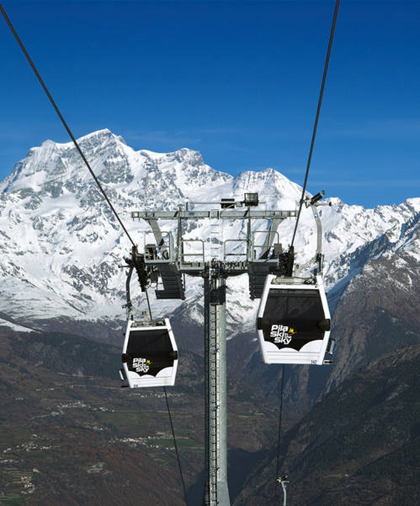
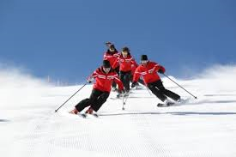
Day 2 – Day 6
07:15 Breakfast
08:15 Depart for Pila
09:30 Issue Equipment
10:00 Lessons
12:00 Lunch
13:00 Lessons
15:00 Return Equipment to ski store
16:15 Return to Hotel
19:00 Dinner
20:15 Evening Activity

Slide 5
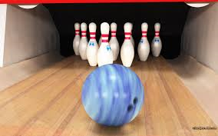
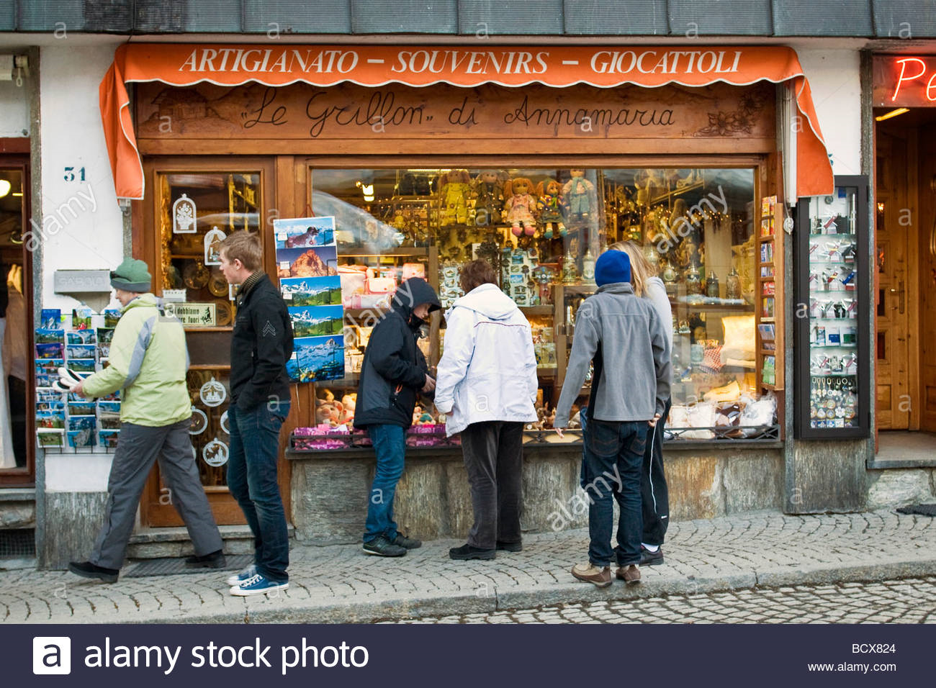
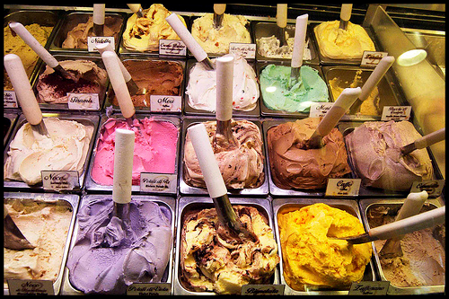
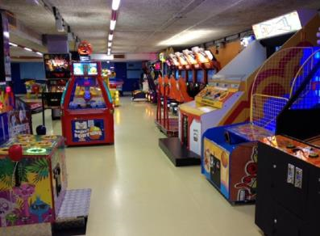
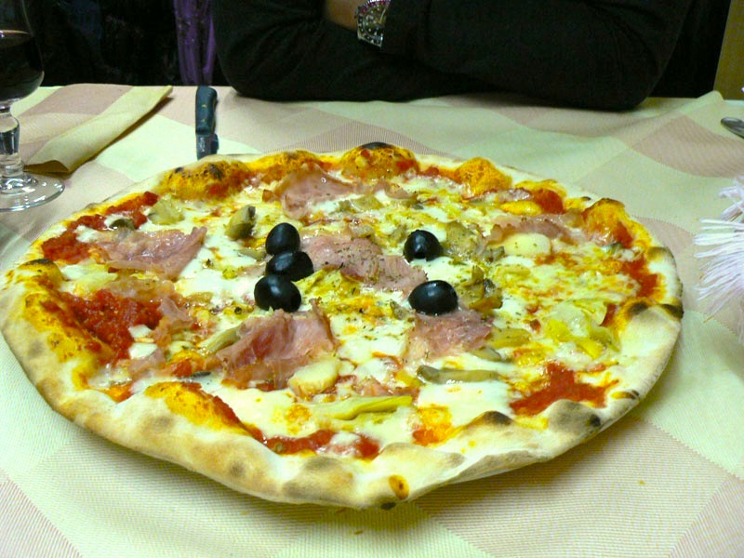
Evening Activities
Video Arcade
Pizza
Bowling
Disco
Shopping
(after skiing on last day)
Presentation & Quiz

Slide 6
Return Date
Friday 18th January
06:15 Breakfast
07:00 Arrive Milan Malpensa
11:45 Easyjet Milan → Edinburgh
13:20 Arrive Edinburgh
14:00 Transfer coach to School
15:15 Arrive School

Slide 7
Clothing
SKI SOCKS (NOT FOOTBALL SOCKS) X 3
SALOPETTES OR TROUSERS AND WATERPROOF OVERTROUSERS (NOT JEANS)
T- SHIRT OR POLO NECK X 2/3
BASE LAYERS X 2
FLEECE
SKI JACKET OR WATERPROOF ANORAK
GLOVES OR MITTS (NOT WOOLLY MITTS)
HAT (COVERS WHOLE HEAD/EARS) THOUGH HELMETS WILL BE WORN

Slide 8
Clothing
LIP SALVE
SUN –CREAM
SUNGLASSES OR GOGGLES
APPROPRIATE FOOTWEAR FOR WALKING ON SNOW
NECK BUFF
OTHER CLOTHING FOR CASUAL/HOTEL WEAR
TOILETRIES
PYJAMAS
MEDICATION
INEXPENSIVE CAMERA

Slide 9
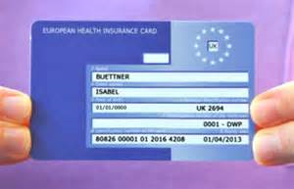
DON’T FORGET
EHIC Card
(www.nhs.uk)
Dietary
Medical

