Slide 1
Head Teacher Welcome
Miss Hunter
Session 2017/18
in Mearns Primary

Slide 2
School Improvement
Targets
Pupil and Parental Engagement
Learning and Teaching
Curriculum

Slide 3
Pupil and
Parental Engagement

Slide 4
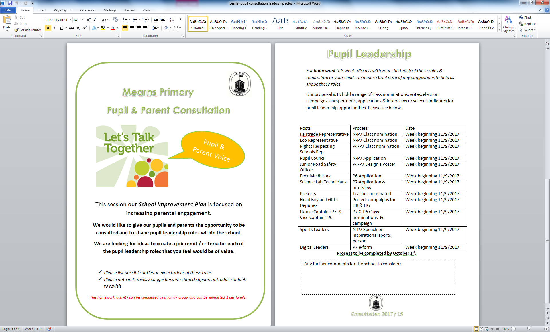
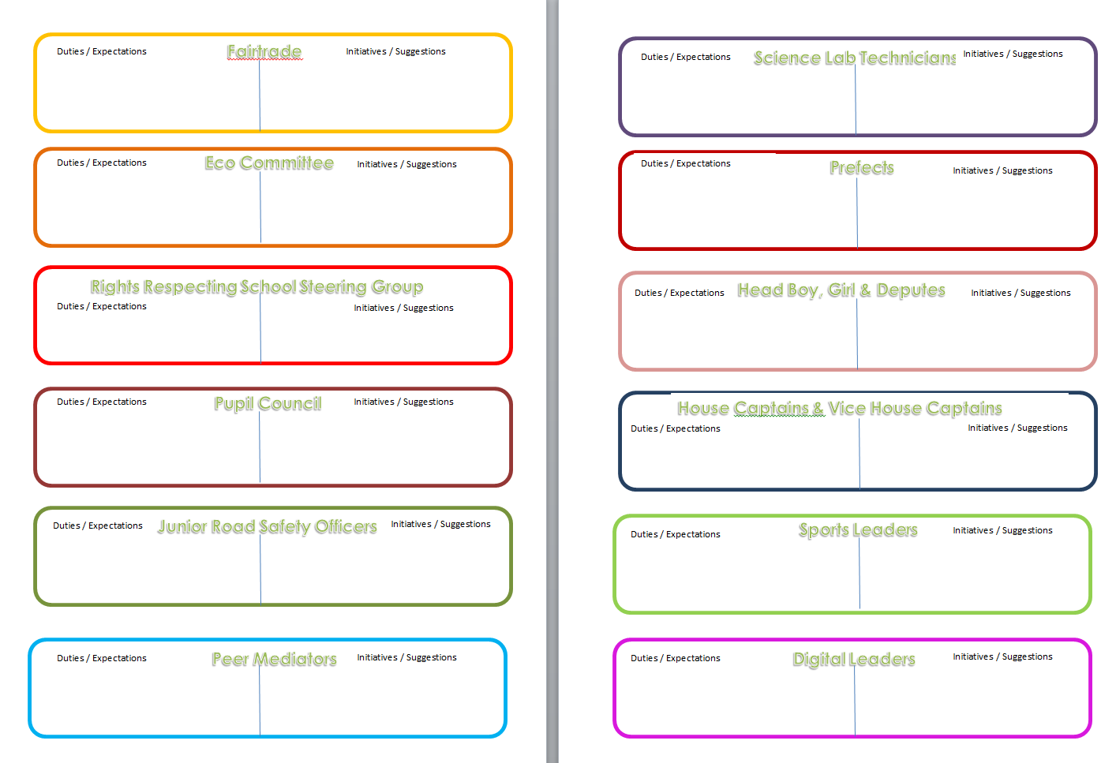
Parental
Calendar
Notes:
Talking homework
Family Friendly awards
Numeracy and Literacy Kits
Parental Calendar
Achievements
Family events

Slide 5
Learning and Teaching

Slide 6
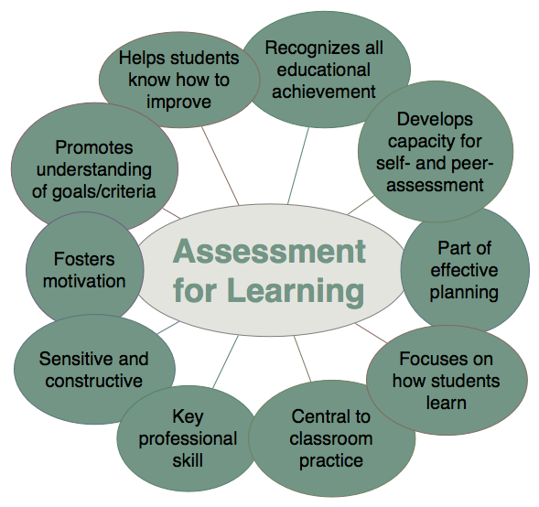
Learning & Teaching
Notes:
Playful Pedagogy
Mindfulness
AiFL
Co-operative Learning
Blooms
Thinking Skills
Outdoor

Slide 7
Curriculum

Slide 8
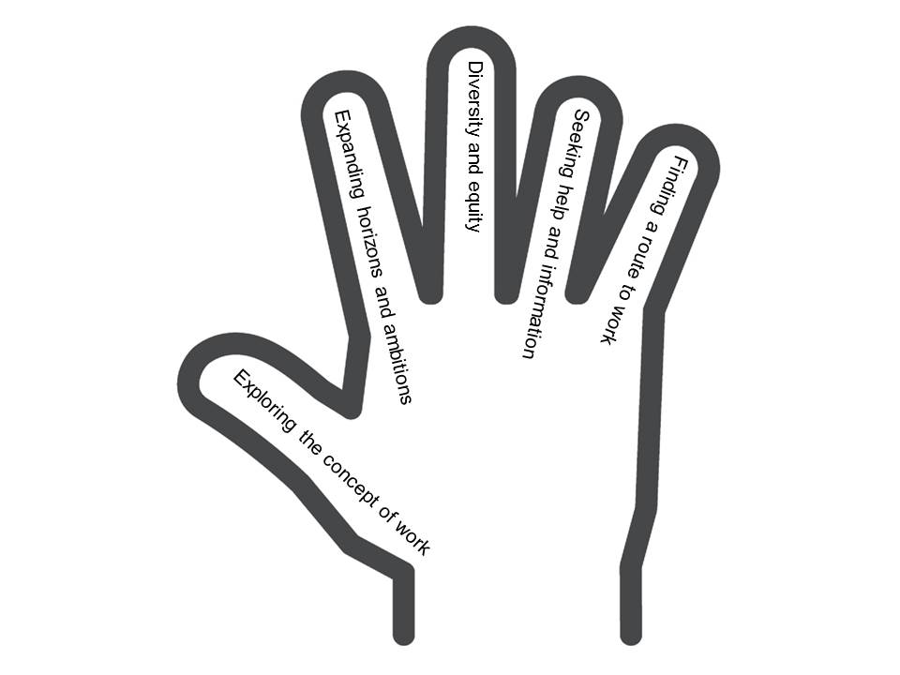
Curriculum
Developing the Young Workforce
Notes:
STEM
Literacy – reading, moving image
DYW
Skills academy

