Slide 1
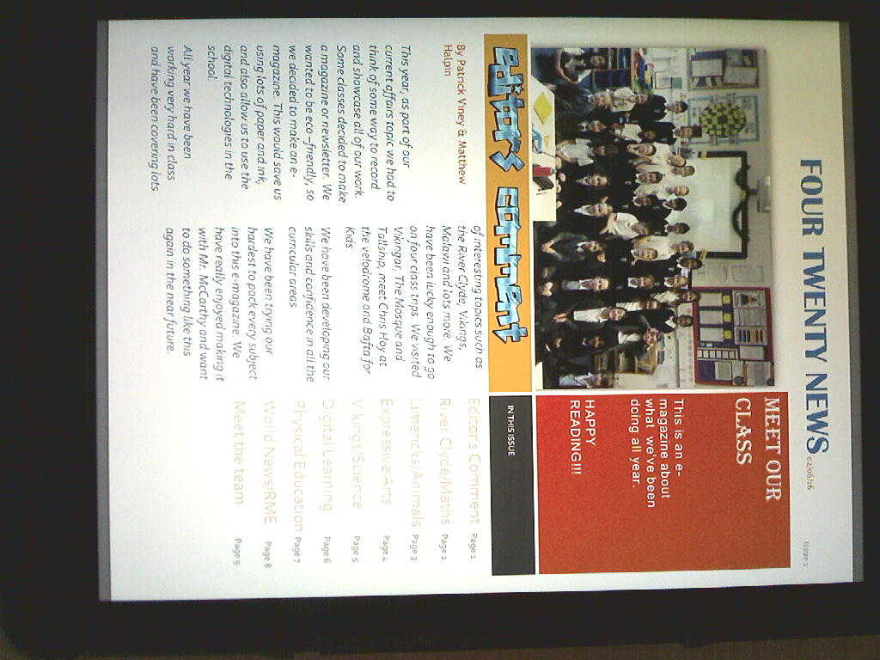
Our e-magazine
Primary 4.20
Current Affairs

Slide 2
In the beginning…
As part of our Current Affairs topic this year, we decided to create an informative e-magazine, to showcase all of our interests and work throughout the year.

Slide 3
Why an e-magazine?
As an eco school we are always thinking of new ways to be eco-friendly. So we decided to create an e-magazine. This would save us using loads of paper and ink, and would also save us spending money in the process.

Slide 4
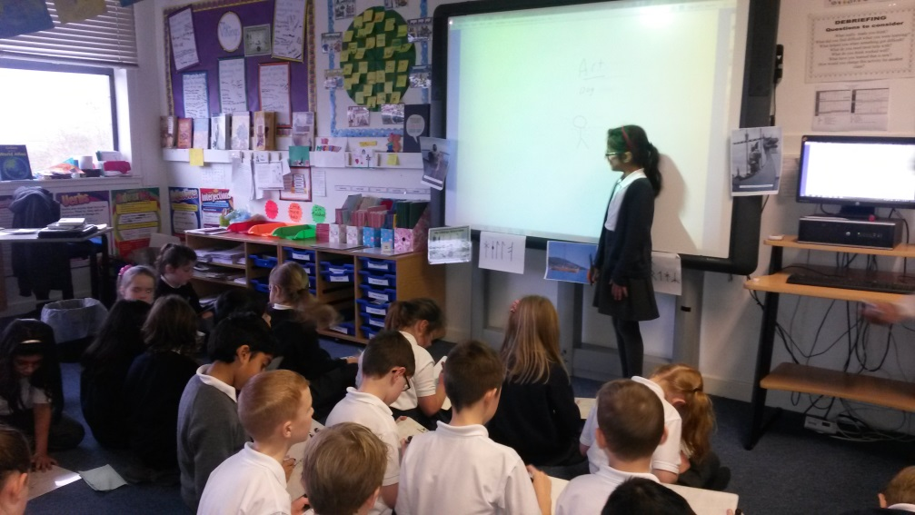
Why an e-magazine?
The creating process of the e-magazine also enabled us to develop our ICT skills, and use all the fantastic digital technology available in the school.

Slide 5
Report Writing
We have been practicing our report writing skills all year. We used the First News resource to study the layout of articles. We also looked at some examples of e-magazines online.
From writing a Viking newspaper article to personal report writing tasks for homework, we have enjoyed researching and writing about our findings.

Slide 6
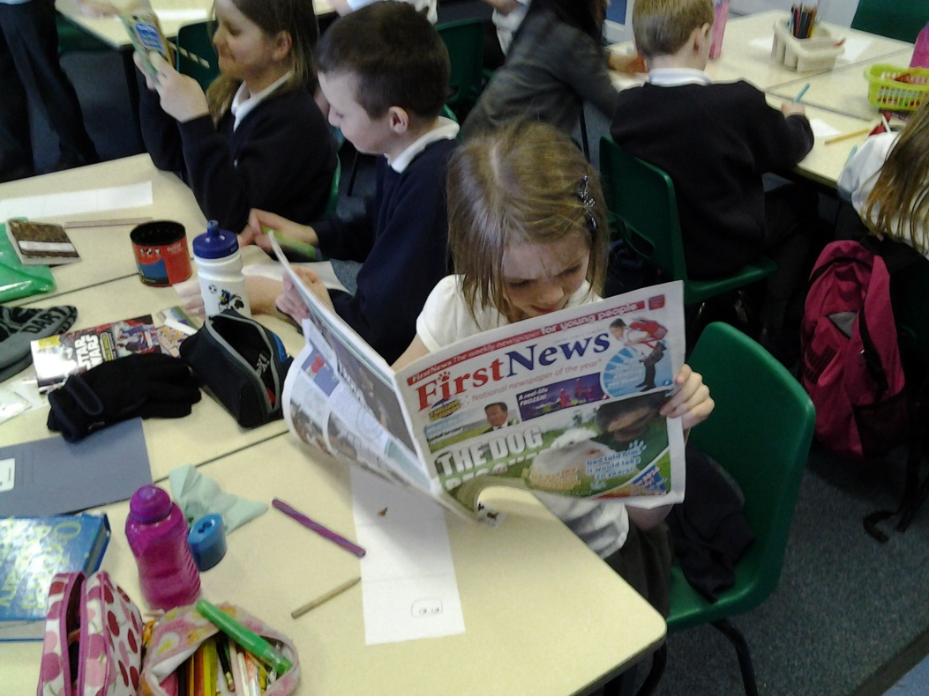
First News
Each week we get the chance to read through the First News newspapers. We then summarise and discuss current issues that are taking place all around the world today.

Slide 7
We began our topic by discussing:
What we already knew
What we would like to know
How we would like to learn it
What we could use to find information
How could we showcase our work

Slide 8
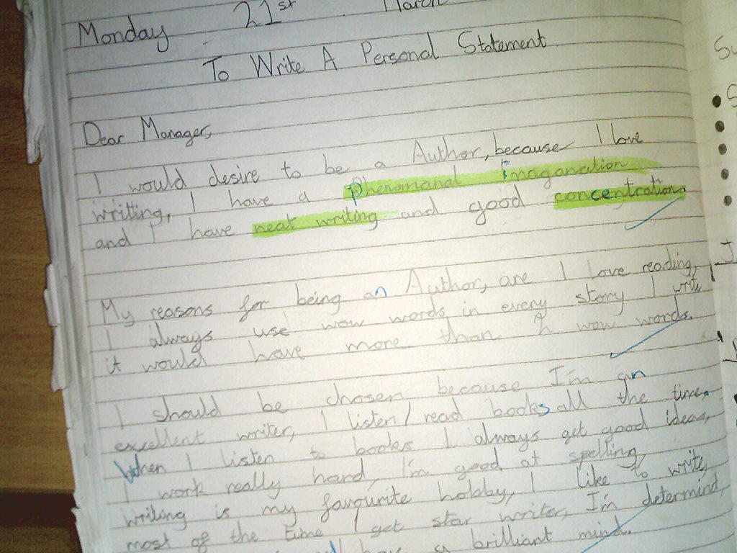
Next…
We discussed what would be involved in creating our e-magazine
We decided what roles would be needed and then each wrote a personal statement including our skills and achievements to convince Mr McCarthy that we should get the role we want.
We brainstormed what to include in our e-magazine and shared the work out in our teams.

Slide 9
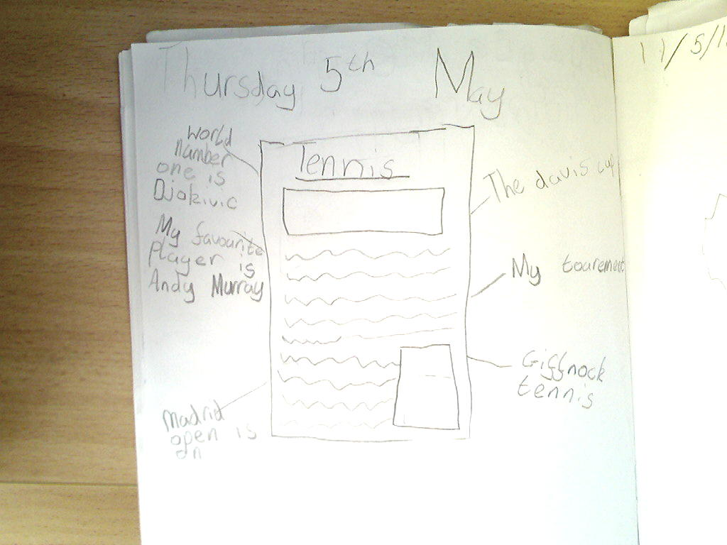
Then…
We used the internet, our class jotters and First News to research information for our articles
We thought about the layout for our articles and drew a sketch of what it would look like
We discussed what images we would use with our articles

Slide 10
After that…
We all wrote out our articles and typed them in a word document
We used the iPads to take the photos we wanted to include with our articles
We worked with Mr McCarthy to upload our articles to our e-magazine and decided on a layout. We chose fonts and colours to personalise our articles

Slide 11
Finally…
Our editors checked over the entire magazine to make sure it was the best it could be
Mr McCarthy showed us how to save the magazine as a PDF and upload it onto the iPads

Slide 12
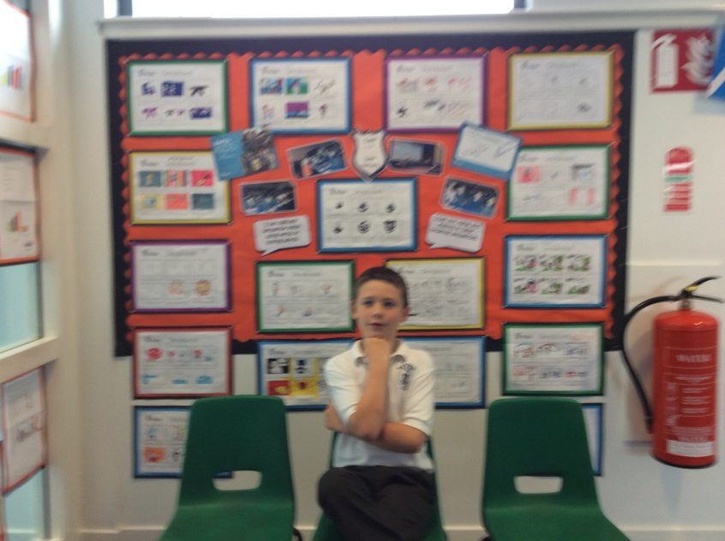
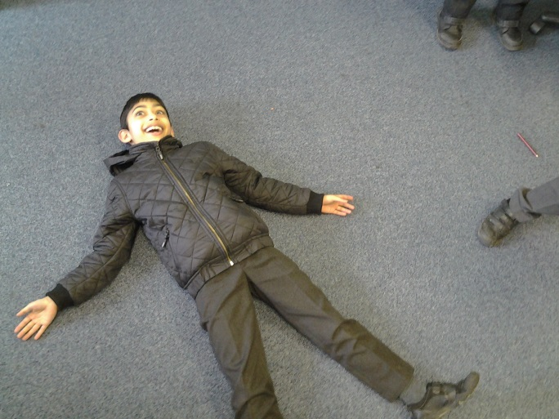
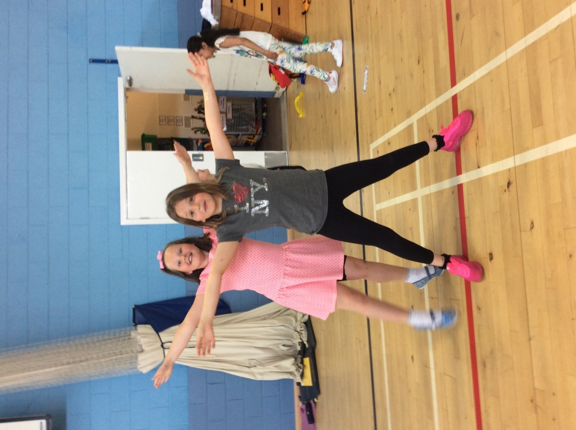
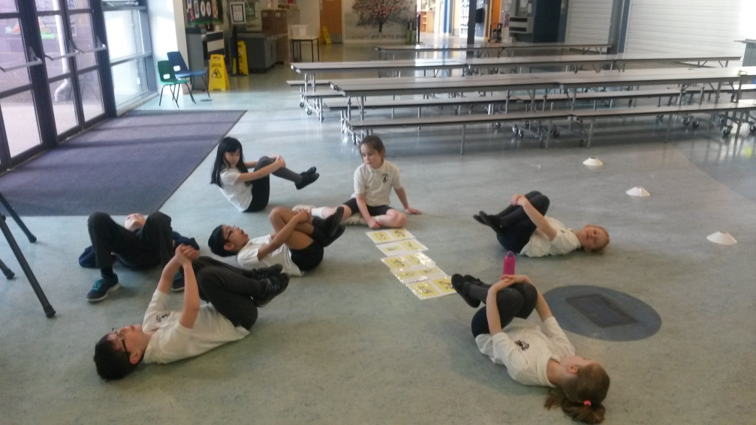
Outtake photos

