Slide 2
World Book Day 2016
4.13 presents

Slide 23
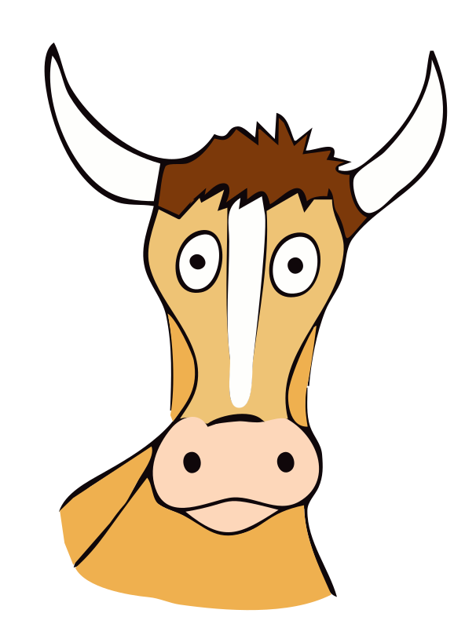
What do you get if you sit under a cow?
A pat on the head.

Slide 24
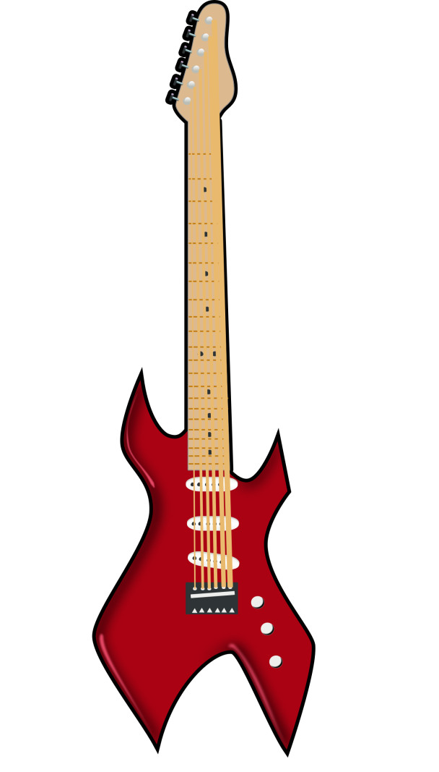
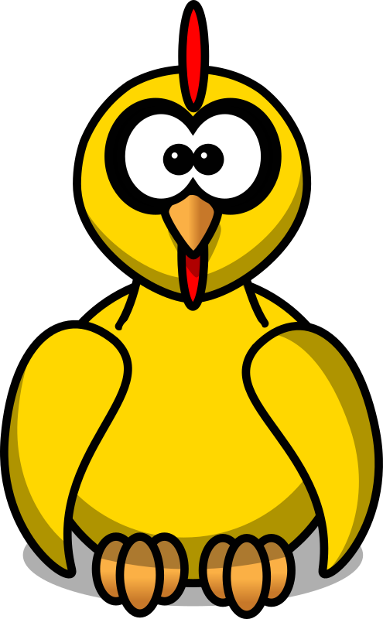
What do you get if you cross a chicken with a guitar?
A hen that plays music
when you pluck it.

Slide 30
Characters

Slide 37
Authors

Slide 53
