Slide 1
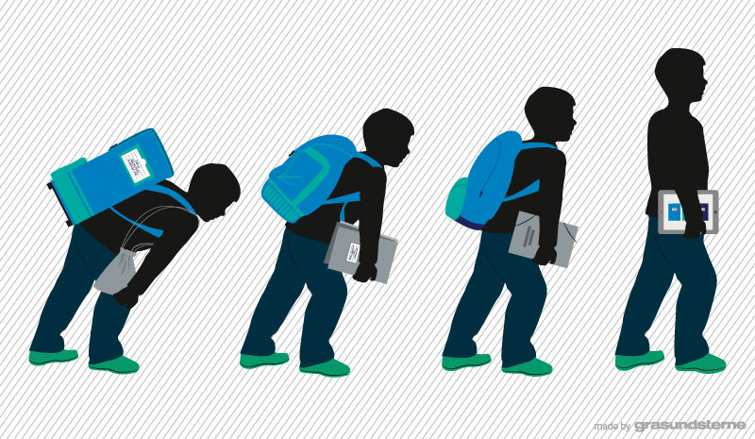
Our digital learning fairy-tale
By primary 4.20

Slide 2
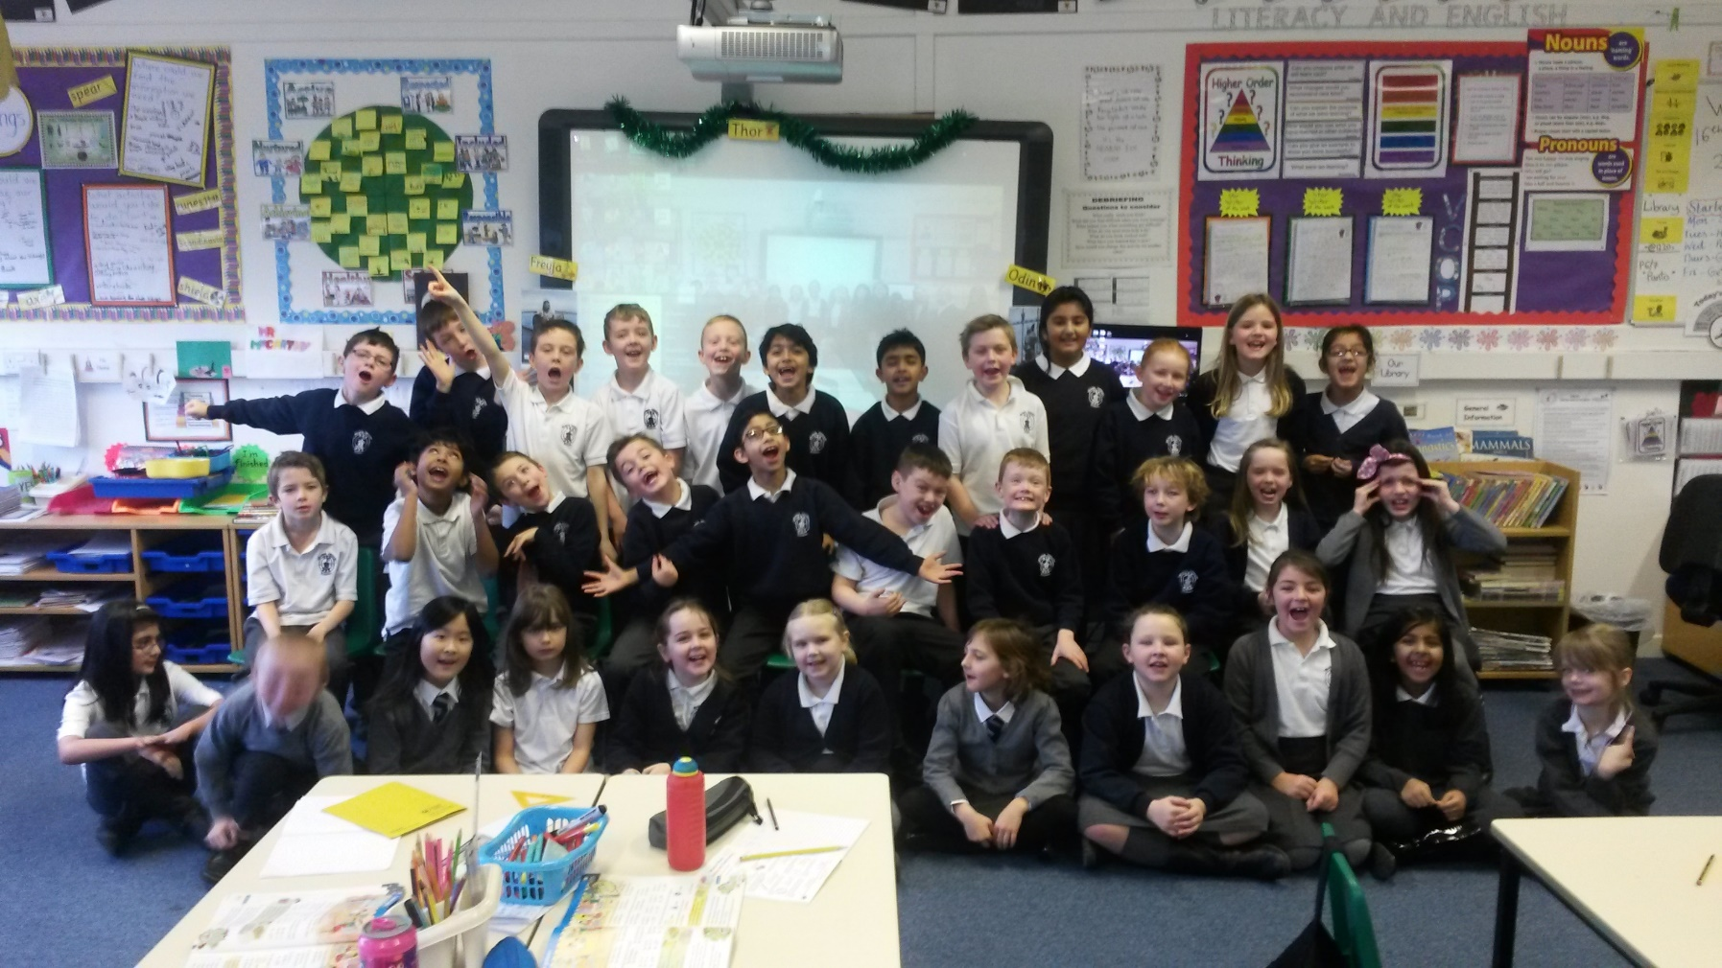
Once upon a time in a fantastic school called Mearns, there was a hardworking class of primary four pupils.

Slide 3
These enthusiastic, young boys and girls loved, more than anything, to learn.

Slide 4
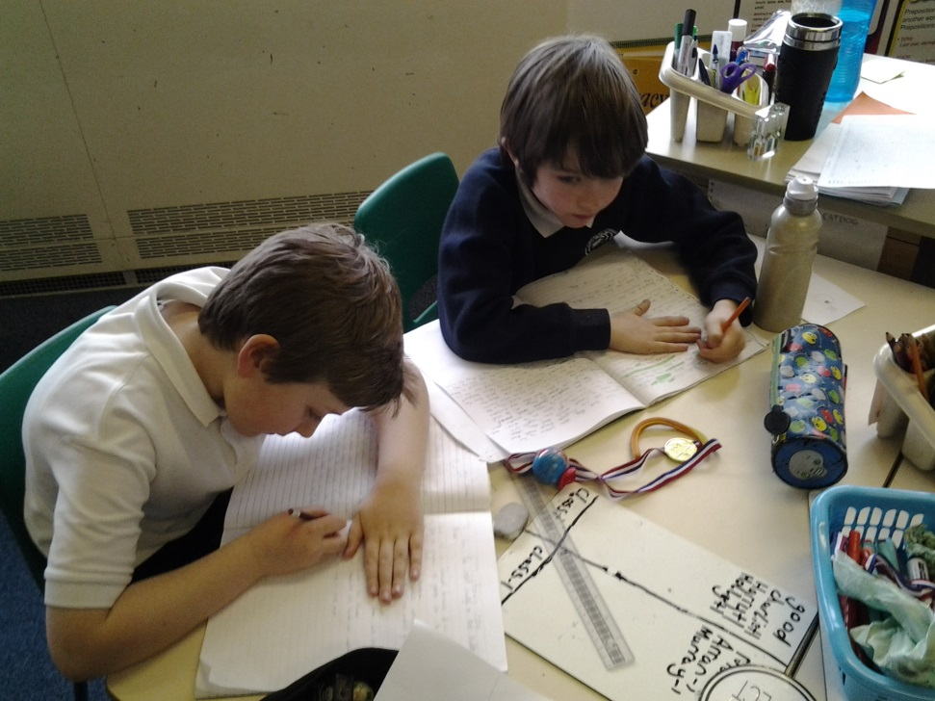
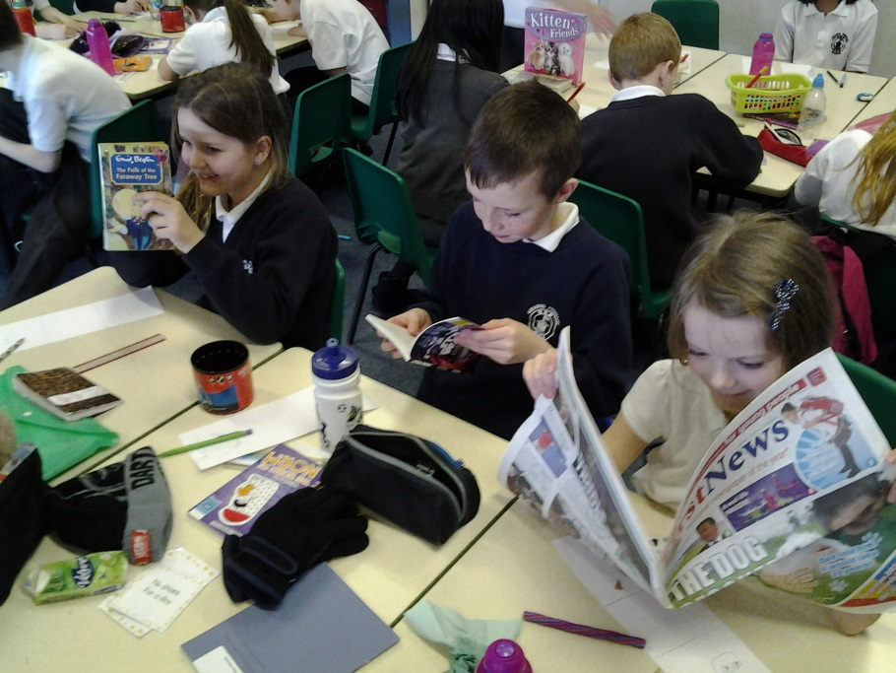
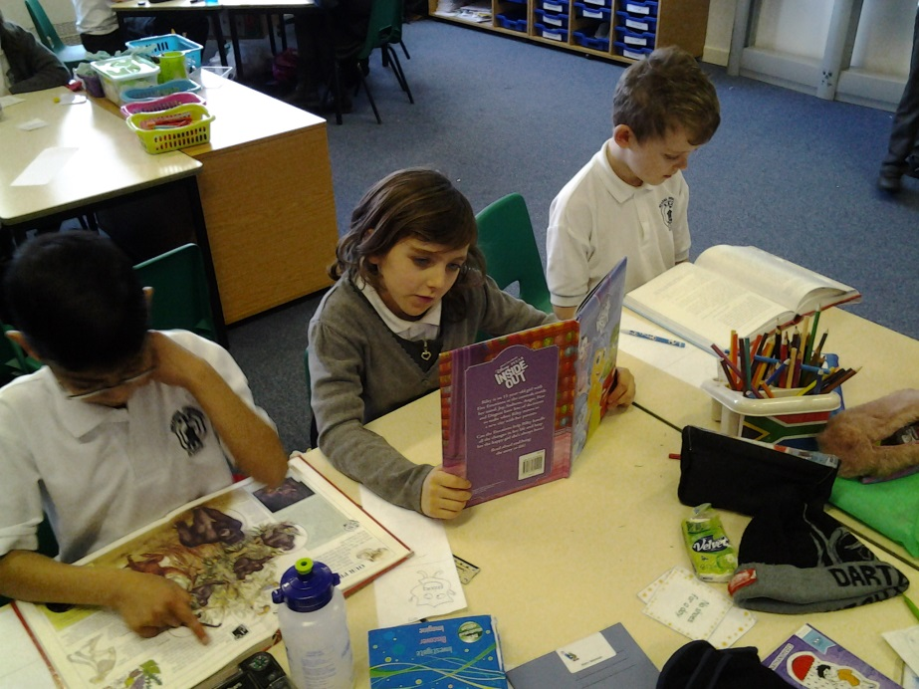
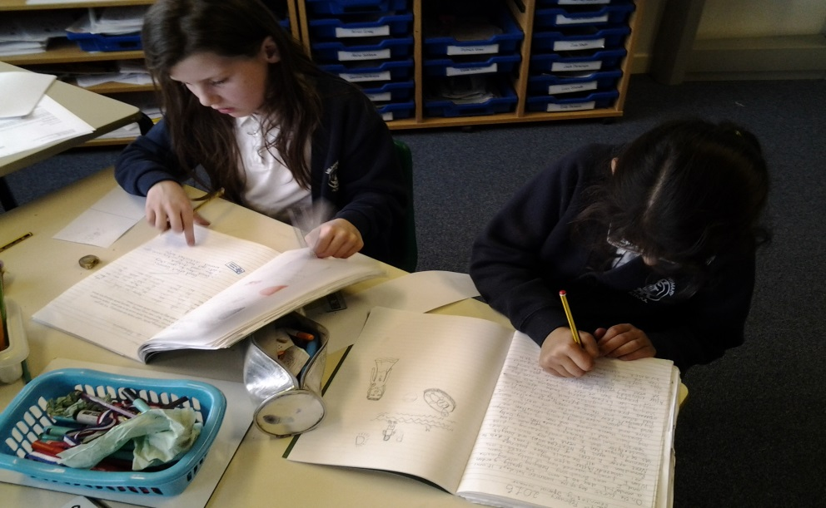
They loved to read, they loved to write

Slide 5
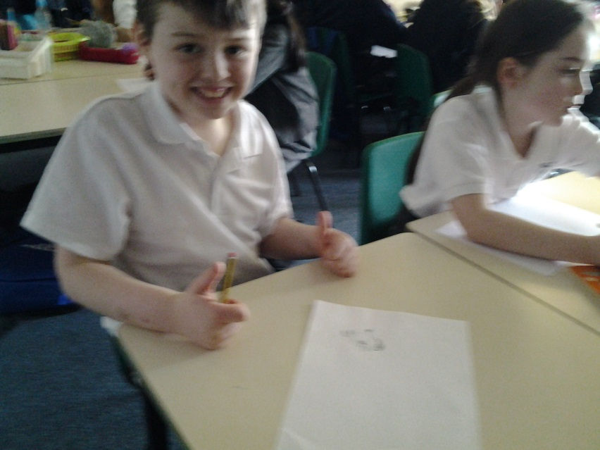
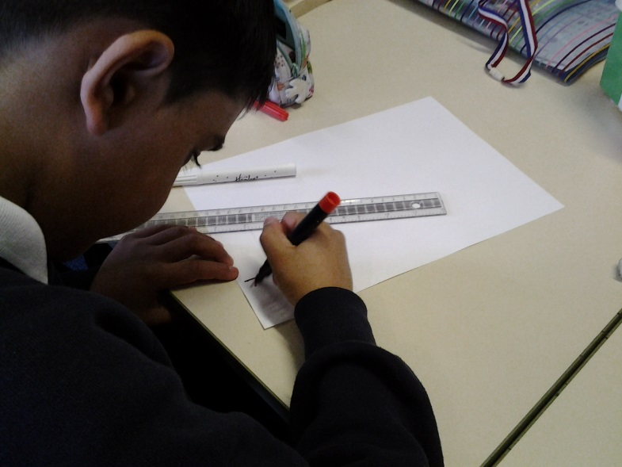
They loved to draw and would rarely fight.

Slide 6
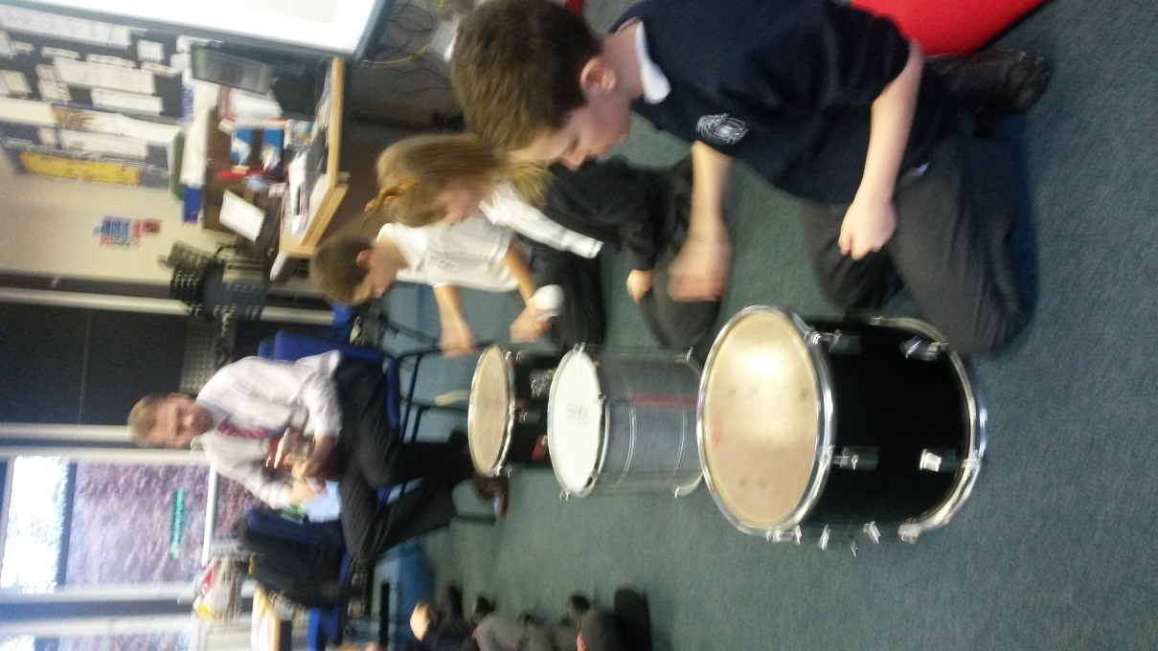
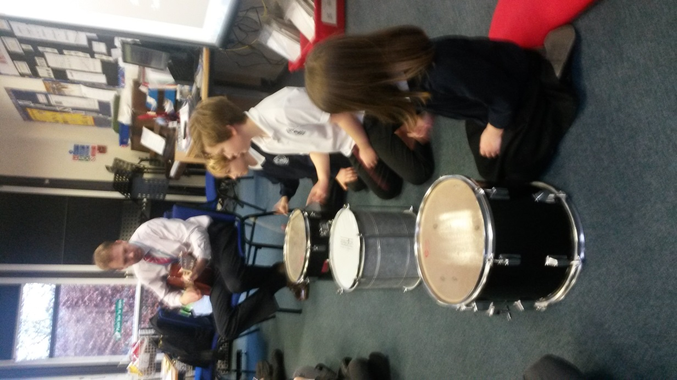
They loved to sing, they loved to run

Slide 7
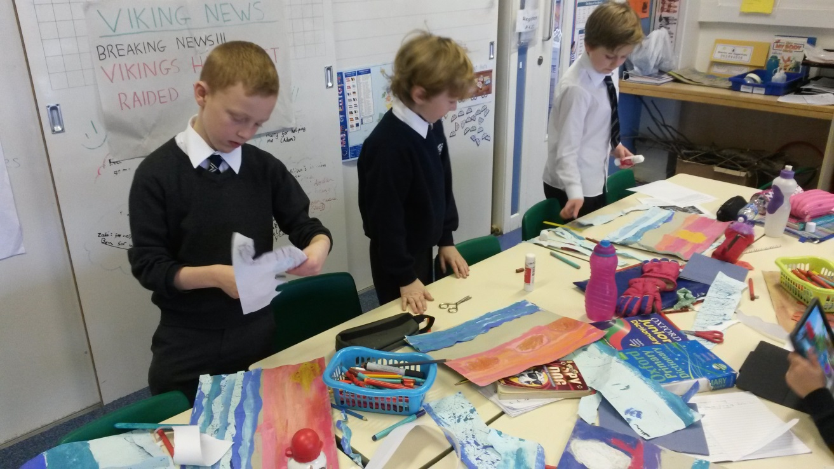
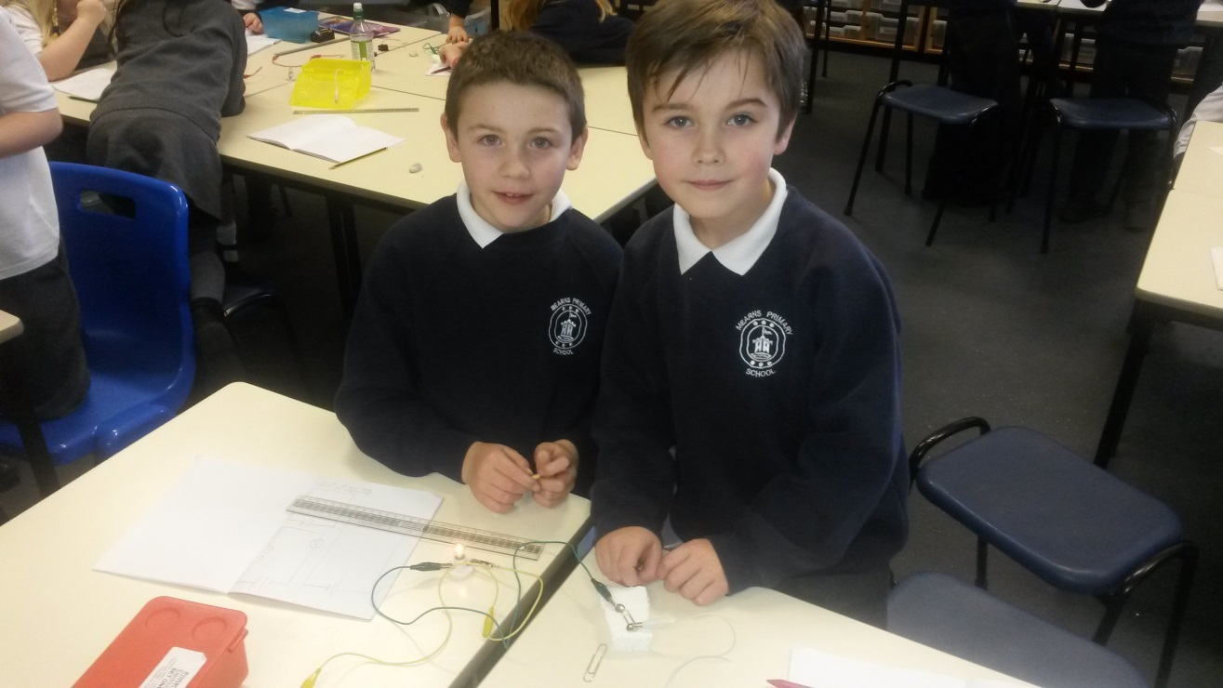
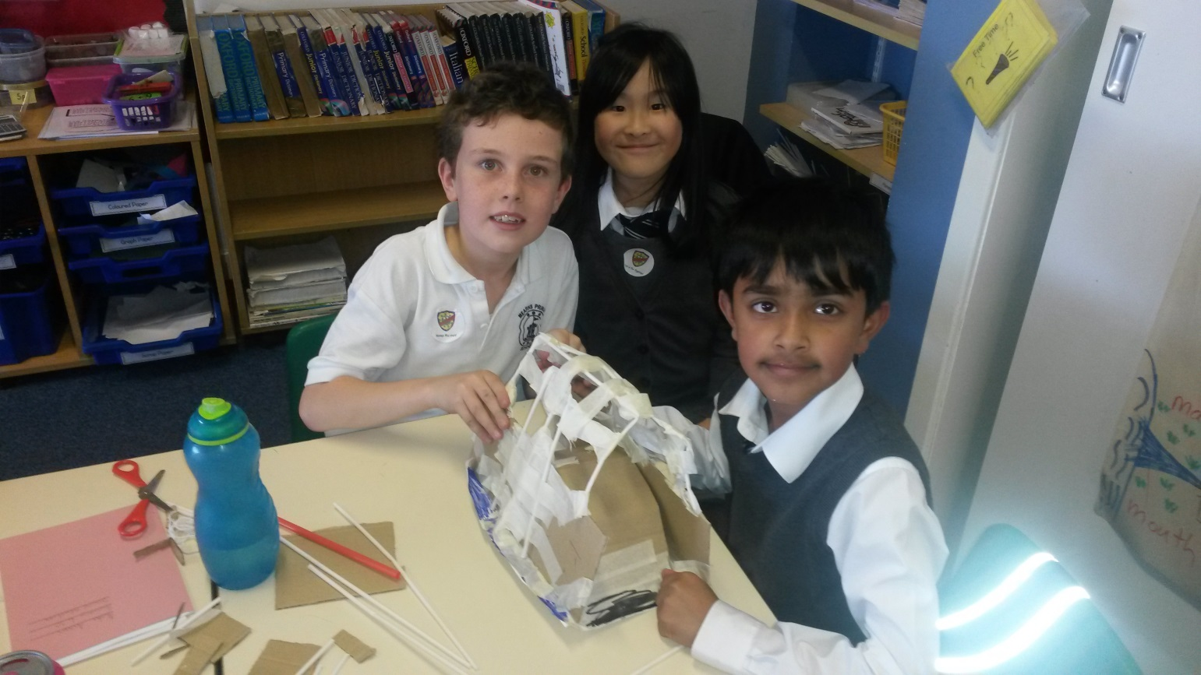
They loved to make, and have lots of fun.

Slide 8
Their lovely school had so much stuff

Slide 9
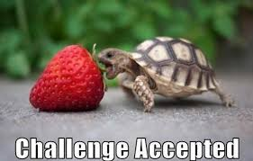
To help make learning challenging and tough.

Slide 10
The boys and girls knew that they were very lucky.

Slide 11
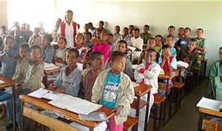
They had so many great resources that others in the world might not.

Slide 12
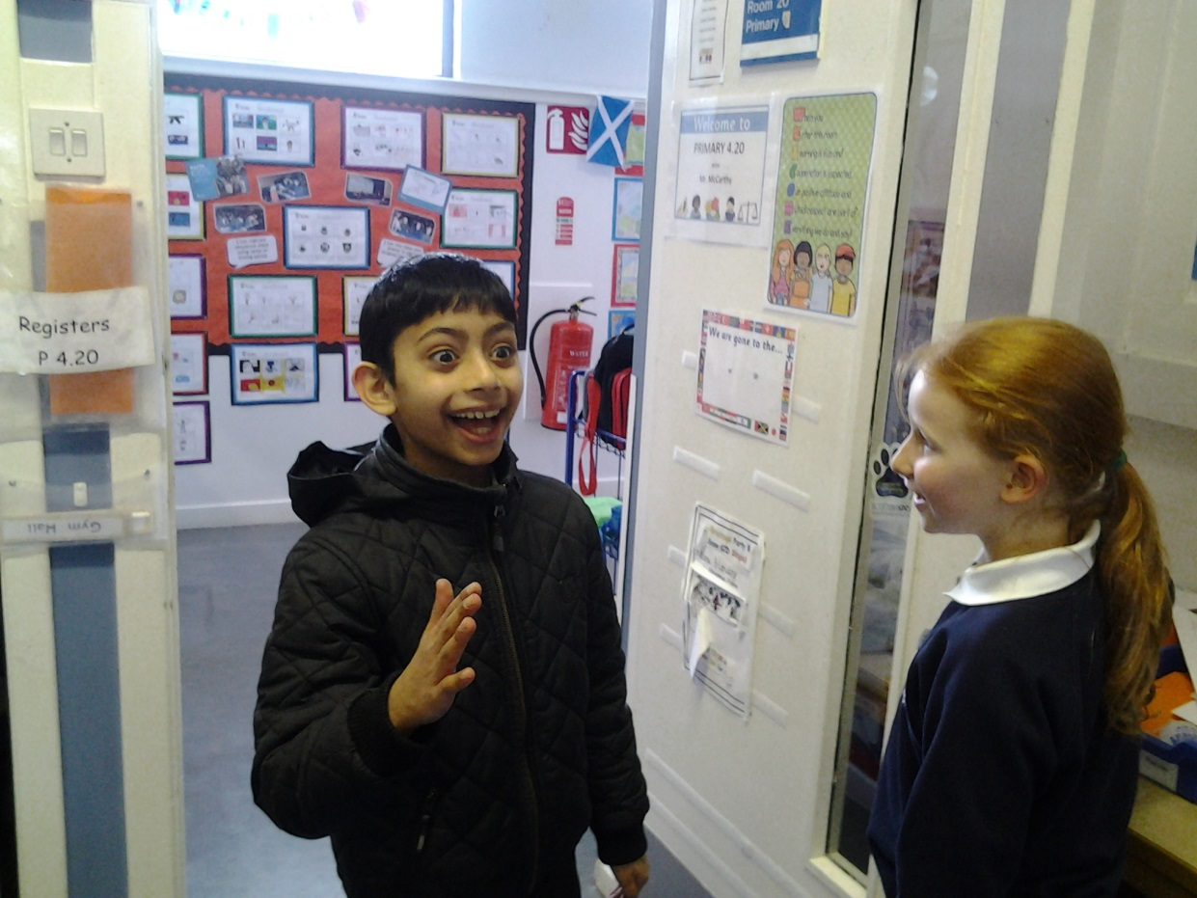
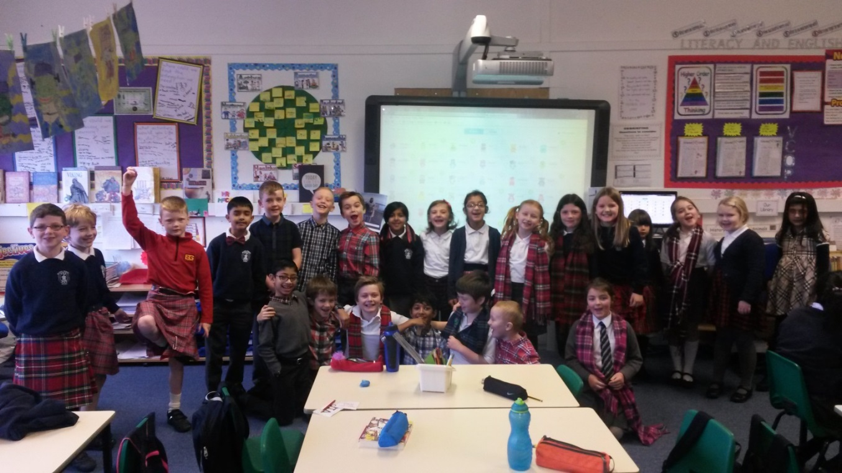
One day, a young boy from a far, far, far away land came to visit the primary four class.

Slide 13
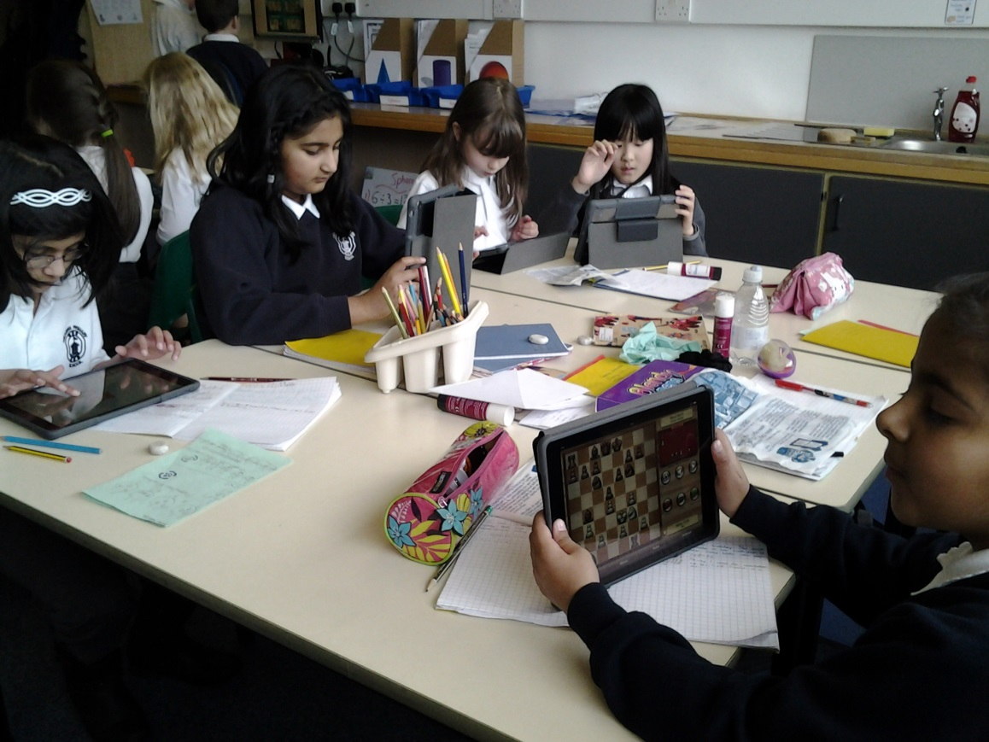
The boy was truly amazed at all the digital technology the boys and girls had access to.

Slide 14
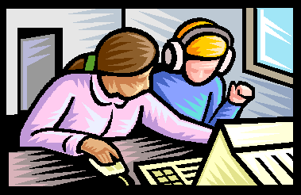
The boys and girls decided that they would show the young boy how they benefited from digital learning.

Slide 15
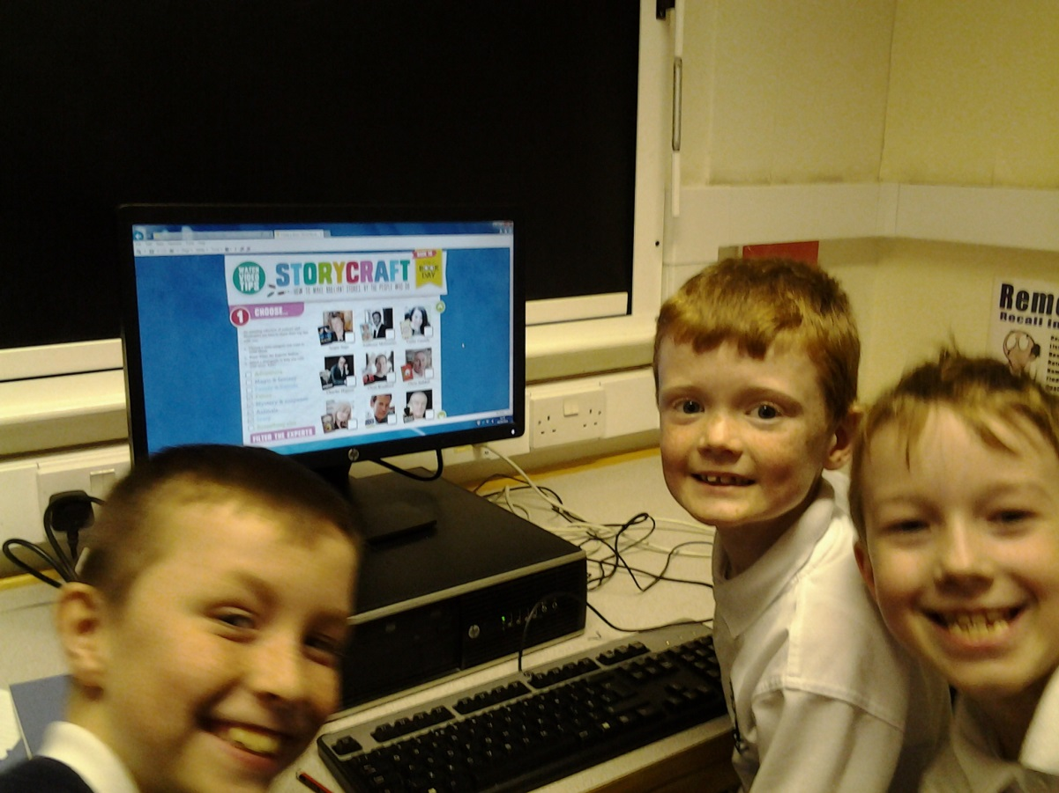
First they showed him the incredible ICT suites, filled with so many fantastic computers.

Slide 16
They explained to the boy what they used these computers for.

Slide 17
‘’We learn computer skills such as typing or how to use software like Microsoft Office,’’ said one of the girls.

Slide 18
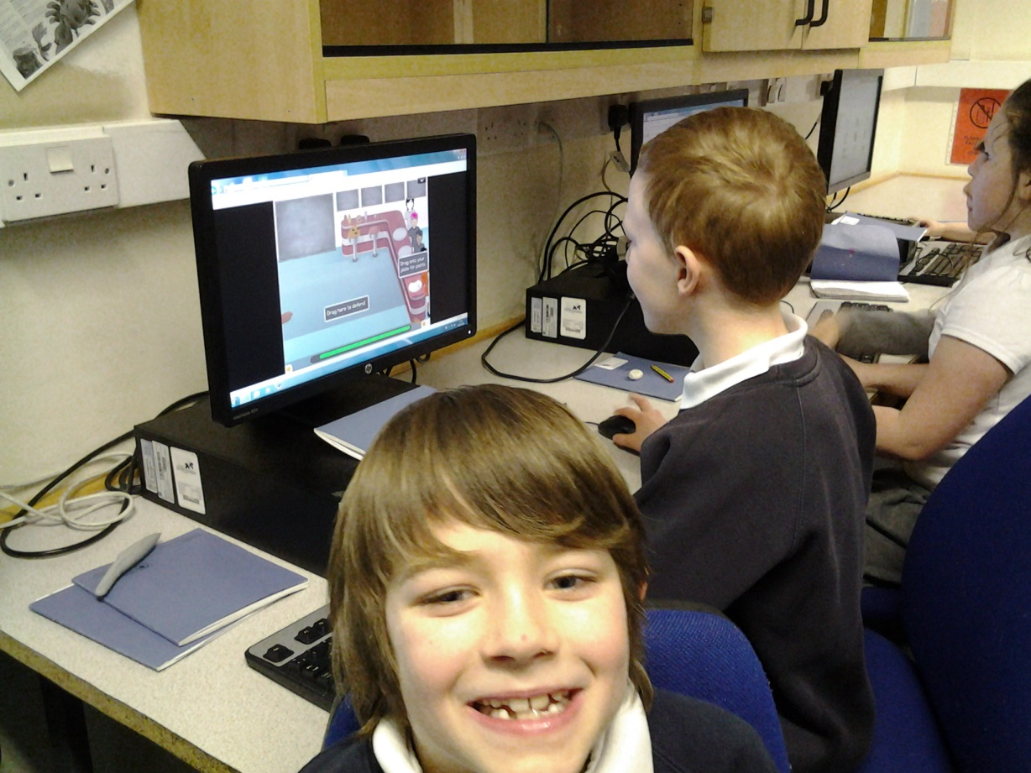
‘’We also use interactive games to make our learning fun,’’ explained another.

Slide 19
Then they showed the boy the huge smartboard in their classroom.

Slide 20
‘’Our teacher uses this to make our learning interesting, engaging and interactive,’’ explained a boy in the class.

Slide 21
‘’We can access the internet, watch videos about our topics, and interactively learn using the touch screen,” added another boy.

Slide 22
The young boy was amazed and stood with his mouth open.

Slide 23
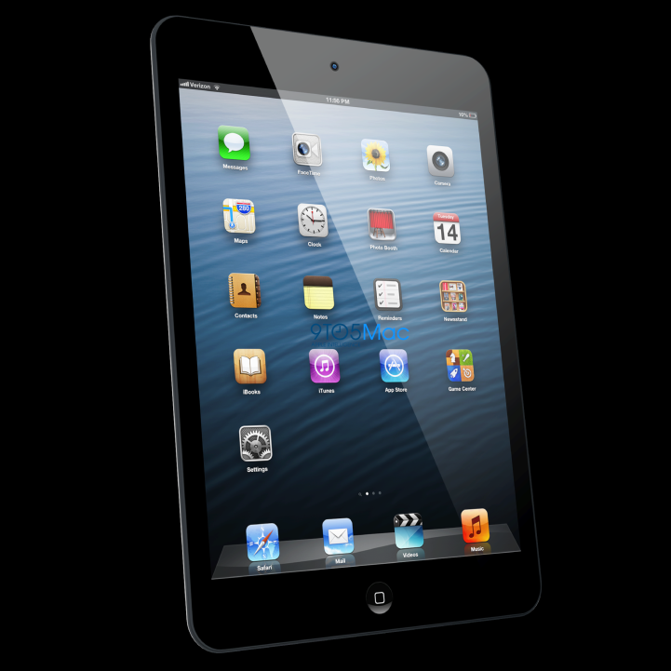
Next the children decided to show the boy the incredible iPads, the school had recently purchased for them.

Slide 24
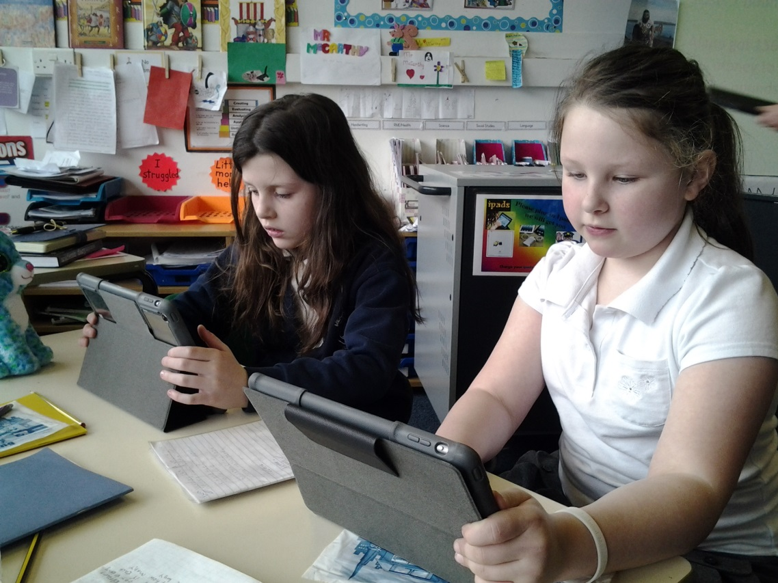
‘’We use these iPads in our classroom. We can learn through interactive apps,” said a boy who had just squeezed to the front.

Slide 25
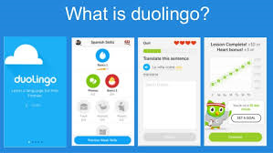
‘’We practice our maths or can learn a new language. We can take notes, photos, videos or recordings, and learn how to edit them’’.

Slide 26
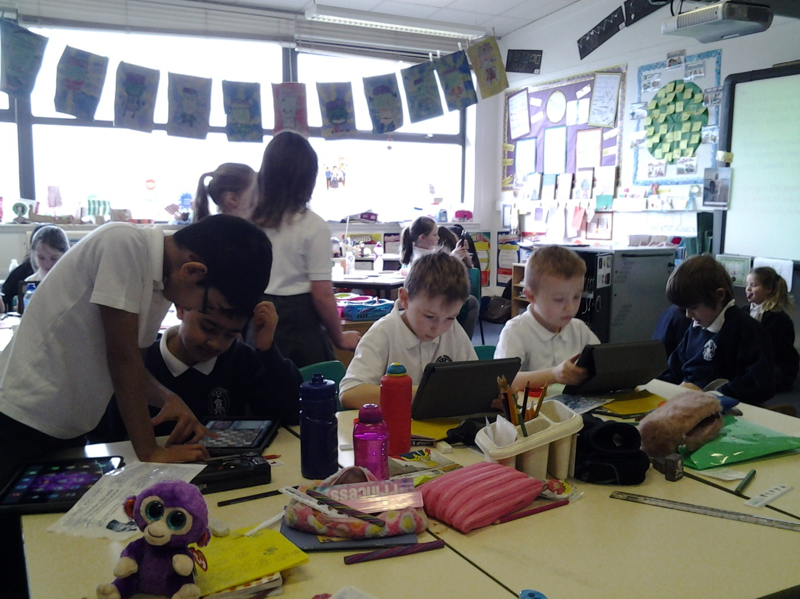
‘’There are endless opportunities for these little, flat computers to enhance our learning’’.

Slide 27
The young boy could not believe his little eyes.

Slide 28
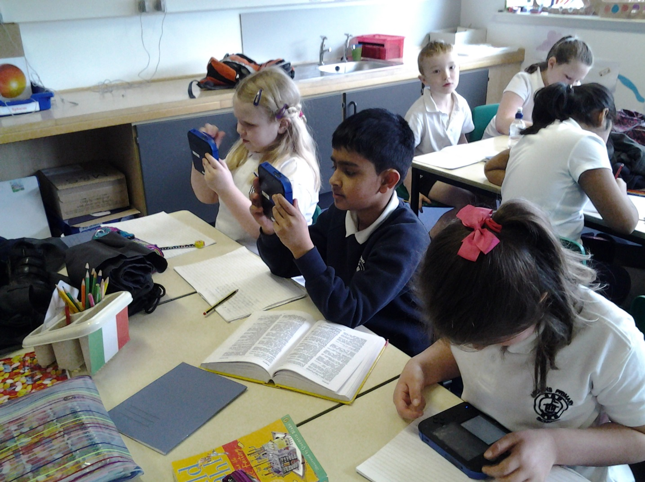
After that the class decided to show the young boy the Nintendos.

Slide 29
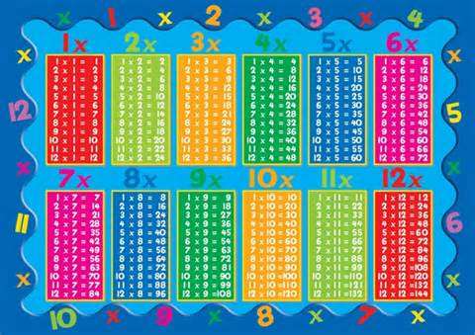
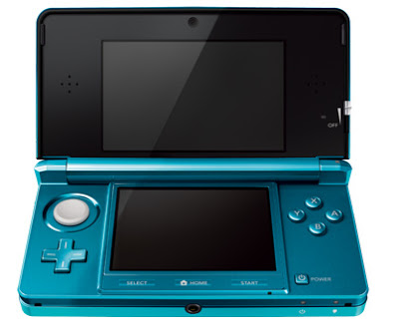
‘’We use these to practice our multiplication tables and more,” murmured a quiet girl in the corner.

Slide 30
Following that, they continued with the stop-watches and heart-rate monitors. “What are these for?’’ asked the young boy.

Slide 31
‘’We use these to help us learn about the human body, and to time ourselves,’’ replied one of the girls.

Slide 32
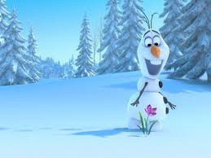
The boy was frozen to the floor in amazement. He was so impressed.

Slide 33
Finally, the boys and girls tried to explain to the young boy all about the incredible software they used each and every day.

Slide 34
‘’We use digital technology when we arrive in the morning, to order our lunches’’

Slide 35
‘’We are starting to create a blog, to keep a digital record of our learning’’

Slide 36
‘’…..and so much more’’

Slide 37
The young boy was speechless. He had enjoyed his visit very much.

Slide 38
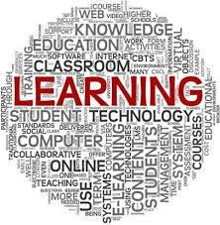
The primary four boys and girls had truly opened his eyes to all the incredible benefits of digital learning.

