Slide 1
Fairtrade Trip
01.03.16

Slide 2
We attended a Fairtrade event with other schools

Slide 3
We got to meet and chat with the Minister of Europe and International Development
Who told us that he is a past pupil of Mearns Primary!!!

Slide 4
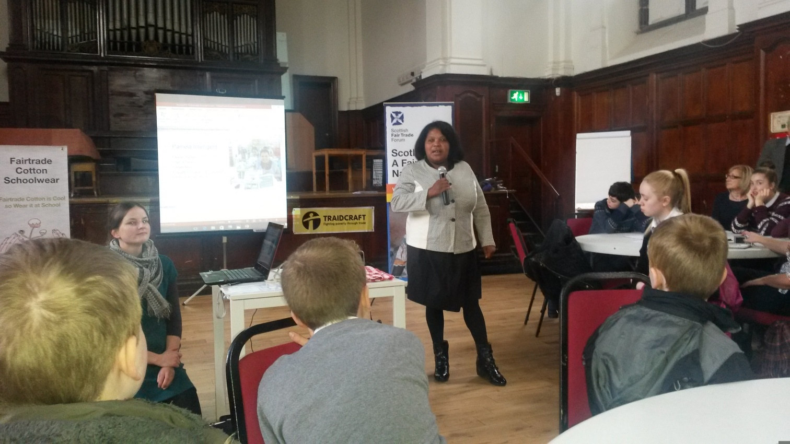
We listened to some very interesting guest speakers
Pamela, from
Mauritius
Humza Yousaf

Slide 5
Pamela started working in a textile family at the age of 15, working from 7.00 in the morning often until 11.00 at night, 7 days a week!
Then she started
working for a Fairtrade
company and her life
has improved in many
ways
Can you think of any
ways in which Pamela’s
life might have
improved because of
Fairtrade?

Slide 6
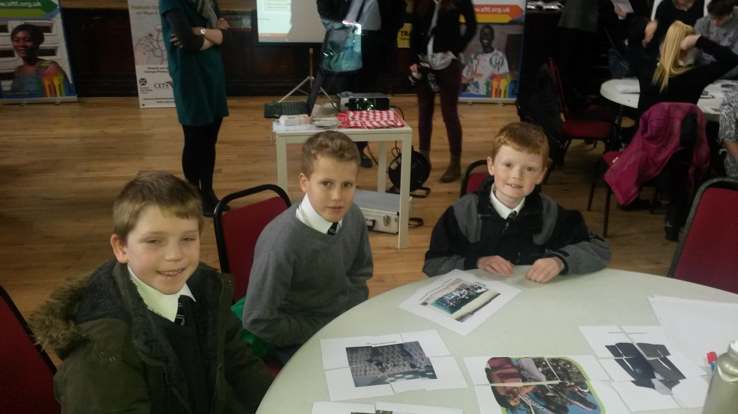
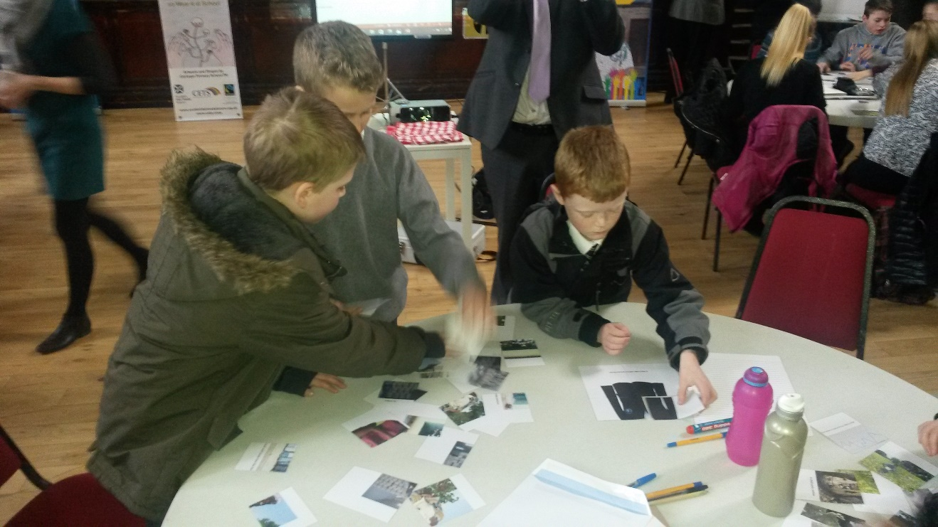
We took part in activities

Slide 7
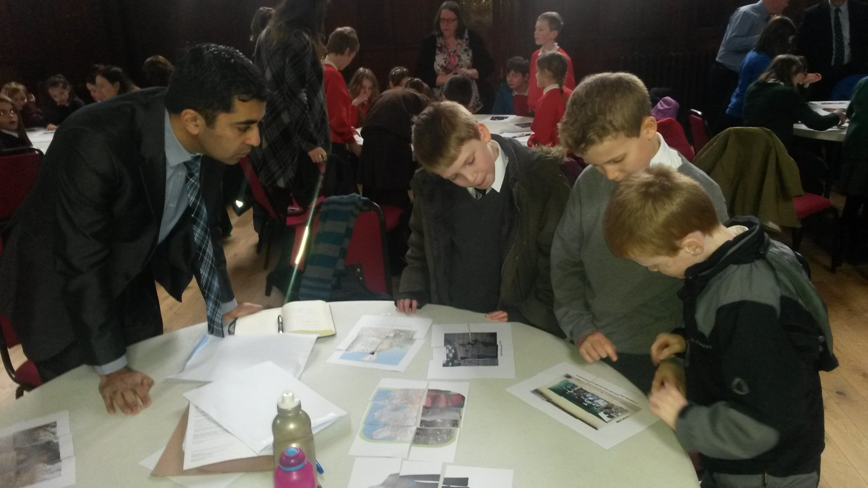
We discussed fair trade issues

Slide 8
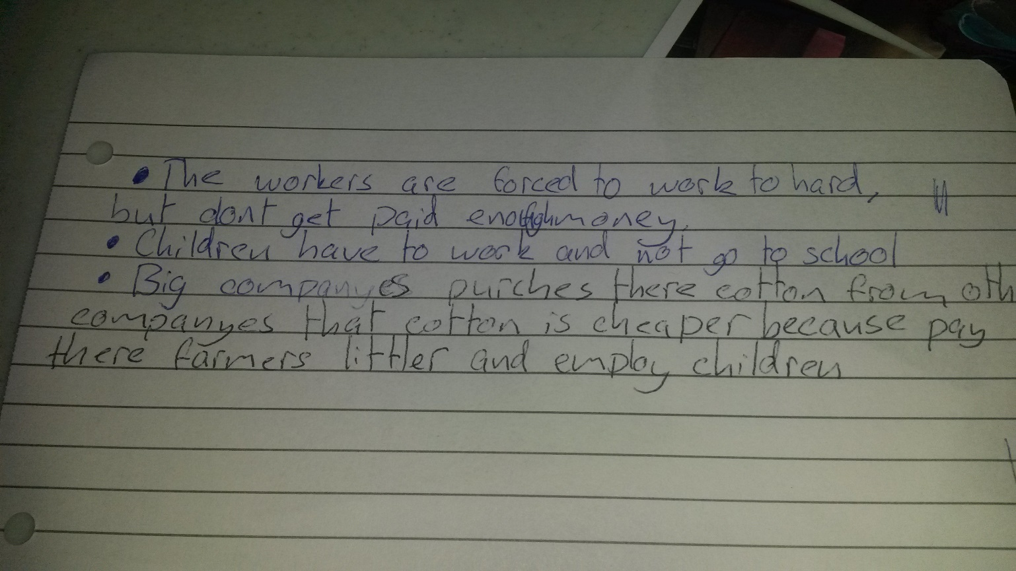
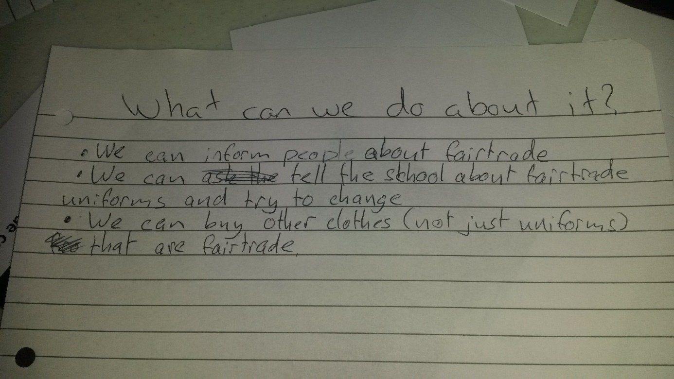
We shared our ideas
What could we all do to help spread awareness of Fairtrade?

