Slide 1
Amelia P3.9 pictured with her Brownie Promise Badge

Slide 2
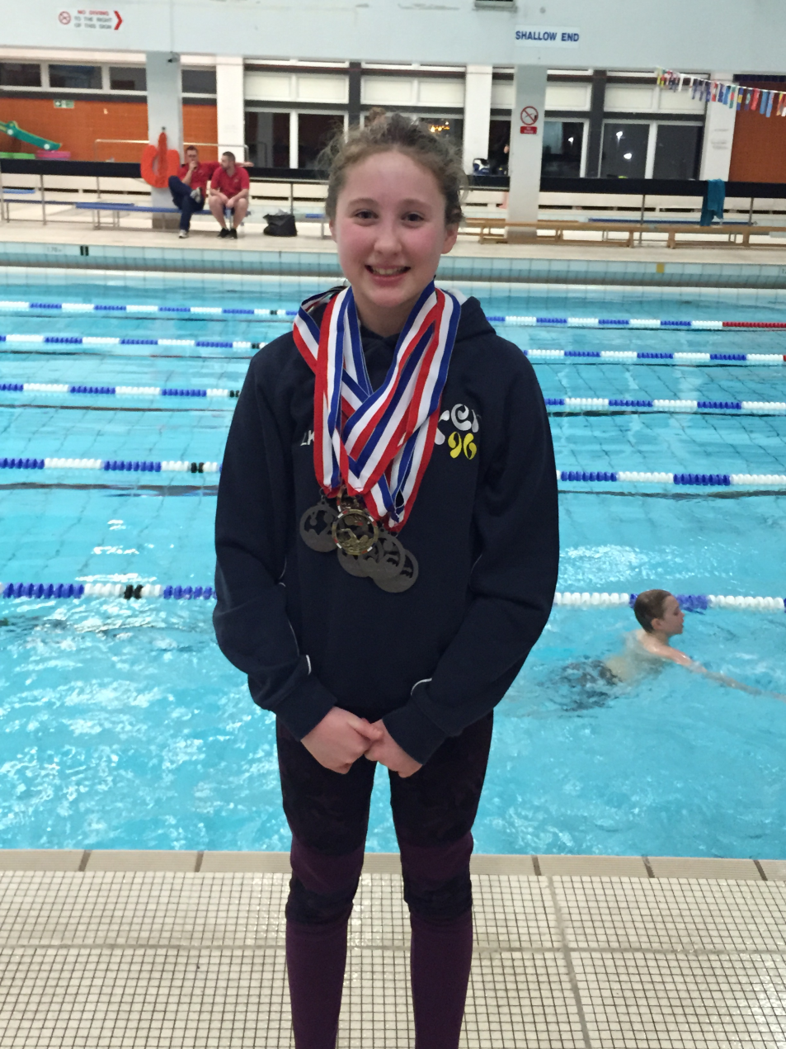
Lauren Chalmers who 6 medals at the South Ayrshire Meet swimming competition

Slide 3
Carys P4.19 with her award for swimming

Slide 4
Ayla P2.7 with her certificate for gymnastics

Slide 5
Maya P4.13 with her medal for swimming 200m

Slide 6
Heidi P4.13 who won awards for swimming and Chinese language

Slide 7
Cameron P7.26 with his achievement award

Slide 8
Danyal P7.27 who won a Gold Medal at Scottish Open Championships for Tae Kwan Do. He will represent Scotland in Belguim in March

Slide 9
Katie P4.14 who swam 400m

Slide 10
Carys, Esther, Eva & Lauren who took part in the Scottish Schools Swimming Competition

Slide 11
Esther P7.26 who recently took part in the West District Long Course Event and won a gold and bronze medal

Slide 12
Amelia P3.9 pictured with her medal for dancing

Slide 13
Matthew P3.9 with his certificate for swimming 50m

Slide 14
Martin P3.9 who swam 200m and 400m. Well done Martin!

Slide 15
Cameron P2.6 with his medal for swimming. Cameron swam 10m

Slide 16
Wint P2.6 with her swimming medal. Wint swam 25m

Slide 17
Cara P2.6 with her swimming medal. Cara swam 10m

