Slide 1
Mearns Primary School Lockerbie Manor Information Evening

Slide 2
About Manor Adventure
Established in 1991
Handles over 75, 000 students + 500 families each year
Largest independent operator

Slide 3
What makes Manor Adventure different?
First class facilities
Safe, secure location
Quality instructors
Tailor made programmes to suit each school
19 outdoor pursuit sessions per week
Profit re-invested every year

Slide 4
Food
Child friendly, plentiful and nutritious
Full cooked breakfast
Substantial lunch
Excellent cooked dinner
Always plenty of choice
Vegetarians, Vegans & special diets catered for

Slide 5
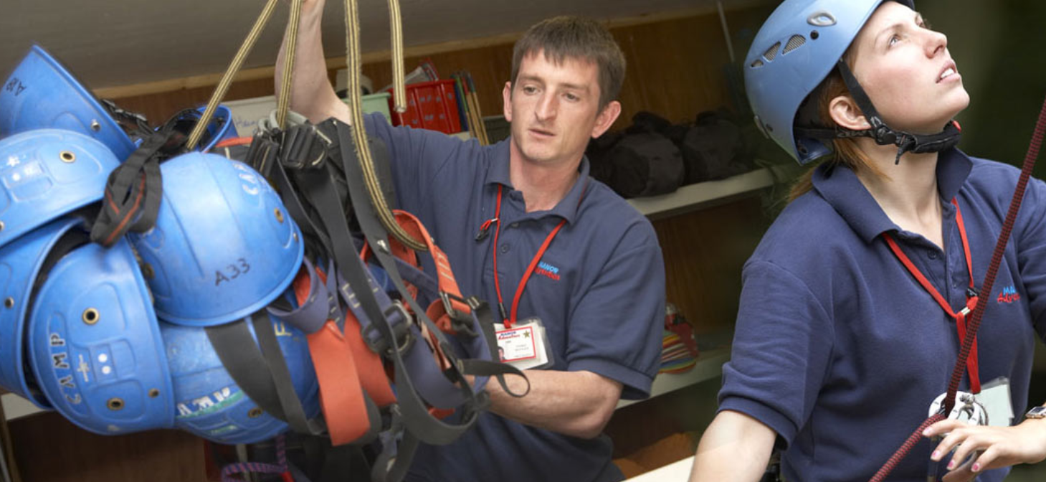
Instructors

Slide 6
Instructors
Reputation is very dependent on quality of instructors. Extensive recruitment process - far exceed blue chip companies
For every 20 vacancies receive over 500 applicants
50 Invited to assessment weekend
Then 30 short listed to selection week

Slide 7
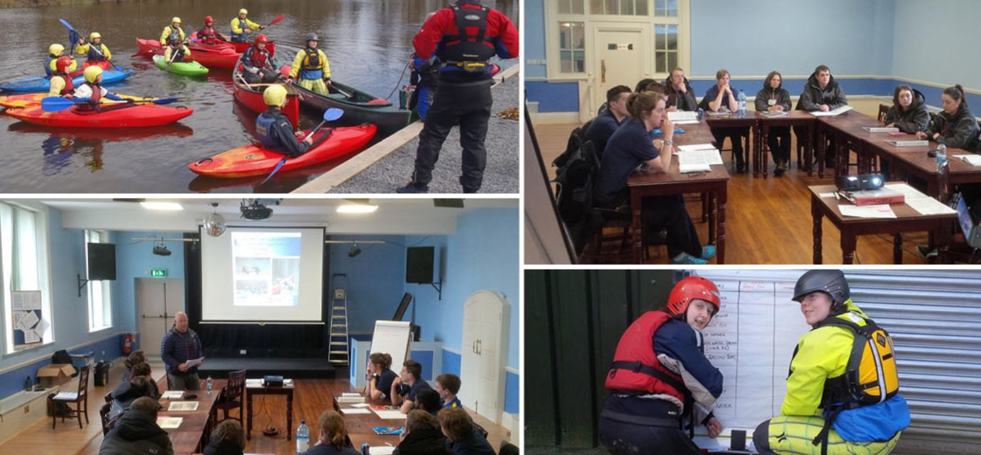
Training Weeks

Slide 8
Instructor Training
NGB Qualifications
Customer Care
Radio voice procedure
First Aid
Fire Marshall trained
Emergency procedures

Slide 9
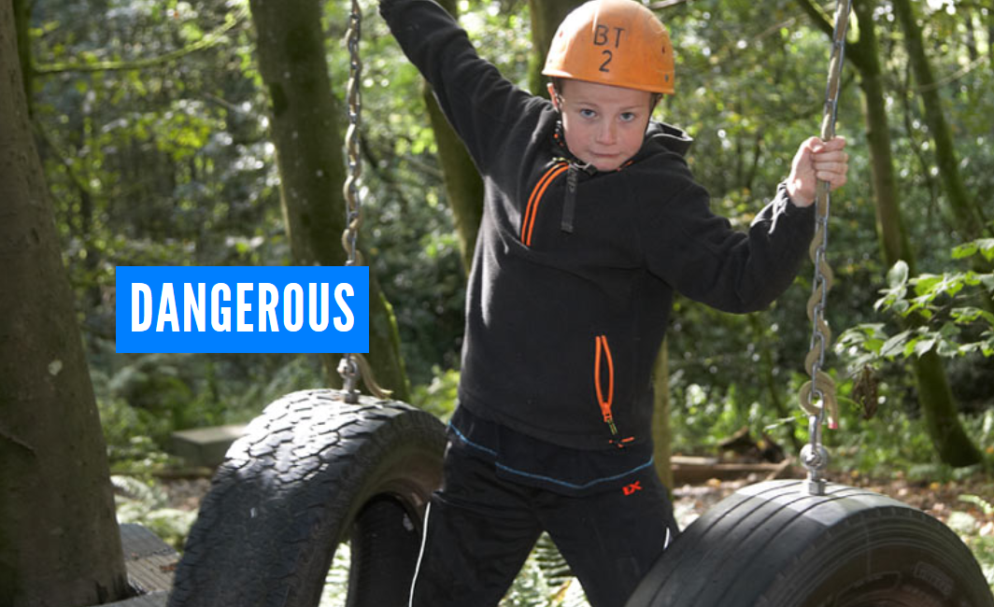
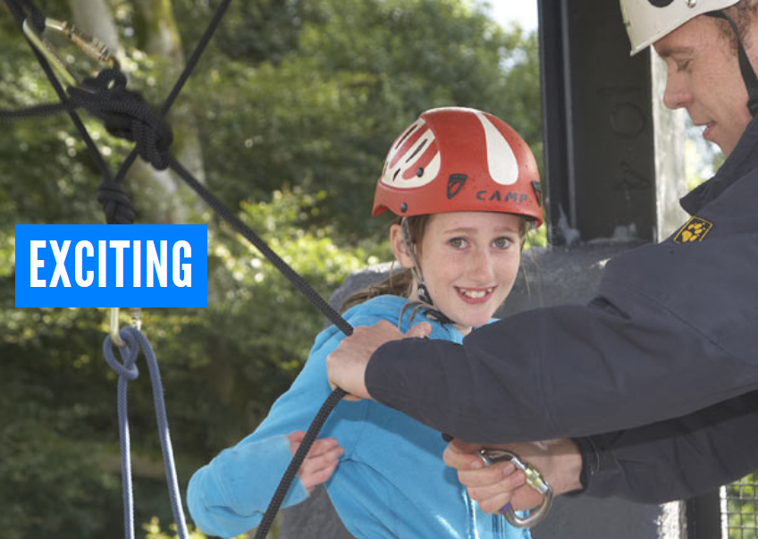
Child Perception

Slide 10
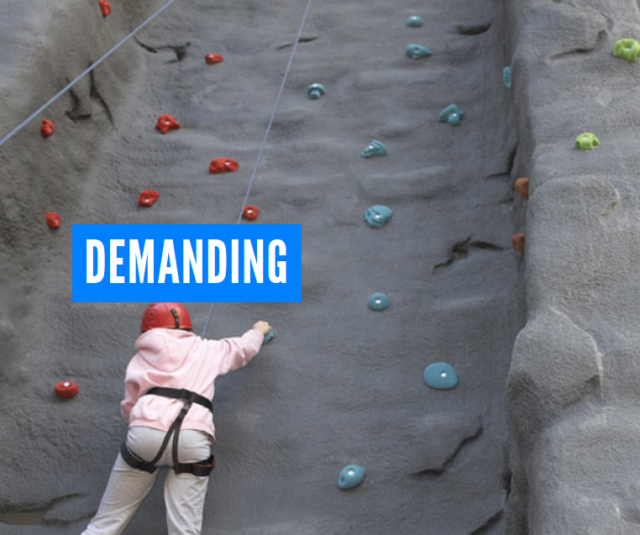
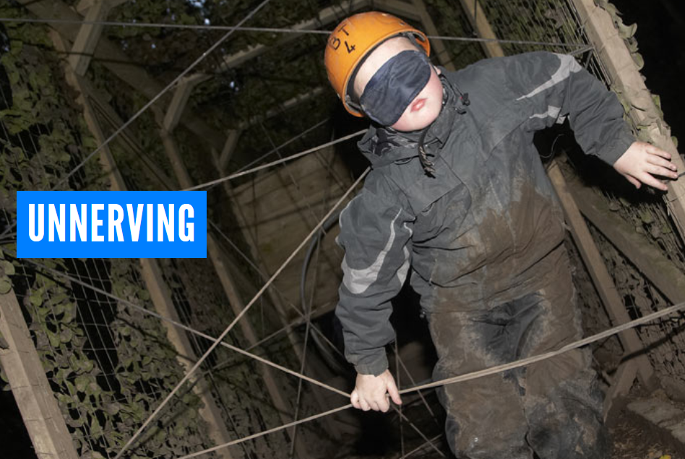
Child Perception

Slide 11
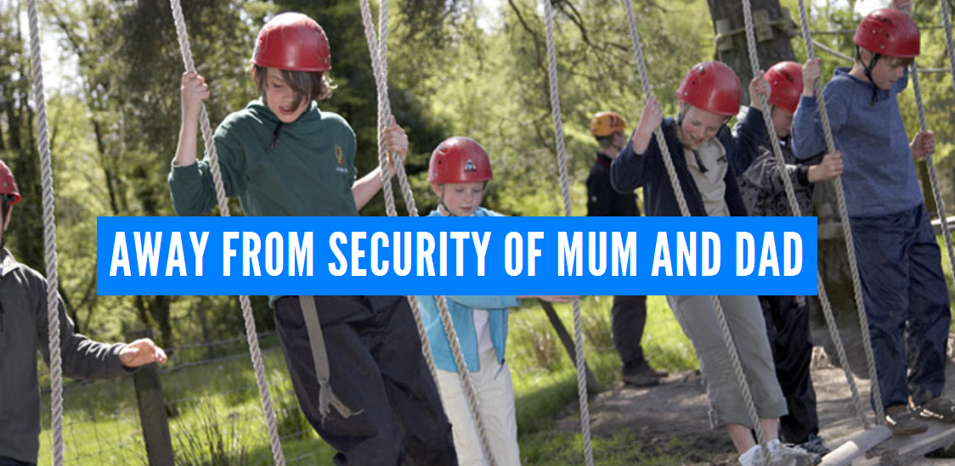

Slide 12
Course benefits for every child
Every child benefits enormously from the course, especially children who are not necessarily academic or sporty.
Education outside the classroom
Develop an inner confidence
Personal achievement
Develop self esteem
Develop social skills
Develop team building skills
Experience new / exciting outdoor pursuits
Learn respect for others

Slide 13
Outdoor pursuits programme
Leave school to arrive at 14.30
Students shown to dormitories/pods
Fire drill
1st outdoor pursuit at 15.30
Each outdoor pursuit lasts 1.5 hours
2nd outdoor pursuit at 19.15
5 outdoor pursuits per day
Depart after lunch at 13.30

Slide 14
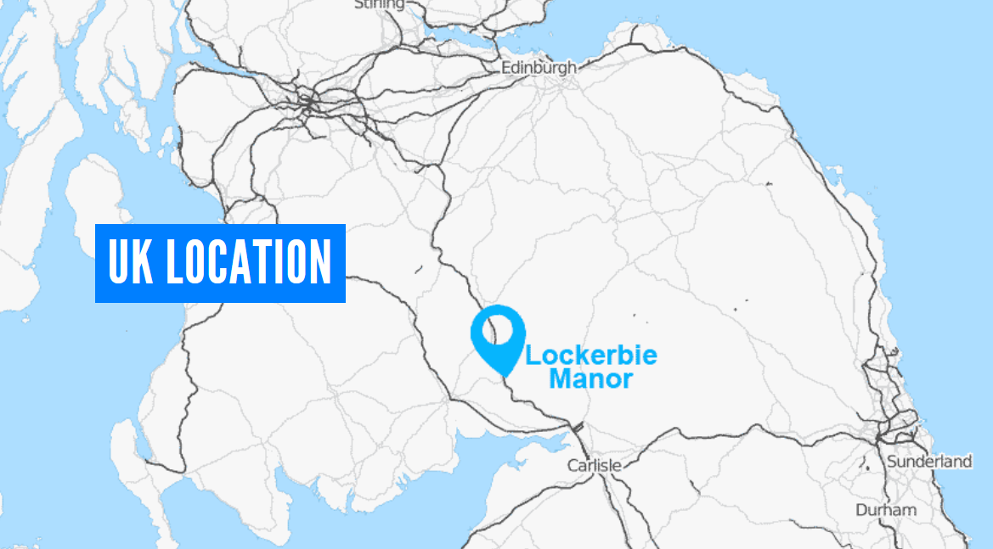

Slide 15
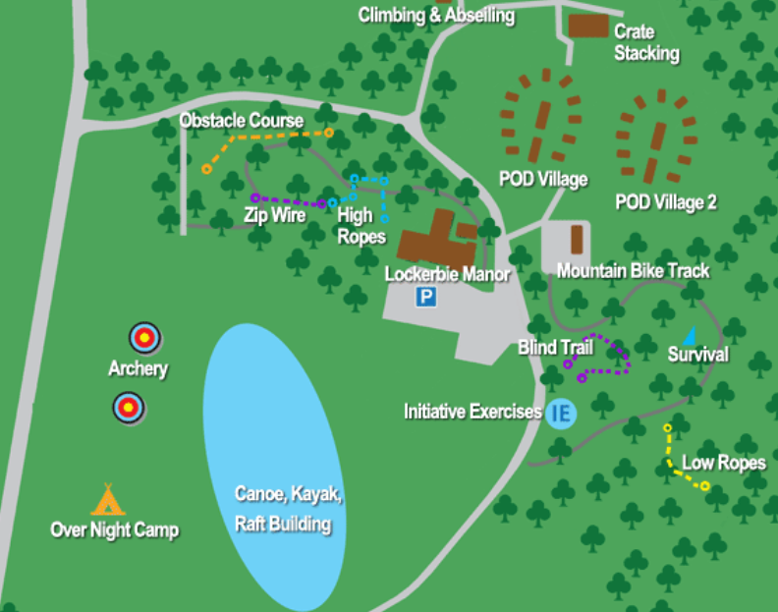

Slide 16
Outdoor pursuits available
Abseiling Archery Blind Trail Camp Craft Skills Climbing Compass Work Evening Walk Fencing
Film Studies / Video Hill Walk Initiative Exercises
Low Ropes Manor Olympics Mountain Biking Nature Trail
Obstacle Course Open Canoes & Kayaking Orienteering Scavenger Skills Team Games Zip Wire

Slide 17
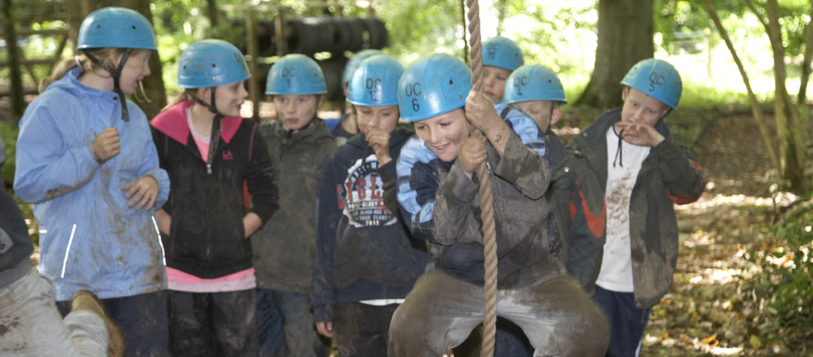

Slide 18
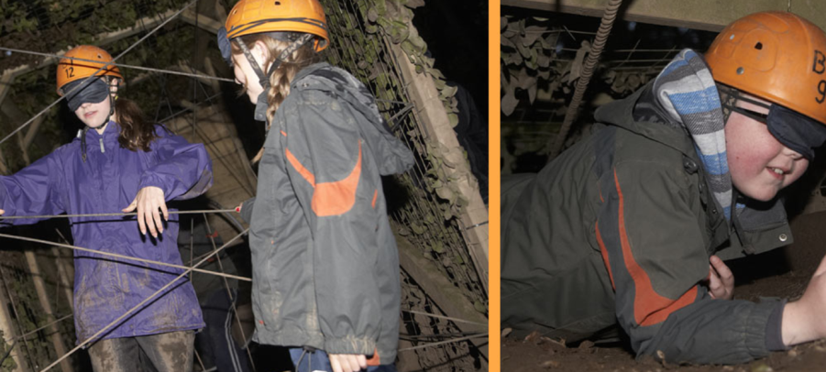
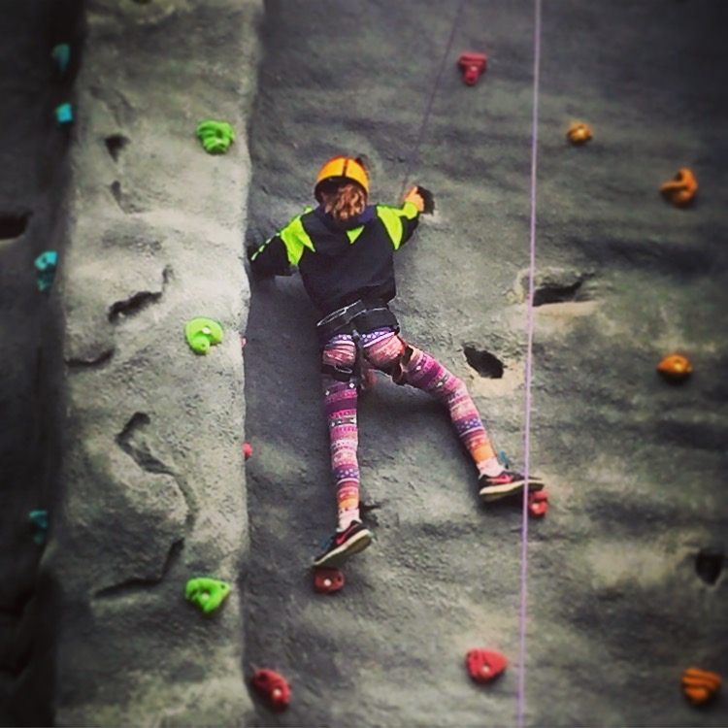
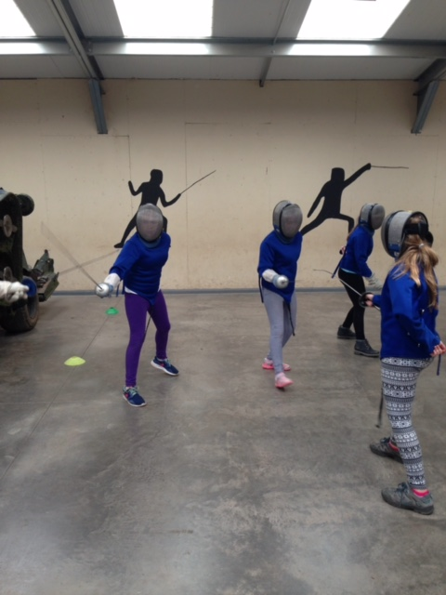
19 outdoor pursuit sessions

Slide 19
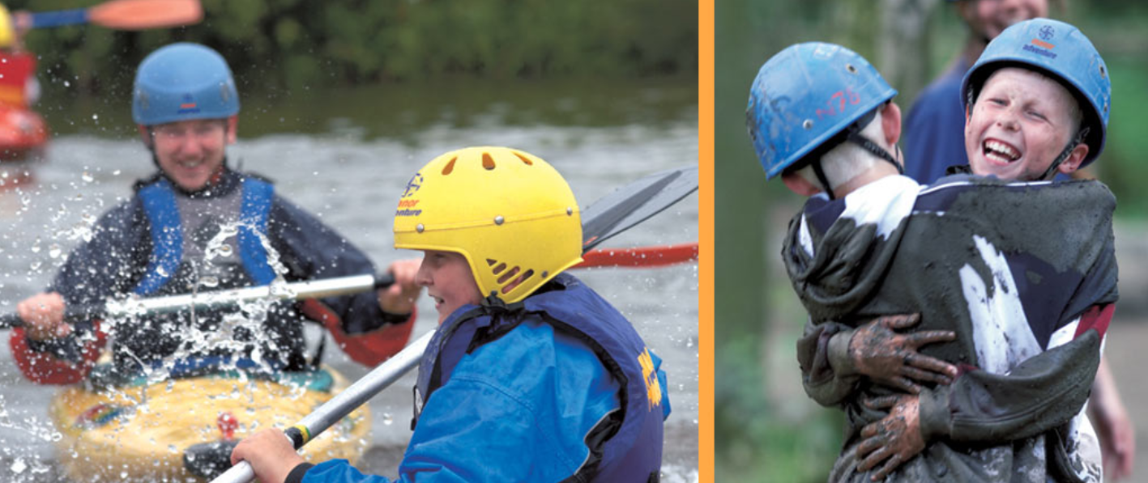

Slide 20
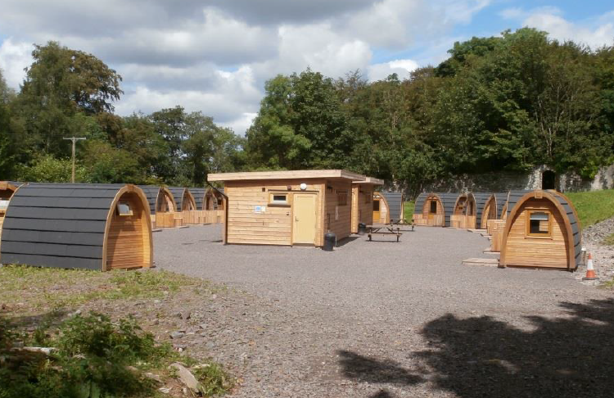
Sleeping arrangements

Slide 21
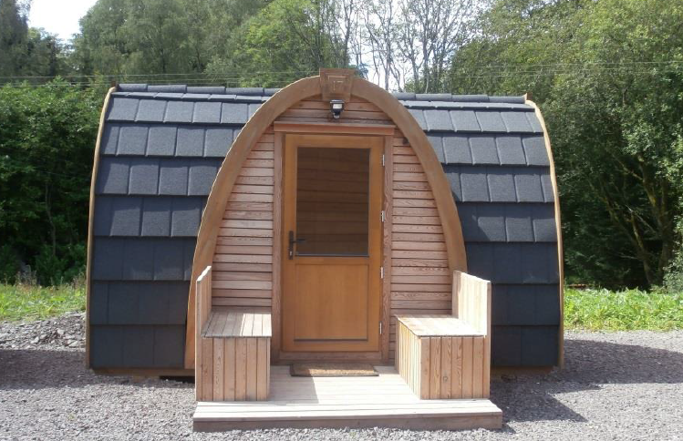

Slide 22
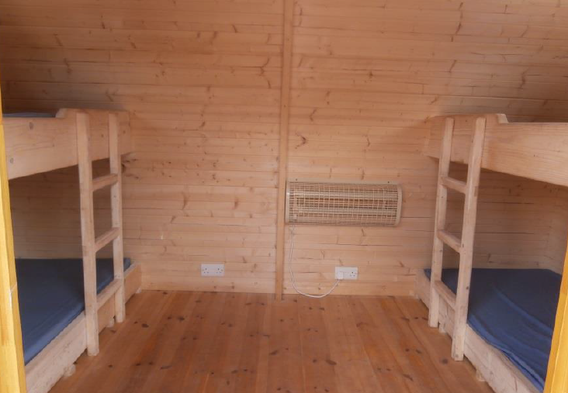
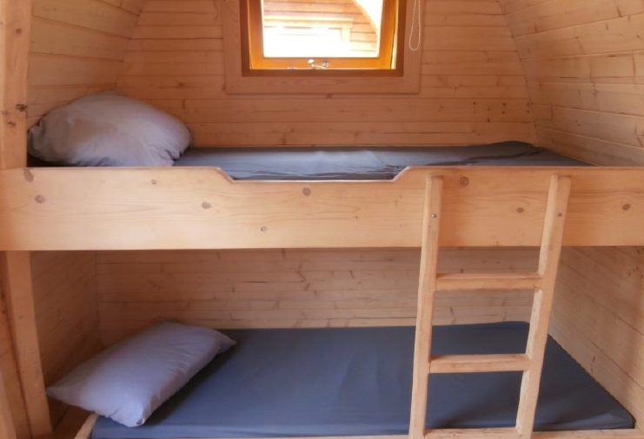

Slide 23
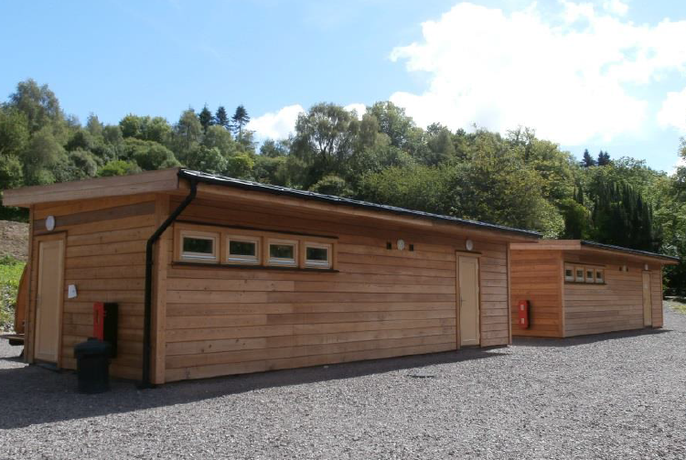

Slide 24
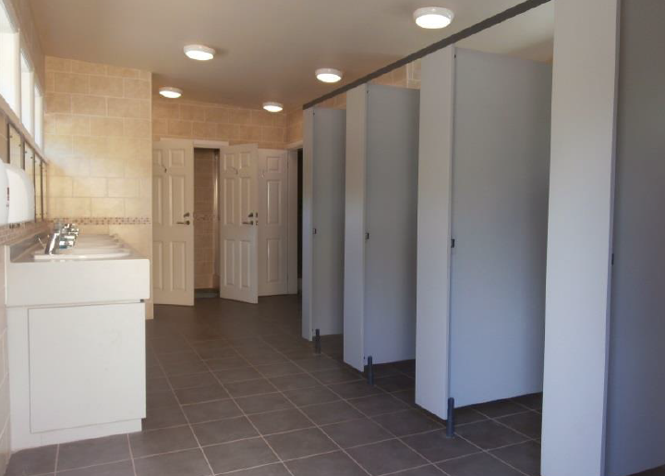
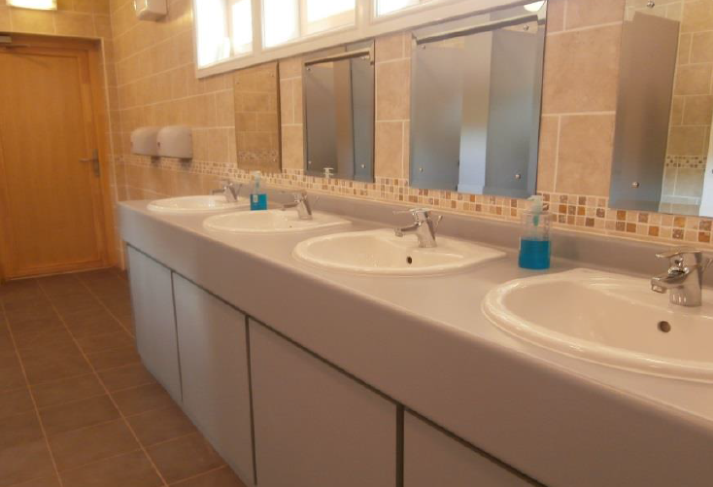

Slide 25
Kit List
Luggage – please restrict this to one case plus one piece of hand luggage
Sleeping bag & pillowcase (pillows and a bottom sheet are provided)
A drink bottle
Rucksack
Torch
Toiletries etc. (please note: deodorants must be roll-on , no aerosols)
Old clothes for activity sessions (long-sleeved tops/jumpers, trousers/jogging bottoms (Not denim jeans), t-shirts and closed-toe shoes are required for nearly all sessions so please bring plenty!)
Waterproof clothing could be useful (jacket/trousers)
Clothes, shoes and underwear for free time
Large plastic bag for dirty clothes
Bath towels x 2
Sun cream and hat
Pyjamas and slippers
Swimming kit (may be useful for water based activities)

Slide 26
Kit List
Books, playing cards and other quiet activities
Money for snacks and souvenirs (please bring coins, not notes)
No wellies!
The children will be participating in approximately 20 sessions throughout the week
Please name all clothing
Denim jeans are not ideal for outdoor use
Please note: No mobile phones, electronic devices or valuables should be brought as the centre are unable to store them and they will not be insured.

