Slide 1
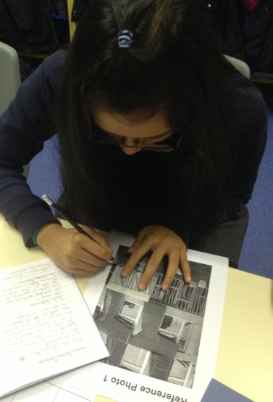
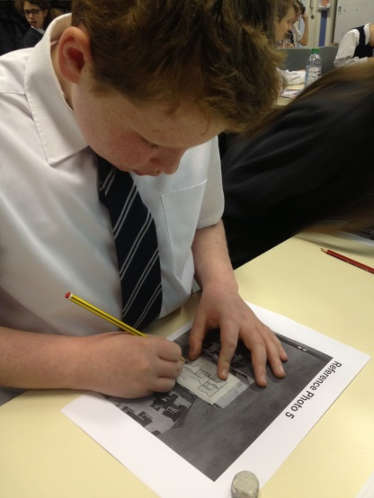
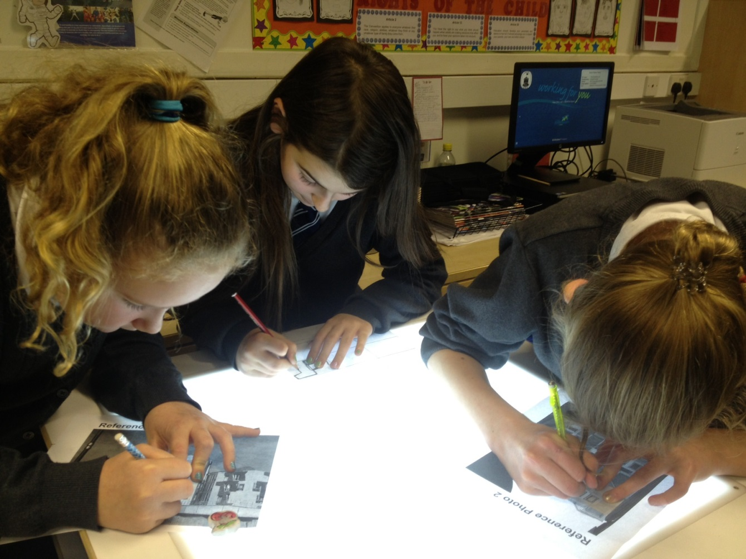
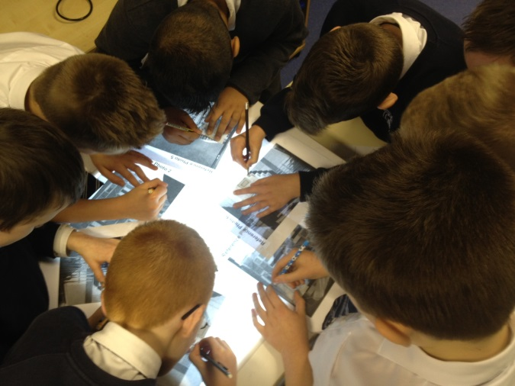
P7’s Scottish Masterclasses: Art & Design
* Looking at and discussing the work of Scottish artists & designers.
* Taking notes and responding to a design brief.
* Creating a repeating pattern for a textile or wallpaper inspired by the architecture of the Scottish Parliament and using a light box.

Slide 2
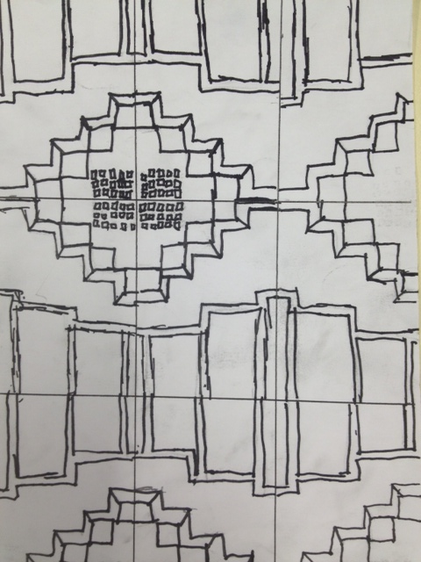
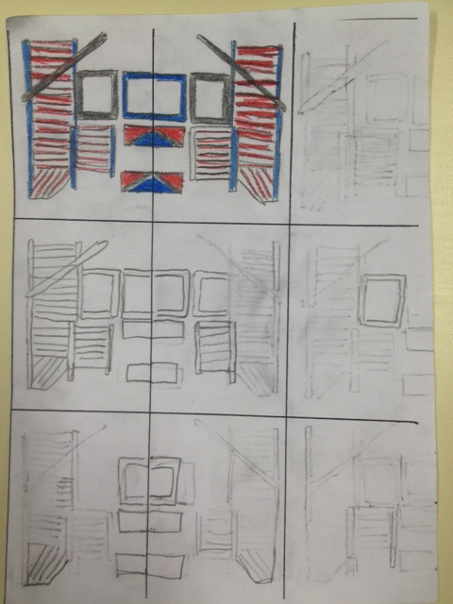
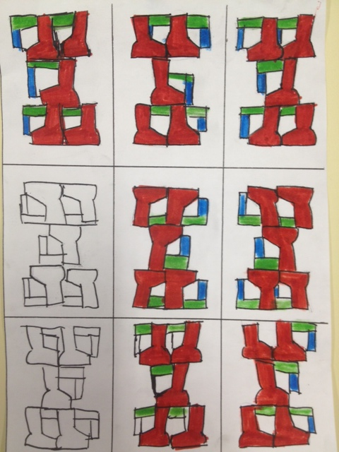
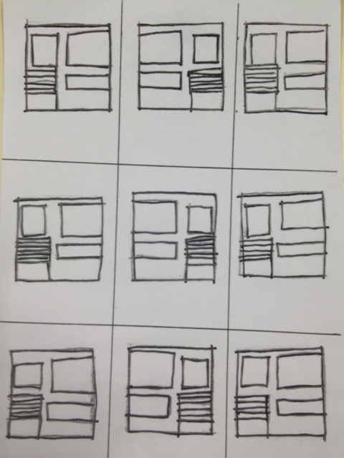
P7’s Scottish Masterclasses: Art & Design
* Looking at and discussing the work of Scottish artists & designers.
* Taking notes and responding to a design brief.
* Creating a repeating pattern for a textile or wallpaper inspired by the architecture of the Scottish Parliament and using a light box.

Slide 3
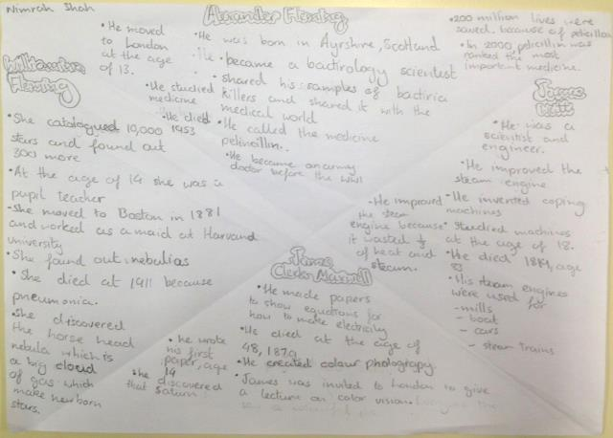
P7’s Scottish Masterclasses: Scottish Scientists & Inventions
* Listening to and watching film clips and animations about the work of Scottish scientists and inventors.
* Discussing the impact of their work on our lives today and taking notes.

Slide 4
P7’s Scottish Masterclasses: Scottish Tourism
* Watching and discussing film clips about tourism in The Cairngorm Mountains, in the north east of Scotland.
* Discussing the impact of tourism on the landscape.
* Creating a poster to attract tourists to The Cairngorms.

Slide 5
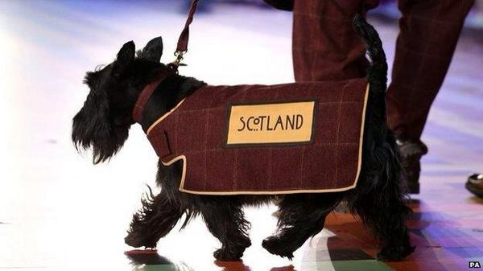
P7’s Scottish Masterclasses: Scots Language
* Listening to, analysing and performing poetry in Scots Language: “A Dug, A Dug” by Bill Keys and “Listen Tae The Teacher”.
* Creating a storyboard of the poem or showing understanding of the vocabulary and main themes by answering questions.

