Slide 1
Jrso and eco
By Liam bothwell, maaria khan, mubeen shah, lewis cooper and moiz maqsood.

Slide 2
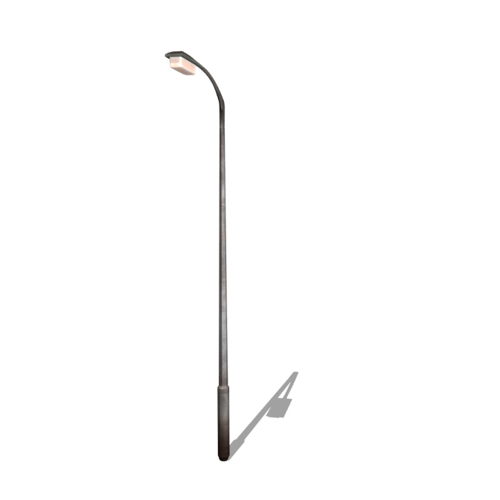
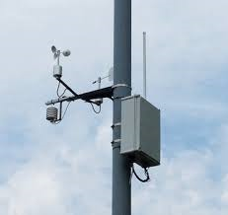
Clean air campaign
Monitoring the air.
Box on lamppost.
Clean air monitor.
How does it work?
http://www.learnaboutair.com/

Slide 3
Clean air campaign
Car Park Inspection
Things We Do Not Expect
Double Parking
Idling
Misusing Disabled Spaces
Cars In Bus Lane
Yellow Lines
Stopped on crossing

Slide 4
Park & Stride Zones
3 Routes
Netherplace Crescent/ Fairweather Place
Hunter Drive
Paidmyre road
We will have an official launch week
of our park and stride routes in term 3.

Slide 5
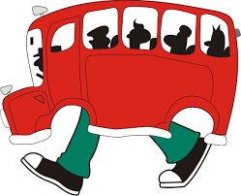
What can you do to help us?
Give parents advice if they are parking unsafely!
Use park and stride zones
Encourage walking
Try and use our walking bus

Slide 6
Thank you for listening!

