Slide 1
OUR TRIP TO VIKINGAR
Primary 4.20
Monday 23rd November 2015

Slide 2
Learning about Viking Clothing!!!

Slide 3
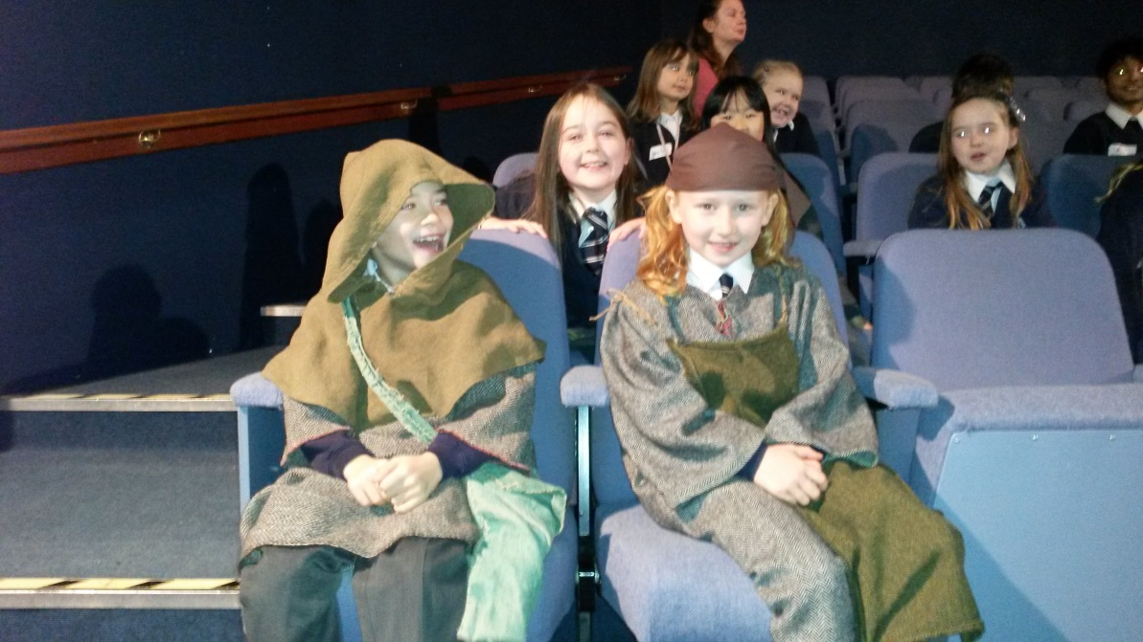
The farmer and his wife…

Slide 4
The first Viking wedding of the day!!!

Slide 5
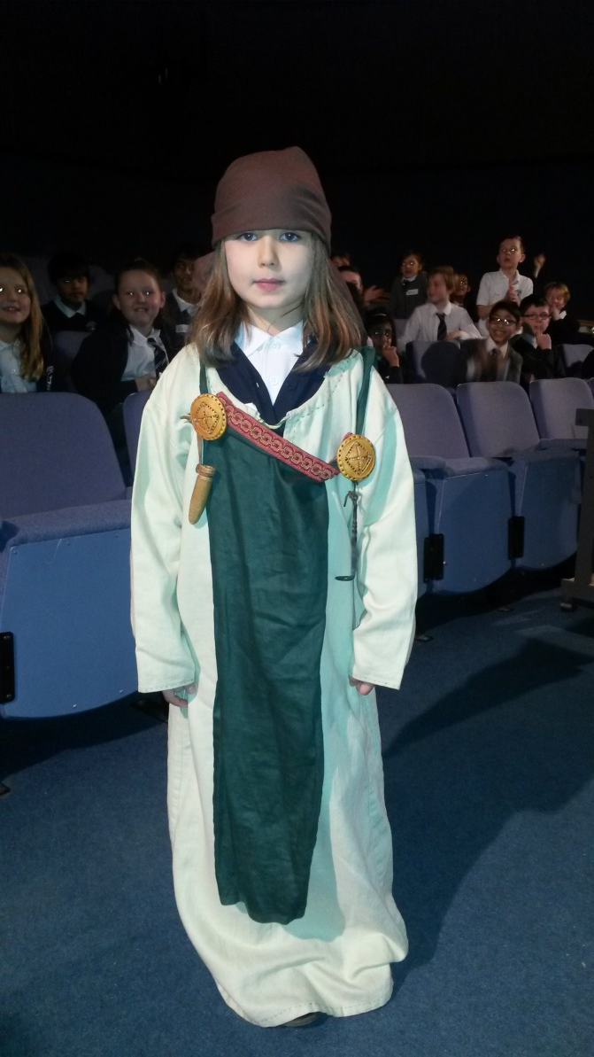
Happy with their new threads!!!

Slide 6
The second Viking wedding of the day!!!

Slide 7
The happy couples all dressed to the max!!!

Slide 8
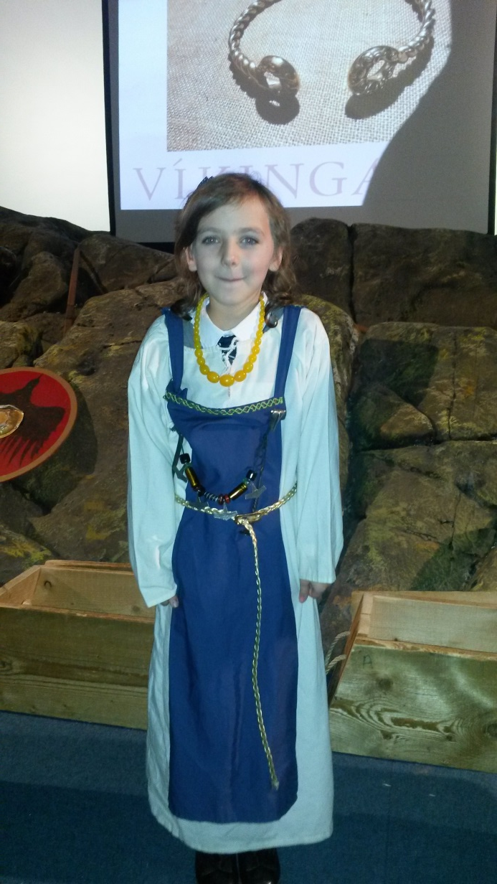
The wealthiest couple!!!

Slide 9
The third and final wedding of the day!!!

Slide 10
Our awesome Vikings!!!

Slide 11
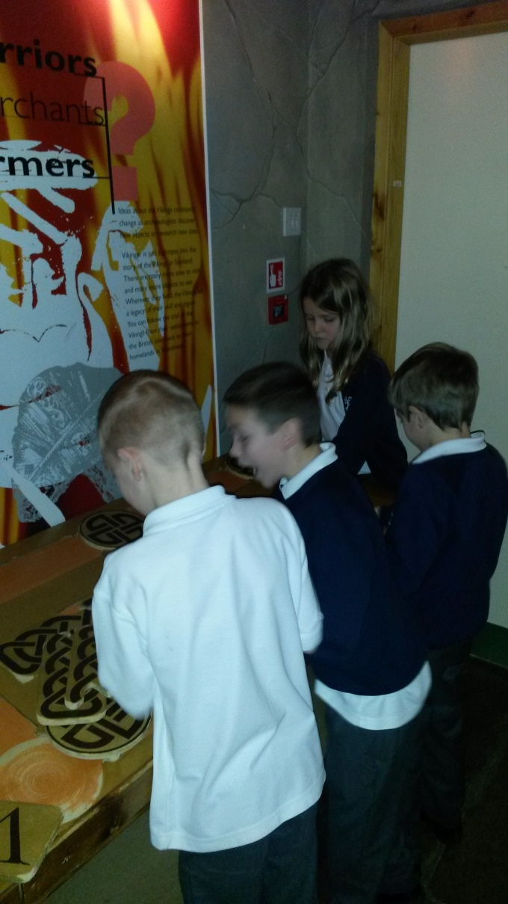
Engaged in learning!!!

Slide 12
Arriving at the longhouse!!!

Slide 13
Getting cosy in the longhouse!!!

Slide 14
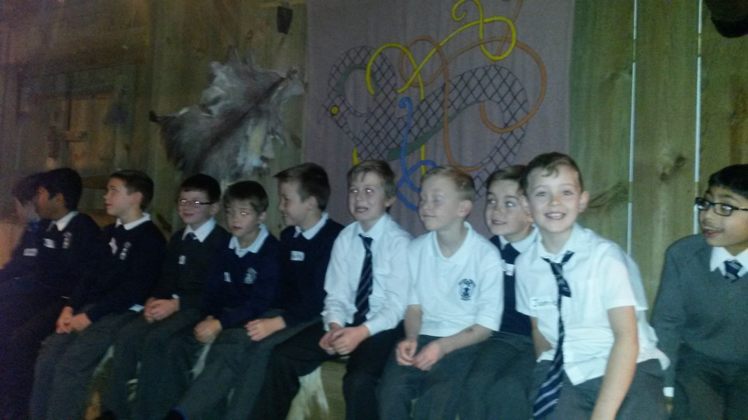
Happy as can be inside the longhouse!!!

Slide 15
Learning about the longhouse from its owner…a real Viking!!!

Slide 16
Making a fine Viking breakfast!!!

Slide 17
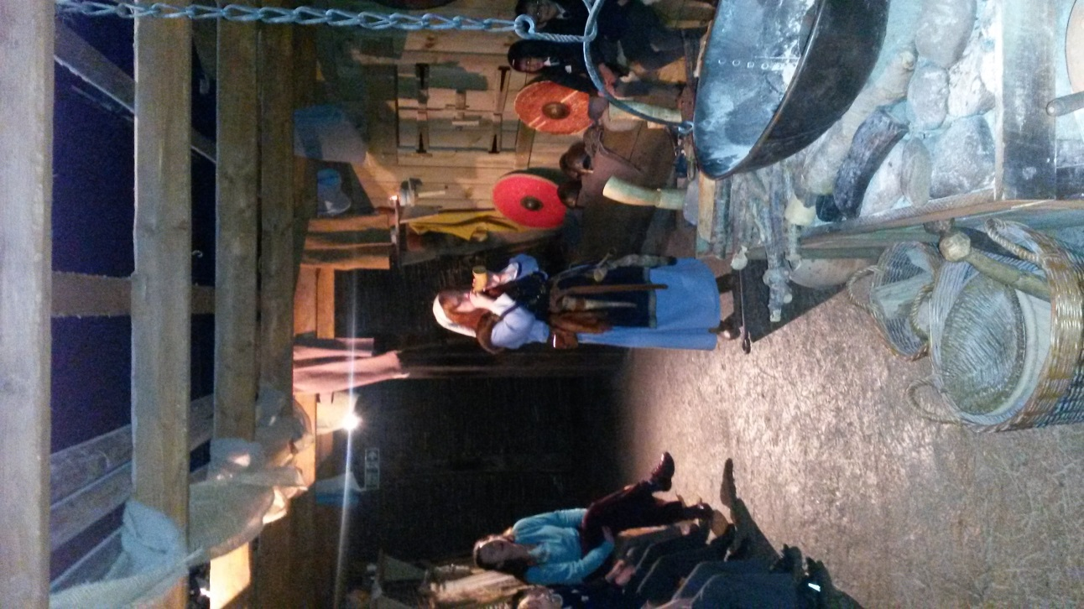
Being shown around the longhouse!!!

Slide 18
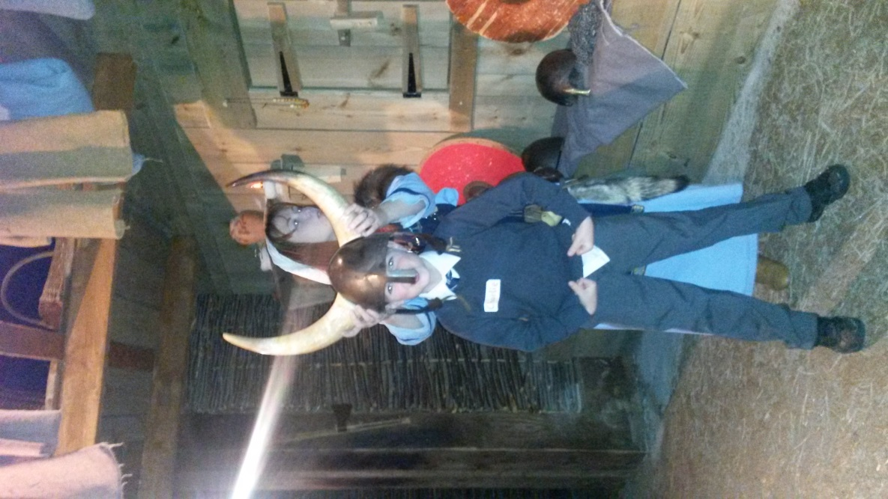
True or false: Viking helmets had horns…

Slide 19
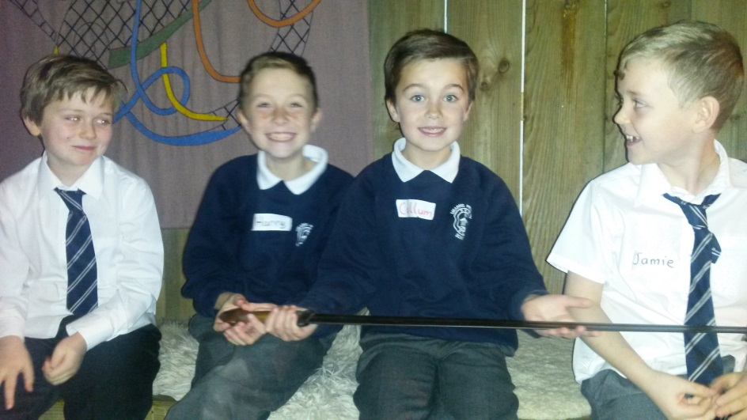
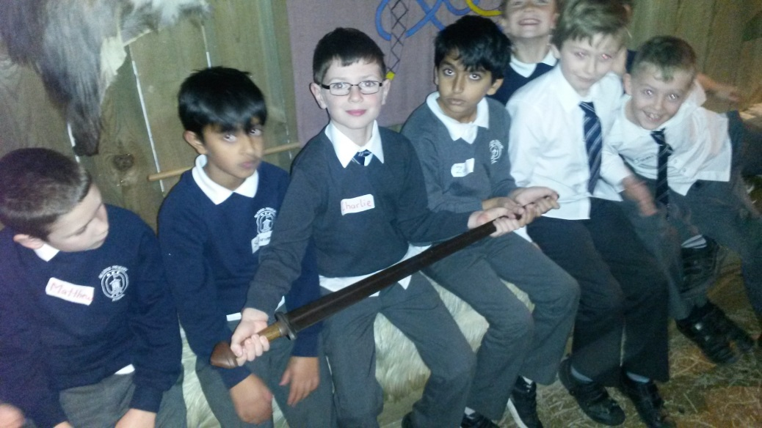
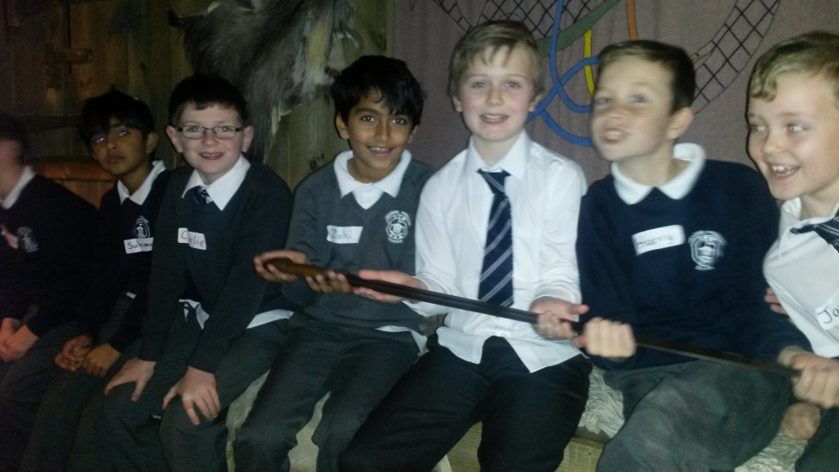
Holding the deadly Viking sword!!!

Slide 20
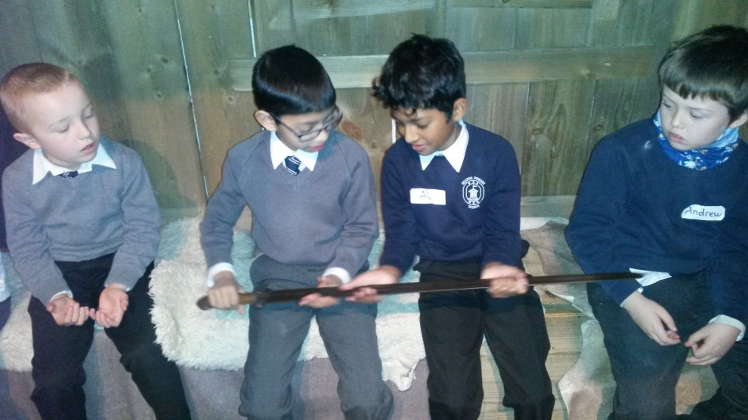
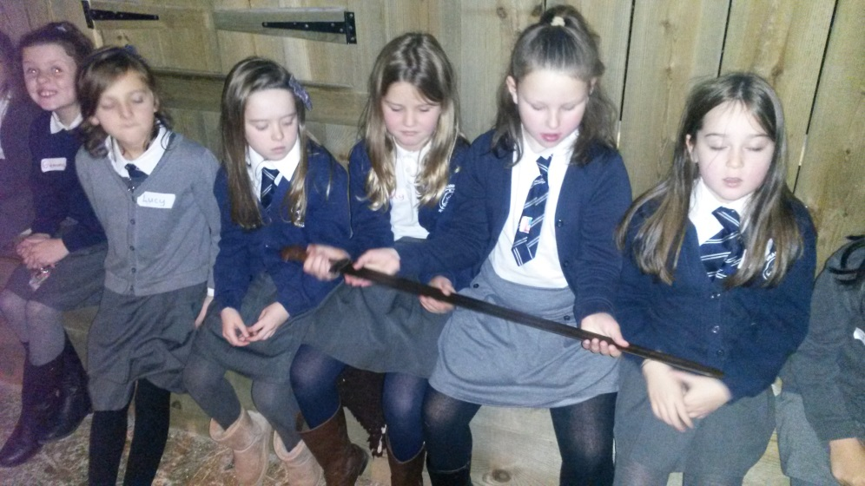
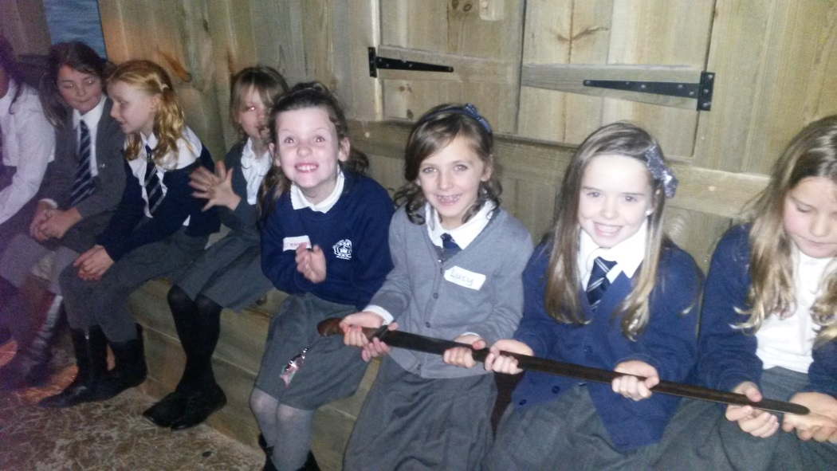
Holding the deadly Viking sword!!!

Slide 21
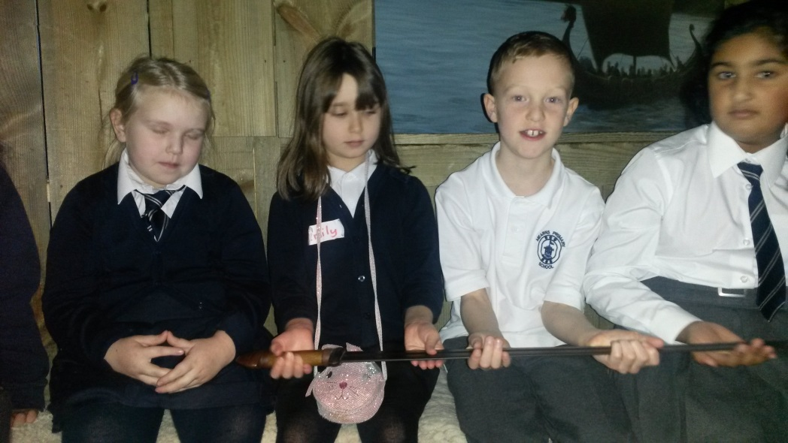
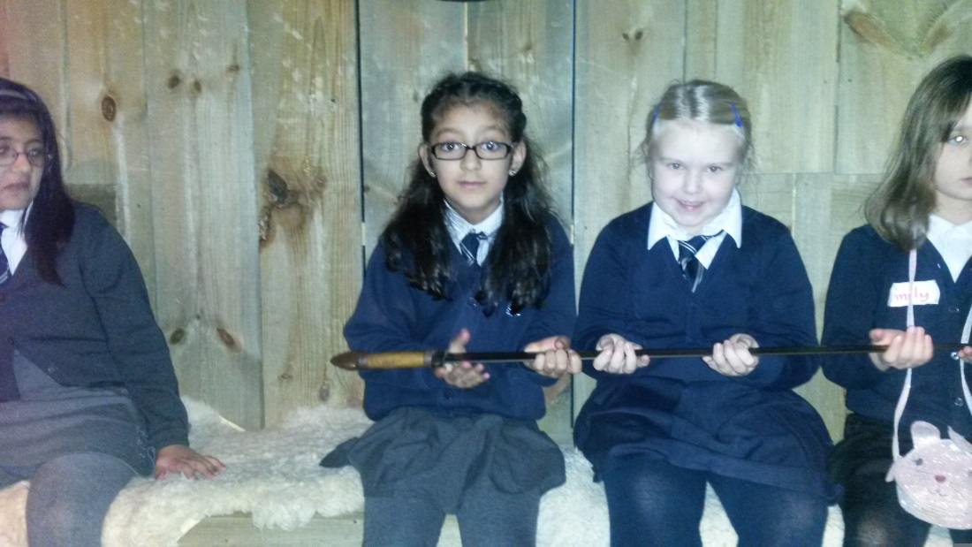
Holding the deadly Viking sword!!!

Slide 22
Testing out the Viking horns!!!

Slide 23
Making some fresh porridge!!!

Slide 24
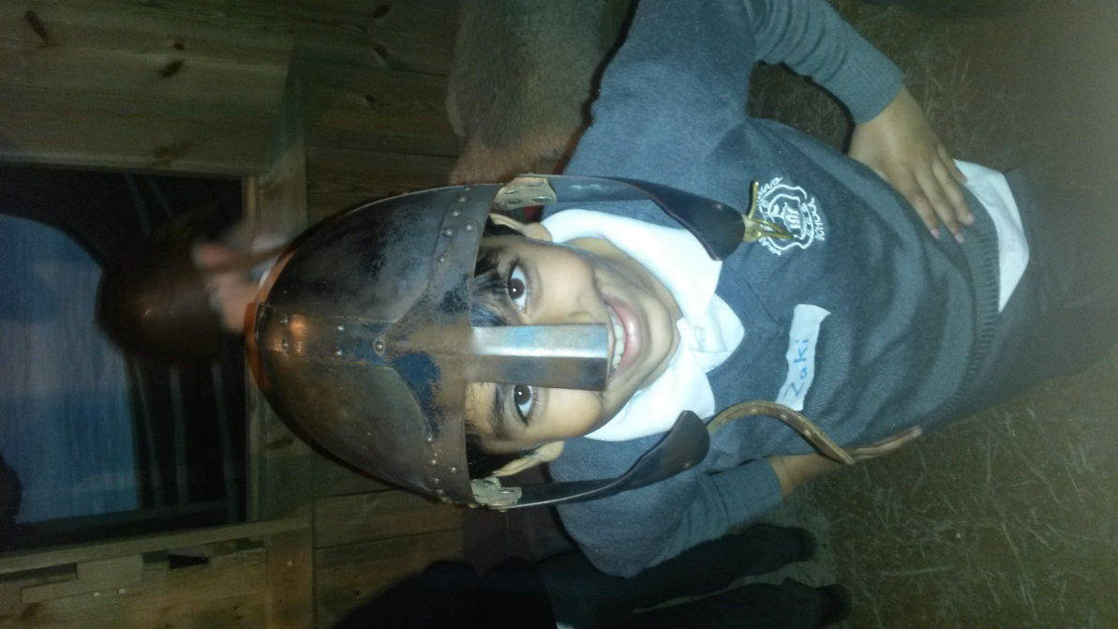
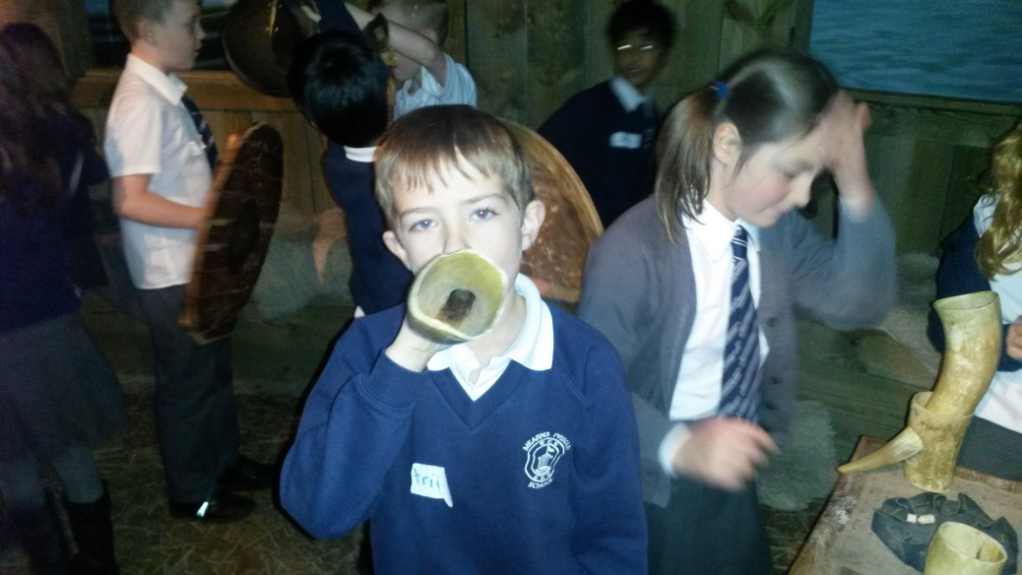
Little Vikings!!!

Slide 25
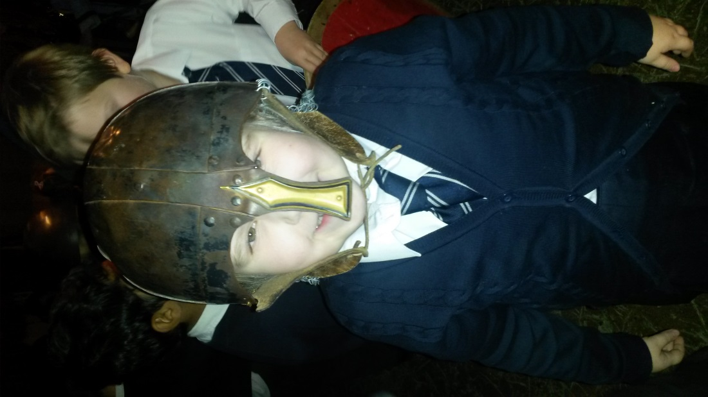
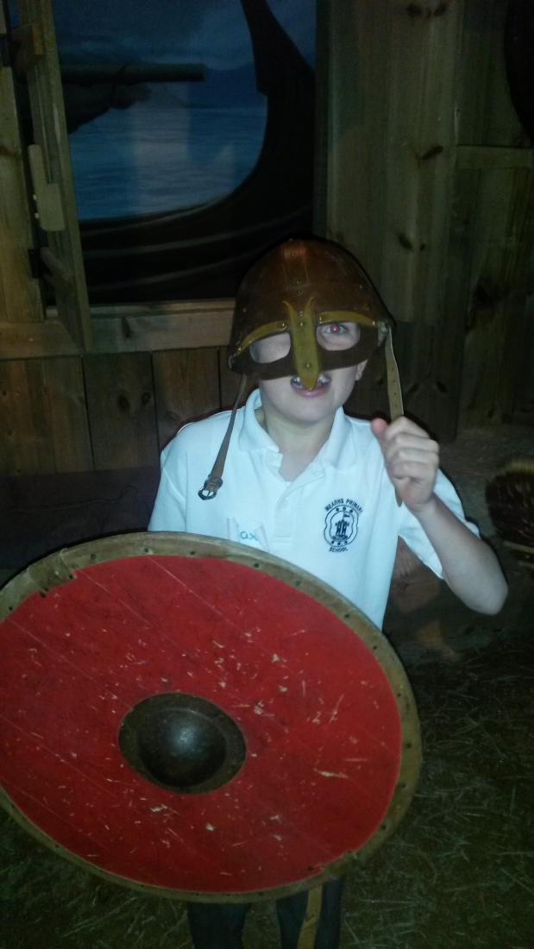
Little Viking Warriors!!!

Slide 26
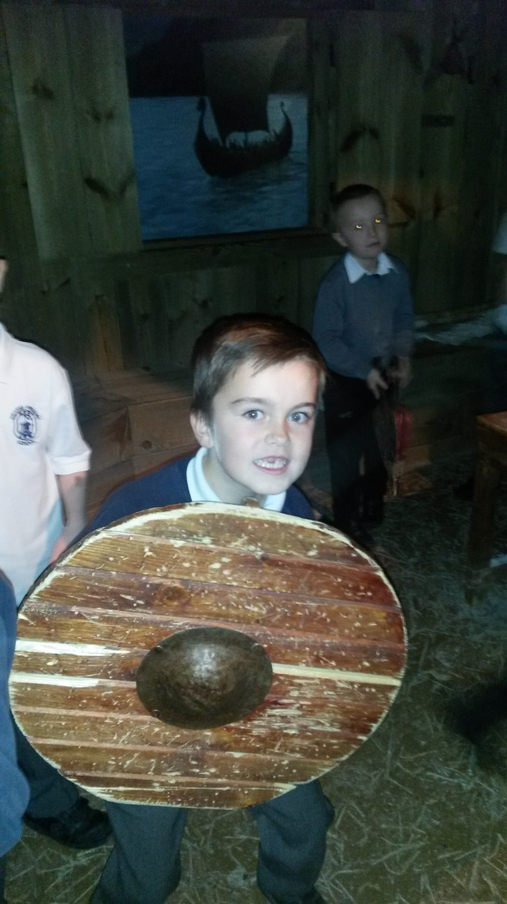
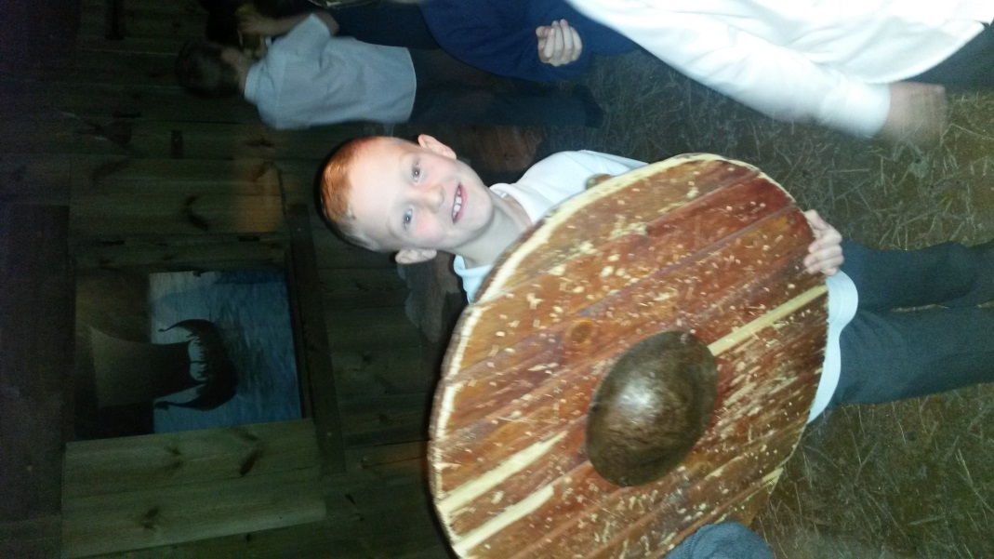
Little Viking Warriors!!!

Slide 27
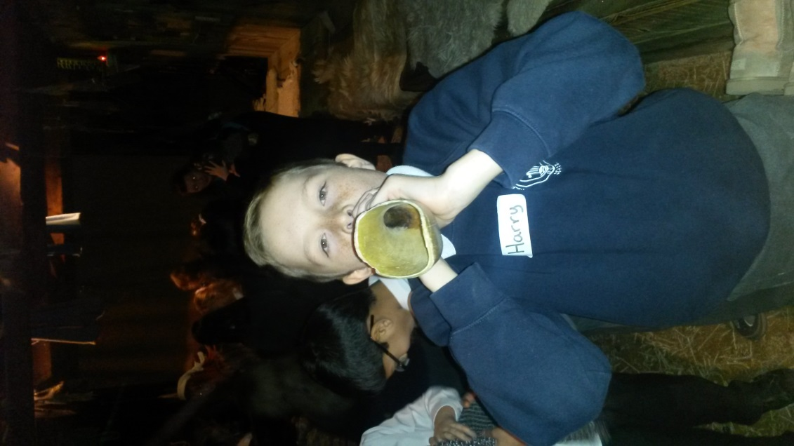
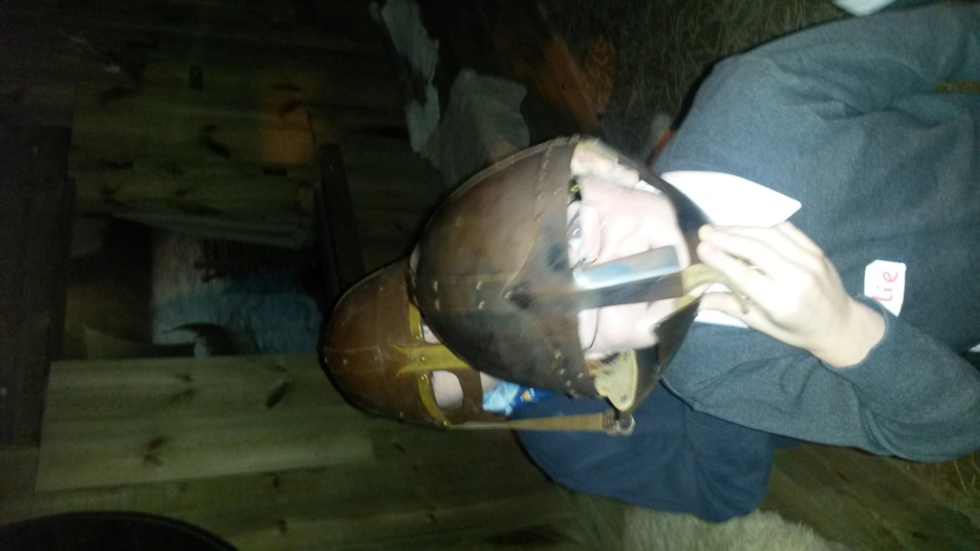
Viking for a day!!!

Slide 28
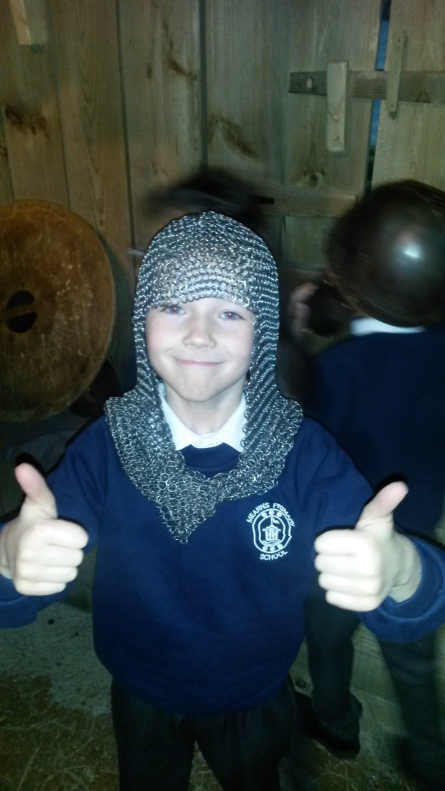
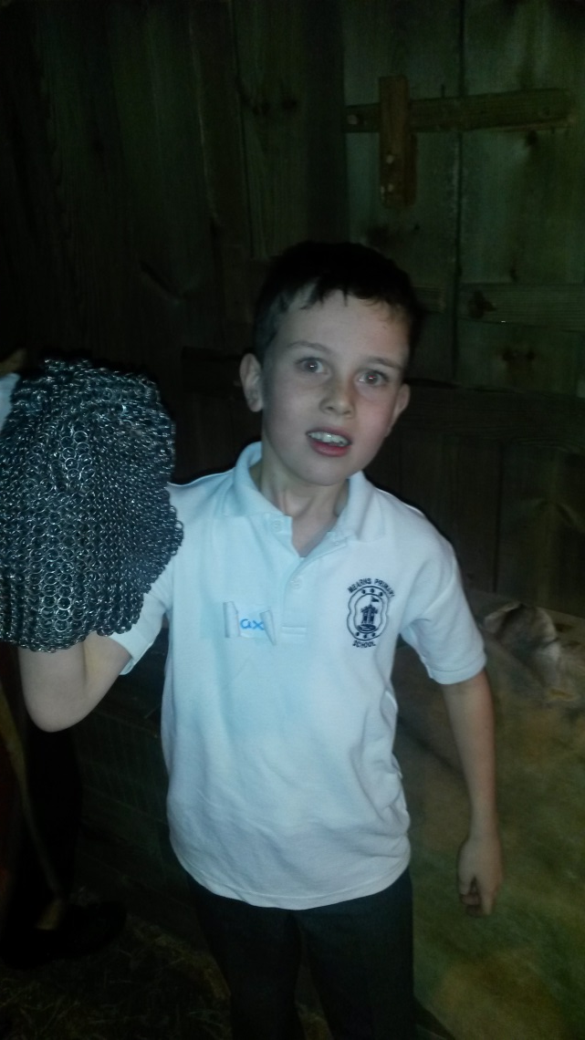
Checking out the chain mail!!!

Slide 29
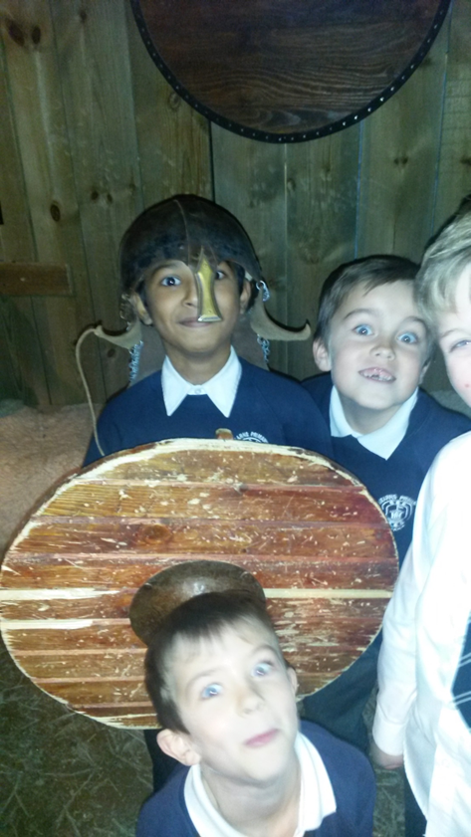
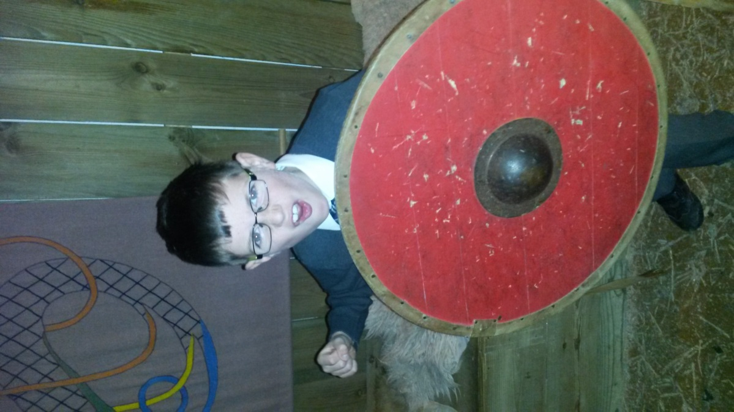
Scary Vikings!!!

Slide 30
In the temple of the Viking Gods!!!

Slide 31
In the temple of the Viking Gods!!!

Slide 32
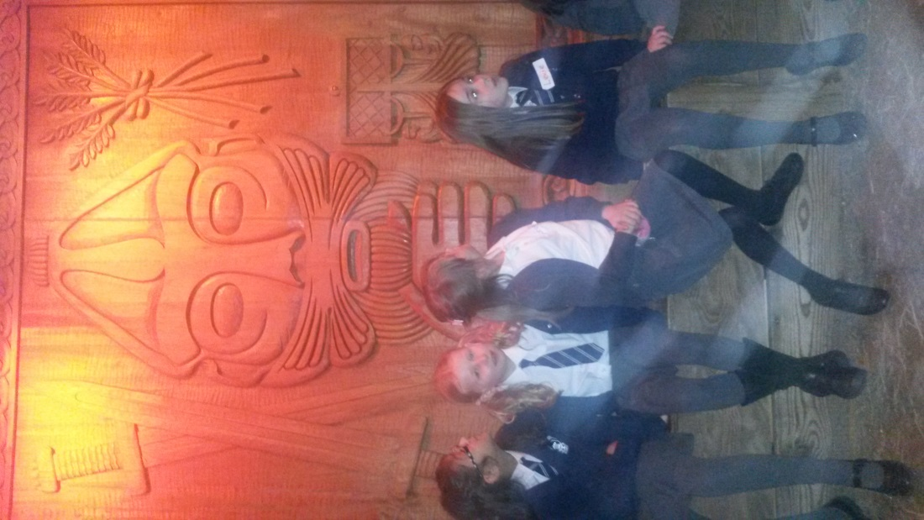
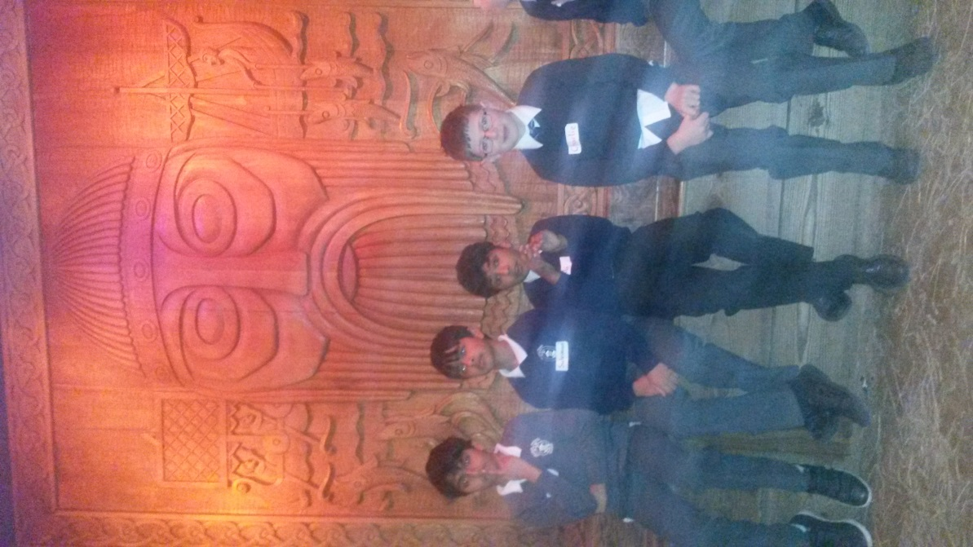
Learning about the Viking Gods!!!

Slide 33
Very engaged pupils!!!

Slide 34
A very happy Primary 4.20

