Slide 1
East Renfrewshire Good Causes
By
Cameron Rae and Haaris Butt

Slide 2
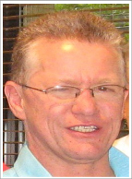
East Renfrewshire Good Causes is a local charity that helps people in East Renfrewshire.
The charity was started by Russell Macmillan.
He was in hospital and he needed a transplant and someone kindly donated their organs.
Without this he wouldn’t be alive.
To say thank you he set up a charity to help other people.

Slide 3
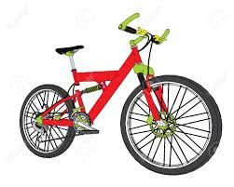
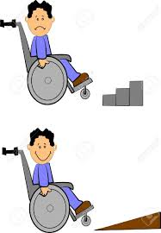
This charity helps local people facing challenges in their lives.
These are some examples:
Helped prepare the house for a person in a wheelchair so they could come home from hospital.
Helped primary school pupils to go on a school trip for a week.
Donated a bike to four children who have never owned a bike.

Slide 4
This charity helps people of all ages in our community.
They have helped our school community.
We would like to help them to help other people.
Dress as you Please Day
Friday 6 November
Please Bring a Donation

