Slide 1
Dyslexia

Slide 2

What is Dyslexia?
Dyslexia is a difficulty with learning to read, write and spell.

Slide 3
How the brain works
Dyslexia does not mean you are not clever.
It means that your brain processes information in a different way which makes reading, writing and spelling difficult.

Slide 4

Skills and Talents
People with dyslexia can be very creative.
They can have good verbal skills (talking) and visual skills(seeing or imagining)
They can think outside the box and see problems in 3D, helping them to solve them.

Slide 5
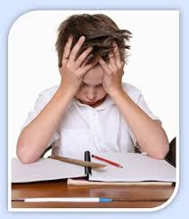
Difficulties
People with dyslexia can have difficulty reading, taking notes and remembering numbers and names.
They can find it difficult to spell and to put things in the right order.

Slide 6
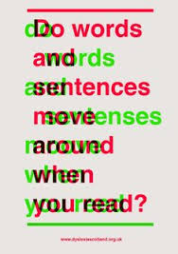
This video shows what text can look like for people with dyslexia.

Slide 7
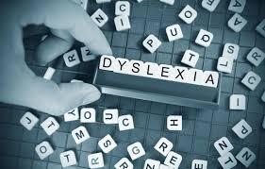
Help
Identifying dyslexia is the first step to overcoming these problems.
After that there are lots of things that can be done to help.

Slide 8

Peer Support
Classmates can help with reading and writing activities.

Slide 9
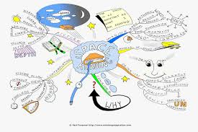
Visual Learning
Mind maps and flow charts can help dyslexics understand topics and remember facts.
They can see the information more clearly because it looks like a picture, not a paragraph of words.

Slide 10
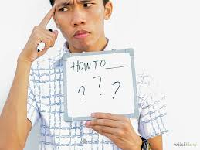
Clear Instructions
Being given instructions one at a time helps people complete tasks.

Slide 11

Colour
Coloured overlays and coloured paper can help with reading as it can stop words jumping about on the page.

Slide 12

ICT
Typing on the computer and printing work can be much easier than writing stories.

Slide 13
Competition
Dyslexia
Matters
Everyone has the right to help in school if they need it.
That is why the RRSA group are talking about Dyslexia today.
We are running a “Dyslexia Matters” poster competition for P3-7.
The winner from Mearns Primary will be entered into an East Ren wide competition. The over all winner will have their poster printed and put on display in all East Ren schools.

Slide 14
Rules
Poster on A4 paper.
Must say “Dyslexia Matters”
Must be colourful and informative.
Deadline: Monday 15th December
Dyslexia
Matters

