Slide 1
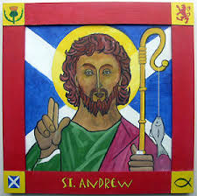
Celebrating
St Andrew’s
Day
Tuesday 24th November P1.4 assembly
Wednesday 25th November P7.26 assembly
Thursday 26th November P3.12 assembly
Friday 27th November Tartan Day – wear something tartan to school and make a donation or bring in a tombola item for the PTA Christmas Fayre.

