Slide 1


Early Level Curriculum for Excellence
Health & Wellbeing
Numeracy & Mathematics
Language & Literacy
Sciences
Social Studies
Technologies
Religious & Moral Education
Notes:
.

Slide 2
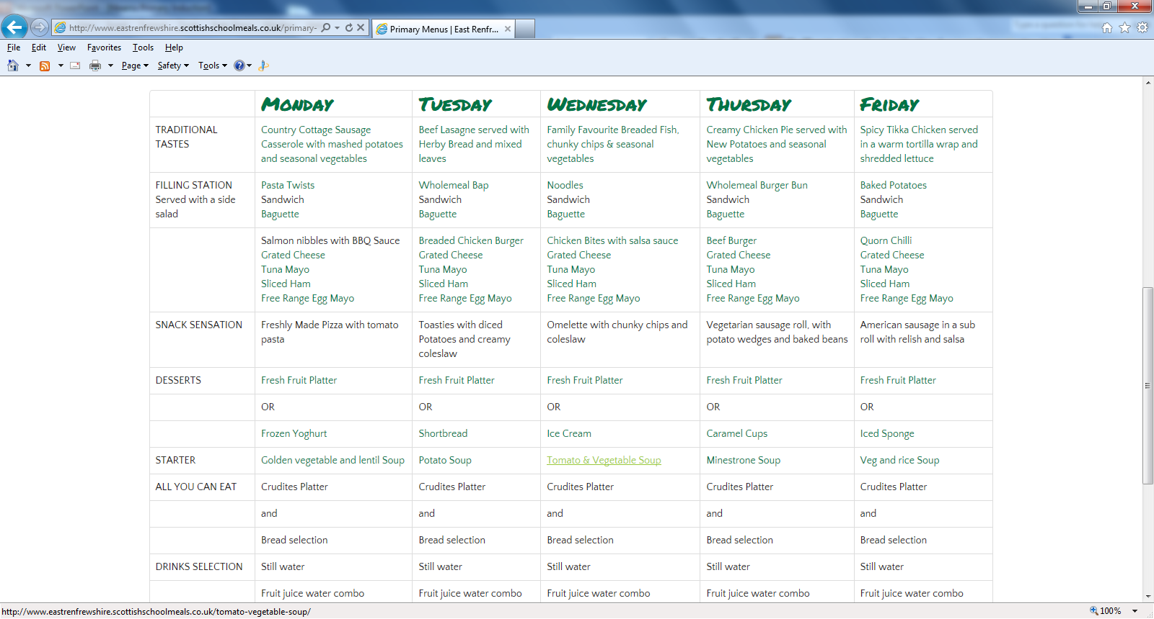
Sample Menu
Sample Menu

Slide 3

Cashless catering
Every pupil will be issued with a Scottish Candidate Number (SCN) which should be used to make online payments for school lunches. You can find a link to cashless catering on our school website via the red telephone!
Pupils will also receive a four digit PIN Number for topping up at the lunch machine located in the school reception.
Kitchen will accept cash until system is set up for P1.
£1.80 cold lunch £1.95 hot lunch

Slide 4
Lunch Date
Lunch with your child
Week beginning 8 September 2014
Mon 1.1
Tues 1.2
Wed 1.3
Thurs 1.4

Slide 5
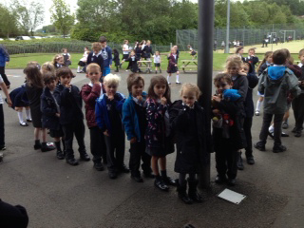
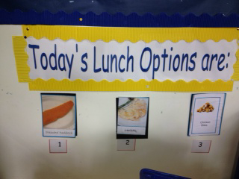
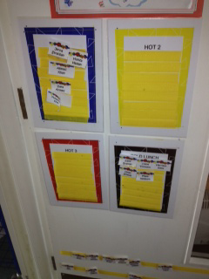
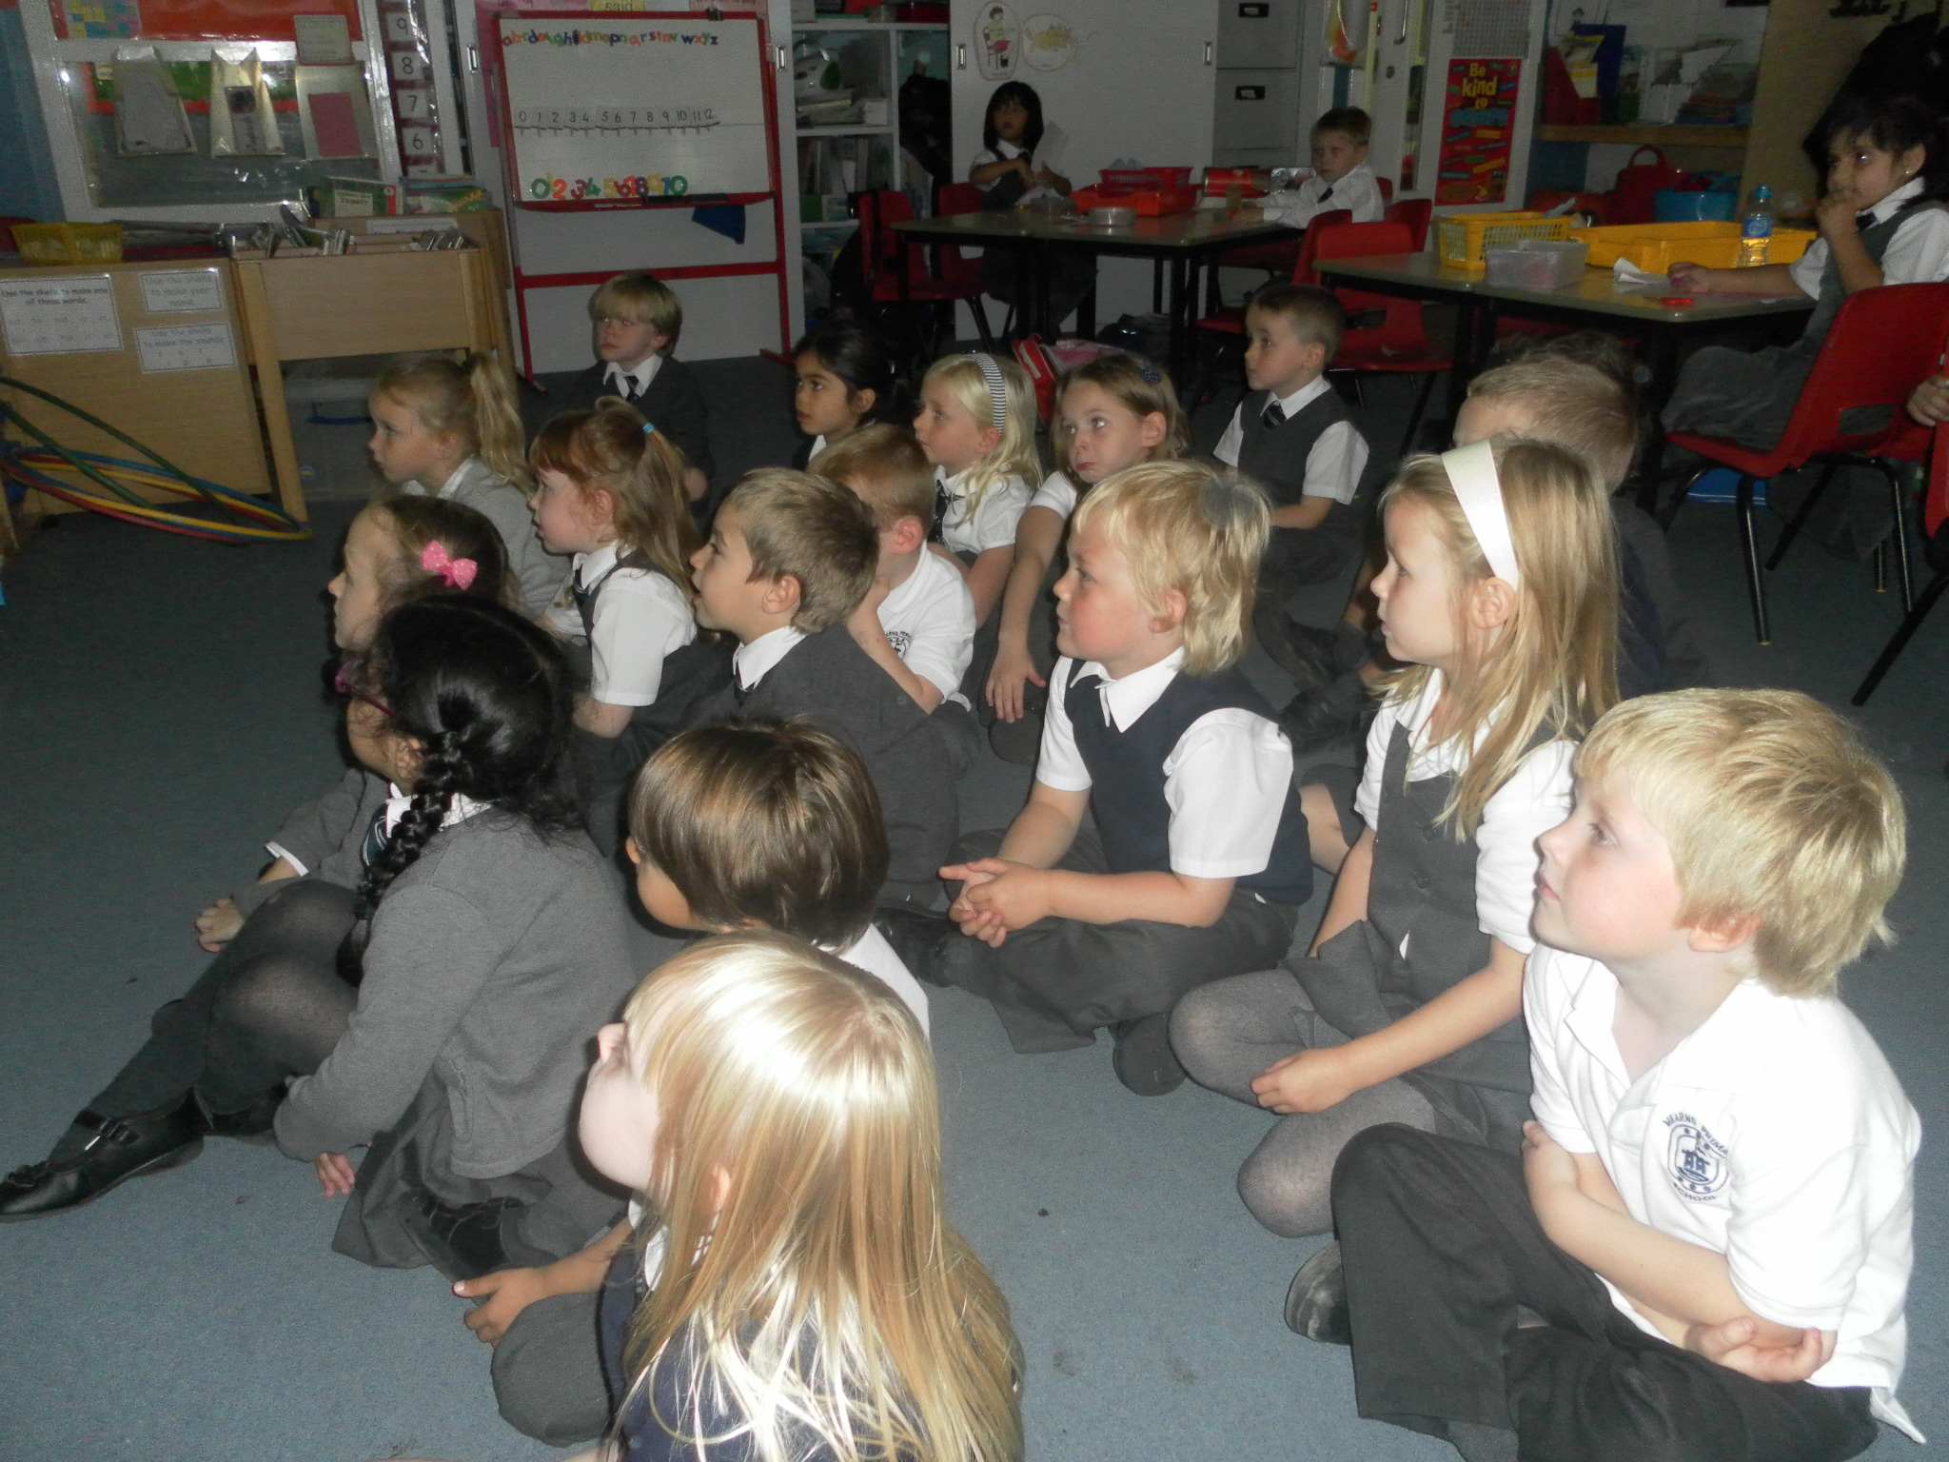
General Routines
Lining up for school
Choosing our lunch
Registration

Slide 6
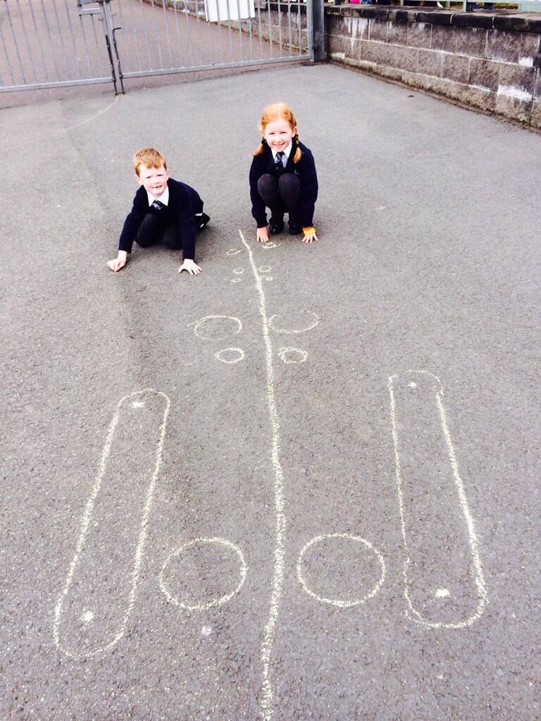
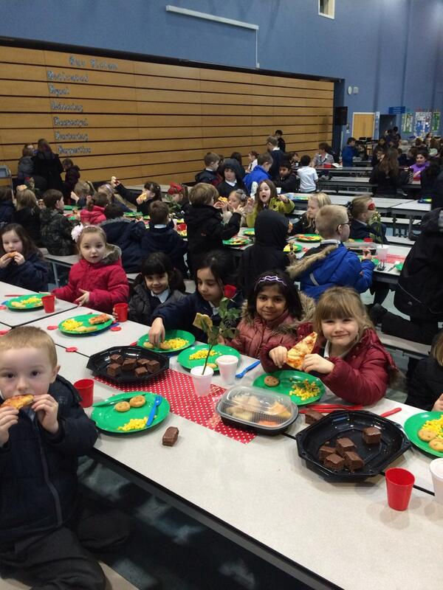
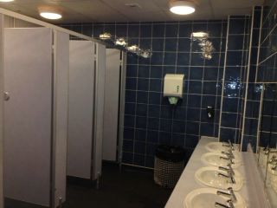
Playtime
Lunch time
Toileting

Slide 7
Day 1
9.15 am start 2.45pm finish
Week 1
9.00am start 3.00pm finish
Week 2
Relaxed entry starts from 8.45am
If parents wish their child may come into school from 8.45am. A pupil support assistant will be on the door and classes will be supervised. Any children who come into school will not be allowed back out into the playground. Parents will not accompany children into class.

Slide 8
Homework
Phonics
Please use a writing pencil in the phonics homework booklets
Please try to collect pictures (or draw pictures) which begin with the relevant sound
Use sound cards to blend and make words
Given out in advance –homework diary
Reading
Please read book and practise words daily
Make a duplicate set of words (handwritten) and play word pairs, snap etc
Make up sentences using the words – silly sentences can be fun
Match the word on the card to the reading book
Please remember to bring in reading books and word pockets daily
Talk about the book!

Slide 9
Homework Continued
Maths
Practising number formation – writing numbers
Recognising numbers
Playing number games such as snap
Counting 0 – 10, forwards and backwards
Discussing 2D and 3D shape properties

Slide 10
Hints and Tips!
Big school bags A4
Please put snacks in school bags, not in lunch boxes
Please ensure all your child’s belongings and uniform are clearly labelled with name and class
Please wear a polo shirt on gym days. Gym bags can be left in school.
Please bring in an art shirt and clearly label your child’s name on it. These are kept in school.
Please check your child’s homework diary every night
For safety reasons, please do not come into the classroom with your child on wet mornings or early entry

