Slide 1

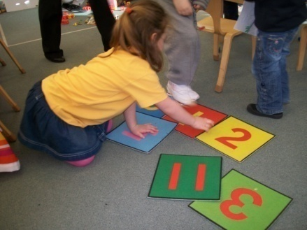
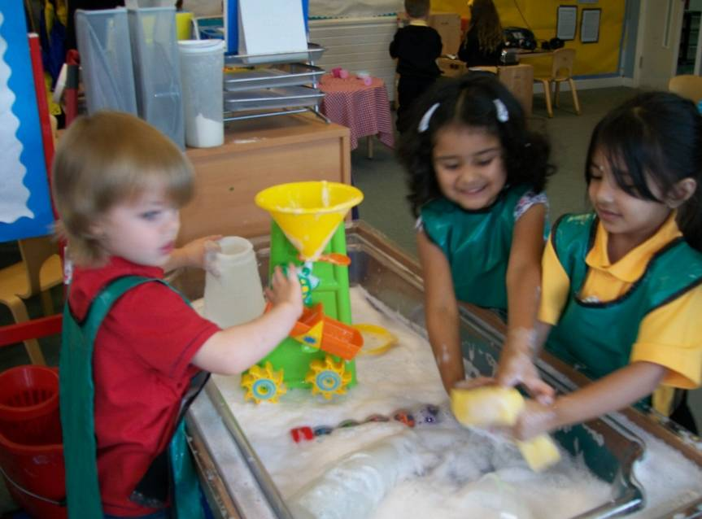
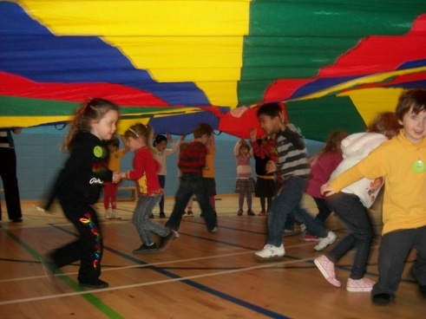

Getting it Right for Mearns Nursery Class

Slide 2

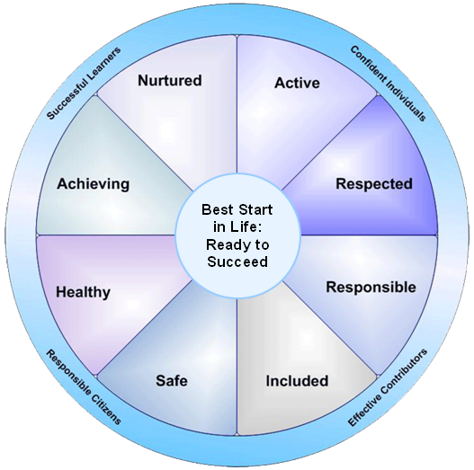
Getting it Right for Every Child
Notes:
Active –mentally engaged in learning activities, outdoor / woodland walkers Mini kickers, cheerleading gym
Respected- Pupil voice responsive planning, children views are listened too, evaluations, questionnaires
Responsible- Pupil & Eco committee, snack & paper Monitors, peer role models
Included- Care plans, EAL STINT pupils are involved in planning, contribute their views on learning through profiles, parent workshops, shadowed sessions, disclosure checked – parental volunteers
Safe- Ratio, collection policy, care plans updated 2 a year, secure door entry, daily risk assessment, fire wardens & procedures, golden rules.
Healthy- Snack, tooth brushing ,gym, outdoor play, dentist/ vision screening, baking sports days etc
Achieving- Achievement boards, shout loud shout proud, celebrate achievement in/out of nursery, star of the day, Self help skills, Curriculum
Nurtured- All of the above, settling in policy, key worker system, rotation system, enhanced transition, home visits

Slide 3
Nursery Staff
Depute Head: Mrs Claire Noble
Mrs. Shona Aitken - CDO
Mrs. Joyce Murray - CDO
Miss Laura Martin - Teacher
Mrs. Barbara McLeish - CDO
Mrs Cathie Kelly - CDO

Slide 4
Session Times
Morning
8.45am - 11.55am
Afternoon
12.30pm - 3.40pm
Wraparound Service

Slide 5
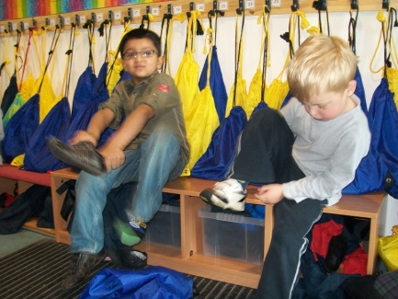
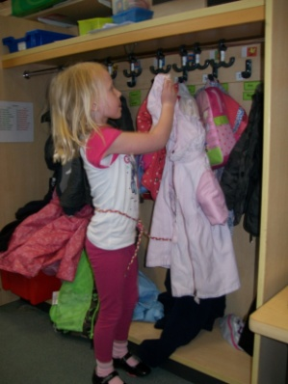
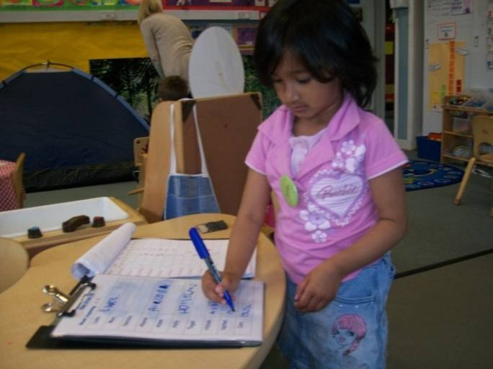
General Routines
Finding our shoe bags and changing our shoes.
Finding our pegs and hanging up our jackets
Signing in
Notes:
Please take shoe bags home very day
Out door / appropriate gym shoes
All items clearly labelled
Parents / children sign in
No toys!

Slide 6
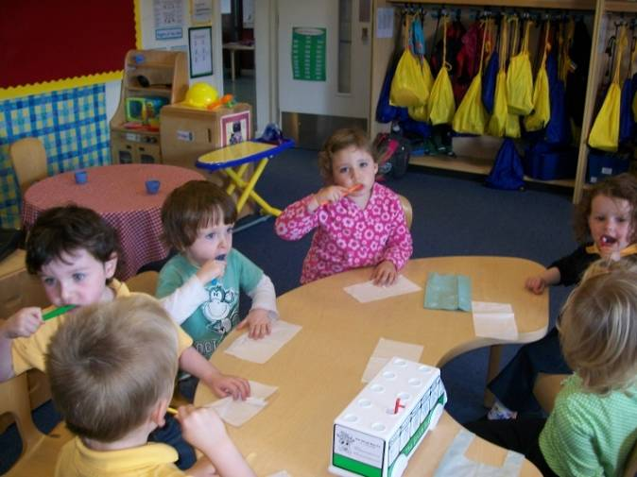
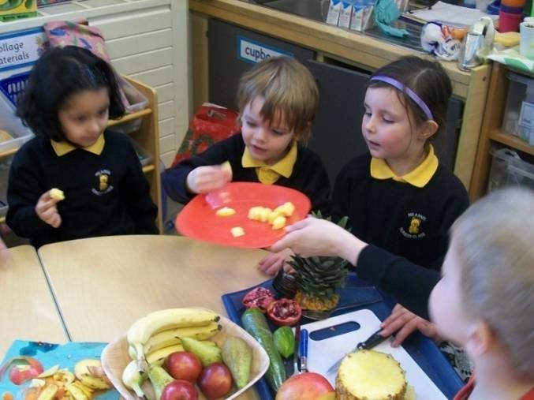
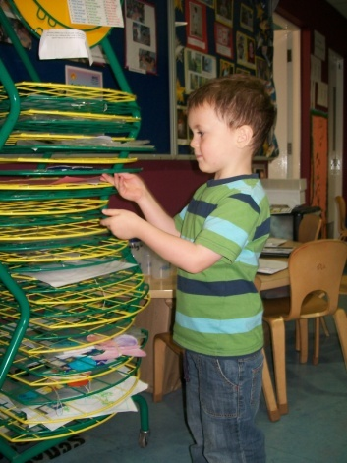
Brushing our teeth.
Snack time
Filing our work

Slide 7
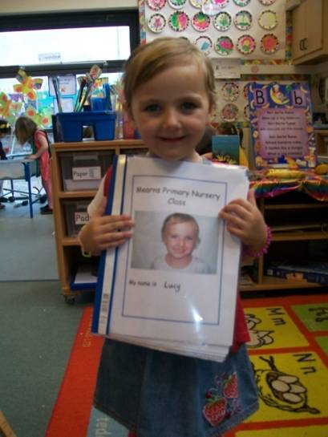
Communication
Keeping each other informed
Open door policy
Parent and planning notice boards
Monthly newsletter
Allergies
Changes to collection of children form
Profiles

Slide 8

Early Level Curriculum for Excellence
  PLAY STRATEGY
        FOR SCOTLAND: OUR VISION
        Play creates a brain that has increased flexibility and improved potential for learning later in life
(Lester & Russell, 2008)

Slide 9
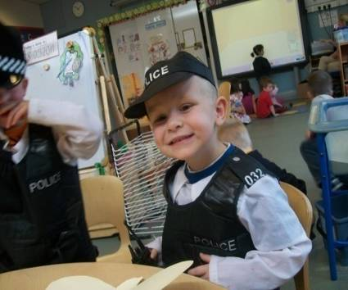
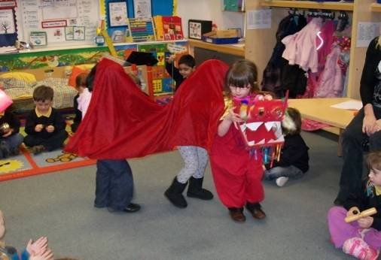
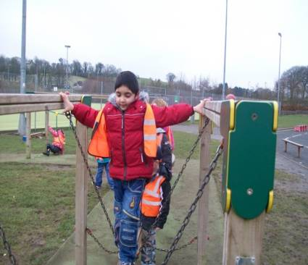
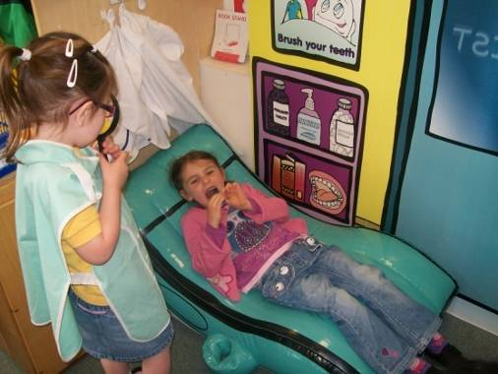
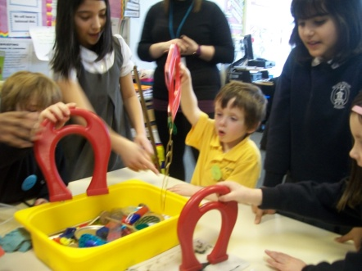
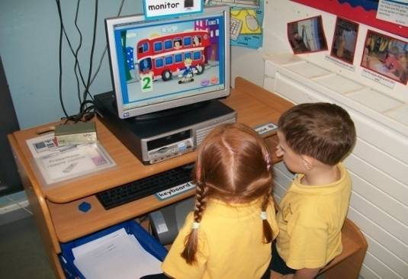
Early Level Curriculum for Excellence
Our children in Nursery are working at Early Level in all areas of Curriculum for Excellence.
Health & Wellbeing
Numeracy & Mathematics
Language & Literacy
Sciences
Social Studies
Technologies
Religious & Moral Education

Slide 10
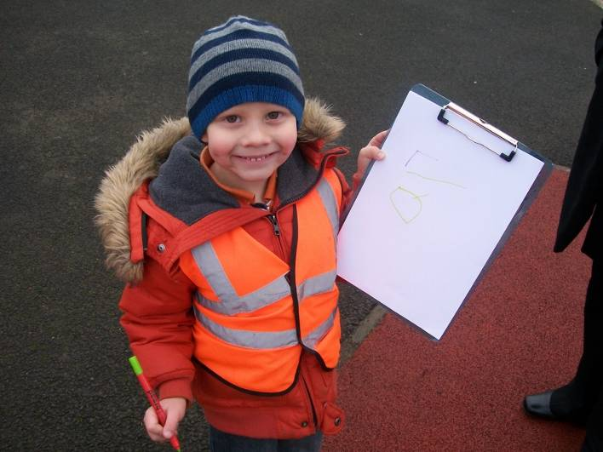
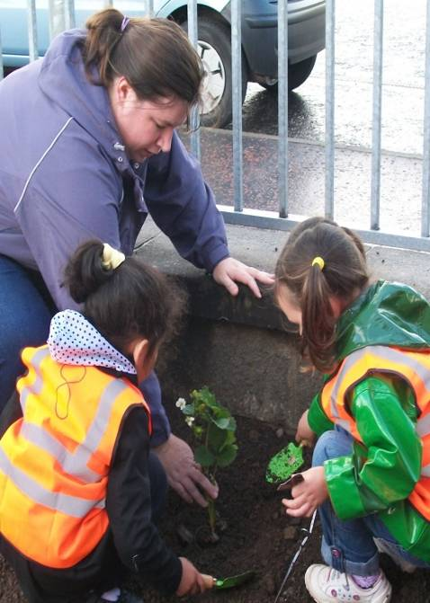
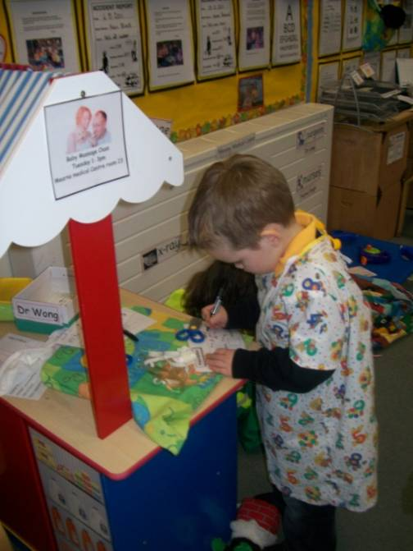
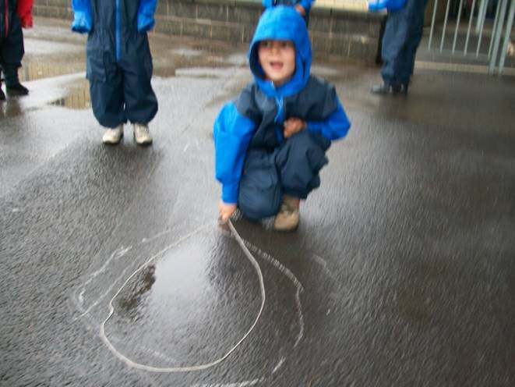
Learning as we play and having fun.

Slide 11
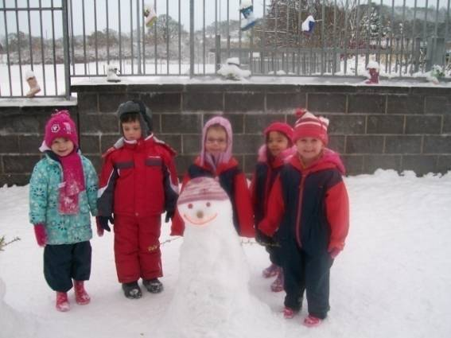
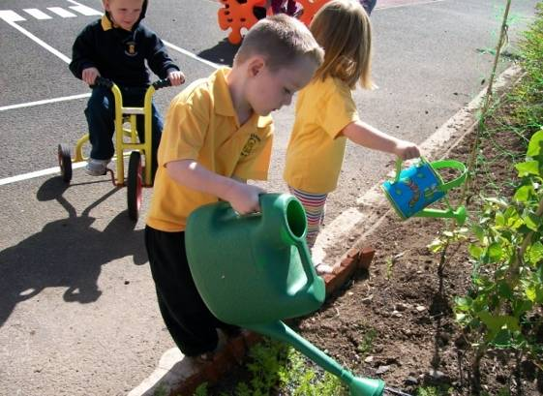
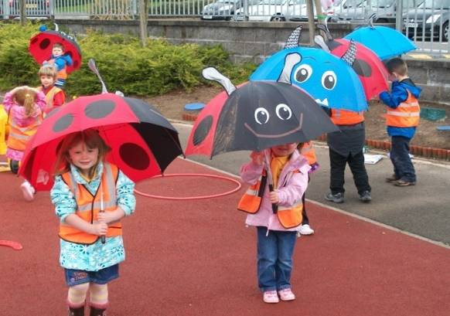
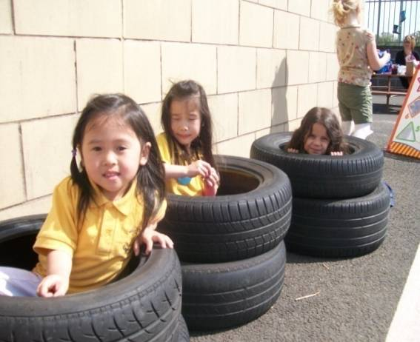
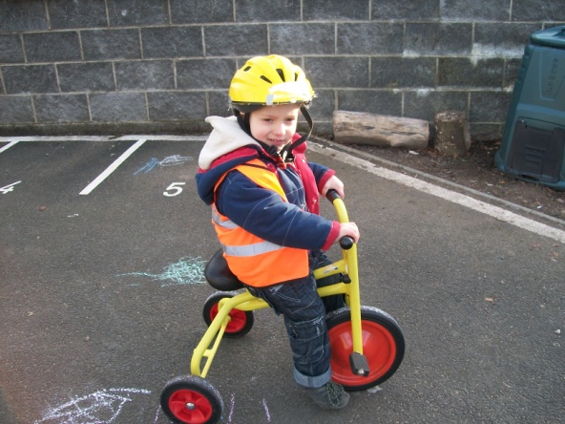
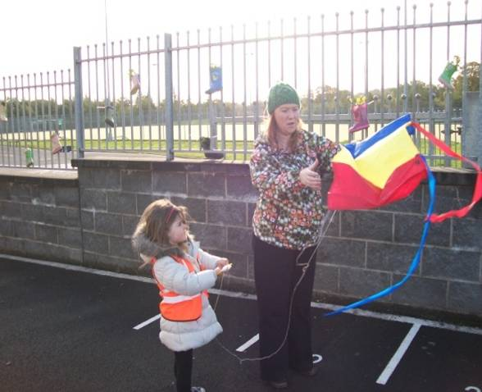
Outdoor Learning
“There’s no such thing as bad weather only bad clothing!”
Be Prepared!
Notes:
Out door / water proofs sun screen / sun hats/ Woodland Walkers

Slide 12
Woodland Walkers

Slide 13
Home Learning
Lending Library
Homework Tasks
Bilingual Book Bags

Slide 14
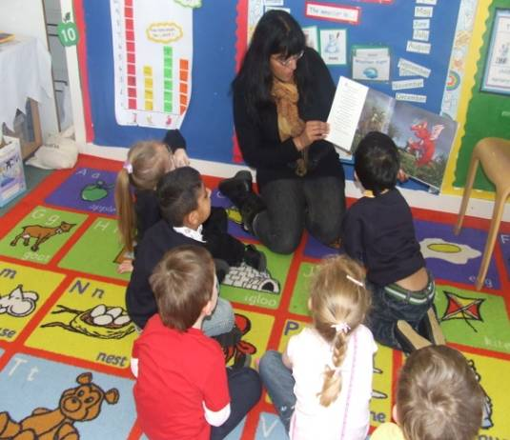
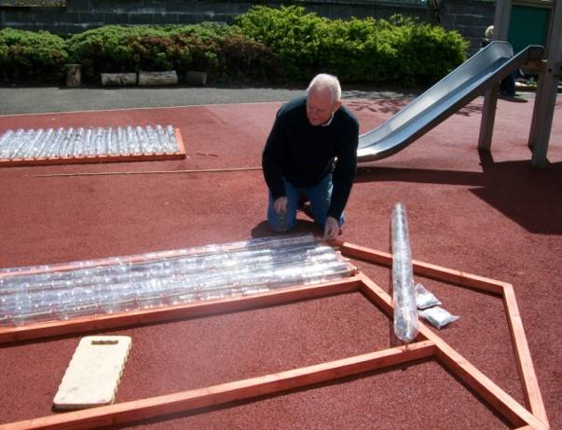
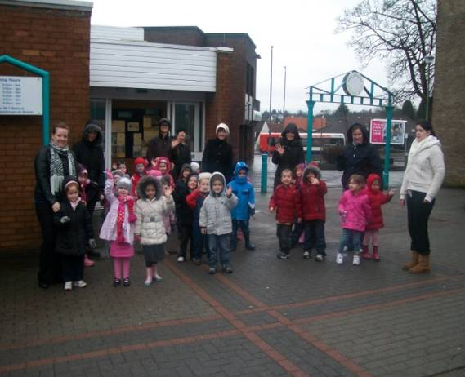
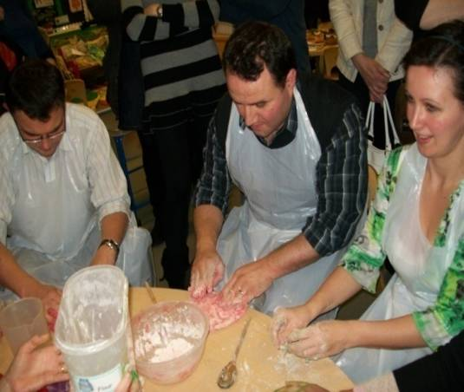
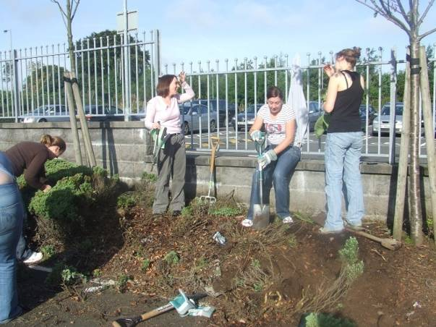
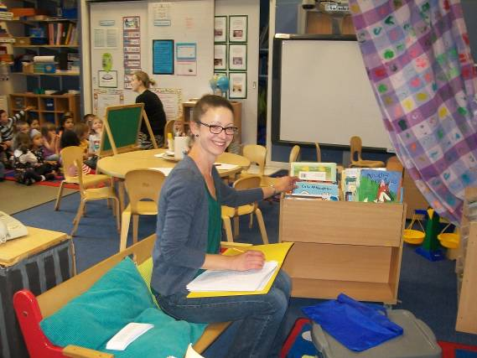
Get Involved
If you are disclosure checked and would like to help out in the nursery please speak to a member of staff.

Slide 15
Notes:
Self help skills
Coats/ shoes etc

Slide 16
Video

Slide 17

Successful Learners
Effective Contributors
Learner
Responsible Citizens
Confident Individuals

