Slide 1
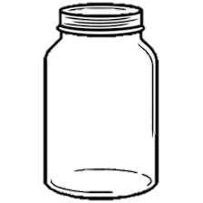
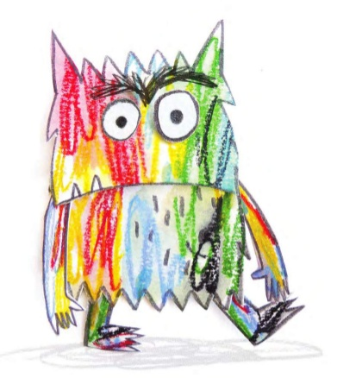
The Colour Monster
Can you help The Colour Monster fill his jars by drawing or writing things that make you feel each of these feelings?
Sad
Fear
Love
Angry
Happy
Calm

