Slide 1
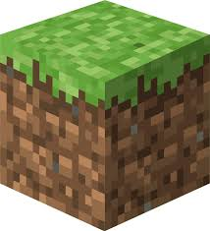
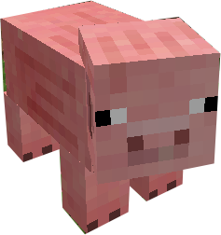
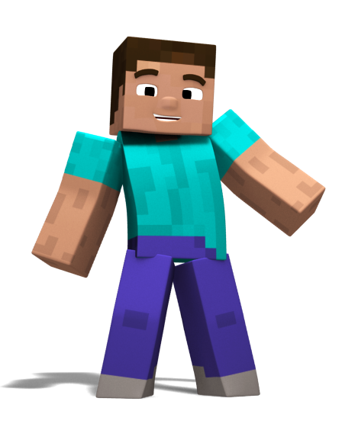
RMPS Homework.
Over this year you must complete 4 pieces of Homework- one from each level and one for each unit of work. They are due in October, December, March and May. You can collect paper and/or templates* from your teacher.
Expert Level
Write a poem/song/rap that summarises a topic we have looked at.
Make it informative and catchy and remember to include key words
Create a starter activity for S1 to complete about this topic.
It can be in any format e.g.. PPT and should be fairly challenging for someone who has completed this work
Write a newspaper report* about a topic we have studied.
Include specific accurate facts with good English. You should include quotes and images.
You are the expert! You can give guidance, troubleshoot and answer questions.
Proficient Level
Create a leaflet which summarises the topic we have studied.
Use key terms and make it informative and eye-catching
Create a comic strip* to explain a topic/story you have learned.
Use pictures and key words to explain this in a clear way.
Create a crossword* with questions clues to the answers in the grid based on a topic we have studied.
Use key words and terms.
You can perform with skill, and help others.
Competent Level
Create a Facebook page/posts* summarising a persons or characters thoughts and beliefs.
Use key terms and make it informative and eye-catching
Create a flow diagram/chart to explain something new you have learned.
Use pictures and key words to explain clearly
Create 10-15 challenging quiz questions about this topic.
Write the questions with the answers separate from the questions.
You can discuss and apply the basic concepts and terms
Novice Level
Create a mind map about the topic we have been studying.
Use key terms and make it informative and eye-catching
Identify the key terms in this unit and make a Glossary.
Find out the definitions and learn the spellings
Write 3 tweets that could help summarise the lesson/topic.
No more than 140 characters each; use #’s for key words and they must be informative…
You understand the basic concepts and terms

