Slide 1
If you are a Scottish school interested in Holocaust Education here are some books you might want to have in your school library.
Get in touch if you have a suggestion you would like to see added- this list will be updated regularly.
Your school librarian will be able to help you with ISBNs, costings and suppliers.

Slide 3
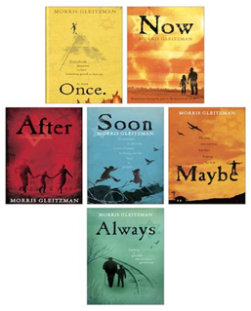
Once, Now,After, Soon, Maybe and Always by Morris Gleitzman
A wonderful series from one of Australia’s best loved children’s authors following the story of a young Jewish boy called Felix desperate to escape a children’s orphanage at the start of the Second World War and his experienced to 1945 and the end of the conflict.
Suitable for 10+

Slide 4
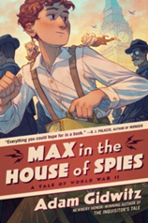
Max in the House of Spies by Adam Gidwitz
Leaving home is hard and Max is alone for the first time in his life. But not for long. Max is surprised to discover that he’s been joined by two unexpected traveling companions, one on each shoulder, a kobold and a dybbuk named Berg and Stein.
Germany is becoming more and more dangerous for Jewish families, but Max is determined to find a way back home, and back to his parents. He has a plan to return to Berlin. It merely involves accomplishing the impossible: becoming a British spy.
Suitable for 10+

Slide 5
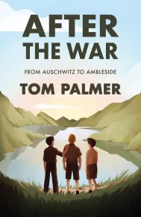
After the War by Tom Palmer
Summer 1945. The Second World War is finally over and Yossi, Ben and Mordecai are among three hundred children who arrive in the English Lake District. Having survived the horrors of the Nazi concentration camps, they've finally reached a place of safety and peace, where they can hopefully begin to recover. But Yossi is haunted by thoughts of his missing father and disturbed by terrible nightmares.
Suitable for 9+

Slide 6
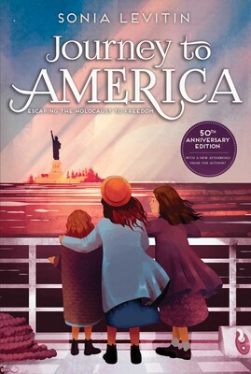
Journey to America by Sonia Levitkin
This is a repackaged 50th anniversary edition of Sonia Levitin's powerful classic story about a young Jewish girl forced to flee her home. In 1938, Lisa Platt and her family know something dangerous is happening in Germany. Lately, there have been more and more restrictions for Jews: yellow stars they have to wear, schools they cannot attend, things they are forbidden to do. When their neighbors are arrested for petty reasons, the Platts realize they have to escape. Forbidden to bring money or possessions out of the country, Lisa's father secretly leaves for America, planning to work until he can send for them. But when conditions in Germany worsen, Lisa, her mother, and her sisters flee to Switzerland to wait, surviving on what little they have in a continent hurtling toward war.
Suitable for 9+

Slide 7
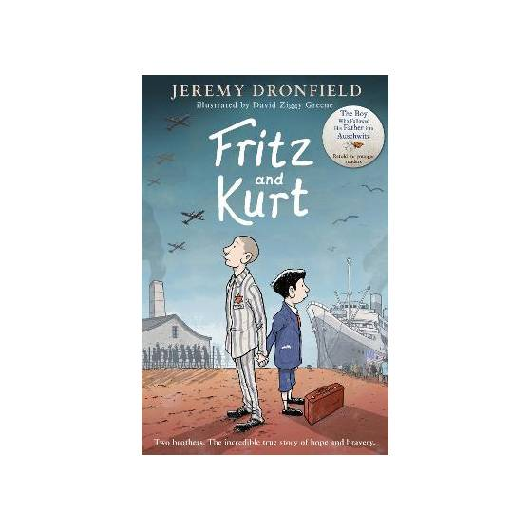
Fritz and Kurt by Jeremy Dronefield
When everything is taken away from you, love and courage are all you have left.
In 1938, the Nazis come to Vienna. They hate anyone who is different, especially Jewish people.
Fritz and Kurt's family are Jewish, and that puts them in terrible danger.
Fritz, along with his father, is taken to a Nazi prison camp, a terrible place, full of fear. When his father is sent to a certain death, Fritz can't face losing his beloved Papa. He chooses to go with him and fight for survival.
Meanwhile, Kurt must go on a frightening journey, all alone, to seek safety on the far side of the world.
In this extraordinary true story, Fritz and Kurt must face unimaginable hardships, and the two brothers wonder if they will ever return home . . .
A retelling of the Sunday Times bestselling The Boy Who Followed his Father into Auschwitz, a Daily Mail and Sunday Express book of the year.
Suitable for 10+

Slide 8
One moment can change a life forever.
A powerful and heart-breaking novel about three childhood friends living during the Second World War whose fates are closely intertwined, even when their lives take very different courses. Inspired by a true story, this is the perfect read for fans of The Book Thief and Anne Frank's The Diary of a Young Girl.
Vienna, 1936.
Elsa, Leo and Max have always been best friends, a special team of three. Then the Nazis come.
As a growing darkness descends around them, Leo and Elsa run for their lives, taking two very different paths across Europe. And Max, once their closest friend, now becomes the enemy as he is drawn into the Hitler Youth. Will the friends ever find their way back to each other? Will they want to?
Suitable for 12+

Slide 9
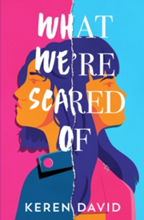
What We’re Scared of by Keren David
Â Evie and Lottie are twin sisters, but they couldn't be more different. Evie's sharp and funny. Lottie's a day-dreamer. Evie's the fighter, Lottie's the peace-maker. What they do have in common is their Jewishness - even though the family isn't religious. When their mother gets a high-profile job and is targeted by antisemitic trolls on social media, the girls brush it off at first - but then the threats start getting uglier. . . What We're Scared Of is a taut thriller, a tale of sibling friendship and rivalry - and a searing look at what happens when you scratch beneath the surface. Another tense thriller by award-winning author, Keren David A dramatic and gripping tale of sibling friendship and rivalry .
Suitable for 12+

Slide 11
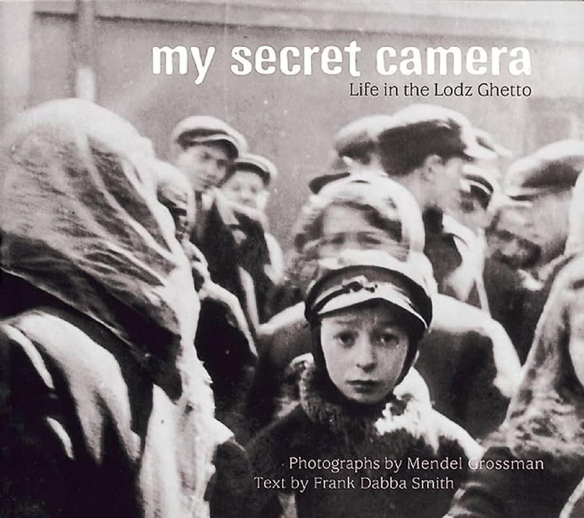
My Secret Camera;Life in the Lodz Ghetto by Mendel Grossman and Frank Dabba Smith
Mendel Grossman, one of the many Jews imprisoned in the Lodz Ghetto during World War II, was driven by a passion to bear witness to the human suffering that was going on around him. He secretly photographed people and events in the ghetto, leaving a historical record. In this photographic information book, the reader is taken on a journey with Grossman and his camera. The text emphasizes hope for the future, rather than the suffering of the past.
Suitable 10+

Slide 12
The Promise by Eva Schloss and Barbara Powers
This is the remarkable true story of a young Jewish girl and her brother caught in a world turned upside down by the Nazis during the Second World War. Eva Schloss describes her happy early childhood in Vienna with her kind and loving parents and her older brother Heinz, whom she adored. But when the Nazis marched into Austria everything changed.
Eva's family fled to Belgium, then to Amsterdam where, with the help of the Dutch Resistance, they spent the next two years in hiding - Eva and her mother in one house, and her father and brother in another. But in the end they were all betrayed and deported to Auschwitz concentration camp in Poland. Despite the horrors of the camp, Eva's positive attitude and stubborn personality (which had often got her into trouble) saw her through one of the most tragic events in history but sadly her father and brother perished just weeks before the liberation. Eva and her mother travelled back to the house in Amsterdam where Heinz and his father had hidden. There they found over thirty beautiful paintings by her brother. For Eva, here was a tangible, everlasting memory of her beloved older brother, and a reminder of her father's promise that all the good things you accomplish will make a difference. Suitable 11+

Slide 13
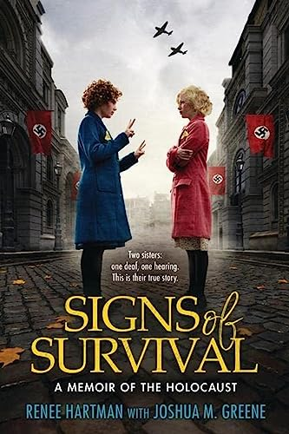
Signs of Survival by Hartman, Renee Hartman and Joshua M. Greene
Meet Renée and Herta, two sisters who faced the unimaginable - together. This is their true story. As Jews living in 1940s Czechoslovakia, Renee, Herta and their parents were in immediate danger when the Holocaust came to their door. As the only hearing person in her family, Renée had to alert her parents and sister whenever the sound of Nazi boots approached their home so they could hide. But soon their parents were tragically taken away, and the two sisters went on the run, desperate to find a safe place to hide.
Eventually they, too, would be captured and taken to the concentration camp Bergen-Belsen. Communicating in sign language and relying on each other for strength in the midst of illness, death and starvation, Renée and Herta would have to fight to survive the darkest of times.
Suitable 10+

Slide 14
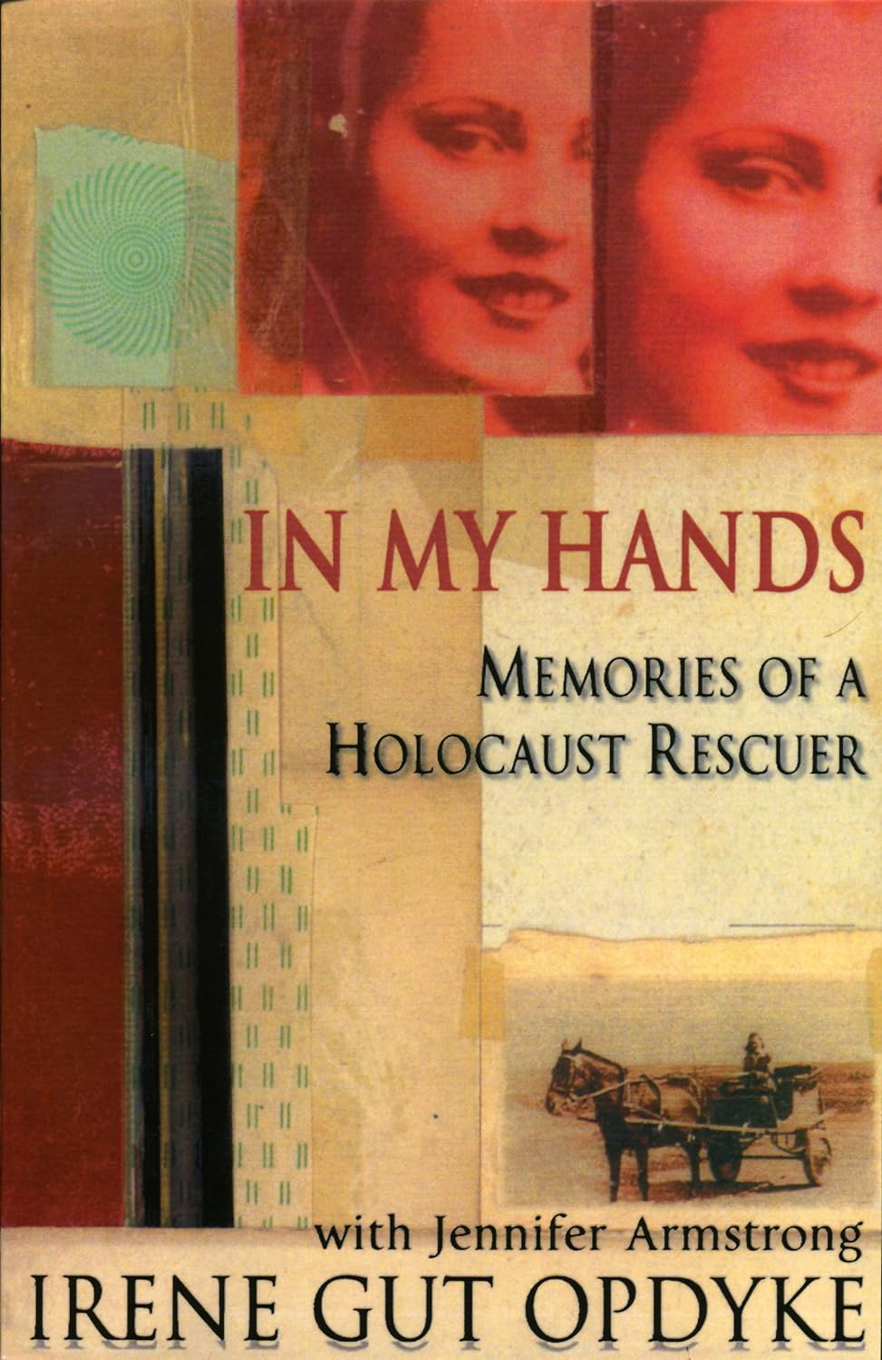
In My Hands; memories of a holocaust rescuer by Irene Gut Opdyke and Jennifer Armstrong
An utterly amazing, true, first-person account of one girl's experience in wartime. Irene Gut Opdyke was a Catholic Polish nursing student when WWII broke out. She soon became mired in the horrors of central Europe as, at various times, a partisan, a refugee, a housekeeper to the Nazis and, over all, as a heroine. She singlehandedly saved the lives of at least 16 Jewish people from the Holocaust.
Now living in America, Irene, with the help of a respected historical novelist, has told her story with all the power and passion that such a remarkable history can inspire.
Suitable 13+

Slide 15
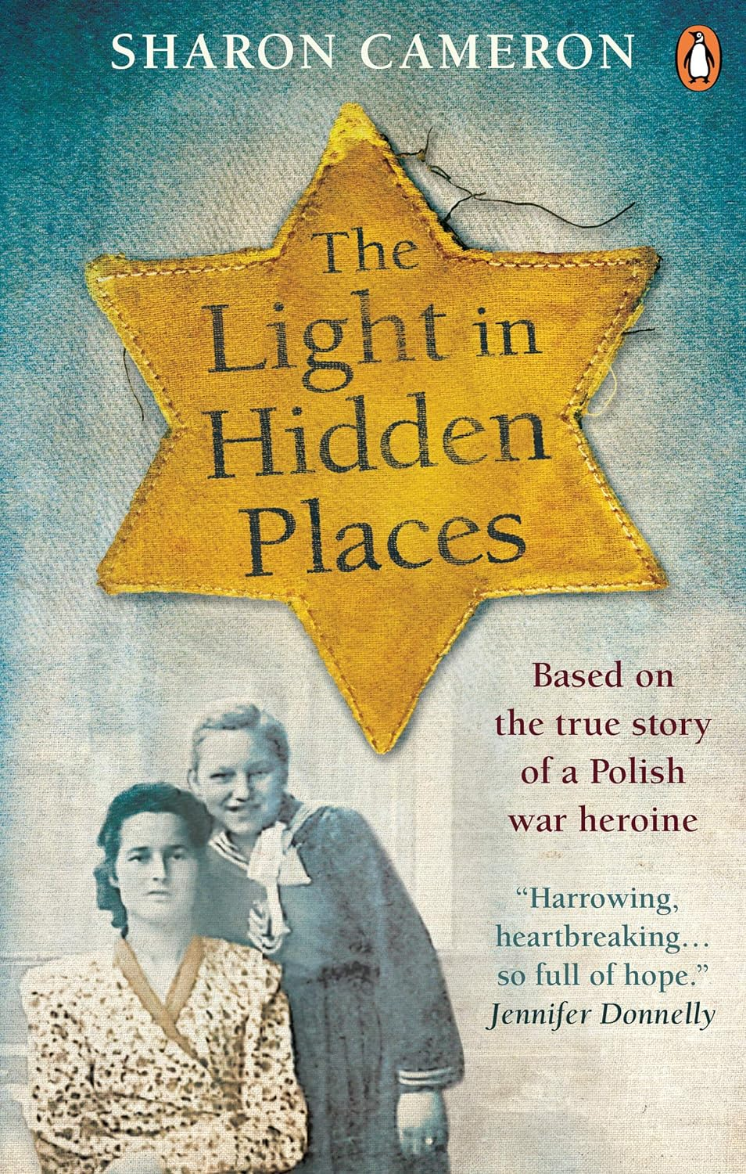
The Light in Hidden Places by Sharon Cameron
It is 1943, and sixteen-year-old Stefania Podgórska has been working for the Diamant family in their grocery store in Przemsyl, Poland, for four years. She has even made a promise to one of their sons, Izio - an engagement they must keep secret since she is Catholic and the Diamants are Jewish.
But everything changes when the German army invades Przemsyl. The Diamants are forced into the ghetto, and Stefania is alone in an occupied city, the only one left to care for her six-year-old sister. And then comes the knock at the door. Max Diamant has jumped from the train headed to a death camp. Stefania and Helena make the extraordinary decision to hide Max, and eventually twelve more Jews. Then they must wait, every day, for the next knock at the door, the one that could destroy everything...
Suitable 13+

Slide 16
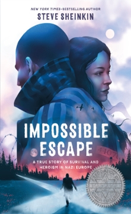
Impossible Escape by Steve Sheinkin
This is the true story of Rudolph (Rudi) Vrba. In 1944, he was just a teenager when he did the impossible and escaped Auschwitz, becoming one of the first survivors to share with the world what was actually going on in the Nazi concentration camps.
But before he escaped, before he became one of the most famous whistle-blowers in the world, he had to survive the concentration camp. This is also the story of Gerta Sidonova¡, his high school friend who fled from Slovakia to Hungary with her family.
There, she lived under assumed names and hid her Jewish identity.
Every day, she risked being found out as Hungary began to cave under pressure from German Nazis. Rudi and Gerta's parallel storylines bring them together as the clock ticks down for Gerta and her family, and Rudi edges towards escape.
Suitable for 12+

Slide 17
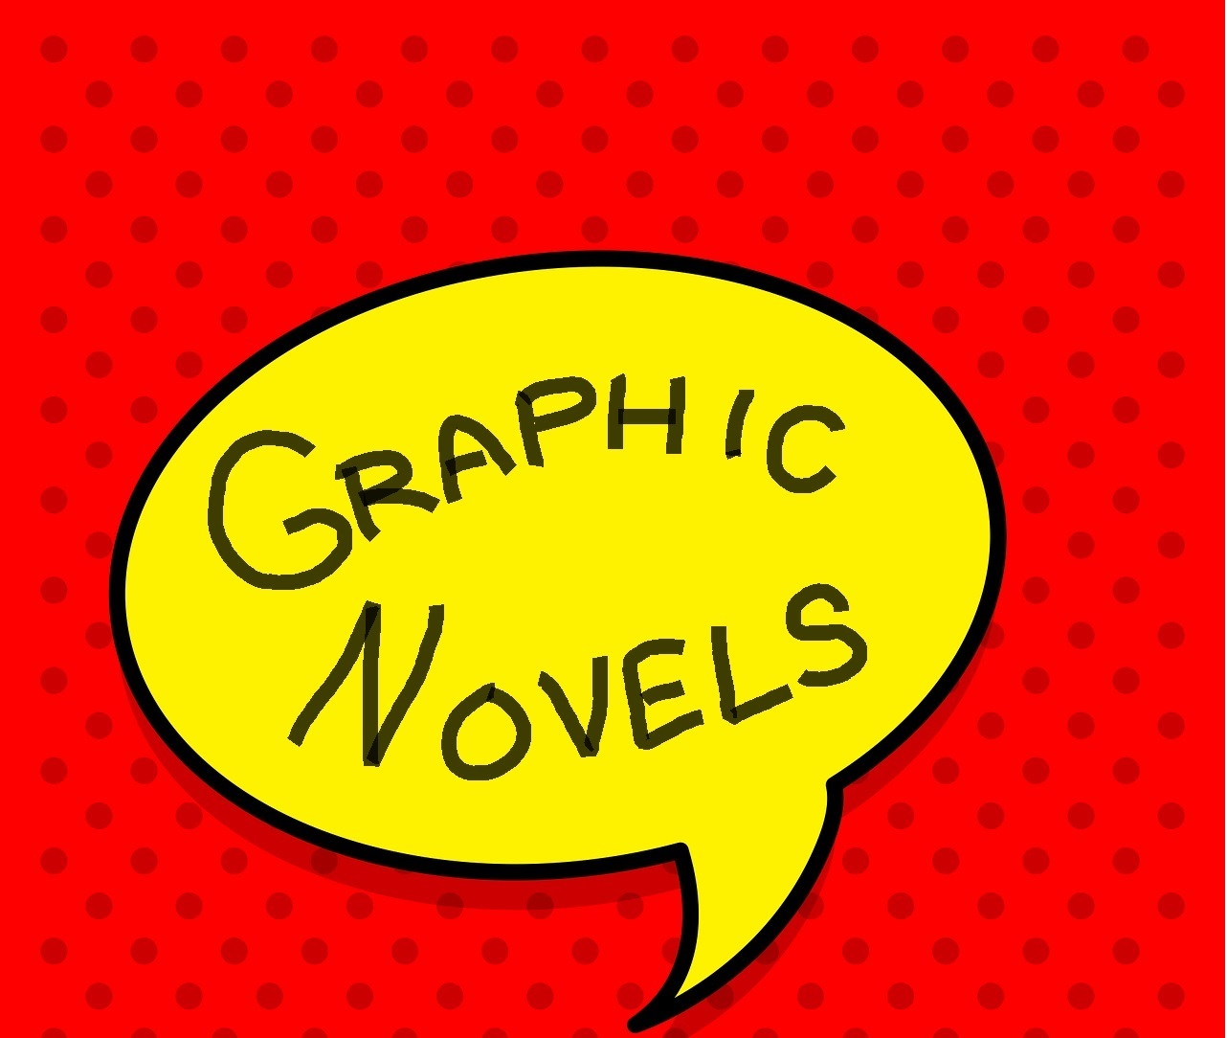

Slide 18
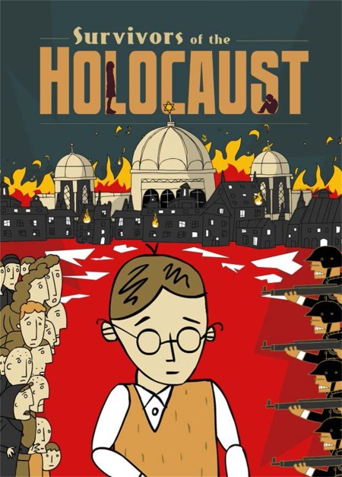
Survivors of the Holocaust by Kath Shakleton
Based on a series of a BAFTA-nominated animated documentaries, the artwork in 'Survivors of the Holocaust' has been reinvented to bring together six different real-life survivors' account of the Holocaust. Every word rings with truth, whether it describes the bleak fear of arriving at Auschwitz or the sheer terror of Kristallnacht, and is complemented by dazzling, clever artwork. This unique children's graphic novel aims to bring the survivors' stories to a new audience. It is an important, timely reminder of the horrors that can be inflicted on innocent people and a reflection of the Holocaust's legacy today.
Suitable for 12+

Slide 19
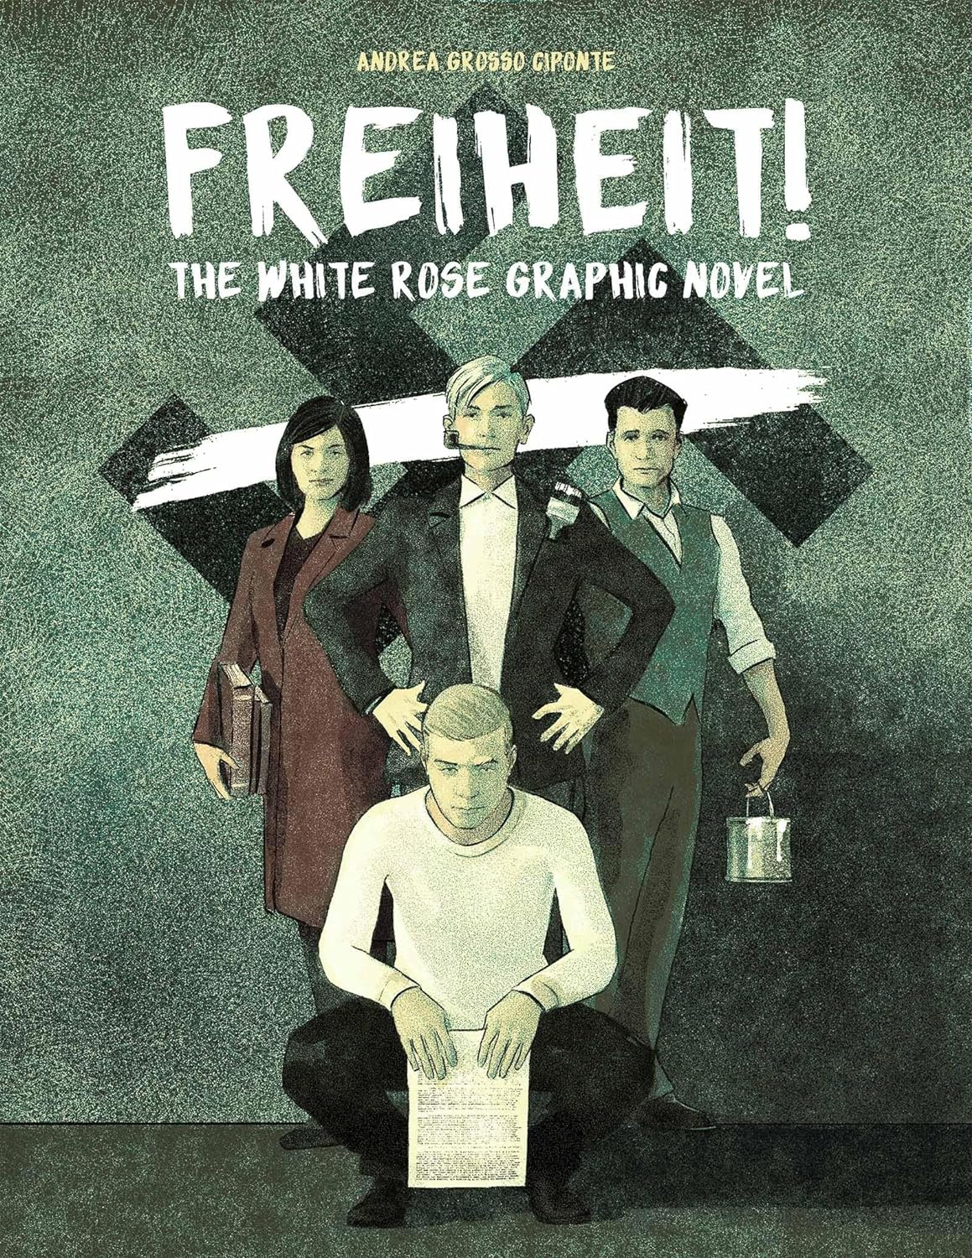
Freiheit! By Andrea Grosso Ciponte
The dramatic true story of a handful of students who resisted the Nazis and paid with their lives, now in a stunning graphic novel.
With an entire nation blindly following an evil leader, where did a handful of students find the courage to resist? The university students who formed the White Rose, an undercover resistance movement in Nazi Germany, knew that doing so could cost them their lives. But some things are worth dying for.
The White Rose printed and distributed leaflets to expose Nazi atrocities and wake up their fellow citizens. The Gestapo caught and executed them. Sophie Scholl was twenty-one; her brother Hans, twenty-four; Christoph Probst, twenty-three; Alexander Schmorell and Willi Graf, twenty-five.
But the White Rose was not silenced. Their heroism continues to inspire new generations of resisters. Now, for the first time, this story that has been celebrated in print and film can be experienced as a graphic novel. Italian artist Andrea Grosso Ciponte’s haunting imagery will resonate with today’s students and activists. The challenges they face may vary, but the need for young people to stand up against evil, whatever the cost, will remain. Suitable for 12+

Slide 20
Alte Zachen ( Old Things) by Ziggy Hanaor and Benjamin Phillips
Bubbe’s relationship with the city is complex & nothing is quite as she remembered it and she feels alienated and angry at the world around her. Benji, on the other hand, looks at the world, and his grandmother, with clear-eyed acceptance. As they wander the city, we catch glimpses of Bubbe’s childhood in Germany, her young adulthood in 1950s Brooklyn, and her relationships; first with a baker called Gershon, and later with successful Joe, Benji’s grandfather. Gradually we piece together snippets of Bubbe’s life, gaining an insight to some of the things that have formed her cantankerous personality. The journey culminates on the Lower East Side in a moving reunion between Rosa and Gershon, her first love. As the sun sets, Benji and his Bubbe walk home over the Williamsburg Bridge to make dinner.
This is a powerful, affecting and deceptively simple story of Jewish identity, of generational divides, of the surmountability of difference and of a restless city and its inhabitants.
Suitable for 12+

Slide 21
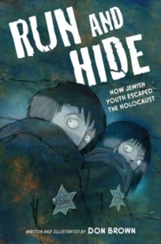
Run and Hide by Don Brown
A gripping nonfiction graphic novel that follows the stories of Jewish children, separated from their parents, who escaped the horrors of the Holocaust.
Unless they could escape, Jewish children would not be spared their deadly fate in the Holocaust, a tragedy of unfathomable depth.
Only 11% of the Jewish children living in Europe before 1939 survived the Second World War. Run and Hide tells the stories of these children, forced to leave their homes and families, as they escaped certain horror.
Suitable for 12+

Slide 23
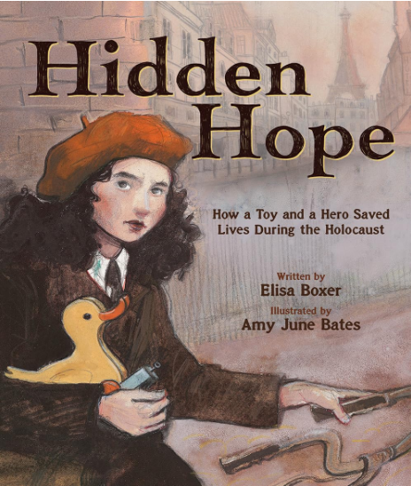
Hidden Hope by Elisa Boxer and Amy June Bates
The remarkable true story of how a toy duck smuggled forged identity papers for Jewish refugees during WWII. During World War II, families all across Europe huddled together in basements, attics, and closets as Nazi soldiers rounded up anyone Jewish. The Star of David, a symbol of faith and pride, became a tool of hate when the Nazis forced Jewish people to carry papers stamped with that star, so that it was clear who to capture. But many brave souls dared to help them. Jewish teenager Jacqueline Gauthier, a member of the French Resistance who had to conceal her identity, was one who risked her life in secret workshops, forging papers with new names and without stars in order to help others escape. But how to get these life-saving papers to families in hiding? An ordinary wooden toy duck held the answer, a hidden compartment: hope in a hollow. Written by award-winning journalist Elisa Boxer and movingly illustrated by the acclaimed Amy June Bates, Hope in a Hollow celebrates the triumph of freedom and the human spirit, a story of everyday heroism, resilience, and finding hope in unexpected places.
Suitable for 8+

Slide 24
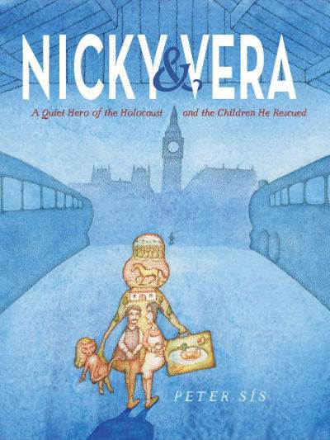
Sís' brilliant and detailed illustrations add an evocative emotional layer to his story of Nicholas Winton, a German-Jewish man living in England who organized the rescue of 699 Jewish children in 1938. Vera was one of those children whose parents decided to send her away on the transport. Nicky's heroism didn't come out into the open until his wife revealed it to the public 50 years later. A stunning book, both visually and emotionally.
Suitable for 7+

Slide 25
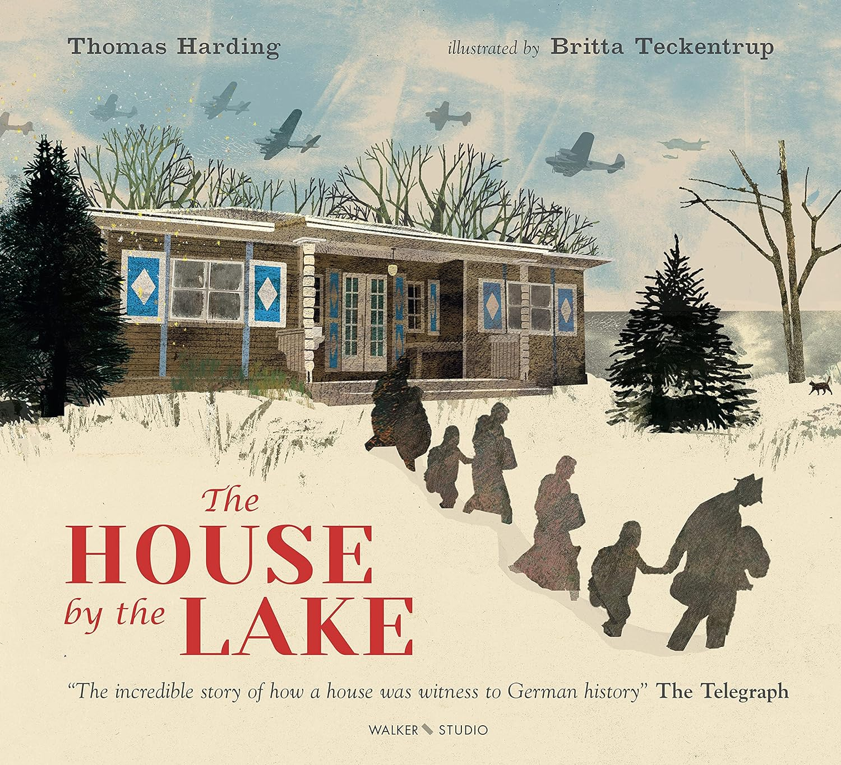
The House by the Lake by Thomas Harding and Britta Teckentrup
A beautiful picture-book adaptation of Thomas Harding's Costa-shortlisted biography for adults, exquisitely illustrated by Britta Teckentrup.
On the outskirts of Berlin, a wooden cottage stands on the shore of a lake. Over the course of a century, this little house played host to a loving Jewish family, a renowned Nazi composer, wartime refugees and a Stasi informant; in that time, a world war came and went, and the Berlin Wall was built a stone's throw from the cottage's back door.
Thomas Harding first shared this remarkable story in his Costa-shortlisted biography The House by the Lake – now he has rendered it into a deeply moving picture-book for young readers. With words that read like a haunting fairy-tale, and magnificent artwork by Britta Teckentrup, this is the astonishing true story of the house by the lake.
Suitable for 8+

Slide 26
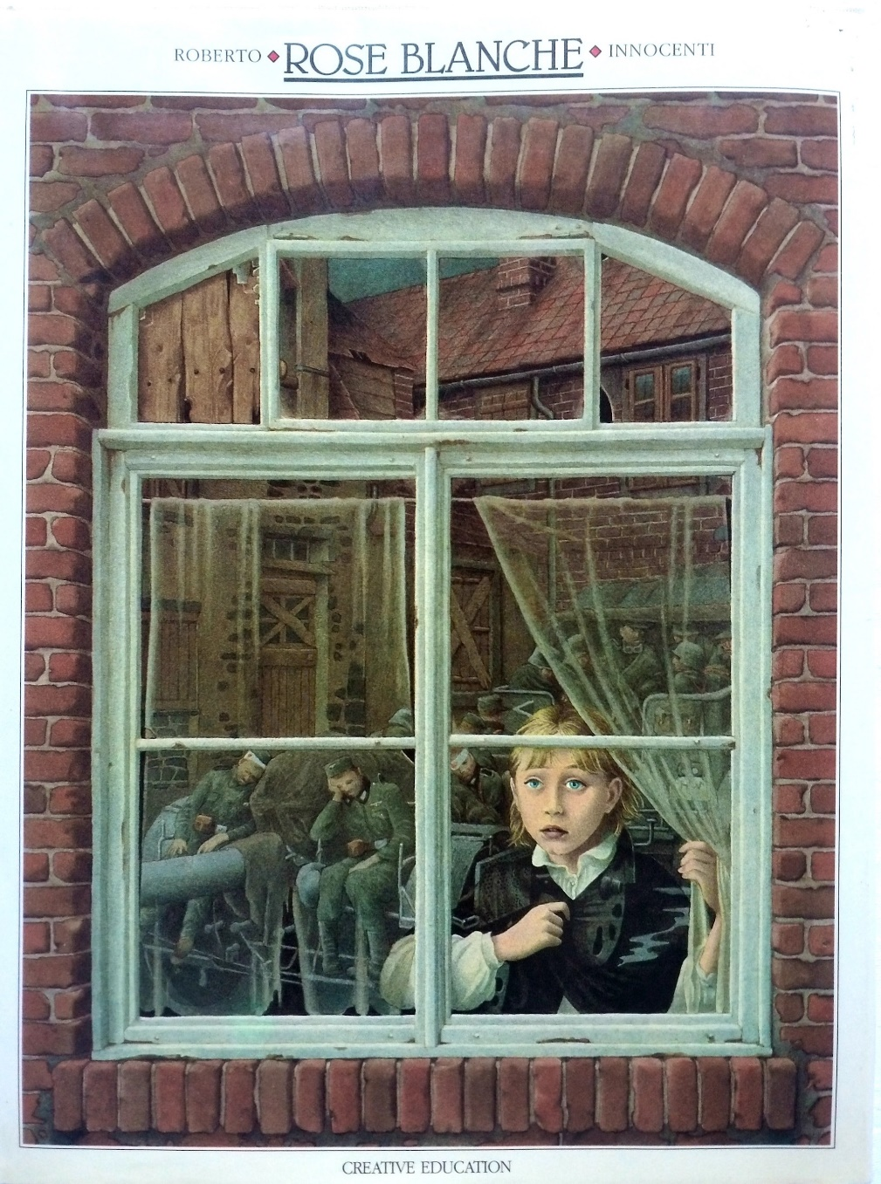
“My name is Rose Blanche. I live in a small town in Germany with narrow streets, old fountains and tall houses with pigeons on the roofs. One day the first truck arrived and many men left. They were dressed as soldiers. Winter was beginning.”
“Rose Blanche” relates the horrors of the Holocaust through the eyes and lived experience of an innocent girl called Rose growing up in a small village in Germany in the 1930s. Rose observes the first signs of the war when soldiers depart for the eastern front. Like most wars, there is an initial groundswell of patriotic optimism, unwavering purpose and a lot of cheering and flag-waving. Good and evil, right and wrong, blame and wrongdoing are clearly delineated in the hearts and minds of those on both sides of the conflict, justifying all manner of irrational and nefarious responses in the name of God and country.
Suitable for Age 12+

