Slide 1
Blurb Better?
Can you re-blurb your book to make it appeal to a wider audience?
Don’t worry if you don’t have the book I have included blurbs in this PP for you to reference.

Slide 2
Blurb- what’s it for?
Make you want to read the book
Give you just enough to intrigue you
Introduce the setting, plot, genre and perhaps a character or two
A NO-SPOILER zone

Slide 3
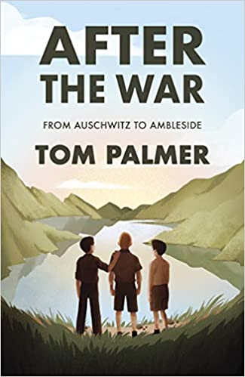
After the War by Tom Palmer
Summer 1945. The Second World War is finally over and Yossi, Leo and Mordecai are among three hundred children who arrive in the English Lake District. Having survived the horrors of the Nazi concentration camps, they've finally reached a place of safety and peace, where they can hopefully begin to recover.
But Yossi is haunted by thoughts of his missing father and disturbed by terrible nightmares. As he waits desperately for news from home, he fears that Mordecai and Leo - the closest thing to family he has left - will move on without him. Will life by the beautiful Lake Windermere be enough to bring hope back into all their lives?
(this blurb talks a lot about the characters and assumes knowledge from the reader about the war – is this the best use of the blurb?)

Slide 4
Are you Watching? by Vincent Ralph
Ten years ago, Jess's mother was murdered by the Magpie Man. She was the first of his victims, but not the last. Now Jess is the star of a YouTube reality series and she's using it to catch the killer once and for all. The whole world is watching her every move. And so is the Magpie Man.
(a very short and sharp blurb – do you think this is effective enough to grab a reader?)

Slide 5
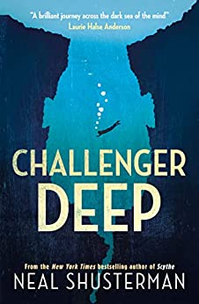
Challenger Deep by Neil Shusterman
Caden Bosch is on a ship that's headed for the deepest point on Earth: Challenger Deep, the southern part of the Marianas Trench. Caden Bosch is a brilliant high school student whose friends are starting to notice his odd behaviour. Caden Bosch is designated the ship's artist in residence to document the journey with images. Caden Bosch pretends to join the school track team but spends his days walking for miles, absorbed by the thoughts in his head. Caden Bosch is split between his allegiance to the captain and the allure of mutiny. Caden Bosch is torn.
( note here that the blurb has used BOLD for the last sentence – you may wish to use this technique in your own example – think why they might have done this and how you can do the same to even better effect)

Slide 6
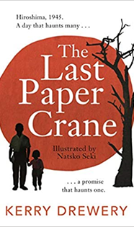
The Last Paper Crane by Kerry Drewery
A Japanese teenager, Mizuki, is worried about her grandfather who is clearly desperately upset about something. He says that he has never got over something that happened in his past and gently Mizuki persuades him to tell her what it is. We are taken to 1945, Hiroshima, and Mizuki's grandfather as a teenage boy chatting at home with his friend Hiro. Moments later the horrific nuclear bomb is dropped on Hiroshima. What follows is a searing account of the blinding flash, the harrowing search for family and the devastation both human and physical. There is also the very moving and human story as the two teenage boys with great bravery search for and find Keiko, Hiro's five-year-old sister. But then Keiko is lost when Mizuki's grandfather has no option but to leave her in a safe place while he goes for help... Despite a desperate search in the aftermath of the bomb, where he leaves origami folded paper cranes for Keiko with his address on everywhere a survivor could be, he cannot find her... A powerful novel that, despite its harrowing subject matter, has hope at its heart.
(There is alot of information in this blurb – is it too long or do we need to set the scene so that readers have a better understanding of the plot?)

Slide 7
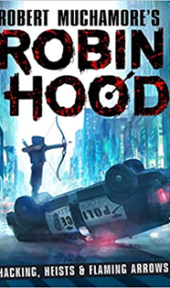
Hacking, Heists & Flaming Arrows by Robert Muchamore
You can't go far without a quick brain and some rule-bending in a place like Locksley. After its vast car plants shut down, the prosperous town has become a wasteland of empty homes, toxic land and families on the brink. And it doesn't help that the authorities are in the clutches of profit-obsessed Sheriff of Nottingham, in cahoots with underworld boss Guy Gisborne. When his dad is framed for a robbery, Robin and his brother Little John are hounded out of Locksley and must learn to survive in the Sherwood forest, stretching three hundred kilometres and sheltering the free spirits and outlaws. But Robin is determined to do more than survive. Small, fast and deadly with a bow, he hatches a plan to join forces with Marion Maid, harness his inimitable tech skills and strike a blow against Gisborne and the Sheriff.
(this is a good sized blurb but does it have too much information? Would a cliff-hanger work better?)

Slide 8
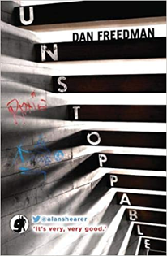
Unstoppable by Dan Freedman
Fourteen-year-old twins, Roxy and Kaine, have only one thing in common. They HATE each other. Kaine is loud, brash and brilliant at football. Roxy is heading for tennis superstardom. When tragedy strikes, their worlds are ripped apart. Can they come together before it's too late?
(Wow, this is what you call a short blurb – is it even long enough to be called a blurb? Is there even enough information to make you want to read? How would you develop it?)

Slide 9
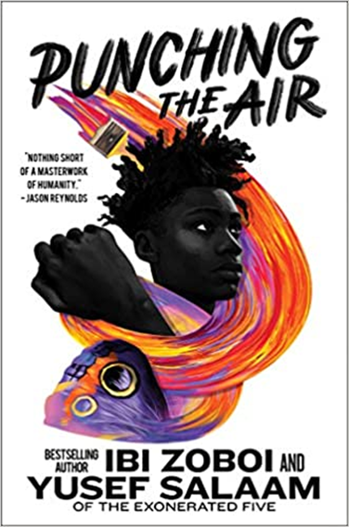
Punching the Air by Ibi Zoboi and Yusef Salaam
One fateful night, an altercation in a gentrifying neighbourhood escalates into tragedy. ‘Boys just being boys’ turns out to be true only when those boys are white. Suddenly, at just sixteen years old, Amal Shahid’s bright future is upended: he is convicted of a crime he didn’t commit and sent to prison. Despair and rage almost sink him until he turns to the refuge of his words, his art. This never should have been his story. But can he change it? With spellbinding lyricism, award-winning author Ibi Zoboi and prison reform activist Yusef Salaam tell a moving and deeply profound story about how one boy is able to maintain his humanity and fight for the truth, in a system designed to strip him of both.
(This is a verse novel so why isn’t the blurb? Could you try?)

Slide 10
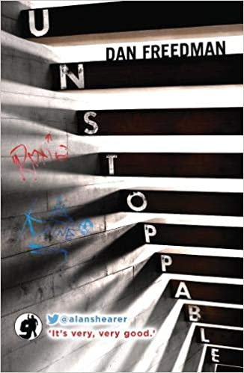
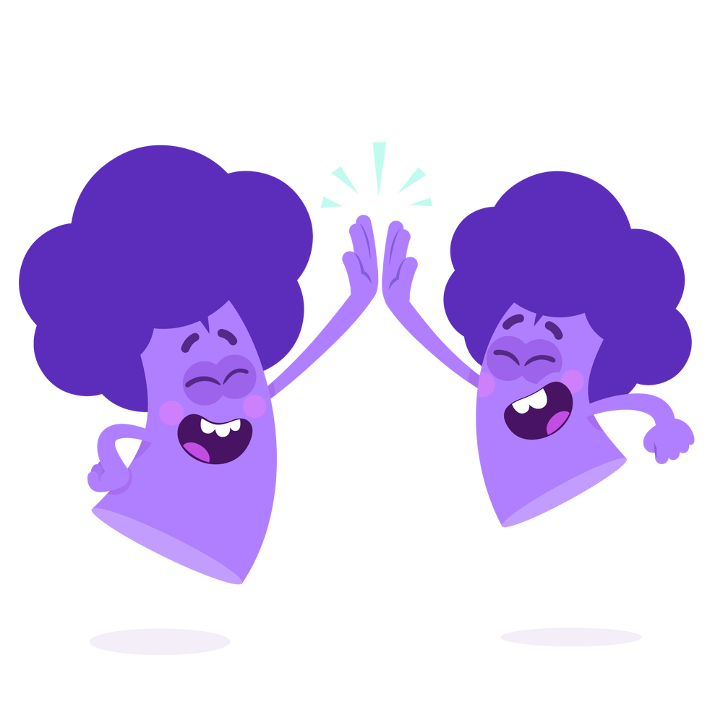
The BookedIn books

