Slide 1
Booked in
Week three – cover story

Slide 2
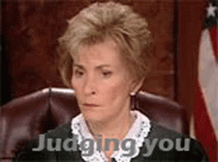
Don’t judge a book by it’s cover
We totally judge books by their covers just as we judge people by their haircuts, shoes and weird hoodies.
How can you improve your Booked In book cover to appeal to a bigger audience and sell even more copies?

Slide 3
Who wore it best?

Slide 4
Make it so
Jump on to Canva
Take a look at your own book cover – what do you like and what would you change?
Using the Canva templates make your own version
Remember to include author and title
Once you are happy with your new version – upload a copy to the Teams site.
Have fun!

Slide 5
Mrs Baird and her bestseller

