Slide 1
Booked In
Week 2 task – words
This task should take you no more than 15 minutes.

Slide 2
Your book needs you!

Slide 3
Word Clouds
Once quick way to get into a topic or book is to create a word cloud. They can also be used as a simple and easy revision tool as well as just looking nice. Word clouds help with pointing out emphasis, help you recognise unusual words and improve vocabulary.
Here is how they work – you create a list of words or grab a bunch of text throw them into the software and out pops a cloud.

Slide 4
Your task
Do a search for a word cloud creator – I use EdWordl but there are lots out there – make sure it is free and don’t sign up to anything!
If you don’t have your book then go in to Amazon (other bookshops are available) and find your book –make sure it is in English! ( if you do have your book you can skip this bit and jump in again at the Fe, Fi, Fo, Fum section )

Slide 5
Click on the button and find the first page of text.
As this material is copyright – as it should author’s deserve to be paid for their work! – I want you type up the first few lines – the more you add the better your word cloud. There is no need to add in punctuation just the words. Save your text!

Slide 6
Save it
You can have a bit of fun at this point with changing colour and size and editing some of the words. You can even sneak your own name in here.
As with your postermywall.com task you will have to print screen and then then crop and save on a publisher document.
Save your document as BookedIn Wordle and upload it to our BookedIn section of teams!

Slide 7
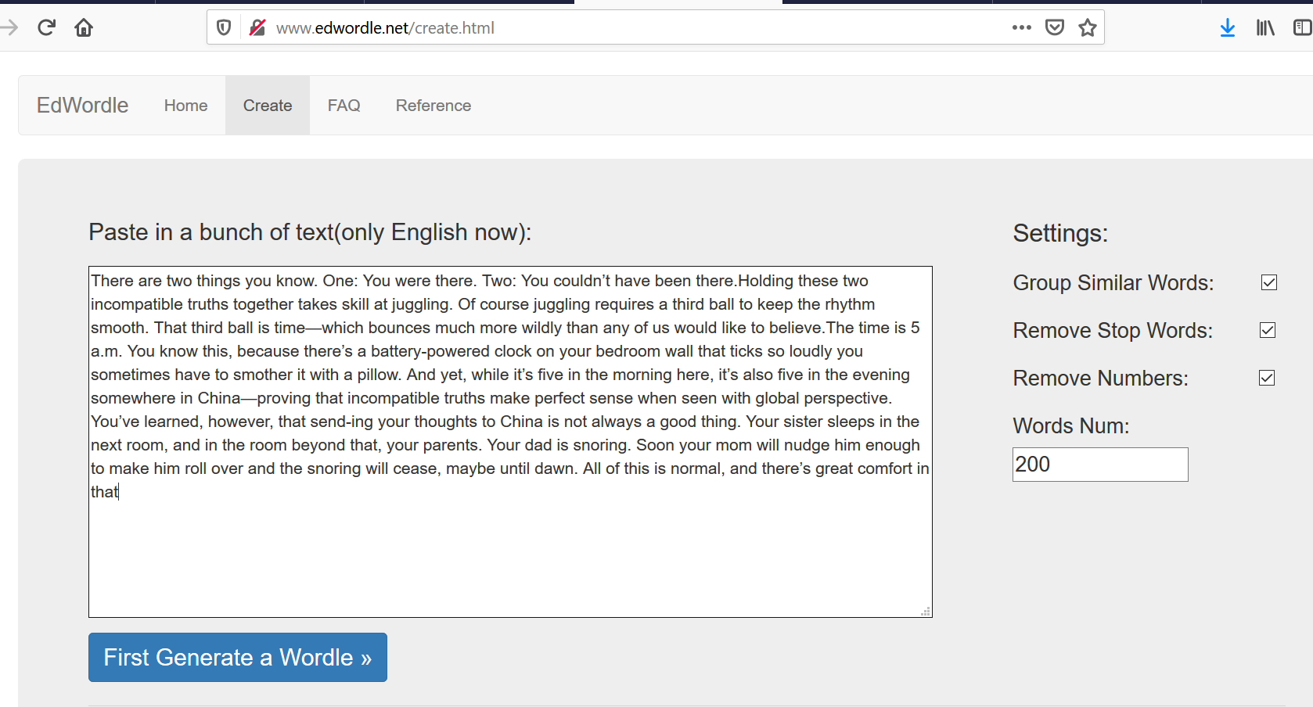
Get pasting!
Paste your copied text into your word cloud maker and click generate or go or engage or whatever your software tells you to.
I changed my words number because I am showing off

Slide 8
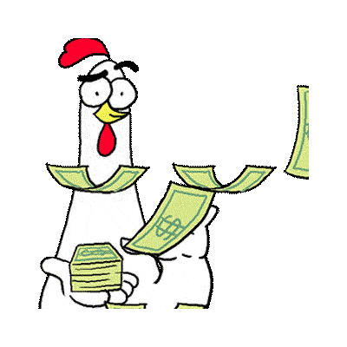
Ta daaaaa!
Wow! Not sure what happened to mine but I look forward to seeing yours.
I you enjoyed this task why not look up how word clouds can help you with reading and studying online or get in touch.
Next time - puppies

