Slide 1
Booked In
Get creative

Slide 2
Postermywall.com
Take a look at the author posters on the booked in Teams page
Go to postermywall.com and create your own poster promoting the booked in scheme
This should take you no more than 30 mins

Slide 3
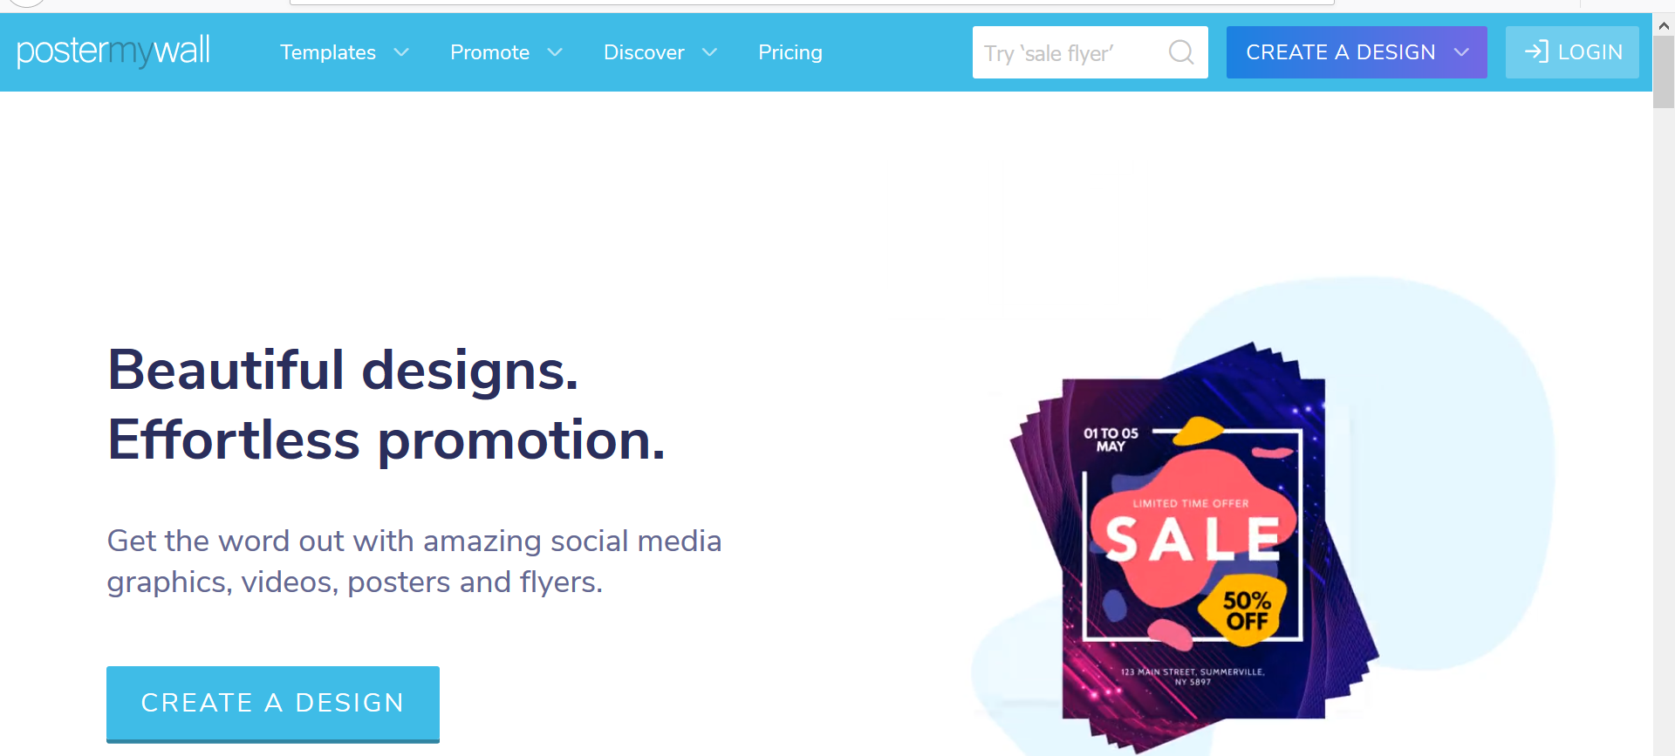
How to… PosterMyWall
Firstly – don’t log in to postermywall.com
Always ask yourself when looking at a new site.
Do they really need my information?
In this case – nope they don’t.
Use the search option at the top of the page if you know what style or genre (tell me you didn’t hear that in my voice!) you want to use, or just take a wee wander through some of the options to see what is available – there’s lots. One warning, don’t use an animated option!

Slide 4
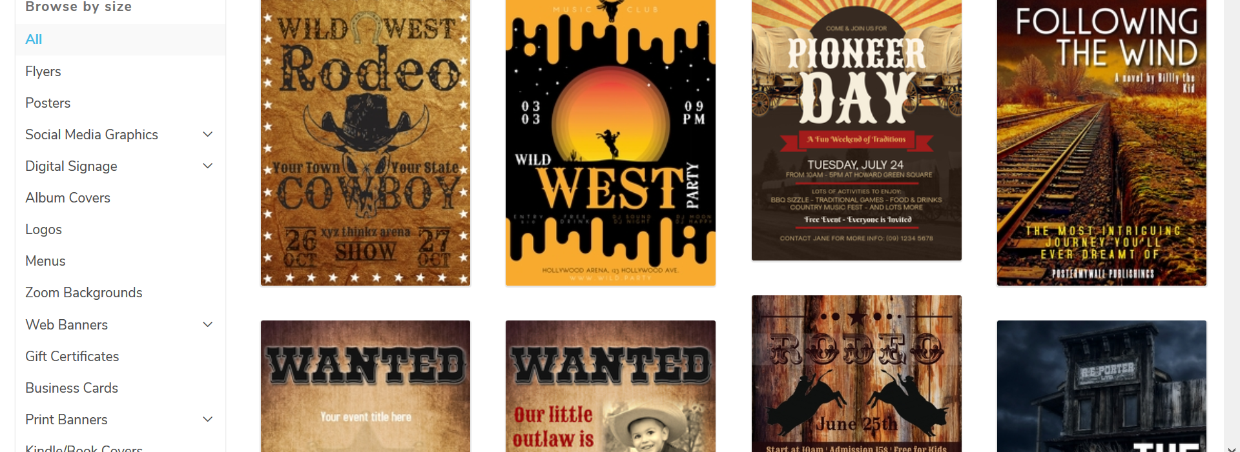
Walk through or should I say mosey?
My search term was WILD WEST
And this was my results
You can see options down the right hand side – pick posters
This will reduce the options and give you
More suitable templates to work with.

Slide 5
Make your selection
I chose a nice simple template.
If you are happy with how it looks then click on the blue box

Slide 6
Fun and Games
You will then end up with your poster as a customisable template.
Think about what you want to say and emphasise.
Any images you wish to add must be from your personal drive – so make sure that you have them to hand – cut and paste doesn’t work here.
Use the buttons left and right to change the text and it’s colour and size.

Slide 7
What are you saying?
The poster should include the name of the scheme – Booked In
Emphasise the positives – new books, free choice, reading with a group, teacher input and support, positive attitudes towards fiction and time to relax with a great read.
You can add in anything else that you think might encourage pupils to take part.
Mrs. Baird’s amazing talks for example?

Slide 8
Useful tips
One of the most annoying things about poster my wall it that text and images move about .
To stop that use the LOCK IN PLACE option.
To do this highlight what you want fixed and at the left hand side you will see this option.
Just use the slider and your text or image will be fixed.
You may need to scroll down to find this option.

Slide 9
Getting the best lay out
Less is more for a poster
Make your point and make it bold.
We want people to stop and get information in 20 seconds not 20 minutes.
Choose your fonts and pictures to match the style of your poster.
Get someone else to look at it before you finish – do they know what you are trying to say? Would they want to join?

Slide 10
Nearly Done
Happy with your final product?
Click on print screen on your own keyboard – usually at the right-hand side and abbreviated.
Open up a publisher document and paste the image – ctr V, or right click paste using your mouse.
Using the crop tool (double click on your image) and edit your poster to fit your page.

Slide 11
Last hurdle
Save your publisher document – call it Booked In.
Upload your document to the Teams shared area.
The best ones might be used for the next group.
Feel proud of yourself and have a cup of tea and a biscuit.
And yes, in case you were wondering, Mrs Baird did find the stickers option on PowerPoint and put in far too many irrelevant cats. Next time it may be chickens|!

