Slide 1
Social Subjects
Ø Free at Last
Ø Making of Modern Britain
Ø Migration and Empire

Slide 2
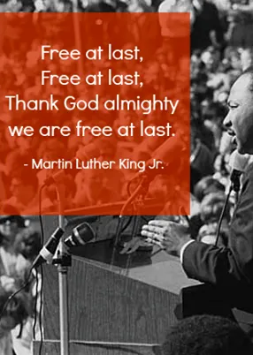
Free at last- civil rights and the American dream

Slide 3
Scottsboro: a novel Feldman, Ellen, 1941-
Set in the 1930s South, this novel of race and class turns on the awful power of a lie. Intertwining real figures from history with fictional characters, the novel offers an account of the infamous Scottsboro case, when a group of black youths were accused of raping two white girls. Don’t read To Kill A Mockingbird read this. Watch this documentary for additional information.

Slide 4
The help Stockett, Kathryn
Aibileen is a black maid, raising her 17th white child, but with a bitter heart after the death of her son. Minny is the sassiest woman in Mississippi. Skeeter is a white woman with a degree but no ring on her finger. Seemingly as different as can be, these women will come together for a clandestine project that will put them all at risk. There is also a movie.

Slide 5
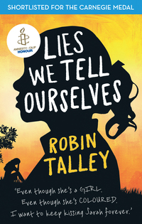
Lies we tell ourselves Talley, Robin, author
In 1959 Virginia, the lives of two girls on opposite sides of the battle for civil rights will be changed forever. Sarah Dunbar is one of the first black students to attend the previously all-white Jefferson High School. Linda Hairston is the daughter of one of the town's most vocal opponents of school integration. She has been taught all her life that the races should be kept 'separate but equal.' Forced to work together on a school project, Sarah and Linda must confront harsh truths about race, power and how they really feel about one another- this is such a good book, I wish more pupils would read it.

Slide 6
The Undefeated by Kwame alexander and kadir nelson
Originally performed for ESPN's 'The Undefeated', this poem is a love letter to black life in the United States. It highlights the unspeakable trauma of slavery, the faith and fire of the civil rights movement, and the grit, passion, and perseverance of some of the world's greatest heroes. The text is also peppered with references to the words of Martin Luther King, Jr., Langston Hughes, Gwendolyn Brooks, and others, offering deeper insights into the accomplishments of the past, while bringing stark attention to the endurance and spirit of those surviving and thriving in the present.
Hear Kwame himself on a recent-ish visit to Glasgow.

Slide 7
To kill a mockingbird Fordham, Fred, 1985- author, artist; Lee, Harper
'Shoot all the bluejays you want, if you can hit `em, but remember it's a sin to kill a mockingbird.' A haunting portrait of race and class, innocence and injustice, hypocrisy and heroism, tradition and transformation in the Deep South of the 1930s, Harper Lee's 'To Kill a Mockingbird' remains as important today as it was upon its initial publication in 1960, during the turbulent years of the Civil Rights movement. Now, this most beloved and acclaimed novel is reborn for a new age as a gorgeous graphic novel. Scout, Jem, Boo Radley, Atticus Finch and the small town of Maycomb, Alabama, are all captured in vivid and moving illustrations by artist Fred Fordham. Oh OK you can read it but this is the graphic novel and beautiful.

Slide 8
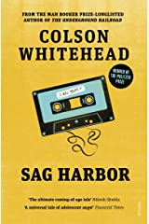
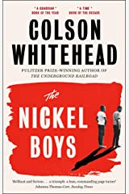
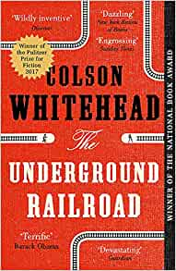
Author profile – colson whitehead
Elwood Curtis has taken the words of Dr Martin Luther King to heart: he is as good as anyone. Abandoned by his parents, brought up by his loving, strict and clear-sighted grandmother, Elwood is about to enroll in the local black college. But given the time and the place, one innocent mistake is enough to destroy his future, and so Elwood arrives at The Nickel Academy, which claims to provide 'physical, intellectual and moral training' which will equip its inmates to become 'honorable and honest men'. In reality, it is a chamber of horrors. Stunned to find himself in this vicious environment, Elwood tries to hold on to Dr King's ringing assertion, 'Throw us in jail, and we will still love you.' But Elwood's fellow inmate and new friend Turner thinks Elwood is naive and worse; the world is crooked, and the only way to survive is to emulate the cruelty and cynicism of their oppressors.The tension between Elwood's idealism and Turner's skepticism leads to a decision which will have decades-long repercussions. Based on the history of a real reform school in Florida that operated for one hundred and eleven years and warped and destroyed the lives of thousands of children, The Nickel Boys is a devastating, driven narrative by a great American novelist whose work is essential to understanding the current reality of the United States. This contains brutal and mature content. Hear an interview with Colson here.

Slide 9
Making of modern Britain- 1880 1951

Slide 10
Whisper My Name by Jane Eagland
Since she was twelve, Meriel Garland has lived with her grandfather in London, exiled from her beloved India following the death of her mother. Now sixteen, Meriel chafes against the strict regime of tests and study that her grandfather imposes on her. Escaping, she discovers a world outside her narrow existence - one that promises admiration for her acting skills, social success and the excitement of seances. But what should have been a game turns serious as the young medium Sophie Casson passes on a message from Meriel's dead mother - and Meriel begins to suspect she might not be alone in the world after all. In searching for the truth about her past, Meriel uncovers a sinister scheme - and soon it's hard to know who she can really trust.
A great fun read about the obsession with spiritualism heading up to the turn of the century. Reminds me of the Cottingly Fairies scam.

Slide 11
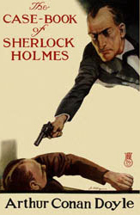
The Casebook of sherlock holmes by Arthur conan doyle
The Case-Book of Sherlock Holmes is the final set of twelve Sherlock Holmes short stories by Arthur Conan Doyle first published in the Strand Magazine between October 1921 and April 1927. You may not think this will help with your history but you would be wrong – the characters are reflective of a class divided society and the detecting, of the changes in scientific discoveries and attitudes. Supposedly reading the Sherlock Holmes stories help you become more organised as you begin to think logically like Holmes. Listen to the whole thing here for free – read by Christopher Lee – bliss!

Slide 12
Brave new world by Aldous huxley
In Huxley's premonition, there is no war or poverty, no illness or unhappiness and certainly no human ugliness. Humans, now, are bred in test-tubes, organised into a pre-ordained caste system and doped into compliance with a drug called 'soma'. Limitless consumerism keeps the populace addicted to desire while enforced promiscuity puts paid to sexual frustration. Only Bernard Marx wants out of this engineered utopia and his attempt to do so sets off a series of events that threaten to shake the new world by its knees. Ignore the terrible recent remake – canned after one series. Check this out instead.
'Words can be like x-rays if you use them properly,' says one character. 'They’ll go through anything. You read and you’re pierced.'

Slide 13
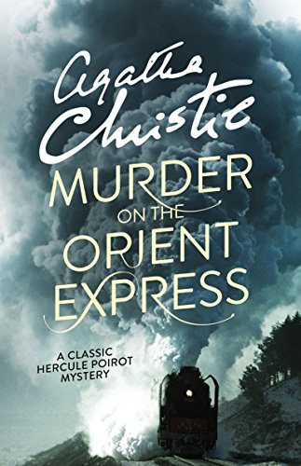
Murder on the orient express by agatha christie
Just after midnight, a snowdrift stops the Orient Express in its tracks. The luxurious train is surprisingly full for the time of the year, but by the morning it is one passenger fewer. An American tycoon lies dead in his compartment, stabbed a dozen times, his door locked from the inside. Isolated and with a killer in their midst, detective Hercule Poirot must identify the murderer – in case he or she decides to strike again. Reflecting attitudes to wards class and power this is a fun and super easy read – can you guess whodunnit?

Slide 14
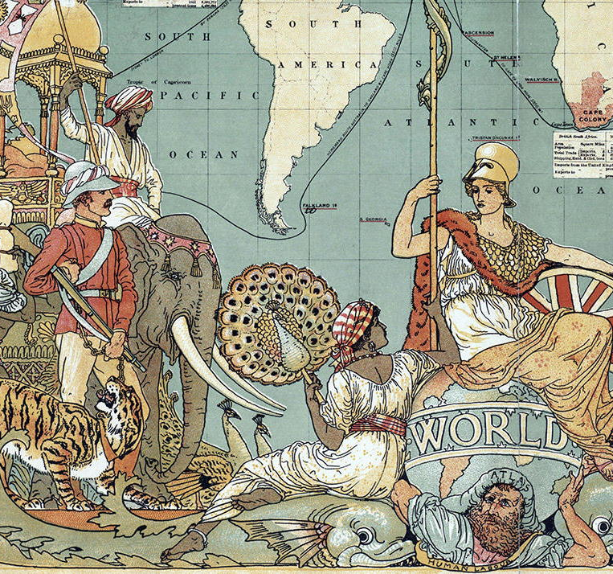
Migration and empire

Slide 15
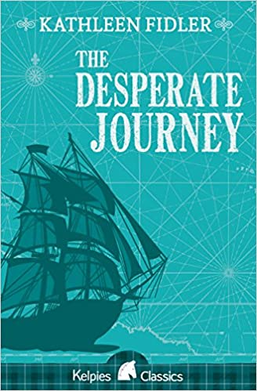
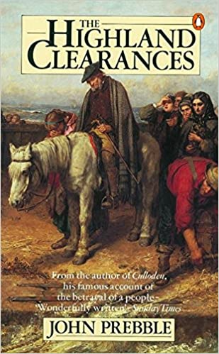
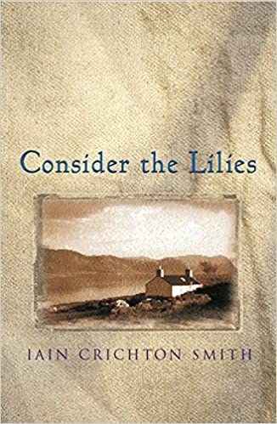
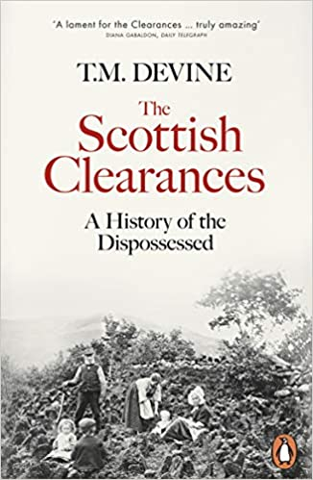
The highland clearances

Slide 16
City of ghosts by bali rai
It's 1919 and Amritsar is a city on the brink of rebellion. Riots, violence and tension spill onto the streets. Bissen Singh fought bravely for the British Empire during World War One. Now he waits patiently for news from England.
This is such a powerful and evocative book.
Learn more about the battle here.

Slide 17
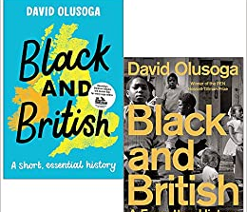
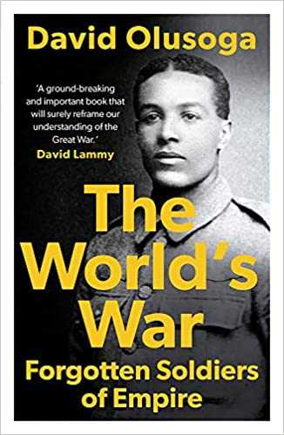
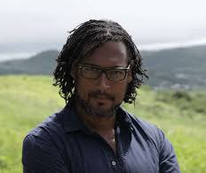
Historian focus: David olusoga
“Our national history cannot be national if, in the near future, one in three young adults feels their stories remain untold, if this country's long global history of empire and interconnections is marginalised and if the historical reality of race is rendered almost invisible.”
David Olusoga
A great wee half hour with – Simon Schama, Mary Beard, Janina Ramirez and David Olusoga watch it here.

Slide 18
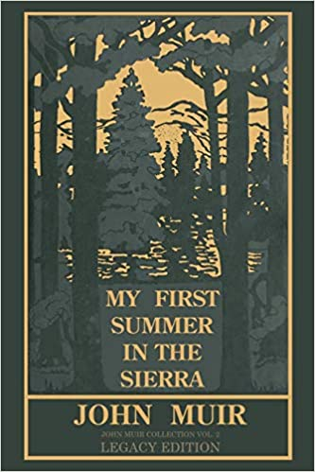
My first summer in the sierra by john muir
In the summer of 1869, John Muir, a young Scottish immigrant, joined a crew of shepherds in the foothills of California's Sierra Nevada Mountains. The diary he kept while tending sheep formed the heart of this book and eventually lured thousands of Americans to visit Yosemite country.First published in 1911, My First Summer in the Sierra incorporates the lyrical accounts and sketches he produced during his four-month stay in the Yosemite River Valley and the High Sierra. His record tracks that memorable experience, describing in picturesque terms the majestic vistas, flora and fauna, and other breathtaking natural wonders of the area. Today, Muir is recognized as one of the most important and influential naturalists and nature writers in America. Great wee video here all about John and his work.

Slide 19
Nat 5 History
Many of the slides have links to other useful resources – take the time to have a wee wander.
If there are any other topics you would like me to suggest books for, let me know.
If there are any other books you would like added in, just get in contact.
I hop you find this of use, take care,
Mrs Baird

