Slide 1
Female Voices
Fiction, non-fiction and more…

Slide 2
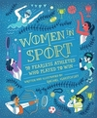
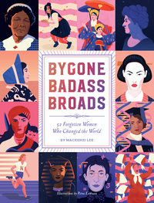
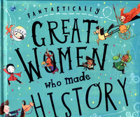
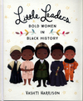
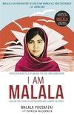
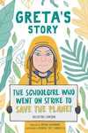
Non-fiction titles

Slide 3
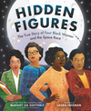
Dorothy Vaughan, Mary Jackson, Katherine Johnson, and Christine Darden were good at math…really good. They participated in some of NASA's greatest successes, like providing the calculations for America's first journeys into space. And they did so during a time when being black and a woman limited what they could do. But they worked hard. They persisted. And they used their genius minds to change the world.
HIDDEN FIGURES
Watch the trailer here

Slide 4
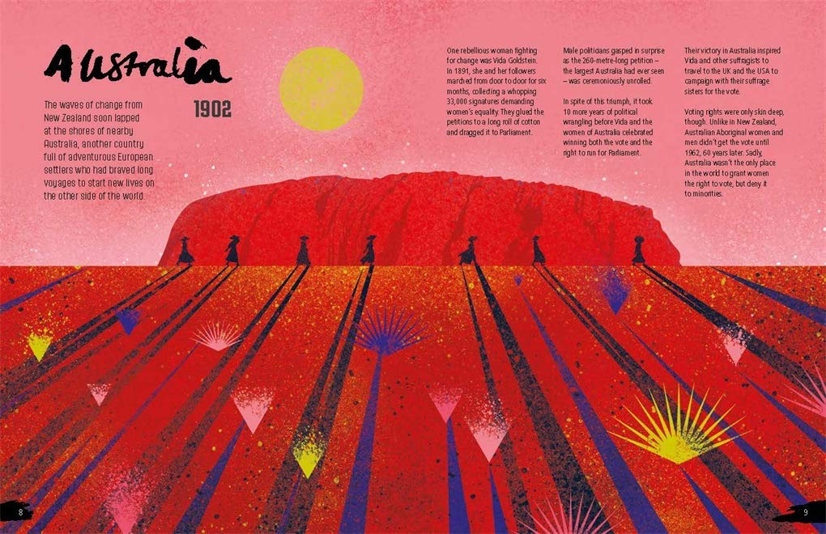
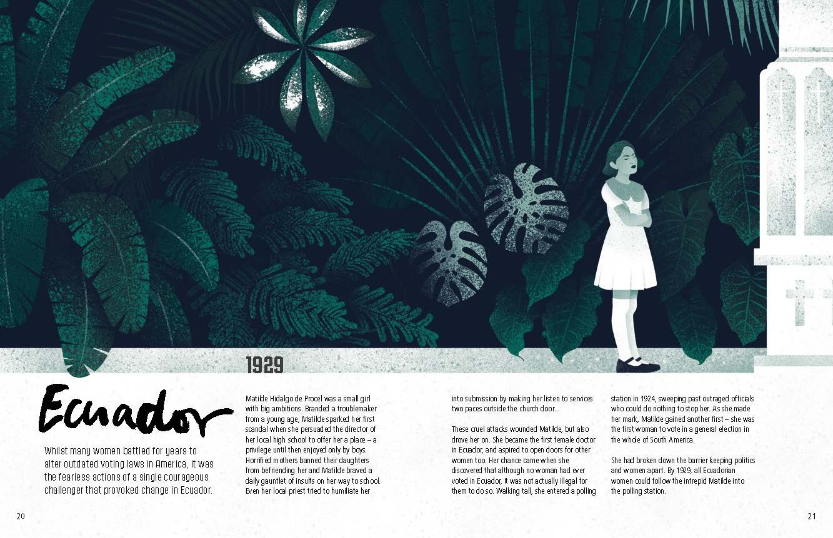
Rebel Voices by Louise Kay Stewart (Author), Eve Lloyd Knight (Illustrator)
The book shares the story of the suffragettes, and of their sisters campaigning for equal rights globally. Discover how 40,000 Russian women marched through St Petersburg demanding their rights, one Canadian woman changed opinions with a play, and Kuwaiti women protested via text message. And read how women climbed mountains, walked a lion through the streets of Paris, and starved themselves, all in the name of having a voice and a choice. Tracing its history from New Zealand at the end of the 19th century, follow this empowering movement as it spread from Oceania to Europe and the Americas, then Africa and Asia up to the present day. And be inspired by the brave women who rioted, rallied and refused to give up. Stunningly illustrated by Eve Lloyd Knight, this book celebrates the women who stood up, spoke up, and refused to behave, rebelling against convention to give women everywhere a voice. And it shows what can be achieved when women stand together, and say enough. This book is big, bold and beautiful.

Slide 5
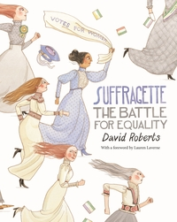
Read together- the suffragette movement

Slide 6
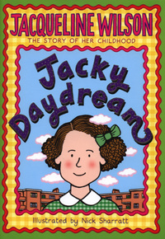
She has sold over ten million books, which have been translated into over 30 languages.
Lots of Jacqueline Wilson's characters .re well-known and well-loved by thousands of readers: Hetty Feather, Ruby and Garnet, Pearl and Jodie, Elsa, Lily and, of course, the brilliant Tracy Beaker! But how much do you know about Jacqueline herself? Jacqueline takes a look back at her own childhood and teenage years in this captivating story of friendships, loneliness, books, family life and much more. She explores her past with the same warmth and lightness of touch that make her novels so special. Best of all, she reveals how she was always determined to be a writer; from the very first story she wrote, it was clear that this little girl had a very vivid imagination! But who would've guessed that she would grow up to be the mega-bestselling, award-winning Jacqueline Wilson? With original photographs and new illustrations by Nick Sharratt, this book is a delight for all of Jacky's fans, and a treat for any new readers too.

Slide 7
Courage to Soar – Simone Biles
Simone Biles' entrance into the world of gymnastics may have started on a daycare field trip in her hometown of Spring, Texas, but her God-given talent, passion, and perseverance have made her one of the top gymnasts in the world, as well as a four-time winner of Olympic gold in Rio de Janeiro. But there is more to Simone than the 19 medals - 14 of them gold - and the Olympic successes. Through years of hard work and determination, she has relied on her faith and family to stay focused and positive, while having fun competing at the highest level and doing what she loves. Here, in her own words, Simone takes you through the events, challenges, and trials that carried her from an early childhood in foster care to a coveted spot on the 2016 Olympic team. Along the way, Simone shares the details of her inspiring personal story.
Watch the routine I taught her here. ( this may be fib)

Slide 8
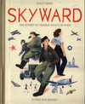
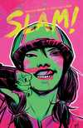
Illustrated books
From roller derby to pilots in WW2 we have lots of brilliant fiction and non-fiction titles for you to enjoy.
Read something and would recommend it for the library? Drop me an email and I will see what I can do.

Slide 9
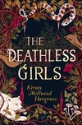
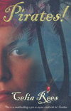
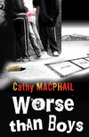
Fiction – pirates and vampires and witches and bullies and brides and more

Slide 11
Who Runs the World? by Virginia Bergin
Welcome to the Matriarchy. 60 years after a virus has wiped out almost all the men on the planet, things are pretty much just as you would imagine a world run by women might be: war has ended; greed is not tolerated; the ecological needs of the planet are always put first. In two generations, the female population has grieved, pulled together and moved on, and life really is pretty good - if you're a girl. It's not so great if you're a boy, but 14 year-old River wouldn't know that. Until she met Mason, she thought they were extinct! Can you imagine the school being only girls and female teachers?

Slide 12
Moxie by Jennifer Mathieu
Vivian Carter is fed up. Fed up with her high school teachers who think the football team can do no wrong. Fed up with sexist dress codes, hallway harassment and gross comments from guys during class. But most of all, Viv Carter is fed up with always following the rules. Viv's mum was a tough-as-nails, punk rock Riot Grrrl in the '90s, and now Viv takes a page from her mother's past and creates Moxie, a feminist zine that she distributes anonymously to her classmates. She's just blowing off steam, but other girls respond and spread the Moxie message. As Viv forges friendships with other young women across the divides of cliques and popularity rankings, she realises that what she has started is nothing short of a girl revolution.

Slide 13
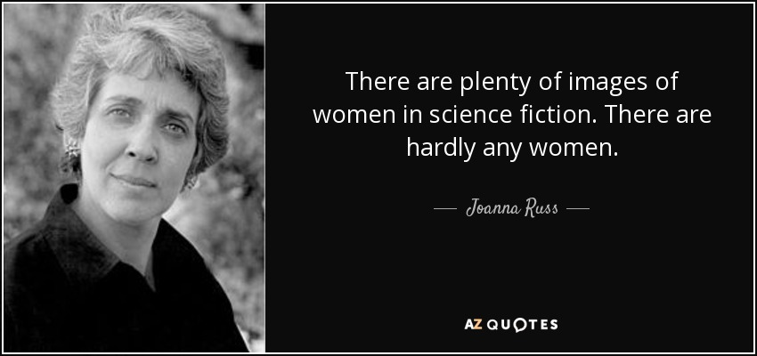
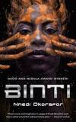
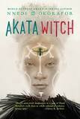
In adult sci-fi female authors number 15% of total in YA it’s closer to 60%.

Slide 14
Education
EVIDENCE – OUT OF SCHOOL CHILDREN
Girls are more likely to never enter primary school than boys.
Less than 40% of countries provide girls and boys with equal access to education. Only 39% of countries have equal proportions of boys and girls enrolled in secondary education.
54 million of the 76 million illiterate young women live in only 9 countries: http://www.uis.unesco.org/literacy/Documents/Intl-literacy-day/literacy-infographic-2013-en.pdf
Despite all international and national efforts, over half of children out of school are girls. 31 million girls are still out of school around the world. http://www.uis.unesco.org/literacy/Documents/Intl-literacy-day/literacy-infographic-2013-en.pdf

Slide 16
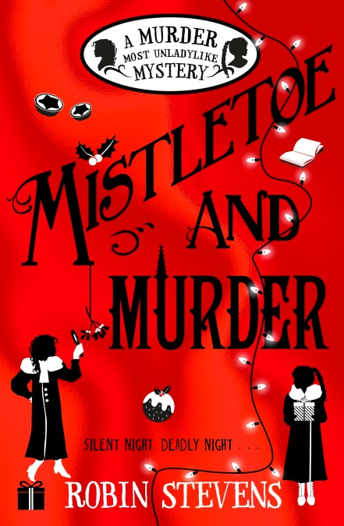
‘I don’t like to see girls wasting their talents. You are both clever, that I can see. And if you have brains, you ought to use them. It isn’t good for women to be ignored and sidelined.’
Aunt Eustacia, Mistletoe and Murder by Robin Stevens

