Slide 1
Environmental Activism
Fiction, non-fiction and more.

Slide 2
Resources- fiction – including clifi non-fiction – people and action illustrated books – the power of the picture and a sneaky wee song!

Slide 3
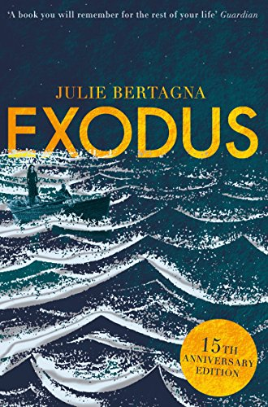
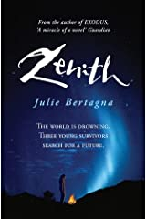
It is 2099 - and the world is gradually drowning, as mighty Arctic ice floes melt, the seas rise and land disappears forever beneath storm-tossed waves. For fifteen-year-old Mara, her family and community, huddled on the fast-disappearing island of Wing, the new century brings flight. Packed into tiny boats, a terrifying journey begins to a bizarre city that rises into the sky, built on the drowned remains of the ancient city of Glasgow. But even here there is no safety and, shut out of the city, Mara realizes they are asylum-seekers in a world torn between high-tech wizardry and the most primitive injustice. To save her people, Mara must not only find a way into the city, but also search for a new land and a new home . . .
Noisy interview at the festival

Slide 4
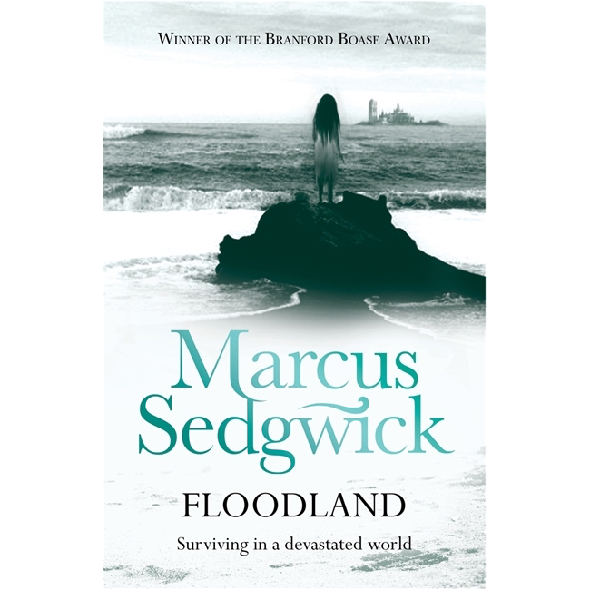
Imagine that a few years from now England is covered by water, and Norwich is an island.
Zoe, left behind in the confusion when her parents escaped, survives there as best she can. Alone and desperate among marauding gangs, she manages to dig a derelict boat out of the mud and gets away to Eels Island. But Eels Island, whose raggle-taggle inhabitants are dominated by the strange boy Dooby, is full of danger too.
The belief that she will one day find her parents spurs Zoe on to a dramatic escape in a story of courage and determination that is handled with warmth and humanity. A great short novel and thanks to the author you can hear the whole story here – read by him.

Slide 5
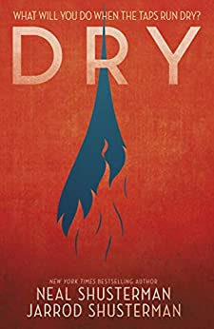
OK enough about flooding what about the opposite – drought?
The drought – or the Tap-Out, as everyone calls it – has been going on for a while now. Everyone’s lives have become an endless list of don’ts: don’t water the lawn, don’t fill up your pool, don’t take long showers. Until the taps run dry. Suddenly, Alyssa’s quiet suburban street spirals into a warzone of desperation; neighbours and families turned against each other on the hunt for water. And when her parents don’t return and her life – and the life of her brother – is threatened, Alyssa has to make impossible choices if she’s going to survive.
This is a brilliant thriller with a huge twist you will not see coming – honesty make sure you have a drink beside you when you red this as it genuinely makes you thirsty!

Slide 6
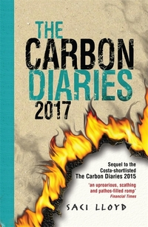
“Imagine a world where carbon dioxide is rationed”
It's January 1st, 2015, and the UK is the first nation to introduce carbon dioxide rationing in a drastic bid to combat climate change. As her family spirals out of control, Laura Brown chronicles the first year of rationing with scathing abandon.
Hear an extract.
It's 2017 and London is a city on the edge, fighting for survival in the new carbon rationing era. As ever, Laura Brown is right on the front line, charting events with acerbic wit as Europe descends into student revolt, strikes and a bitter water war

Slide 7
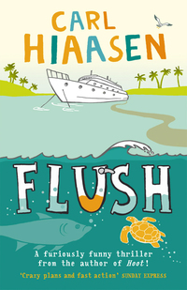
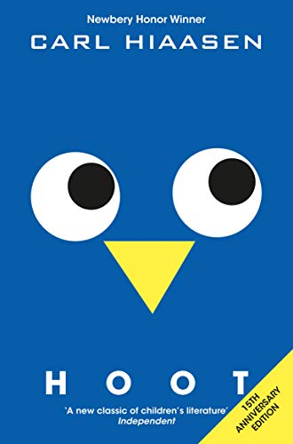
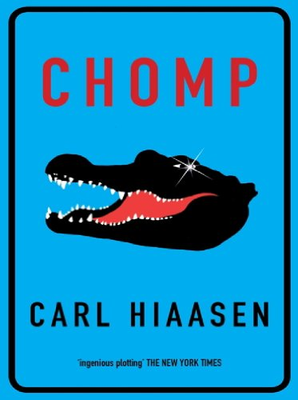
Carl Hiasson-
born and raised in Florida. After graduating from the University of Florida, he joined the Miami Herald as a general assignment reporter and went on to work for the newspaper’s weekly magazine and prize-winning investigations team. As a journalist and author, Carl has spent most of his life advocating for the protection of the Florida Everglades. He and his family live in southern Florida.
Endangered animals
Eco activists
Animal Protection
Pollution
Saving Owls

Slide 8
Books

Slide 9
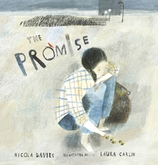
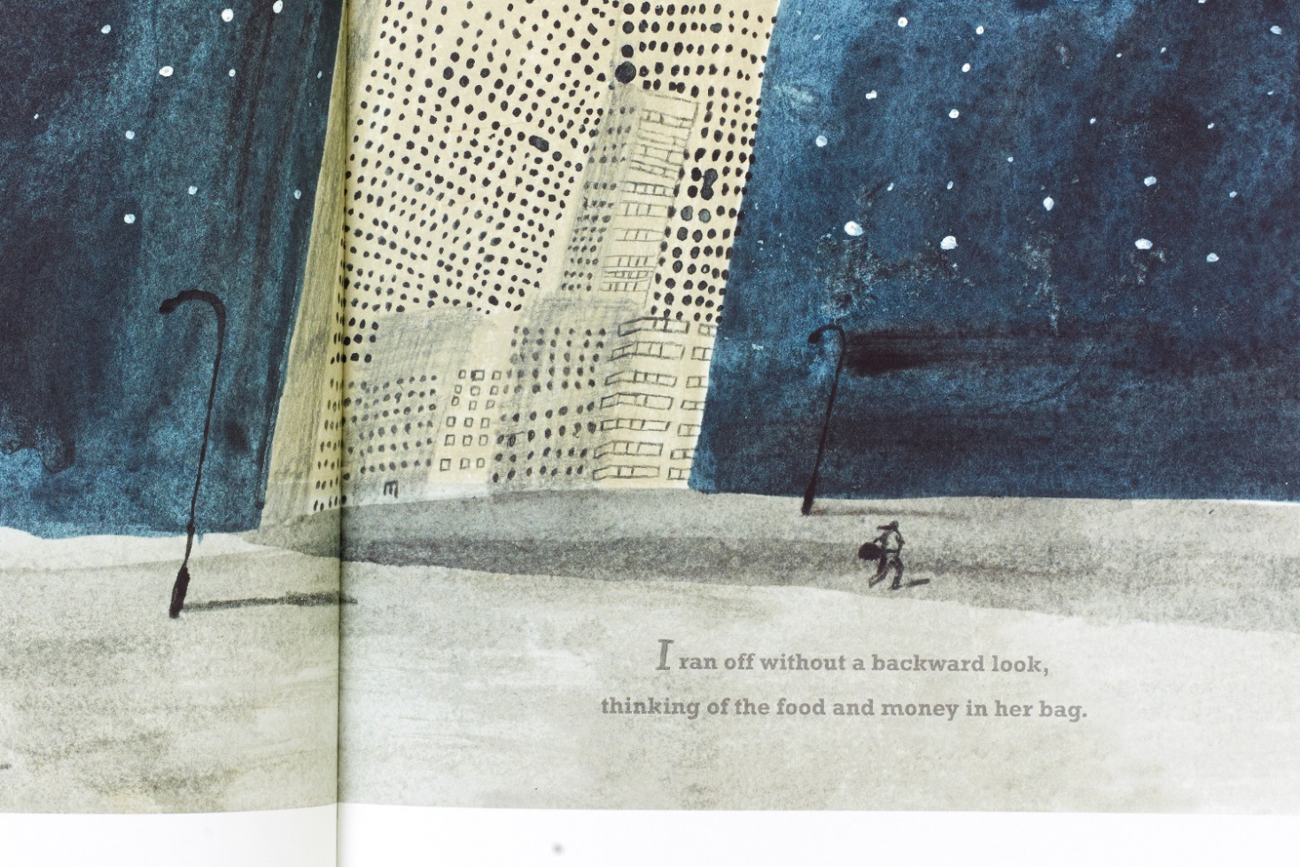
On a mean street in a mean city, a thief tries to snatch an old woman's bag. But she finds she can't have it without promising something in return - to 'plant them all'. When it turns out the bag is full of acorns, the young thief embarks on a journey that changes her own life and the lives of others for generations to come.
Hear the author read

Slide 10
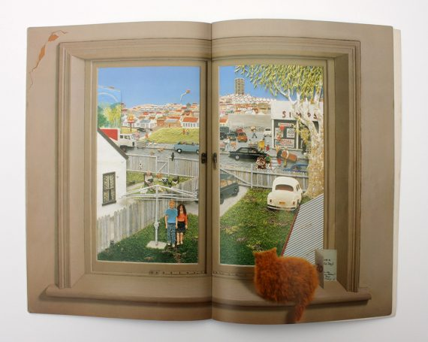
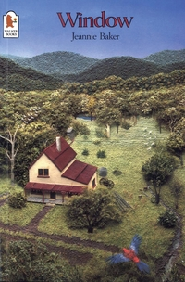
This is a wordless picture book- if you click on the font cover the link will take you to a short video of the book. Look how the view changes – what is happening to our society and is it for the better? How has the view outside your window changed?

Slide 11
Non-fiction
Facts and information about the environment and what you can do to help.

Slide 12
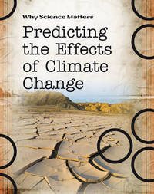
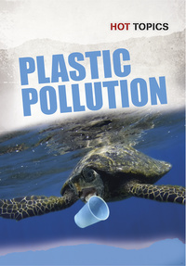
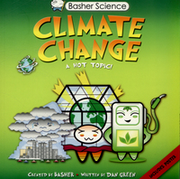
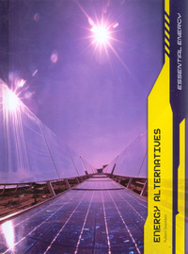
Lots to choose from

Slide 13
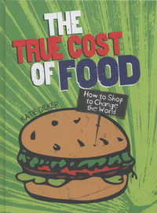
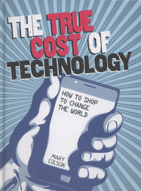
Where does the food we eat come from? What are the working conditions like for people who form part of the supply chain for the world's food industry? What impact do food choices have on our lives and on the environment - both in terms of what we eat and the food we waste? How can we improve our lives and those of others with the things we buy? This book aims to answer these questions.
So, how much does a burger cost?
Other titles in the series include:

Slide 14
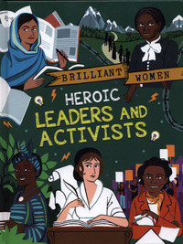
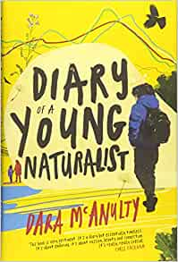
“You have stolen…
Fun with David
People who make a difference:

Slide 15
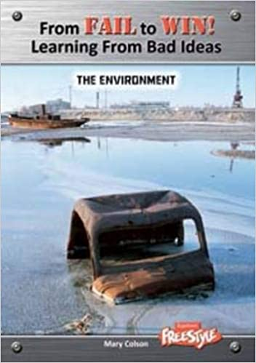
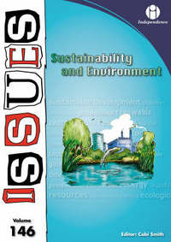
While trends show that we are making the effort to living greener lives, the problem of pollution has not gone away, with the UK dumping more waste into landfill than any other EU country. Will our environmental legacy survive? This book explores the issues involved.
Have you ever wondered what went wrong when inventions, structures and technology failed spectacularly?

Slide 16
Part popular science, part green-lifestyle guide, 'How Bad are Bananas?' provides the facts we need to make carbon-savvy purchases and lifestyle decisions. Listen to the podcast here

Slide 17
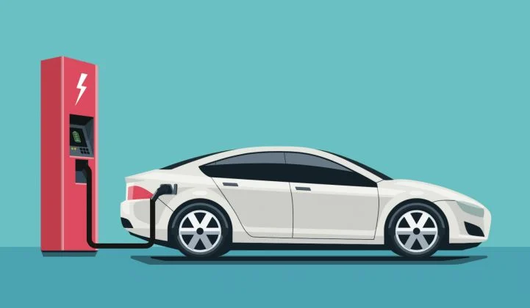
You might think about getting an electric car to help the environment – click on the image and sing along!

