Slide 1
Holocaust Memorial Day 2021
“Be the light in the darkness”

Slide 2
What is Holocaust Memorial Day?
Holocaust Memorial Day Trust (HMDT) encourages remembrance in a world scarred by genocide. We promote and support Holocaust Memorial Day (HMD) – the international day on 27 January to remember the six million Jews murdered during the Holocaust, alongside the millions of other people killed under Nazi Persecution and in genocides that followed in Cambodia, Rwanda, Bosnia and Darfur.
27 January marks the anniversary of the liberation of Auschwitz-Birkenau, the largest Nazi death camp.
The Holocaust threatened the fabric of civilisation, and genocide must still be resisted every day. Our world often feels fragile and vulnerable and we cannot be complacent. Even in the UK, prejudice and the language of hatred must be challenged by us all.

Slide 3
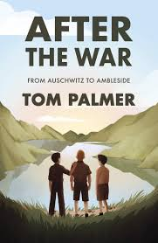
After the War by Tom Palmer
Summer 1945. The Second World War is finally over and Yossi, Leo and Mordecai are among three hundred children who arrive in the English Lake District.
Having survived the horrors of the Nazi concentration camps, they’ve finally reached a place of safety and peace, where they can hopefully begin to recover.
Will life by the beautiful Lake Windermere be enough to bring hope back into all their lives?
Lots of resources relating to this book can be found here.
Hear Tom read the first chapter
Look out for the BBC documentary on the Ambleside children.

Slide 4
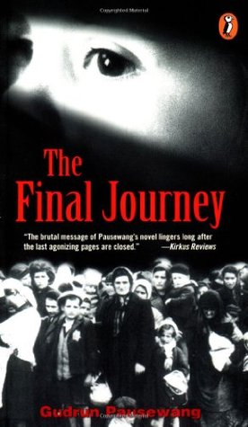
The Final Journey by Gudrun Pausewang
Alice is eleven years old, and it is wartime. She is on a train with no seats, no lights, no sanitary facilities. Her parents and her grandmother are missing, and Alice doesn't know where she is going. Maybe she will get to play outside again, maybe she will see her parents. But as the train rolls on, Alice begins to realize that just when you think things can't possibly get any worse, they do. A haunting German book in translation.
Read more about the holocaust trains here

Slide 5
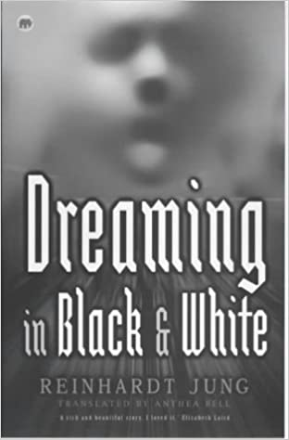
Dreaming in Black and White by Reinhart Jung
This haunting short novel explores the Holocaust from a rarely told perspective. Following a school history assignment, Hannes, a German boy, is disturbed by dreams that transport him back to the 1930s. There, he is persecuted by fellow students and teachers because Hannes is disabled, and like the Jews and "social misfits," the Nazi regime has labelled him "not worth living." Although his mother rushes to protect him, his father seems intimidated-even swayed-by the Nazi propaganda. Meanwhile, the dreams themselves are becoming all too real and Hannes begins to fear: Will he escape this nightmarish world in time to save himself?
This book deals with the Aktion T4 programme where those with disabilities were euthanised. Click here if you want to know more.

Slide 6
Béla Guttmann was the first of a breed of globe-trotting superstar football coaches, achieving his greatest successes before Pep Guardiola or José Mourinho were even born. He was also a Holocaust survivor. In 1944, much of Europe had wanted Guttmann dead. He hid for months in an attic near Budapest as thousands of fellow Jews in the neighbourhood were dragged off to be murdered. Later, he escaped from a slave labour camp before a planned deportation and almost certain death. His father, sister and wider family were murdered. This book is an extraordinary and compelling account of Guttman's life.
The Greatest Comeback by David Bolchover

Slide 7
Over a Thousand Hills I Walk with You by Hanna Jansen
Before that fateful April day, Jeanne lived the life of a typical Rwandan girl. Then, in one horrifying night, everything changed. Political troubles unleashed a torrent of violence upon the Tutsi ethnic group. Jeanne's family, all Tutsis, fled their home and tried desperately to reach safety. Jeanne was the only survivor.
Read “where tears have no power” poem here.

Slide 8
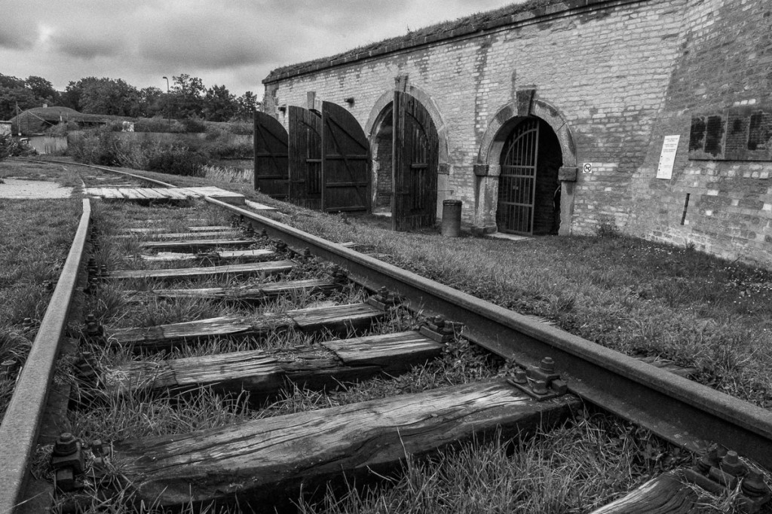
Terezin

Slide 9
