Slide 1
Modern Studies
Reading for S2 and S3

Slide 2
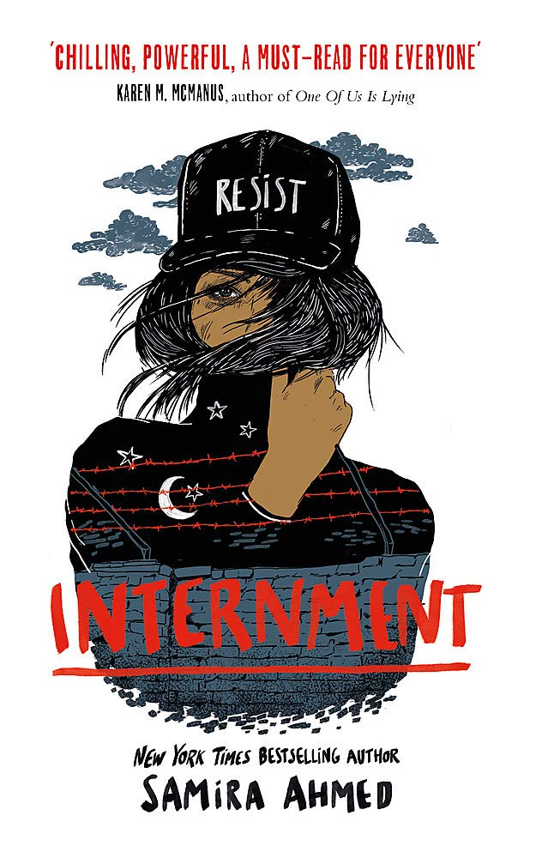
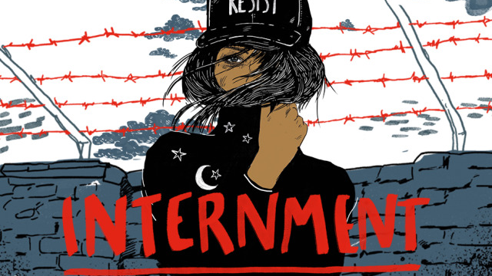
Internment by Samira Ahmed
Set in a horrifying 'fifteen minutes in the future' United States, seventeen-year-old Layla Amin is forced into an internment camp for Muslim-Americans along with her parents. With the help of newly-made friends also trapped within the camp, her boyfriend on the outside, and an unexpected alliance, Layla begins a journey to fight for freedom, leading a revolution against the internment camp's Director and his guards

Slide 3
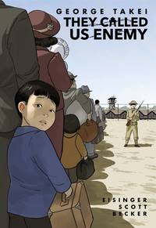
If you like Internment then you might like…
George Takei has captured hearts and minds worldwide with his captivating stage presence and outspoken commitment to equal rights. But long before he braved new frontiers in 'Star Trek,' he woke up as a four-year-old boy to find his own birth country at war with his father's and their entire family forced from their home into an uncertain future. In 1942, at the order of President Franklin D. Roosevelt, every person of Japanese descent on the west coast was rounded up and shipped to one of ten 'relocation centres,' hundreds or thousands of miles from home, where they would be held for years under armed guard. 'They Called Us Enemy' is Takei's firsthand account of those years behind barbed wire, the joys and terrors of growing up under legalized racism, his mother's hard choices, his father's faith in democracy, and the way those experiences planted the seeds for his astonishing future. This is a graphic novel.
Hear George talk abut his experience here

Slide 4
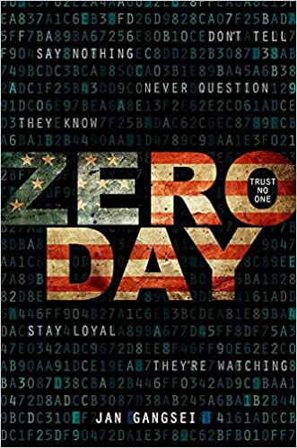
Eight years ago, Addie Webster was the victim of the most notorious kidnapping of the decade. Her father Mark Webster is now president of the United States, fighting to keep the oval office after a tumultuous first term. Then the unthinkable happens: the president's daughter resurfaces. Addie is brought back into her family's fold, but there are those in the president's political circle who find her timely return suspicious. Addie's childhood friend Darrow soon realises that Addie has come home with a mission...but will she choose to complete it?
One minute review
A great political thriller perfect for this time of year.

Slide 5
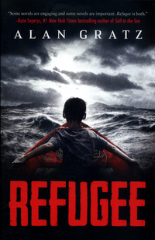
This action-packed novel tackles topics both timely and timeless - courage, survival, and the quest for home. Three kids go on harrowing journeys in search of refuge. And although Josef, Isabel, and Mahmoud are separated by continents and decades, shocking connections will tie their stories together in the end. Please note Alan Gratz does not write bad or boring books.
Want to know more? Here is a short Ted Talk on the plight of refugees

Slide 6
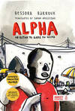
If you like Refugee then you might like…

Slide 7
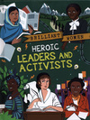
Non-fiction for feminisnts
Emma Watson talks about what it means to be a feminist here

Slide 8
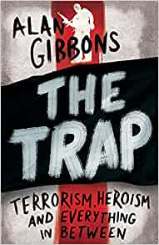
Controversial title- what do you think?
THE TRAP is a teen thriller about espionage, a missing brother and the ever-raging war on terror by million-copy-selling author, Alan Gibbons. MI5 agent, Kate, receives a tip-off about an asset, who seems too good to be true. Amir and Nasima are trying to make friends at their new school but struggling to keep a terrible secret. A group of jihadists are planning something. And behind it all stands Majid. Brother. Son. Hero. Terrorist. Spanning Iraq, Syria and England, THE TRAP grapples with one of the greatest challenges of our time.
Was originally to be called The Isis Trap but his publishers changed it at the last minute.

Slide 9
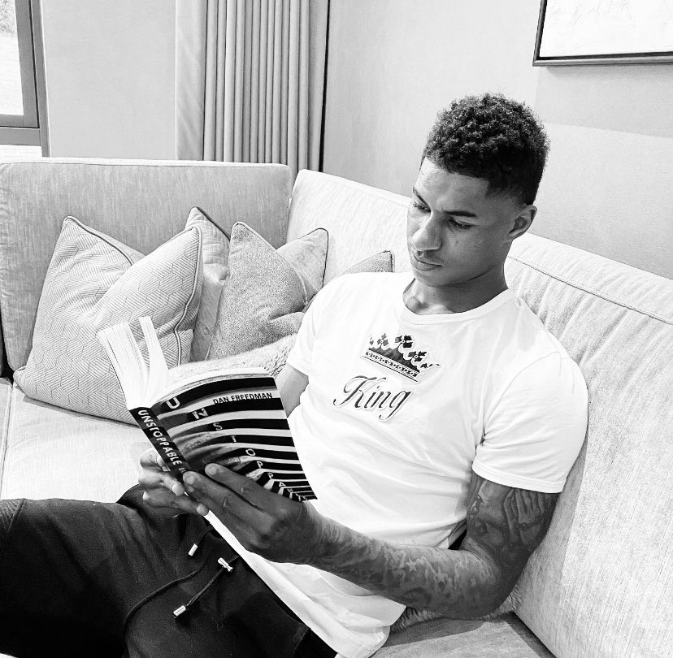
Fourteen-year-old twins, Roxy and Kaine, have only one thing in common. They HATE each other. Kaine is loud, brash and brilliant at football. Roxy is heading for tennis superstardom. When tragedy strikes, their worlds are ripped apart. Can they come together before it's too late?
Dan was inspired by visits to London schools and the violence the pupils spoke to him about. Hear him read a section.
Before becoming an author, Dan was managing editor for The FA for seven years. He interviewed the likes of Messi and Ronaldo and has been to two World Cups as part of the official England Team group.
So good Marcus Rashford is a fan!

Slide 10
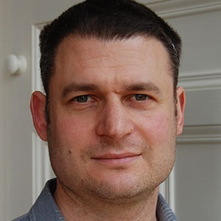
Author focus - William Sutcliffe
“I have published 12 novels, including five for young adults. Over the years I have done many events, including talks, readings and workshops for all ages. I always make sure that my talks are an interactive conversation rather than just a speech.
The topics covered by my YA fiction are delinquency in Bad Influence, global injustice and 1st/3rd world differences in The Wall (shortlisted for the Carnegie Medal), poverty and social conditioning in Concentr8 (shortlisted for the YA book prize), and drone warfare in We See Everything.”

Slide 11
William Sutcliffe
In a future London, Concentr8 is a prescription drug intended to help kids with ADD. Soon every troubled teen is on it. It makes sense, doesn't it? Keep the undesirable elements in line. Keep people like us safe from people like them. What's good for society is good for everyone. Troy, Femi, Lee, Karen, and Blaze have been taking Concentr8 as long as they can remember. They're not exactly a gang, but Blaze is their leader, and Troy has always been his quiet, watchful sidekick - the only one Blaze really trusts. They're not looking for trouble, but one hot summer day, when riots break out across the city, they find it

Slide 12
William Sutcliffe
Joshua is a troubled boy who lives with his mother and stepfather in a divided city, where a wall and soldiers separate two communities, and the rubble-strewn residue of their broken world gives hints of the old life before the wall was built. Joshua discovers a manhole, which leads to a tunnel, which leads in pitch darkness under the wall and across to the other side. Forbidden territory, dangerous territory, violent territory, which a boy like him - visibly different - shouldn't stray into. An act of kindness from a girl saves his life, but leads to a brutal act of cruelty and a terrible debt he's determined to repay. And no one, no one must find out that he's been there - or the consequences will be unbearable.

Slide 13
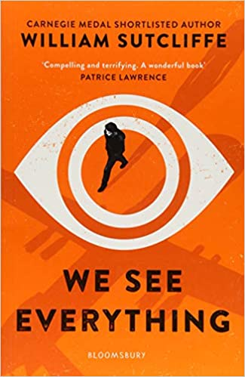
William Sutcliffe
Lex lives on The Strip - the overcrowded, closed-off, bombed-out shell of London. He's used to the watchful enemy drones that buzz in the air above him. Alan's talent as a gamer has landed him the job of his dreams. At a military base in a secret location, he is about to start work as a drone pilot. These two young men will never meet, but their lives are destined to collide. Because Alan has just been assigned a high-profile target. Alan knows him only as #K622. But Lex calls him Dad.

Slide 14
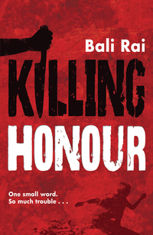
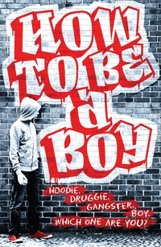
Top Picks you can download from the library and start reading today- click on the cover
Please note you will have to have your Borrow Box account set up to do this – any problems just ask!

