Slide 1
Beyond my Window
S1 creative writing competition

Slide 2
Click on the book cover.

Slide 3
Change
Did you see how the view from the window changed over time?
Our views of outside have been limited recently and perhaps many of us have been looking out our windows more wishing we could experience more of the world outside.

Slide 4
Your window
Take a couple of minutes to look outside – try different windows – which view is your favourite and which is your least? Think about how these views make you feel.
Over the past few weeks the views from our windows have changed, from stormy, to rainy, to sunny and even snow and ice. Even the weather makes us view what is outside our window differently.

Slide 5
Castle in Wales

Slide 6
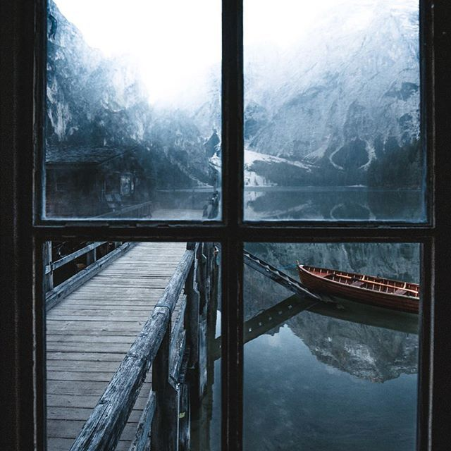
Germany in winter

Slide 7
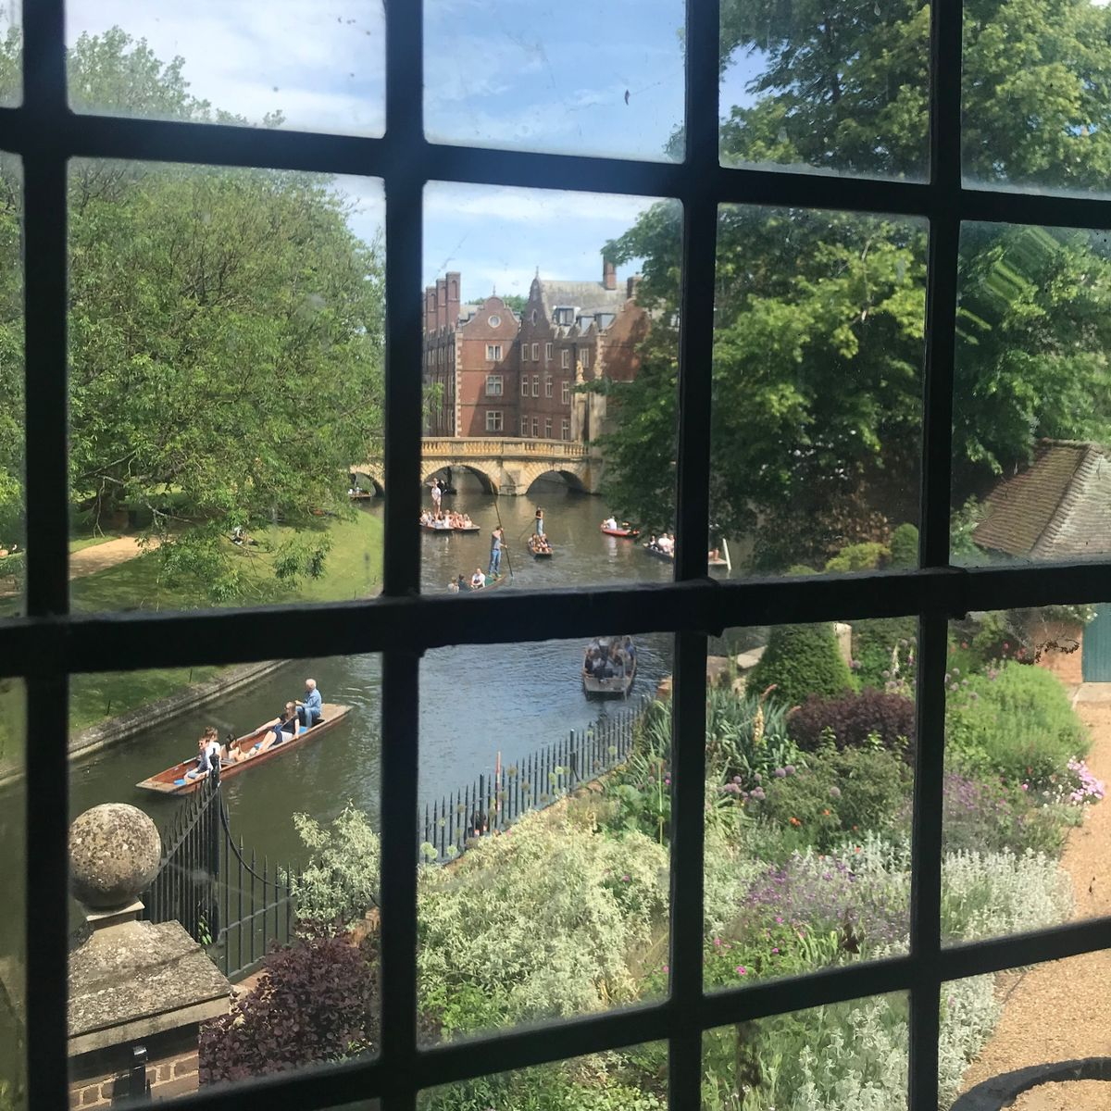
Summer in Cambridge

Slide 8
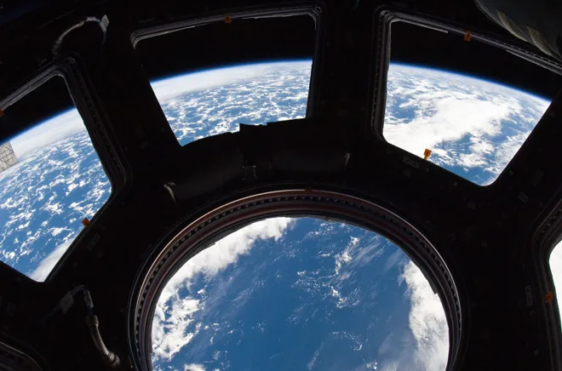
Space station

Slide 9
Alternative Views
Sometimes we let our mind wander when we look out of the window – where else could we be?

Slide 10
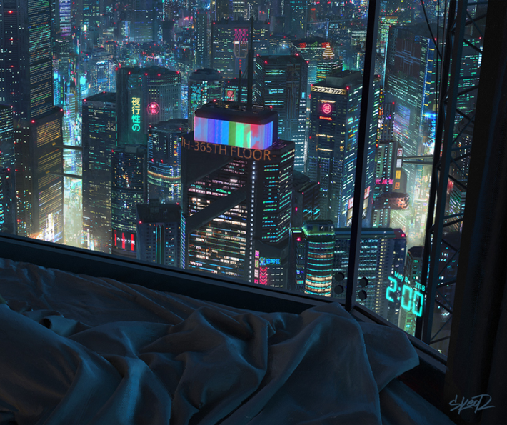
Futuristic View

Slide 11
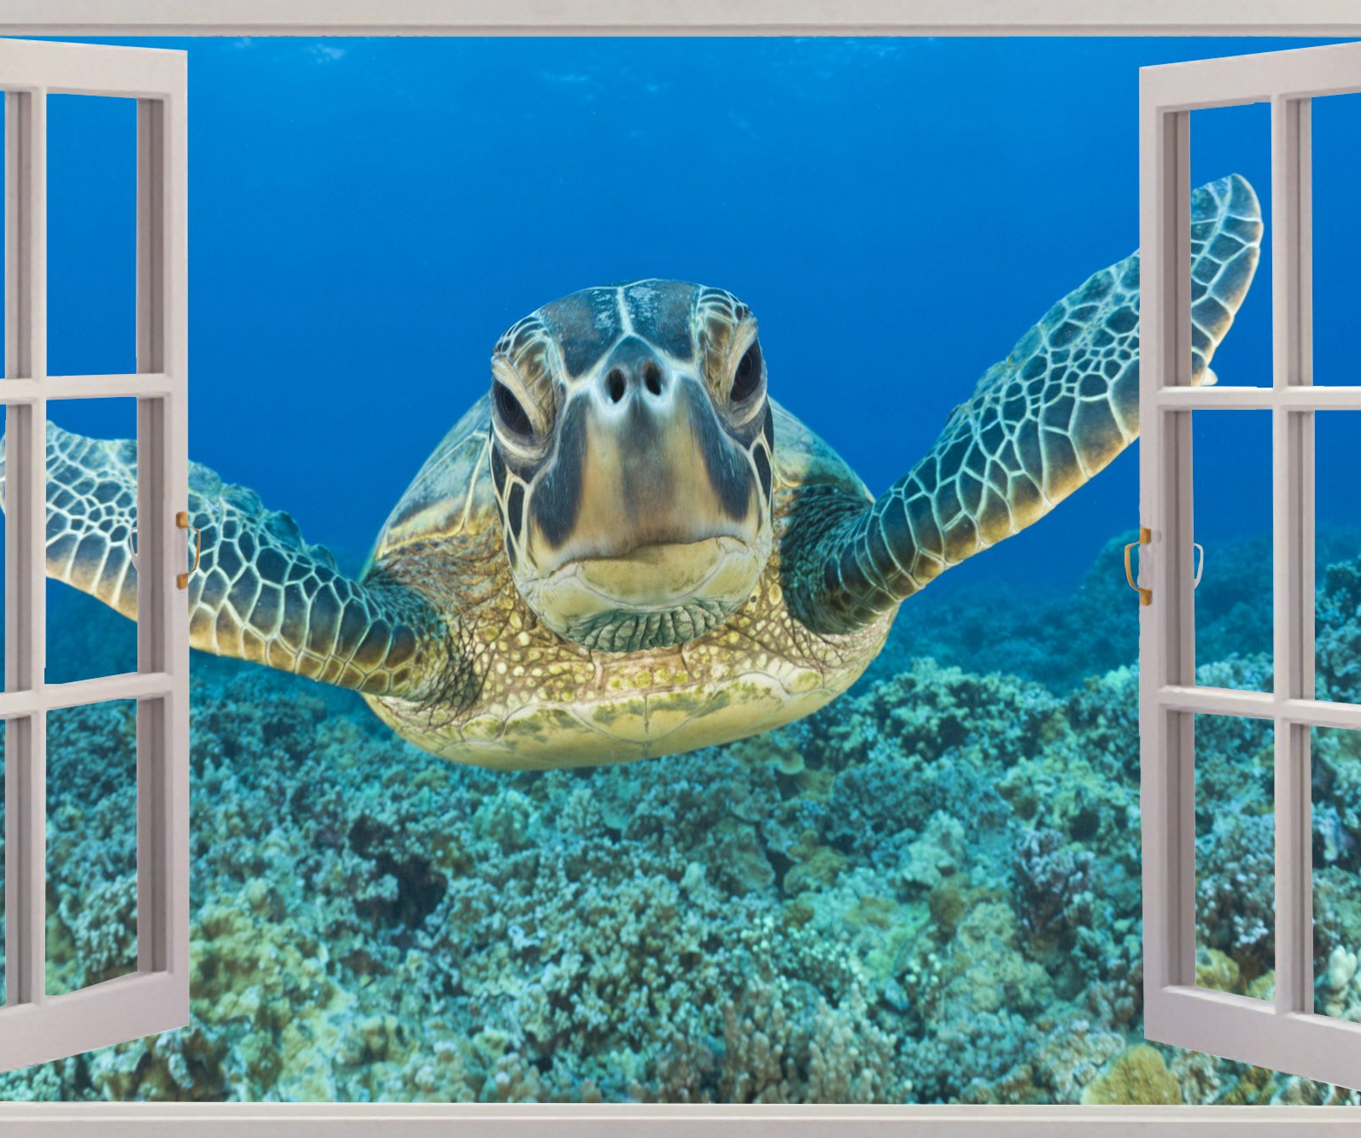
UnderSea View

Slide 12
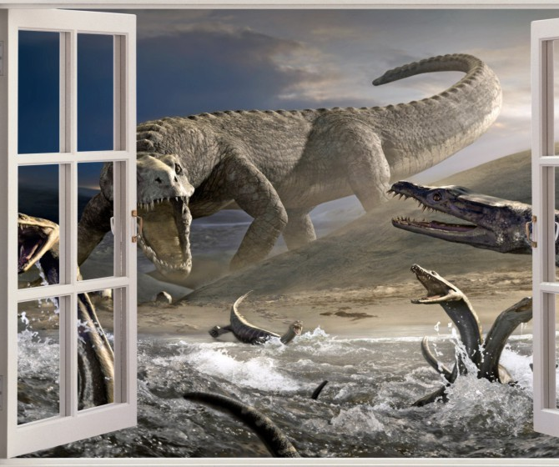
Jurassic View
No, not a view from Mrs Baird’s bedroom when she was wee!

Slide 13
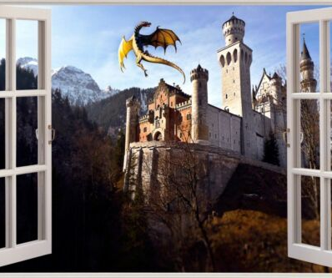
Fantasy View

Slide 14
Your challenge
Using your own window or an imagined one as inspiration write a poem, letter or short paragraph about what is beyond your window.
Your response can be as serious or as silly as you like.
You can add , cartoons, illustrations or even photographs to your work (please don’t include people in the pics).
We would like to display the entries on our return to the school.
Your entry should be easily recognisable as a window.

Slide 15
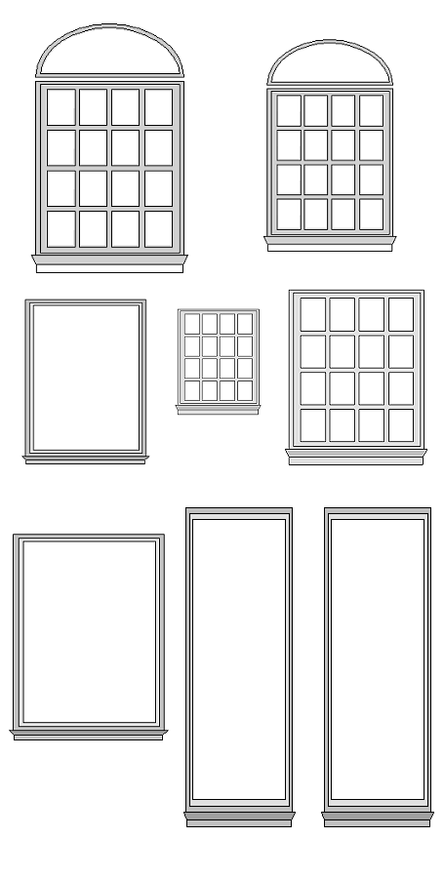
Some design ideas.
Find a clip art image of a window online and use this as your base. If you plan to add lots of images or drawings then why not use a template with lots of sections?

Slide 16
Mix it up
pictures
Big picture
Story in sections or different points of view
Story in the middle

Slide 17
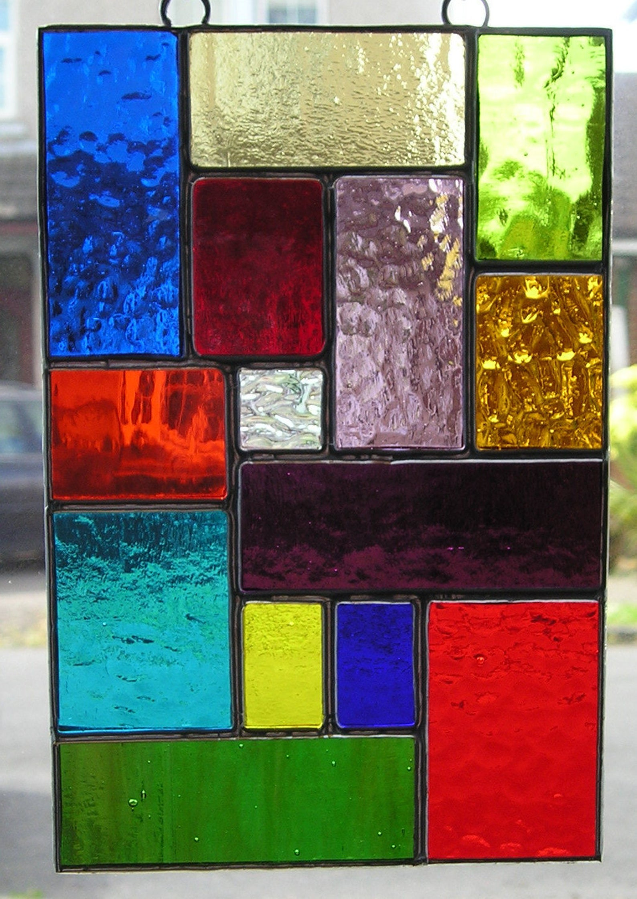
More ideas
What about using a stained glass effect?
You can do this online or offline or a mix of both.

Slide 18
Finished article
Upload your finished work by Friday 12 Feb.
To Mrs Baird’s page - direct link
Or look use code - zhu6912
There may be prizes……….

