Slide 1
Historical fiction
S3+

Slide 2
Warsaw, Poland. The year is 1940 and Lillia is 15 when her mother, Alenka, disappears and her father flees with Lillia and her younger sister, Naomi, to Shanghai, one of the few places that will accept Jews without visas. There they struggle to make a life; they have no money, there is little work, no decent place to live, a culture that doesn't understand them. And always the worry about Alenka. How will she find them? Is she still alive? Meanwhile Lillia is growing up, trying to care for Naomi, whose development is frighteningly slow, in part from malnourishment. Lillia finds an outlet for her artistic talent by making puppets, remembering the happy days in Warsaw when they were circus performers. She attends school sporadically, makes friends with Wei, a Chinese boy, and finds work as a performer at a "gentlemen's club" without her father's knowledge. But meanwhile the conflict grows more intense as the Americans declare war and the Japanese force the Americans in Shanghai into camps. More bombing, more death. Can they survive, caught in the crossfire? Hear more from the author.

Slide 3
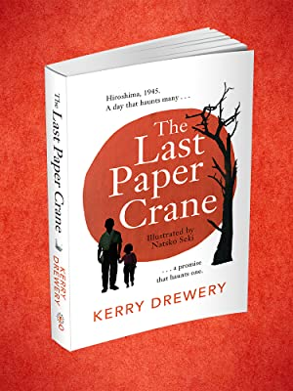
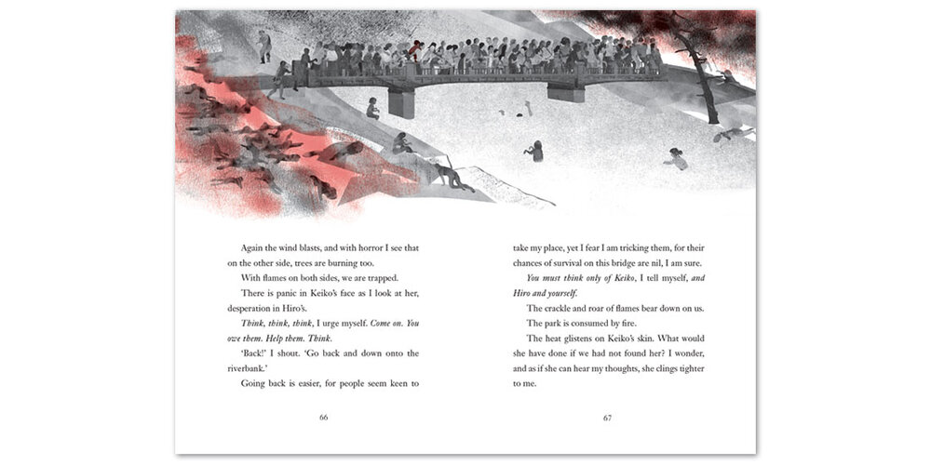
I think this book is amazing!
Beautifully written by Kerry Drewery and delicately illustrated by Natsko Seki, Paper Crane tells one boy’s story of the bombing of Hiroshima. There is no blaming of sides, there is no demonising of individuals; there is only a boy and his survival. Sometimes brutal and always honest this is a book that will stay with you for a long time. Hear an extract.

Slide 4
Dae ye ken yer ain history?
When her father, Robert the Bruce, is crowned King of Scotland, Marjorie Bruce becomes a princess. But Edward Longshanks, the ruthless King of England, captures Marjorie and keeps her prisoner in a wooden cage in the centre of a town square, exposed to wind, rain, and the bullying taunts of the townspeople. Marjorie knows that despite her suffering and pain, she must stay strong: the future of Scotland depends on her. (to get a feel for the era this link will take you to the trailer for Outlaw King (rated 18)– be aware it’s a bit gruesome - lots of hairy Scotsmen and fighting)
Did you know that this book was published on the Isle of Lewis?

Slide 5
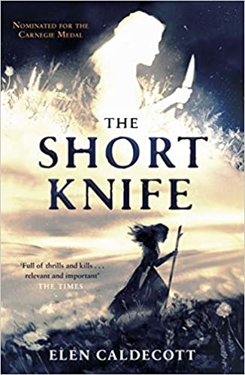
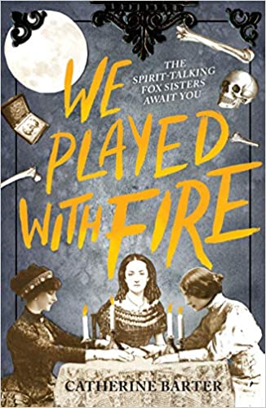
Most Wanted
These are some books I would love for the library but they are either not available in the UK or not out yet – one can but dream… What would you add?
Click on each of the book covers to find out more.

Slide 6
Madrid, 1957. Under the fascist dictatorship of General Francisco Franco, Spain is hiding a dark secret. Meanwhile, tourists and foreign businessmen flood into Spain under the welcoming promise of sunshine and wine. Among them is eighteen-year-old Daniel Matheson, the son of an oil tycoon, who arrives in Madrid with his parents hoping to connect with the country of his mother's birth through the lens of his camera. Photography--and fate--introduce him to Ana, whose family's interweaving obstacles reveal the lingering grasp of the Spanish Civil War--as well as chilling definitions of fortune and fear. Daniel's photographs leave him with uncomfortable questions amidst shadows of danger. He is backed into a corner of difficult decisions to protect those he loves. Lives and hearts collide, revealing an incredibly dark side to the sunny Spanish city. Includes vintage media reports, oral history commentary, photos, and more.
In-depth author interview here.

Slide 7
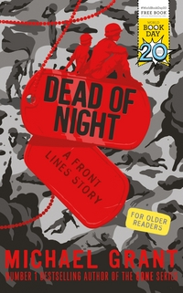
This is a great wee book – a spin off from the Front Lines series by Michael Grant ( a re imagining of WW2 if women could sign up as GIs) though you don’t have o know the series to enjoy this book.
Rio Richlin doesn't have superpowers. She is an ordinary young woman. A soldier in the American army, wearing a uniform, carrying a rifle, and fighting alongside thousands who are trying to make a difference, trying to change the world. At least, that's the plan. Right now she's part of a squad on a training exercise in some place called Wales. They're cold, they're wet, and Rio's pretty sure they're also lost. Spending the night in a creepy old inn wasn't part of the plan at all.
Echoes of Dickens and horrors this title is only 112 pages long but fair packs a punch. Warning not for the faint of hearted. I have met Michael on a few occasions – he is a very “interesting” person.
As for a copy when we get back to school.

Slide 8
As violent protests engulf LA and the city burns, Ashley tries to continue on as if life were normal. Even as her self-destructive sister gets dangerously involved in the riots. Even as the model black family facade her wealthy and prominent parents have built starts to crumble. Even as her best friends help spread a rumor that could completely derail the future of her classmate and fellow black kid, LaShawn Johnson. If you want to know more about the riots – click here. With her world splintering around her, Ashley, along with the rest of LA, is left to question who is the us? And who is the them?
If you are a fan of Angie Taylor and Nic Stone – this is a must read.

Slide 9
It's 1917, and World War I is at its zenith when Hazel and James first catch sight of each other at a London party. She's a shy and talented pianist; he's a newly minted soldier with dreams of becoming an architect. When they fall in love, it's immediate and deep--and cut short when James is shipped off to the killing fields. Aubrey Edwards is also headed toward the trenches. A gifted musician who's played Carnegie Hall, he's a member of the 15th New York Infantry, an all-African-American regiment being sent to Europe to help end the Great War. Love is the last thing on his mind. But that's before he meets Colette Fournier, a Belgian chanteuse who's already survived unspeakable tragedy at the hands of the Germans.
The 15th Infantary is now known as the 369th and were dubbed the Harlem Hellfighters – want to know more?

Slide 10
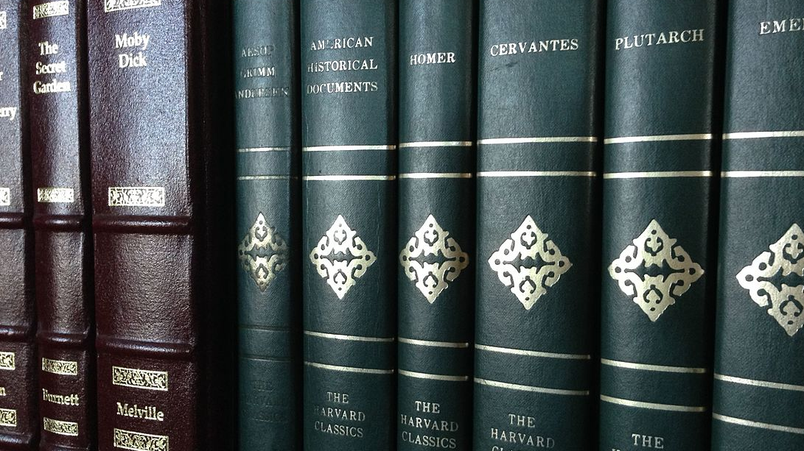
Classics
There is so much out there that it is hard to know where to start.
Sometimes the issue with historical fiction can be that it is too specific and meant to be of it’s time – an example of the is Gulliver’s Travels. Sure, you can read it as a story of a giant in a little land but that’s not really what its about- it’s about politics and empires and monarchs and generals and if you are not aware of the specifics you might not enjoy the book.
I have included 3 classics here that you can just throw yourself into – some swash buckely, some social commentary but all free to download from Project Gutenberg.
Mrs Baird.
This Photo by Unknown Author is licensed under CC BY-SA

Slide 11
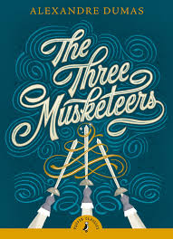
Young D'Artagnan arrives in Paris to join the King's elite guards, but almost immediately finds he is duelling with some of the very men he has come to swear allegiance to - Porthos, Athos and Aramis, inseparable friends: the Three Musketeers. Young D'Artagnan arrives in Paris to join the King's elite guards, but almost immediately finds he is duelling with some of the very men he has come to swear allegiance to - Porthos, Athos and Aramis, inseparable friends: the Three Musketeers. Soon part of their close band, D'Artagnan's loyalty to his new allies puts him in the deadly path of Cardinal Richlieu's machinations. And when the young hero falls in love with the beautiful but inaccessible Constance, he finds himself in a world of murder, conspiracy and lies, with only the Musketeers to depend on.
One for all and all for one – a great read! Download it here for free.

Slide 12
David's father has recently died, and he is now an orphan. Since he is now 17, he has decided it is time to go and seek his fortune. Before he leaves for Edinburgh, he meets with his guardian, Mr. Campbell. Campbell reveals that David has an uncle, Ebenezer Balfour, of the House of Shaws—meaning that David is, to his surprise, from a wealthy family.
David decides to go to Cramond, where his uncle lives, and meet his wealthy relatives.
David walks 2 days to Edinburgh, and soon finds his way to Cramond. As he begins to ask about the House of Shaws, he finds it is an unpopular place. His Uncle is not liked by the community, and is in fact the only occupant of the house. Nevertheless, David continues. Ebenezer gives him a cold welcome, and seems very interested in the death of David's father. Ebenezer treats David badly, almost as if David were a thief, but he wins some of David's respect by giving the lad money But when Ebenezer nearly sends David to his death in the tower adjacent to the house, the boy demands to know why his uncle hates him and, if he does, why he wants him to stay. Can you guess what happens next? (spoiler alert in title)
How good is this cover? Click on pirate to read the book.

Slide 13
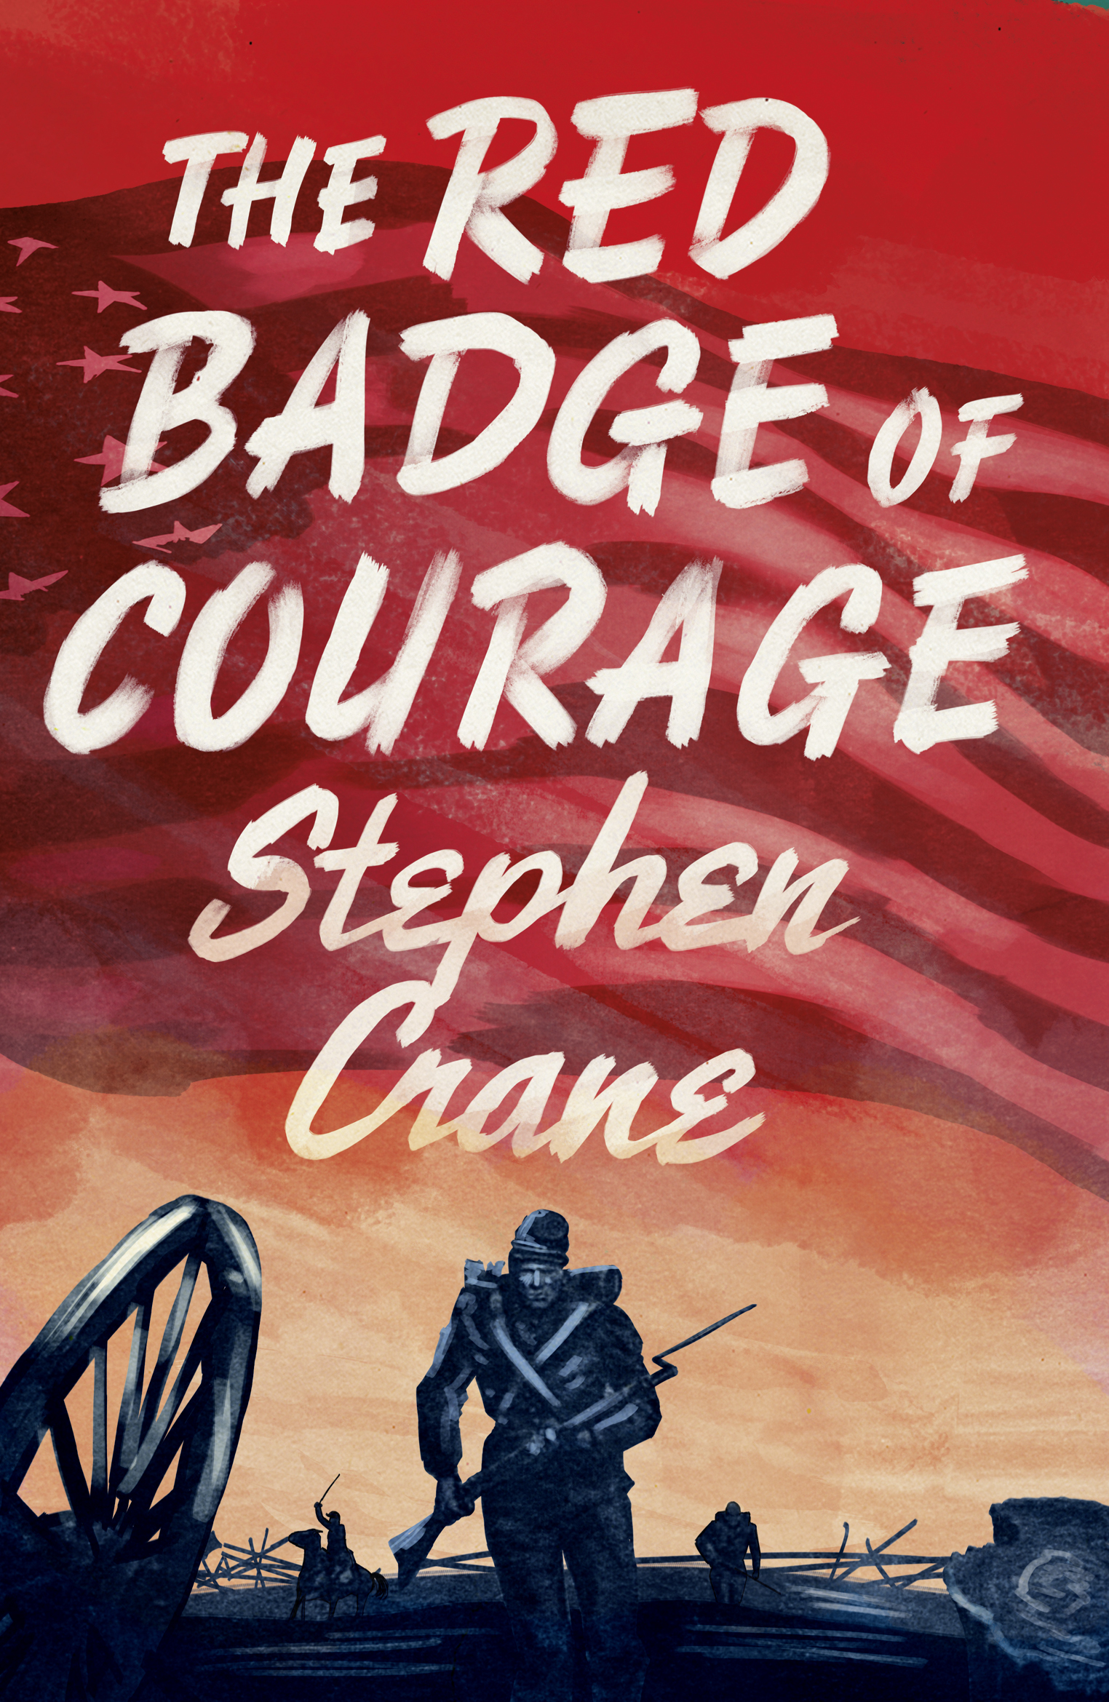
During the Civil War, a Union regiment rests along a riverbank, where it has been camped for weeks. A tall soldier named Jim Conklin spreads a rumor that the army will soon march. Henry Fleming, a recent recruit with this 304th Regiment, worries about his courage. He fears that if he were to see battle, he might run. The narrator reveals that Henry joined the army because he was drawn to the glory of military conflict. Since the time he joined, however, the army has merely been waiting for engagement.
At last the regiment is given orders to march, and the soldiers spend several weary days traveling on foot. Eventually they approach a battlefield and begin to hear the distant roar of conflict. After securing its position, the enemy charges. Henry, boxed in by his fellow soldiers, realizes that he could not run even if he wanted to. He fires mechanically, feeling like a cog in a machine.
A controversial title, banned in some places.

