Slide 1
WW2
“The world is full enough of hurts and mischances without wars to multiply them.” ― J.R.R. Tolkien, The Return of the King

Slide 2
Fiction

Slide 3
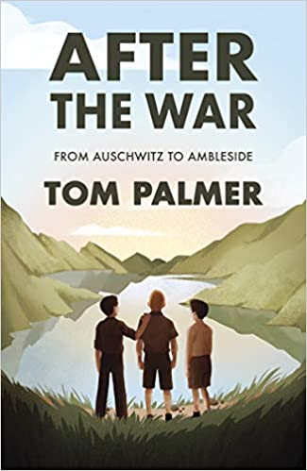
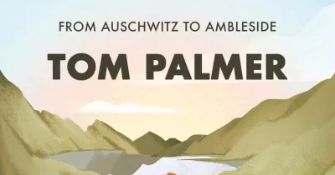
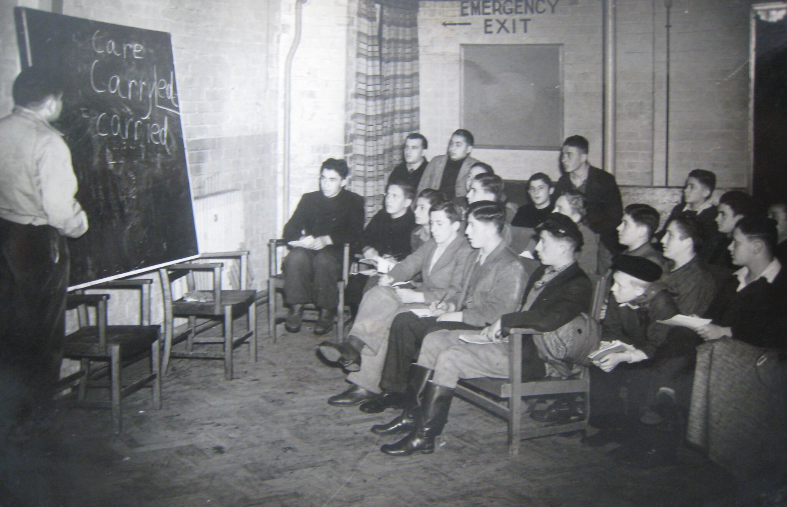
My current favourite
Did you know that when the War ended Britain took in children from the concentration camps and sent them for rehabilitation to the Lake District? This is such a fascinating story told beautifully, as always, by Tom. Look out for the story on BBC . More resources here.

Slide 4
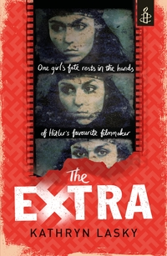
'Next stop Hollywood!' Django yelled as the bus transporting the Nazis' Gypsy prisoners turned west. Django and 15-year-old Lilo are picked out of a lineup by Hitler's favourite filmmaker, Leni Riefenstahl, to work as extras in her new movie. Lilo, her mother, and her new friend Django soon find themselves in the alternate reality of a film set. Amid glamorous surroundings, the Gypsy extras are barely fed, closely guarded, and kept locked in a barn when they're not working. At the centre of this strange world is Riefenstahl herself - beautiful, charming, but ultimately deadly. Available on Audible. Click the link above to find out more about the propagandist movies made during WW2.

Slide 5
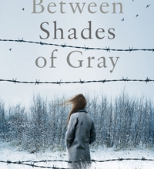
“He threw his burning cigarette onto our clean living room floor and ground it into the wood with his boot. We were about to become cigarettes.” ― Ruta Sepetys, Between Shades of Gray
One night 15-year-old Lina, her mother and young brother are hauled from their home by Soviet guards, thrown into cattle cars and sent away. They are being deported to Siberia. An unimaginable and harrowing journey has begun. Lina doesn't know if she'll ever see her father or her friends again. But she refuses to give up hope.
The movie adaptation was called Ashes in the Snow – watch the trailer here. Can’t imagine why they changed the name!

Slide 6
Only in wartime could a stalwart lass from Manchester rub shoulders with a Scottish aristocrat; one a pilot, the other a special operations executive. But when a vital mission goes wrong, one of the friends has to bail out of a faulty plane over France. She is captured by the Gestapo and becomes a prisoner of war.
This is a challenging and thought provoking book. With probably one of the best book trailers I have seen. Did you know the author is a trained pilot – you should look out for her other titles including a sequel for this one called Rose Under Fire.

Slide 7
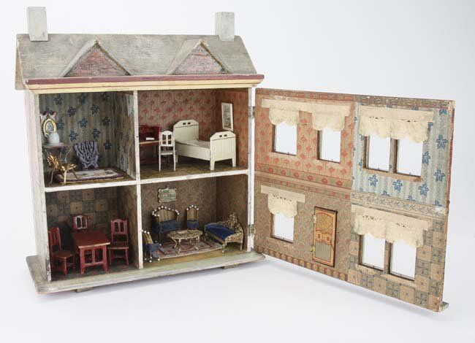
This is one of my favourite YA WW2 novels.
When Peter's parents are killed, he is sent to an orphanage in Warsaw. German soldiers decide that Peter is racially valuable - he is a 'Volksdeutscher.' But the apparently Aryan boy is not quite the specimen they think he is. Deciding he doesn't want to be a Nazi, Peter elects to take a very dangerous risk.
Such a brilliant thriller, so well researched that you will feel as if you are in Nazi Germany.

Slide 8
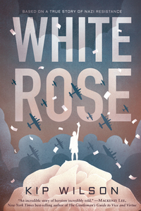
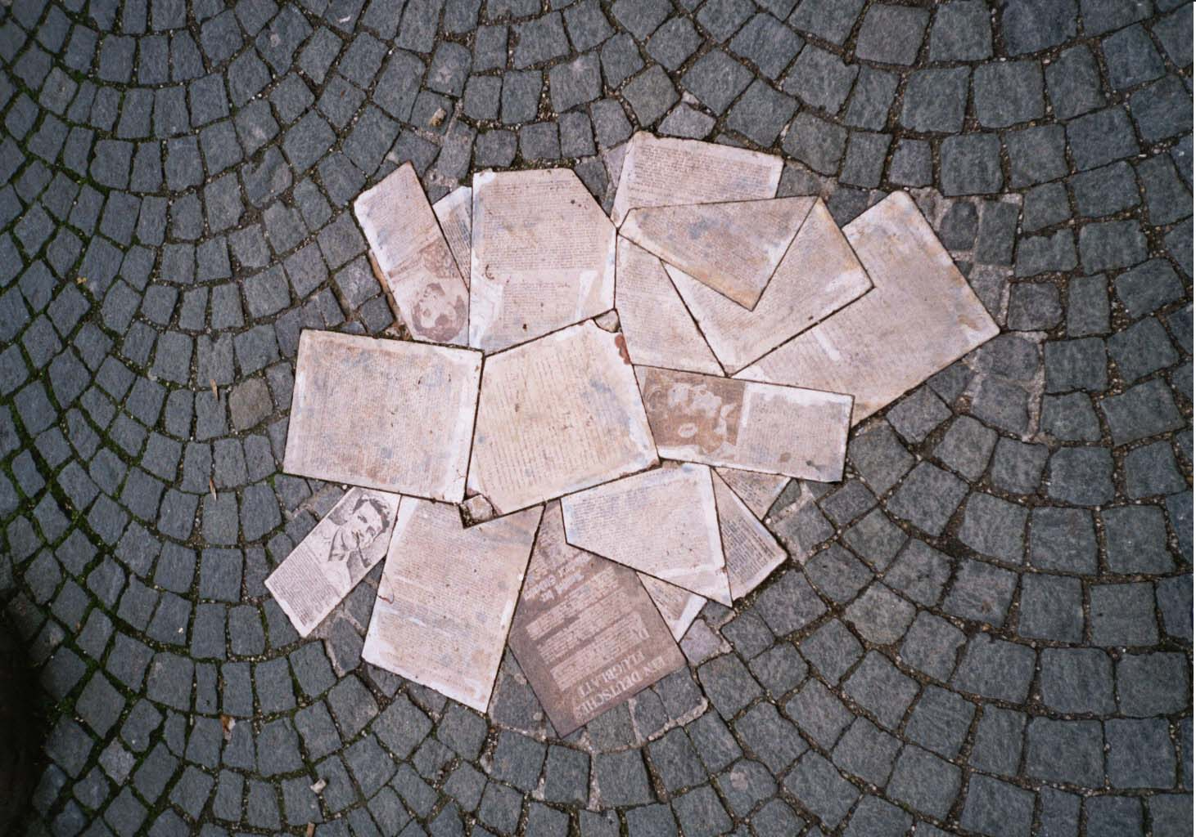
Tells the story of Sophie Scholl, a young German college student who challenges the Nazi regime during World War II as part of the White Rose, a non-violent resistance group. This is the fictionalised story of a real young woman and the risks she took to show the world of the dangers of the rise of the National Socialists.
The Sophie Scholl memorial

Slide 9
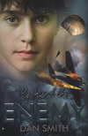
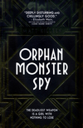
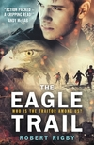
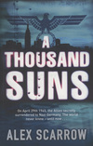
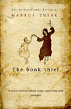
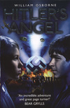
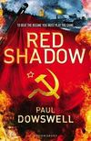
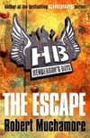
Other titles you might be interested in…

Slide 10
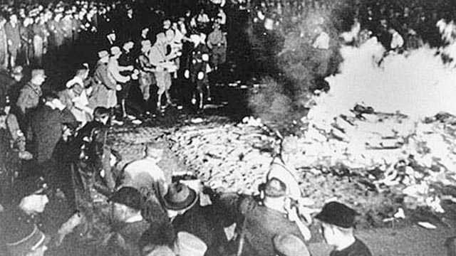
Non-Fiction
“It is there, where they burn books, that eventually they burn people.” ― Heinrich Heine

Slide 11
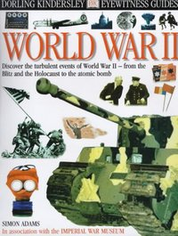
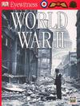
If you are starting a new topic and we have the DK book about it then ignore the Google or the Wikiness – always go straight for an Eyewitness title. The pictures are always great and the text just enough to get you going but never so much as to drown you.

Slide 12
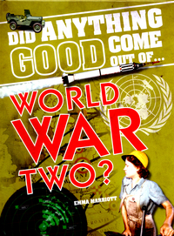
An interesting take on a very difficult time period. This title looks at the events leading up to the Second World War, the most widespread war in history, in which the major participants used all their industrial, economic, and scientific might to wage 'total war'. It examines the legacy of the war, both in terms of the bad things that came out of it, such as the fear and mistrust between the USA and Russia that led to the Cold War, and the good things, including advances in medicine and computing, and the establishment of the United Nations.

Slide 13
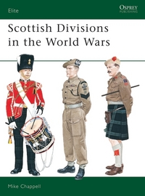
If you are serious about the details of militaria during any time period then the Osprey books will be well know to you. So much research must have gone in to each of these titles. If you like one you might end up finding yourself collecting all the others.
Over the centuries of their existence the Scottish regiments of the British Army have gained a reputation in war that is the envy of all and which can be matched, or surpassed, by very few. The very description 'Scottish soldier' conjures up images ranging from the 'thin red streak tipped with a line of steel' of the 93rd Highlanders at Balaclava, and the charge of the Scots greys at Waterloo, to the more recent deeds of Scottish regiments in the Falkland Islands and the Persian Gulf. Mike Chappell chronicles the remarkable history of the Scottish units which fought in the two world wars.

Slide 14
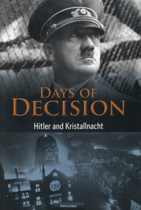
Why did Adolf Hitler encourage attacks on Jews and their property, escalating Nazi Germany's anti-Semitic policies to new levels of brutality? How did his decision affect countries around the world and change the course of history? This book looks at a momentous event from the build-up to World War II, showing how one of the world's most infamous leaders took a major step towards the events we now know as the Holocaust.

Slide 15
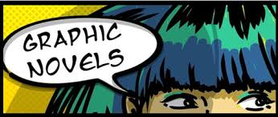

Slide 16
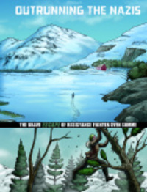
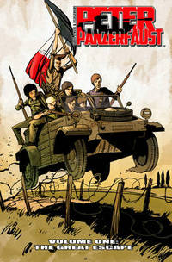
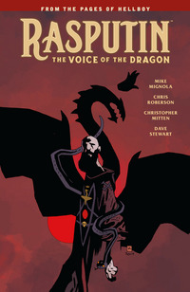

Slide 17
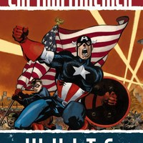
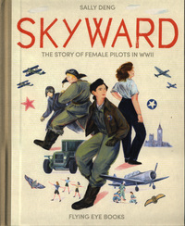
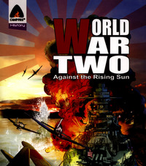

Slide 18
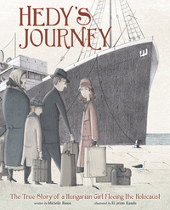

Slide 19
Over to you
Do you have any favourite reads that you think should be added?
Just let me know and I will put them in.
Remember if you don’t have copies of the books at home you can try Borrow Box from ER Libraries – just download the app and take a look .
Or, at the moment, Audible are allowing free downloads of lots of books for young people – so you can listen to your favourites or something new for nothing!
Let me know how you get on or if you need any help.
Take care,
Mrs Baird

