Slide 1
Space Exploration
To the library and beyond…

Slide 2
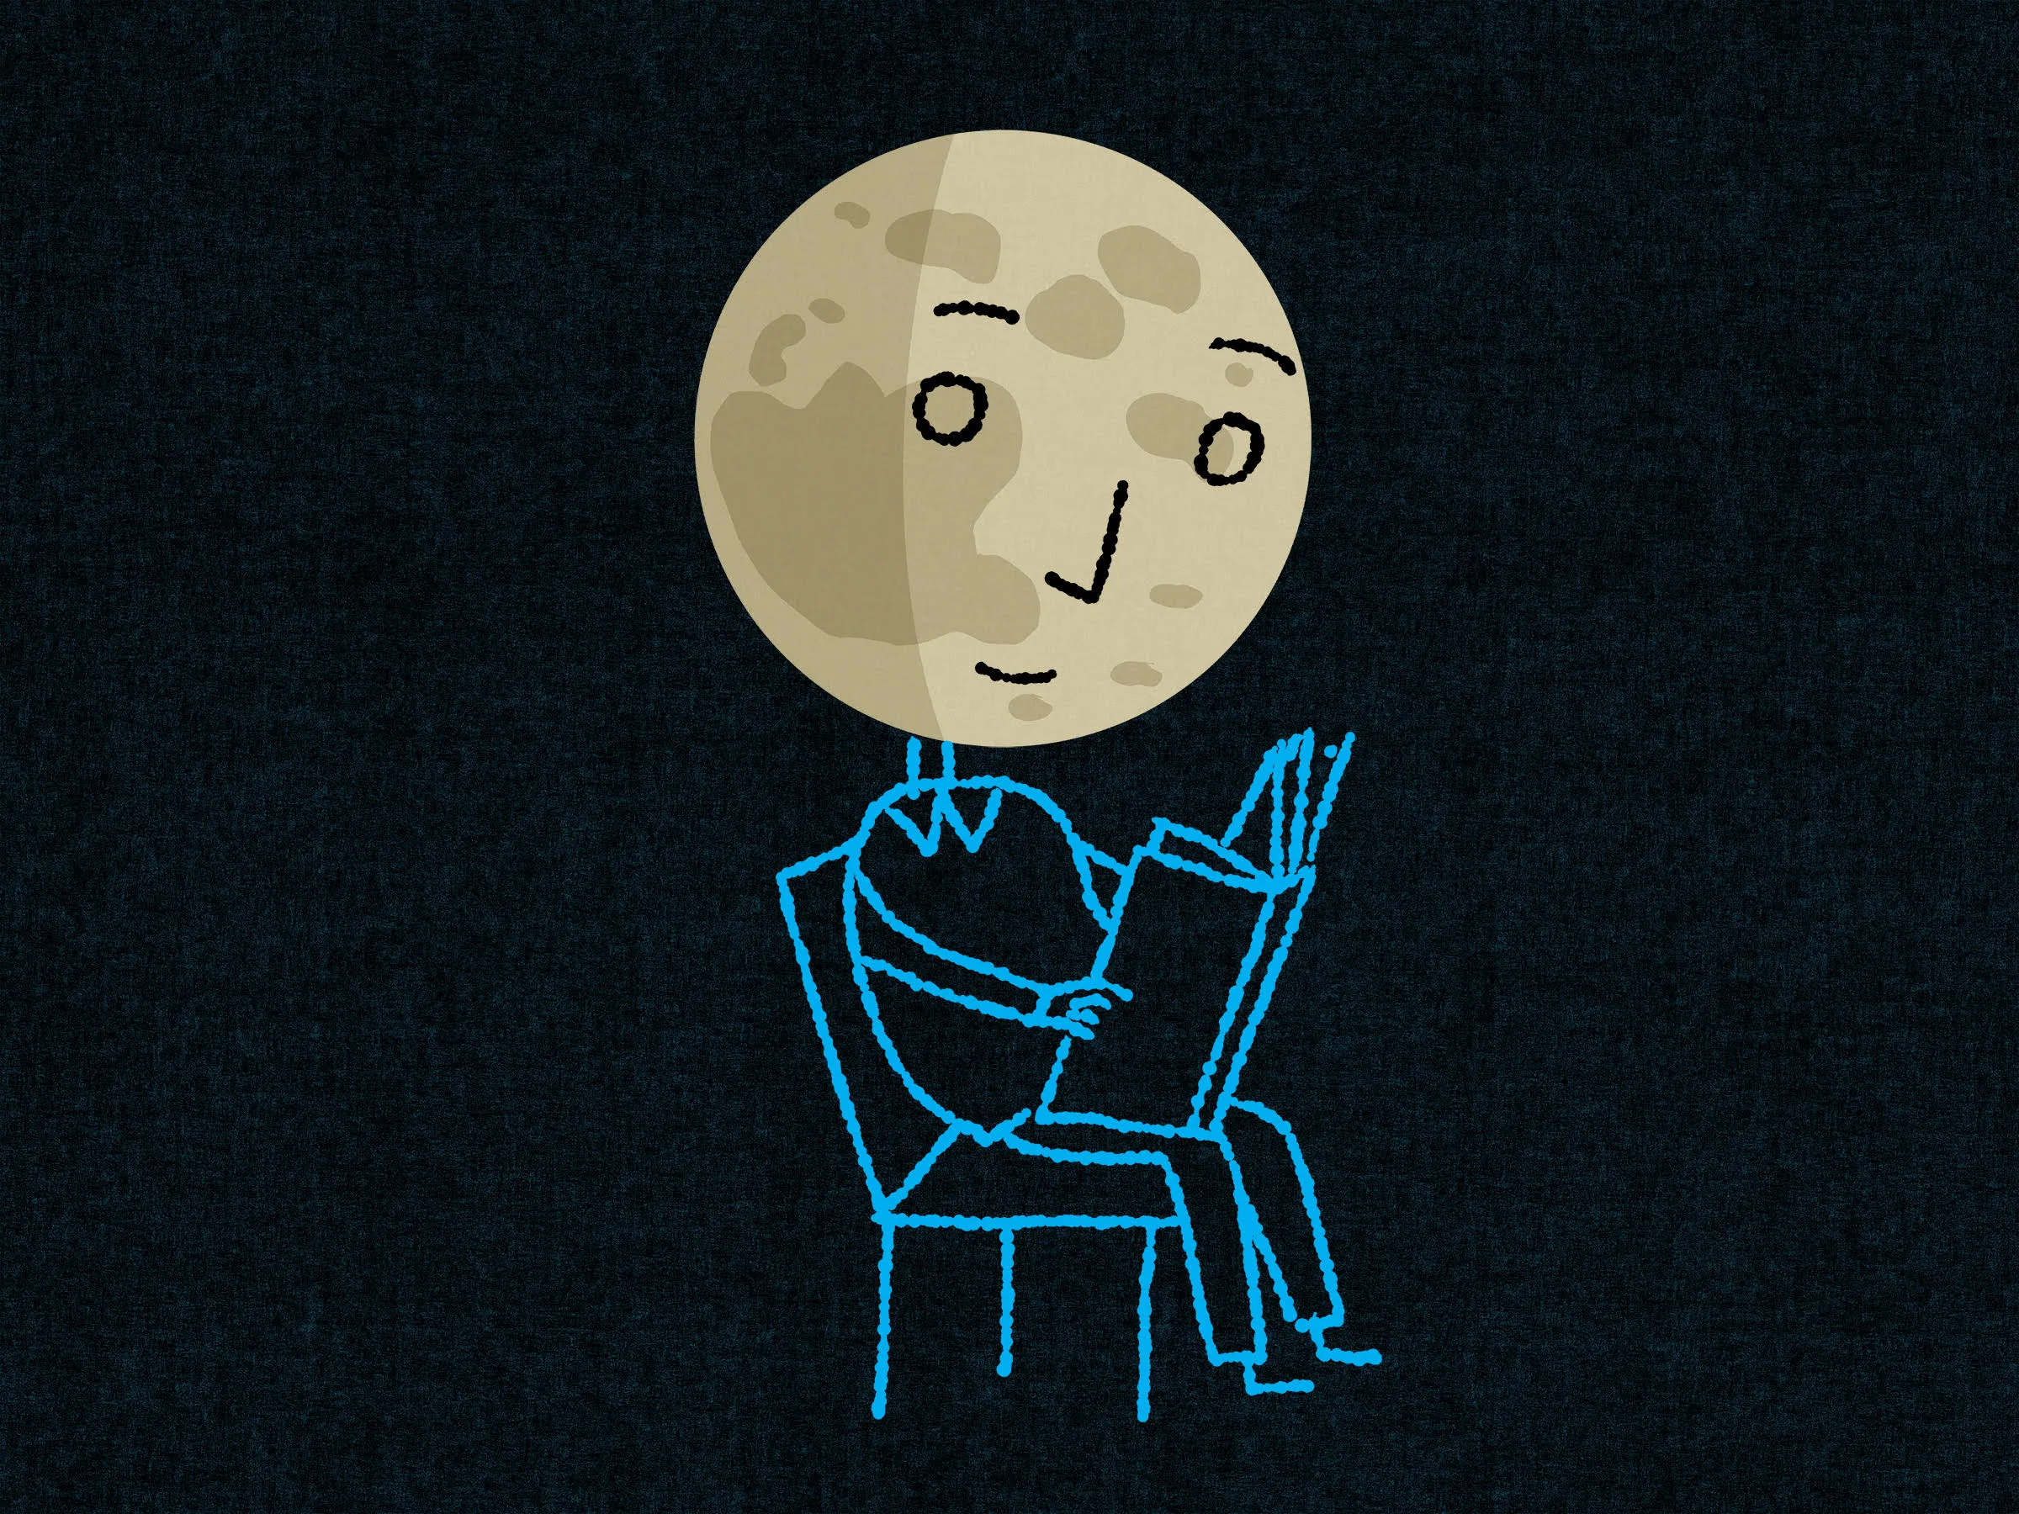
Fiction

Slide 3
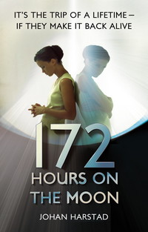
Three teenagers are going on the trip of a lifetime. Only one is coming back. It's been more than forty years since NASA sent the first men to the moon, and to grab some much-needed funding and attention, they decide to launch an historic international lottery in which three lucky teenagers can win a week-long trip to moon base DARLAH 2
Watch an interview with the author here

Slide 4
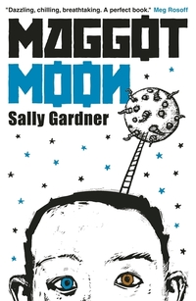
When his best friend Hector is suddenly taken away, Standish Treadwell realises that it is up to him, his grandfather and a small band of rebels to confront and defeat the ever-present oppressive forces of The Motherland.
A really interesting book that has more than a hint of Orwell plus a dose of conspiracy theory as well. Did you know that the author was expelled from school for being “thick” ( her words) and it was only till much later she was diagnosed with dyslexia.
Dyslexia, the moon and Sally

Slide 5
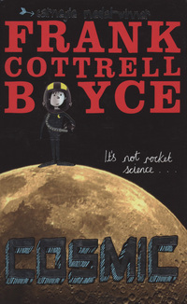
Super-sized Liam is the only 11 year old to ever ride the G-force defying Cosmic rollercoaster - or be offered the chance to ride a Porsche. Long-legged Liam makes a giant leap for boy-kind by competing with a group of adults for the chance to go into space- would you?

Slide 6
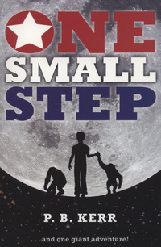
It's 1969 and 11-year-old Scott is doing all the things that normal boys do - as well as flying planes with his Air Force flight instructor dad. But when Scott successfully crash lands a training plane, NASA come to call. They are conducting a secret space programme - a test flight before the first moon landing. And who better to pilot their craft than a young boy aviator? This is the story of the secret mission that landed an eleven-year-old boy and two chimps on the moon months before Neil Armstrong. It is one exciting adventure and the ride of a lifetime!
Read on here…

Slide 7
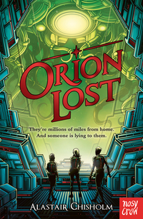
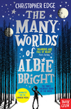
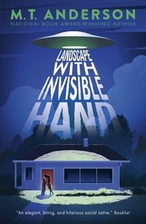
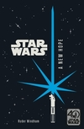
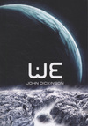
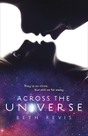
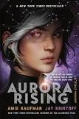
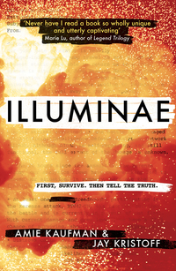

Slide 8
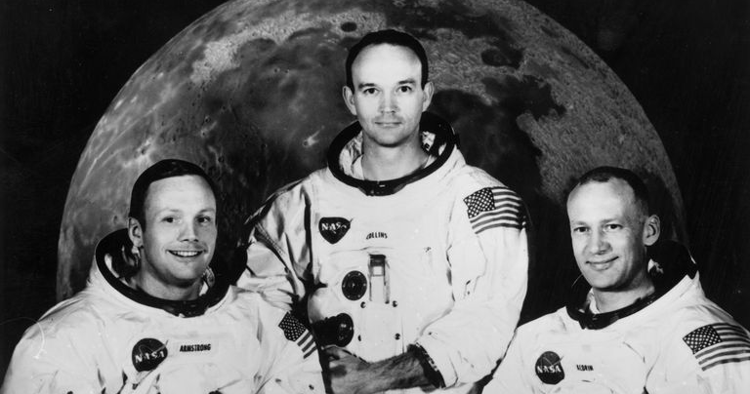
Non-Fiction
https://www.thoughtco.com/did-politics-fuel-the-space-race-3963848

Slide 9
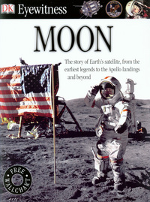
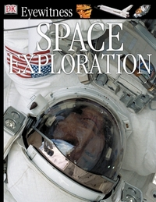
DK books are brilliant – that’s fact! High quality images and well researched information and some of the best page layouts you will find in non fiction.
Why not take a look at their web site for examples of what I am talking about? This edition on space exploration is one of the best (their dinosaurs one is great too).

Slide 10
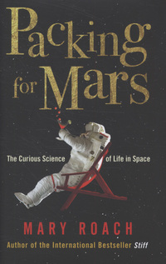
Space is a world devoid of the things we need to live and thrive. Space exploration is in some ways an exploration of what it means to be human. Space agencies have set up all manner of quizzical and startlingly bizarre space simulations, and it's possible to preview space without ever leaving Earth. But if you had to go what would you take and what would you leave? Hear the author talk about this very topic.

Slide 11
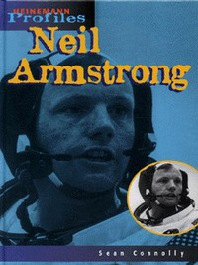
Neil Alden Armstrong was an American astronaut and aeronautical engineer, and the first person to walk on the Moon. He was also a naval aviator, test pilot, and university professor. This book is a great introduction to the great man himself. Often quiet and incredibly focussed, it was Neil who took that giant leap for mankind.

Slide 12
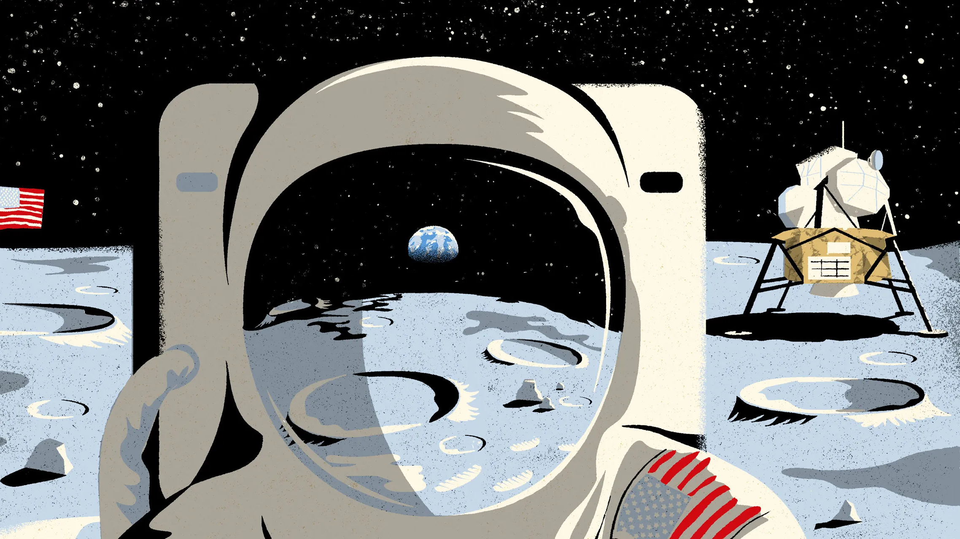
Graphic Novels

Slide 13
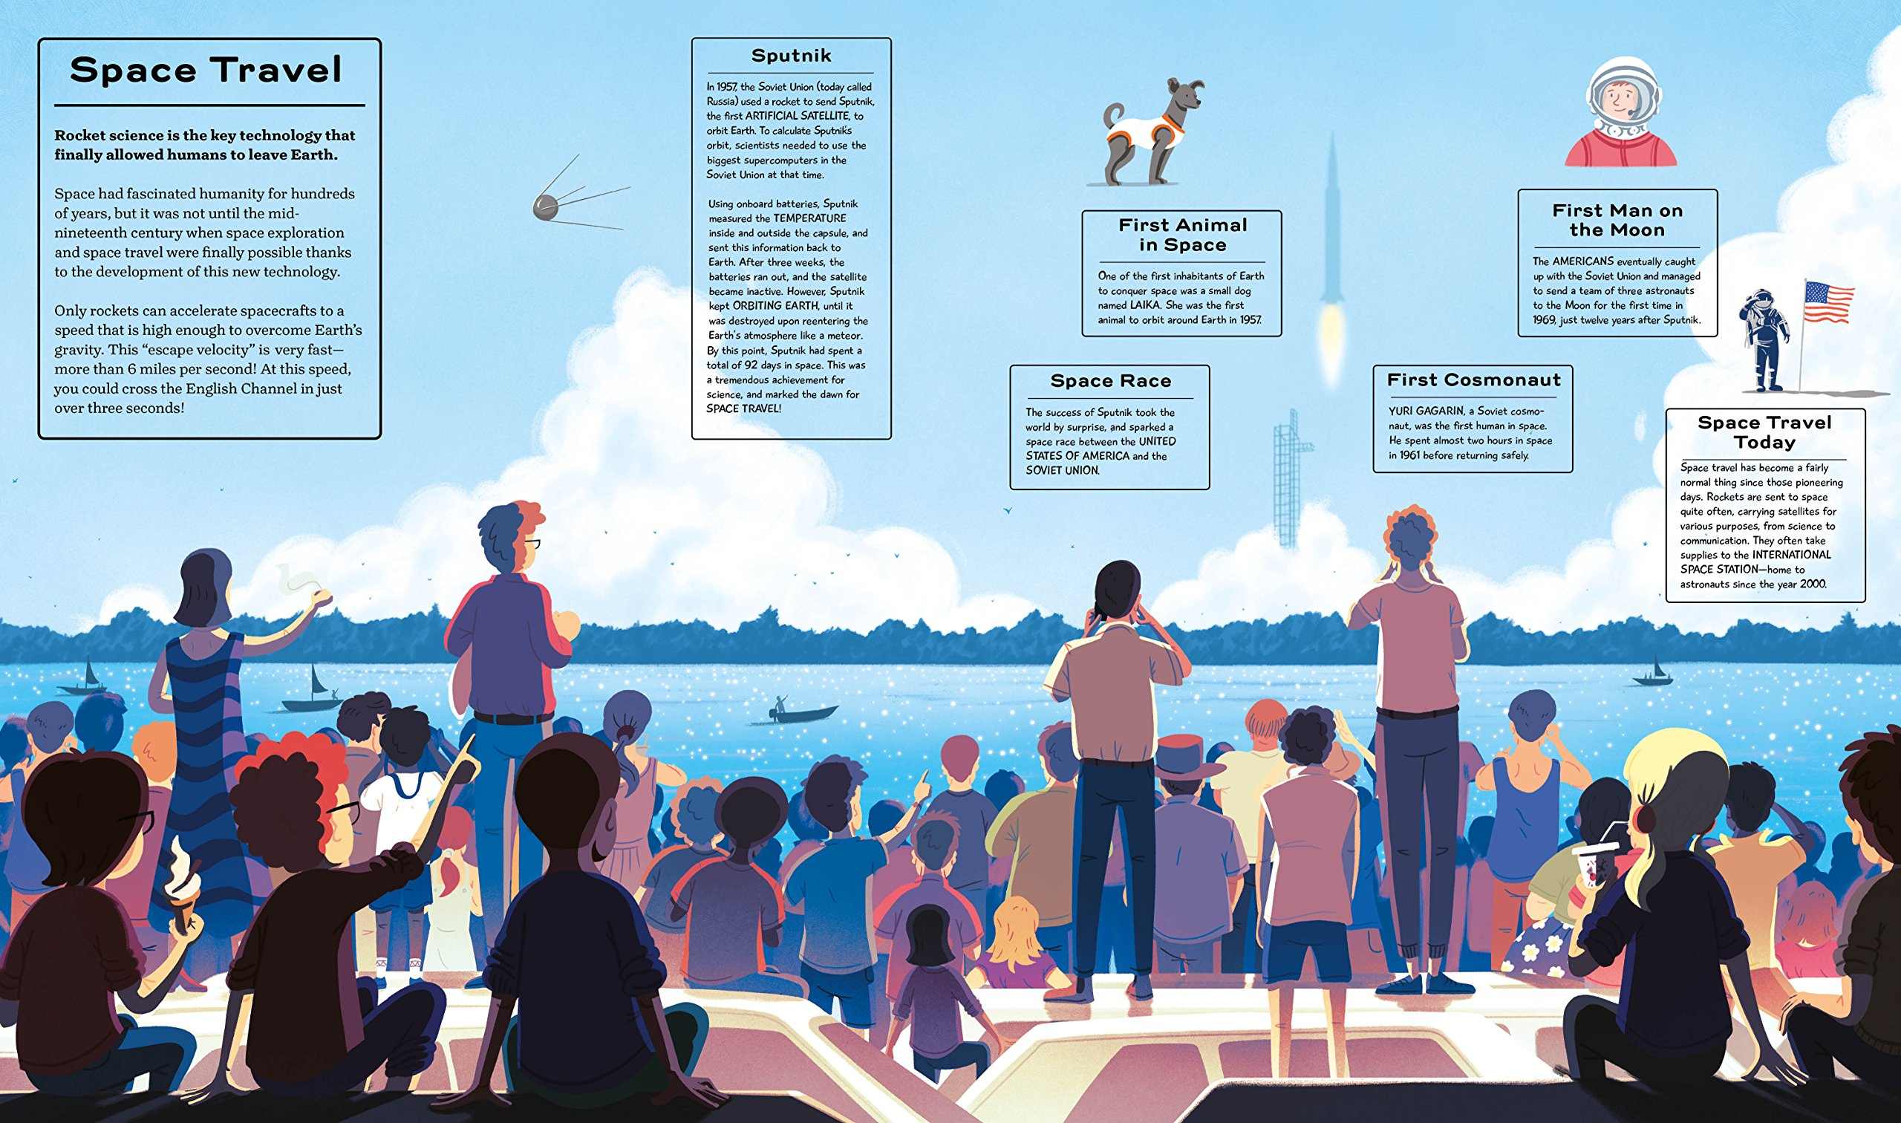
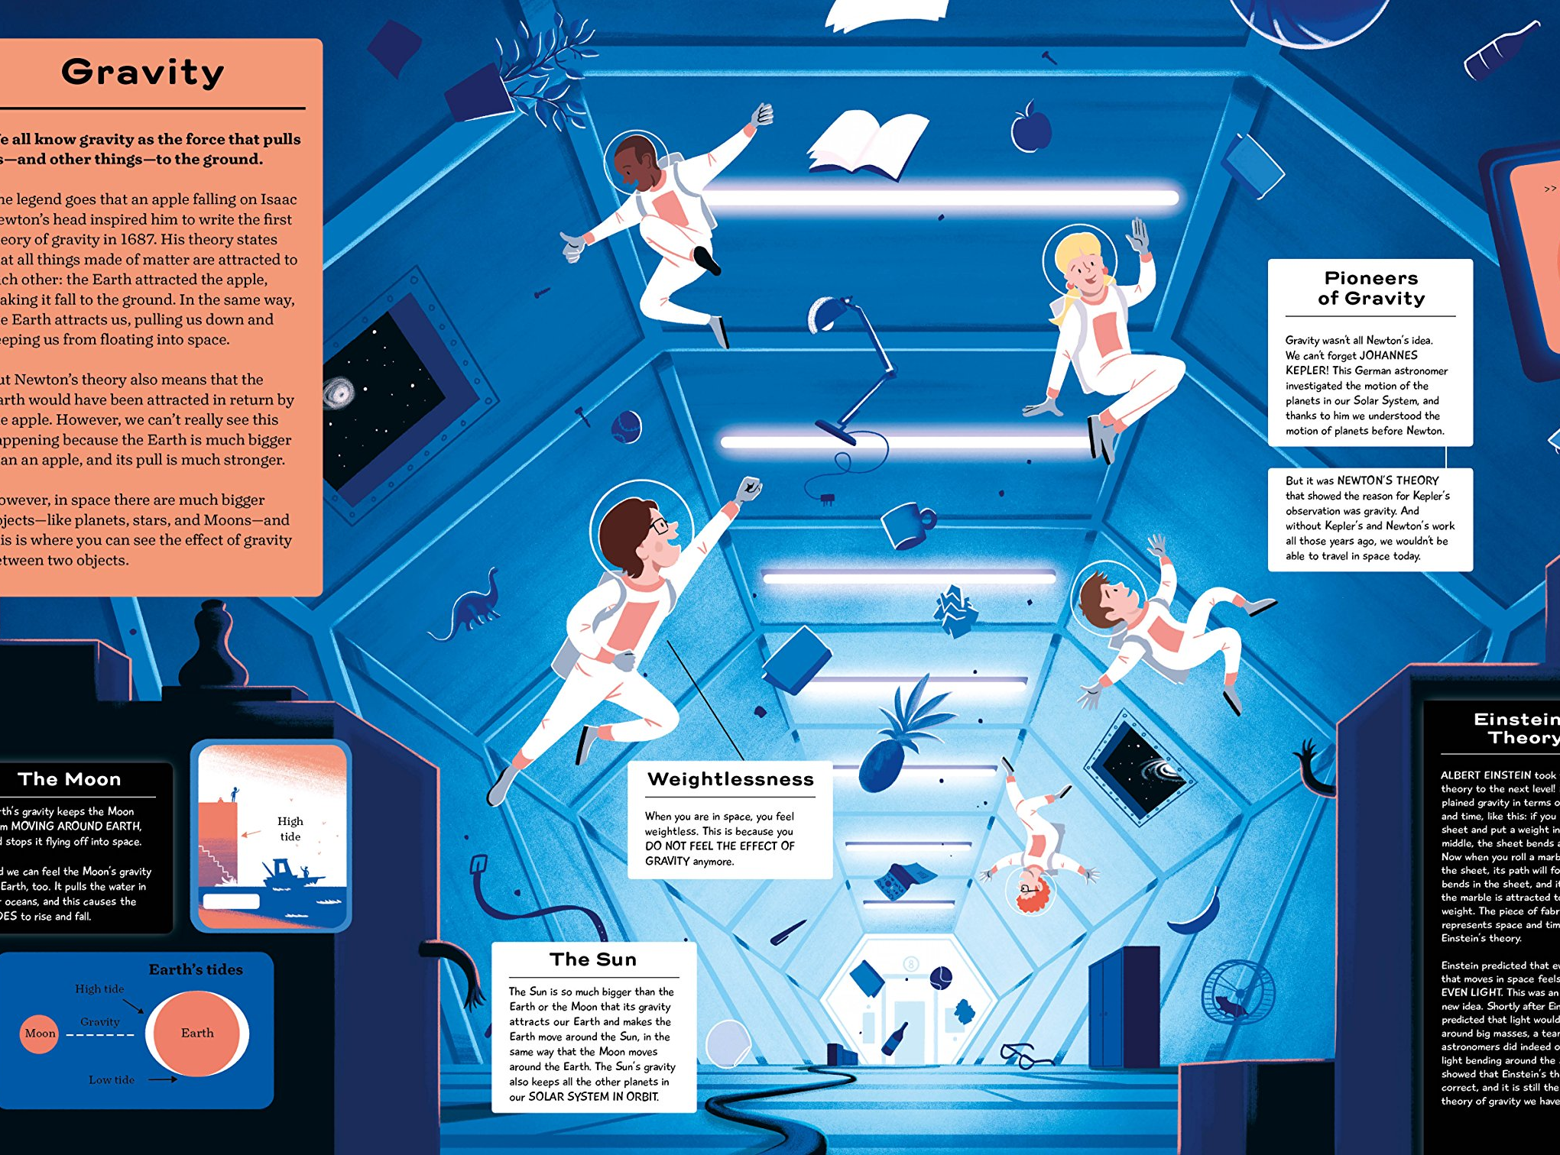
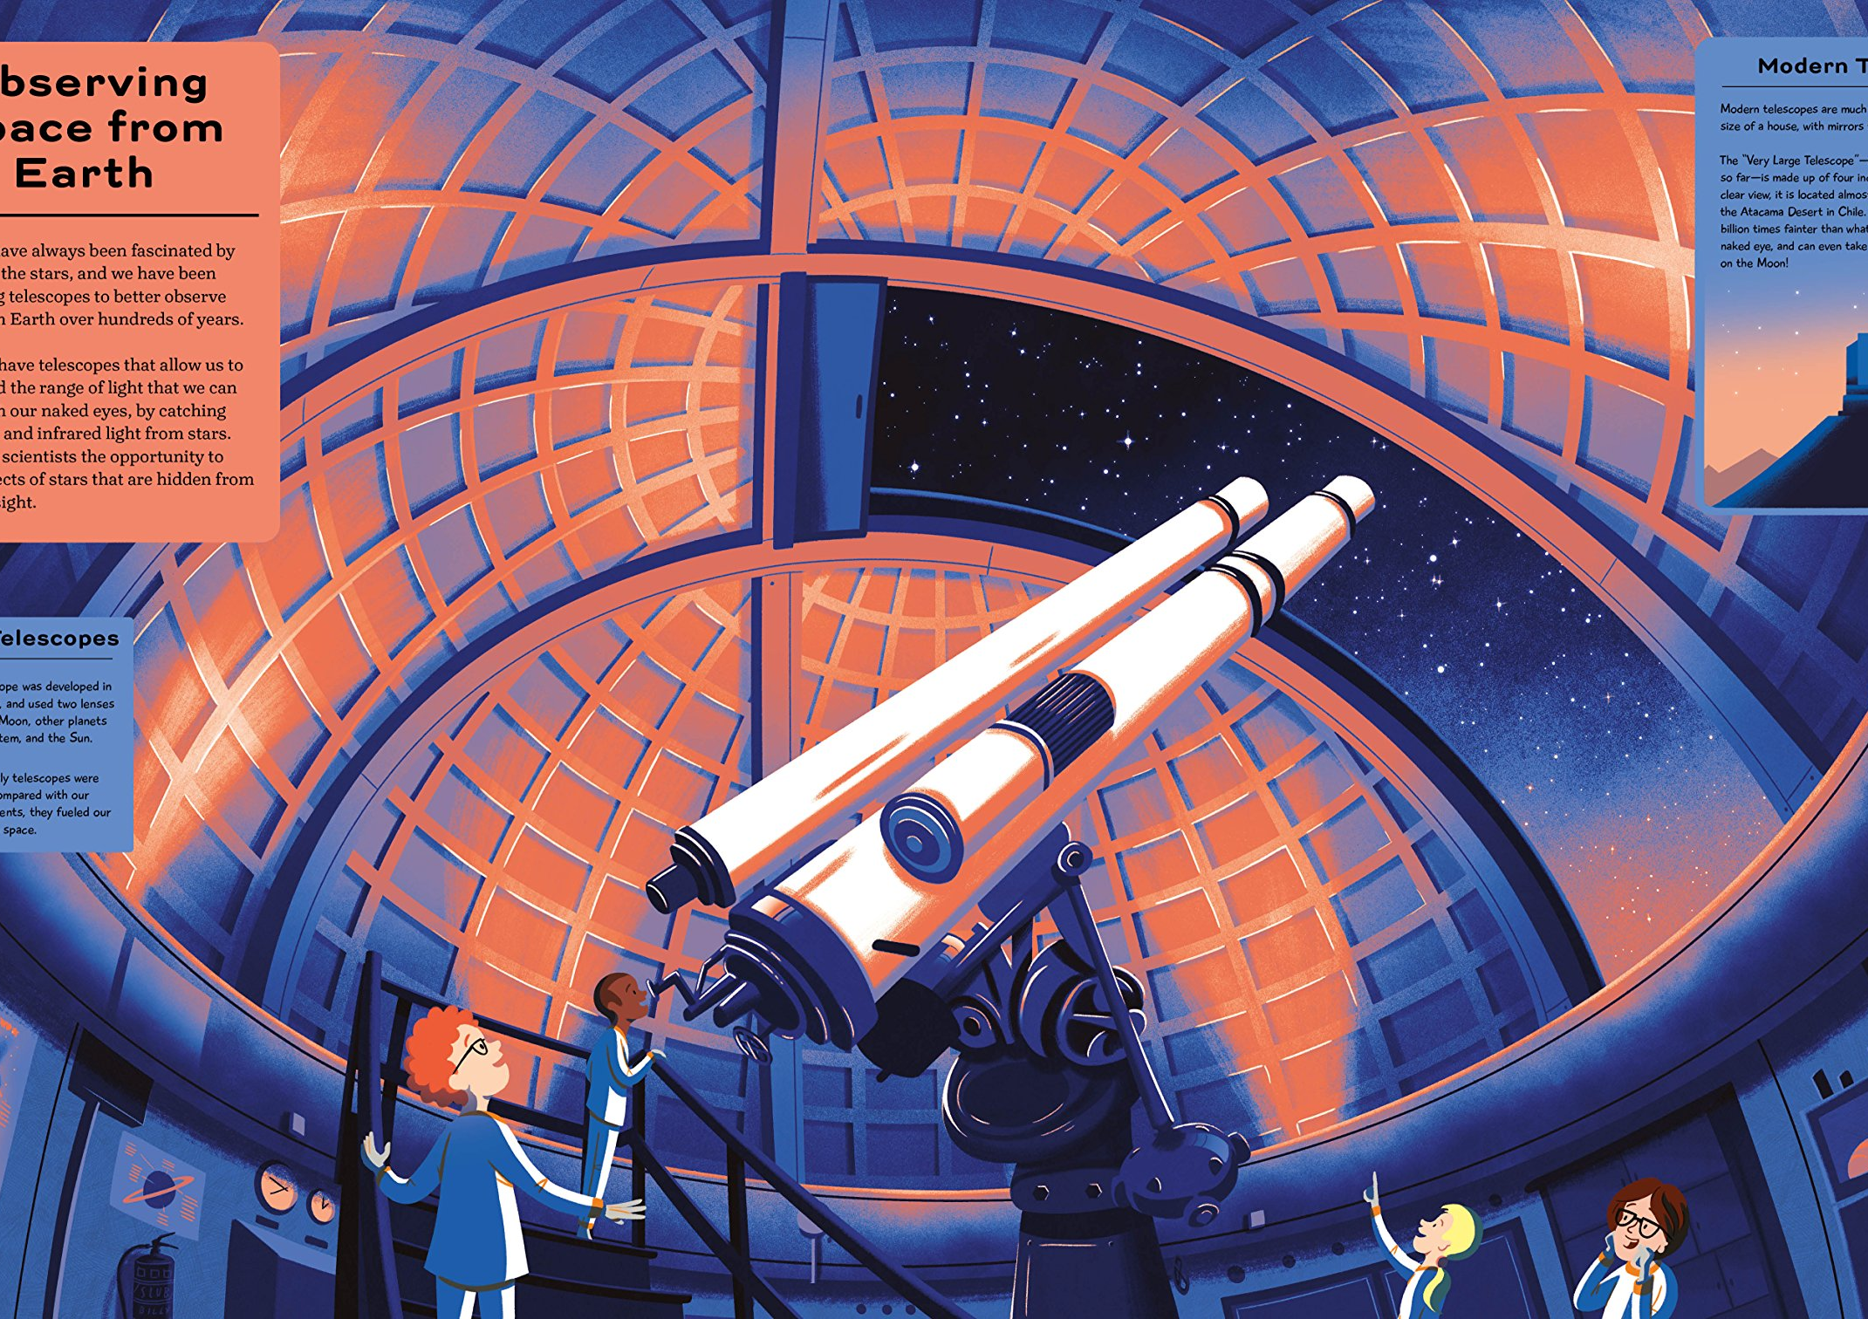
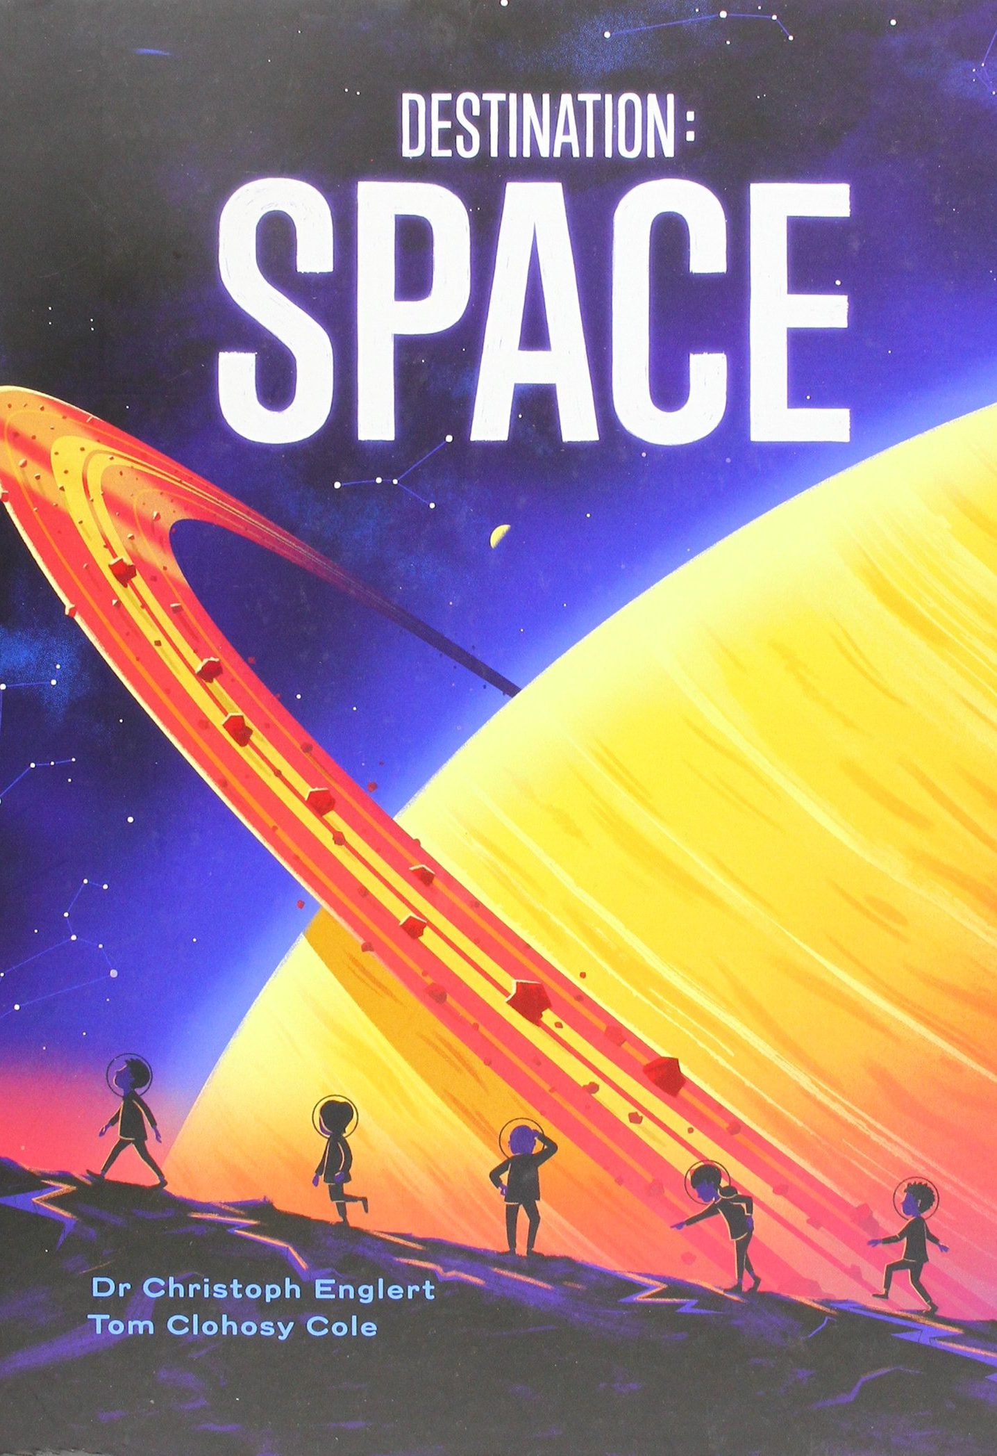
This book is big, bold and beautiful, every page is chock full of stunning images and nuggets of great facts. As bold as the topic it covers.

Slide 14
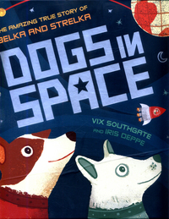
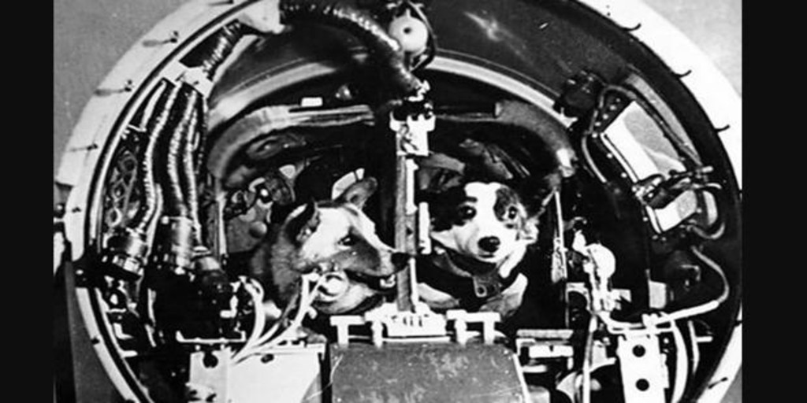
I love this big picture book telling the story of Belka and Strelka ; space dogs, and it’s all true. The illustrations are gorgeous and the dogs are heroic – what more do you want? Take a minute or two and find out what happened to them by following this link to the Cosmonautics Museum in Moscow.

Slide 15
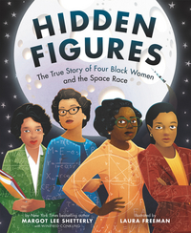
Based on the New York Times bestselling book and the Academy Award-nominated movie, author Margot Lee Shetterly and illustrator Laura Freeman bring the incredibly inspiring true story of four black women who helped NASA launch men into space to picture book readers! Dorothy Vaughan, Mary Jackson, Katherine Johnson, and Christine Darden were good at math - really good. They participated in some of NASA's greatest successes, like providing the calculations for America's first journeys into space. And they did so during a time when being black and a woman limited what they could do. But they worked hard. They persisted. And they used their genius minds to change the world. In this picture book edition, we explore the story of four female African American mathematicians at NASA and how they overcame gender and racial barriers to succeed in a highly challenging STEM-based career. See the movie trailer here.

Slide 16
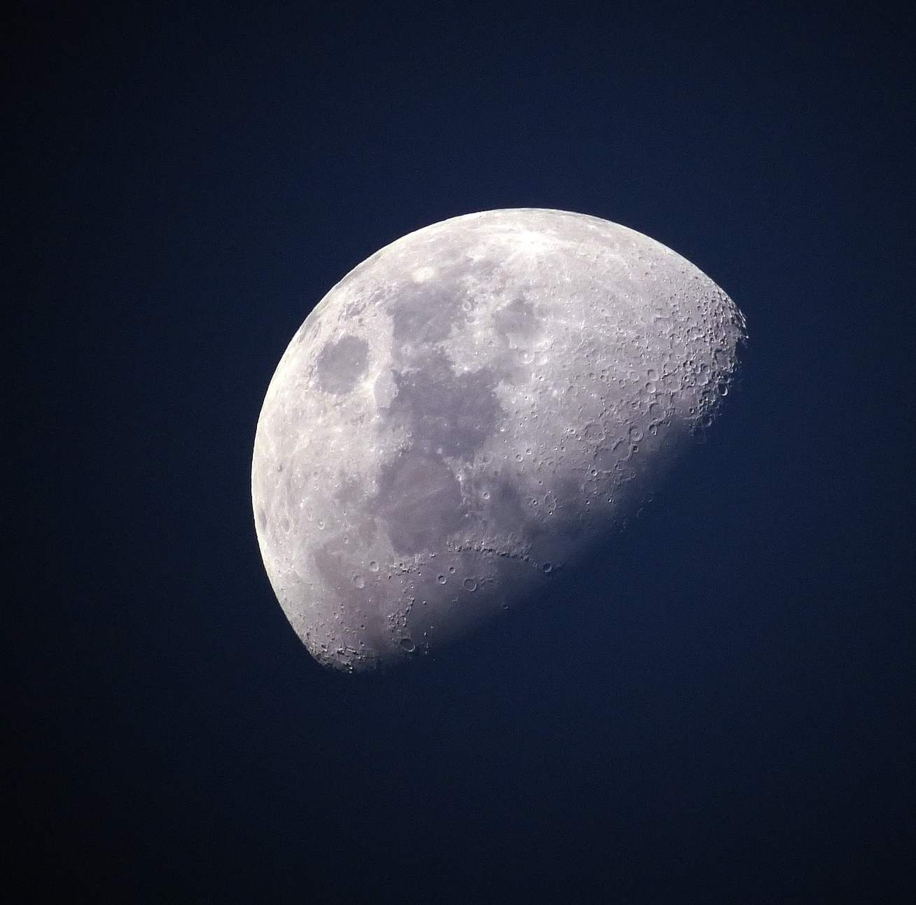

Slide 17
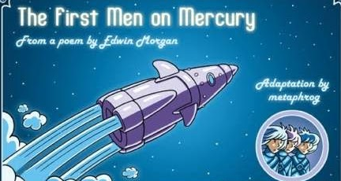
The First Men on Mercury by Edwin Morgan
The poem was given the graphic novel treatment by the talented Metaphrog from Glasgow.
You can take a look here and make of it what you will.

Slide 18
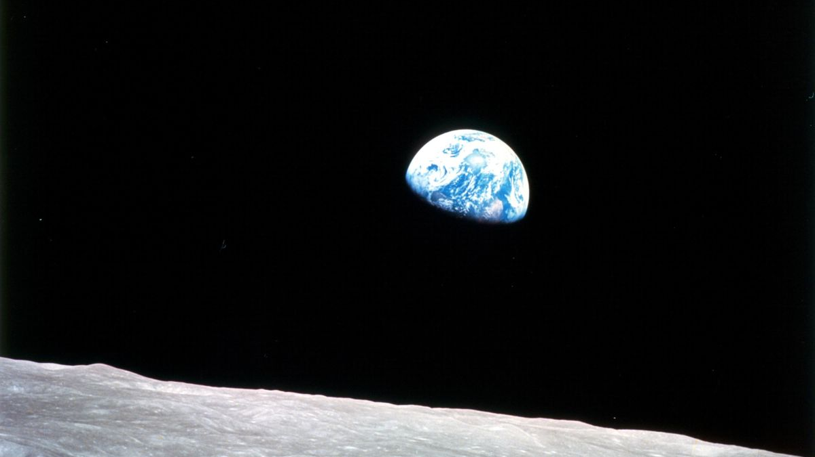
The Bonnie Broukit Bairn by Hugh MacDiarmid
Mars is braw in crammasy, Venus in a green silk goun, The auld mune shak’s her gowden feathers, Their starry talk’s a wheen o’ blethers, Nane for thee a thochtie sparin’ Earth, thou bonnie broukit bairn! – But greet, an’ in your tears ye’ll drown The haill clanjamfrie!
crammasy crimson wheen o’blethers pack of nonsense broukit neglected haill clanjamfrie whole crowd of them
You might just notice this poem is in Scots. It’s one of my favourites- can you work out what Hugh is saying about our Solar system? How many words do you understand? Did you need the mini glossary?
Here is a link to a Scots dictionary for help

Slide 19
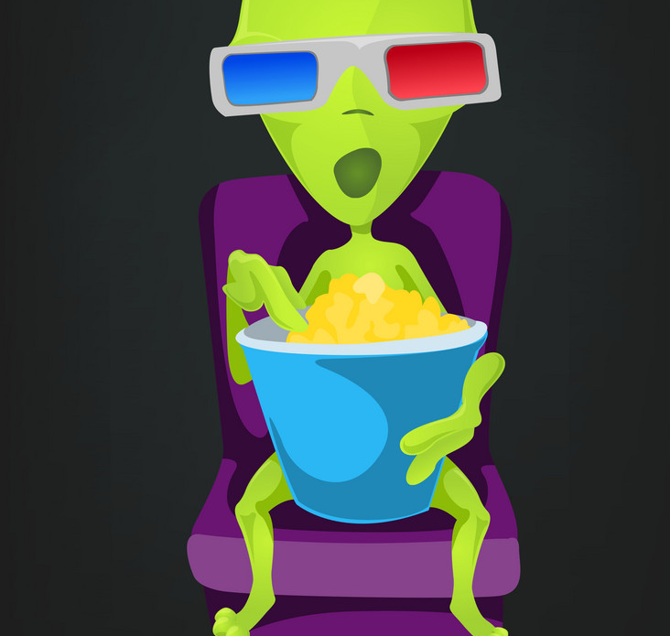

Slide 20
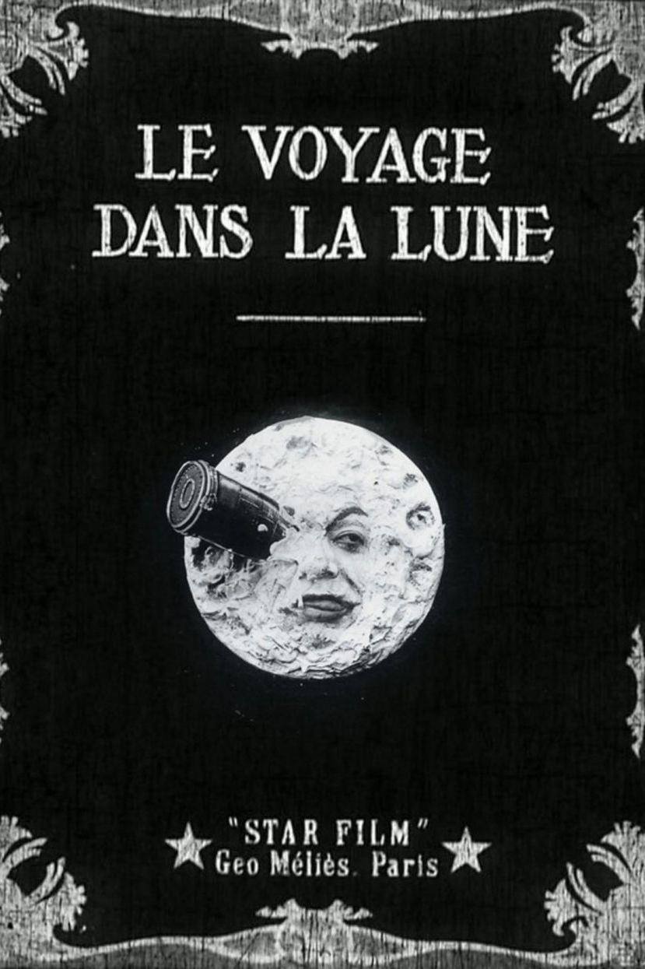
Did you know?
One of the very first movies to be made included a moon landing – well sort of.
A Trip to the Moon

Slide 21
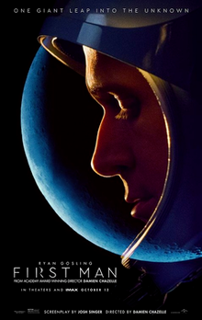
An interesting take on the moon landings based on a book of the same name about Neil Armstrong. It’s a long film and sometimes seems more like a documentary. It really gets into the mindset of one of the world’s most famous men. It was not a big hit at the box office but it’s a super film – I suggest if you plan to watch it – split it into a few parts rather than watching it in one sitting.
Take a test fight here

Slide 22
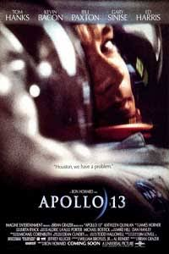
Arguably one of the best space movies of all time. You should recognise most of the actors especially the lead played by Tom Hanks. It’s another long film (they don’t seem to make short films about the space race; The Right Stuff for example is 3 hours and 13 minutes long!) but totally worth it. Even though we all know what is going to happen this movie keeps you on the edge of your seat willing the astronauts well.
Houston we have a problem

Slide 23
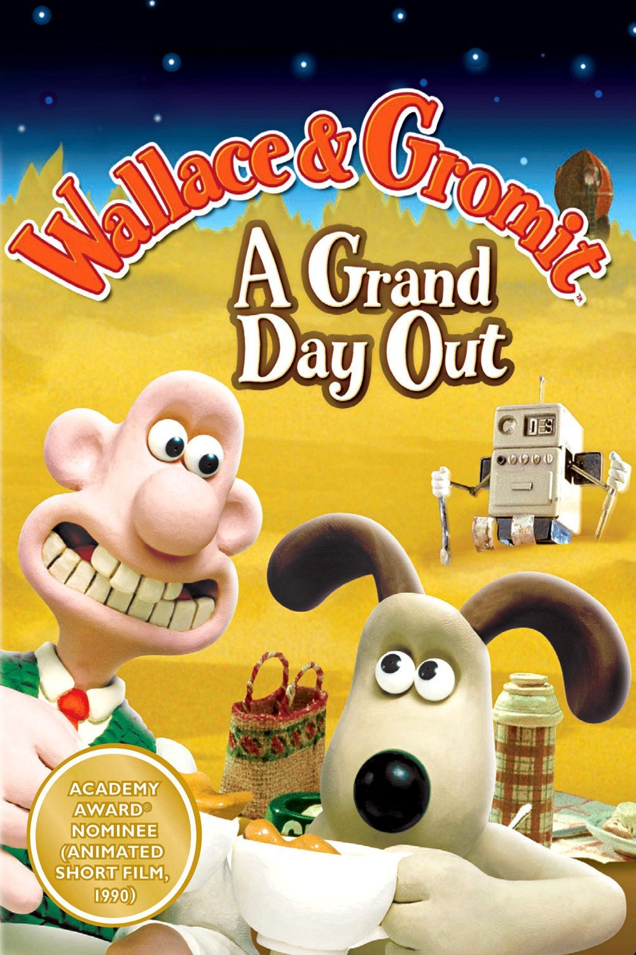
Can I really include this one?
What is the moon really made out of?
Click the cheese to find out!

Slide 24
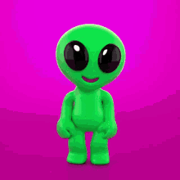
Let me know
Do you know of ay other great books or movies or poems that would help with this topic?
Just get in touch and I can add them in.
Take care and hope to see you soon.
Mrs. Baird

