Slide 1
Civil Rights Movement
“My mission in life is not merely to survive, but to thrive; and to do so with some passion, some compassion, some humor, and some style” ― Maya Angelou
Reading around your topic

Slide 2
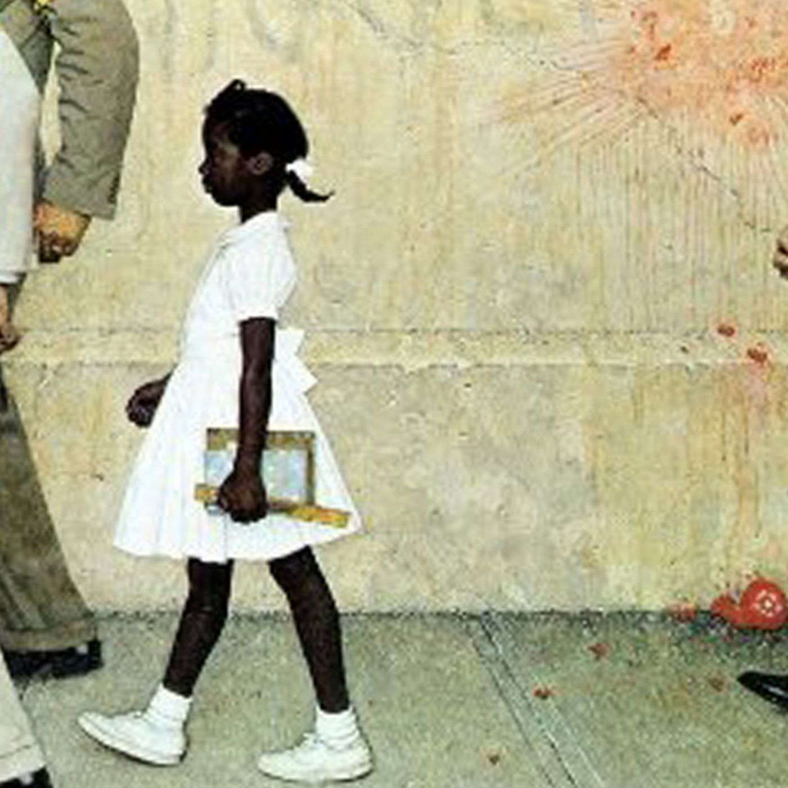
Fiction Titles
"The Problem We All Live With" is a 1964 painting by Norman Rockwell. An iconic image of the civil rights movement in the United States, it depicts Ruby Bridges, a six-year-old African-American girl, on her way into an all-white public school in New Orleans on Nov. 14, 1960, during the process of racial desegregation. [Times files] Use the hyperlink to read an interview with Ruby.

Slide 3
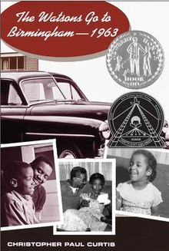
Lies we tell ourselves
Talley, Robin, author
In 1959 Virginia, the lives of two girls on opposite sides of the battle for civil rights will be changed forever. Sarah Dunbar is one of the first black students to attend the previously all-white Jefferson High School. Linda Hairston is the daughter of one of the town's most vocal opponents of school integration. She has been taught all her life that the races should be kept 'separate but equal.' Forced to work together on a school project, Sarah and Linda must confront harsh truths about race, power and how they really feel about one another
This book tells the story of a loving African-American family living in the town of Flint, Michigan, in 1963. When the oldest son (Byron) begins to get into a bit of trouble, the parents decide he should spend the summer and possibly the next school year with Grandma Sands in Birmingham, Alabama. The entire family travels there together by car, and during their visit, tragic events take place. The book was adapted for Hallmark Channel in 2013. Click the link

Slide 4
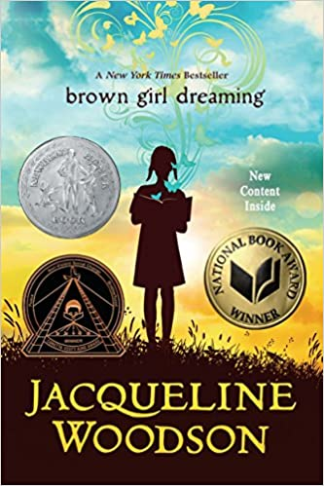
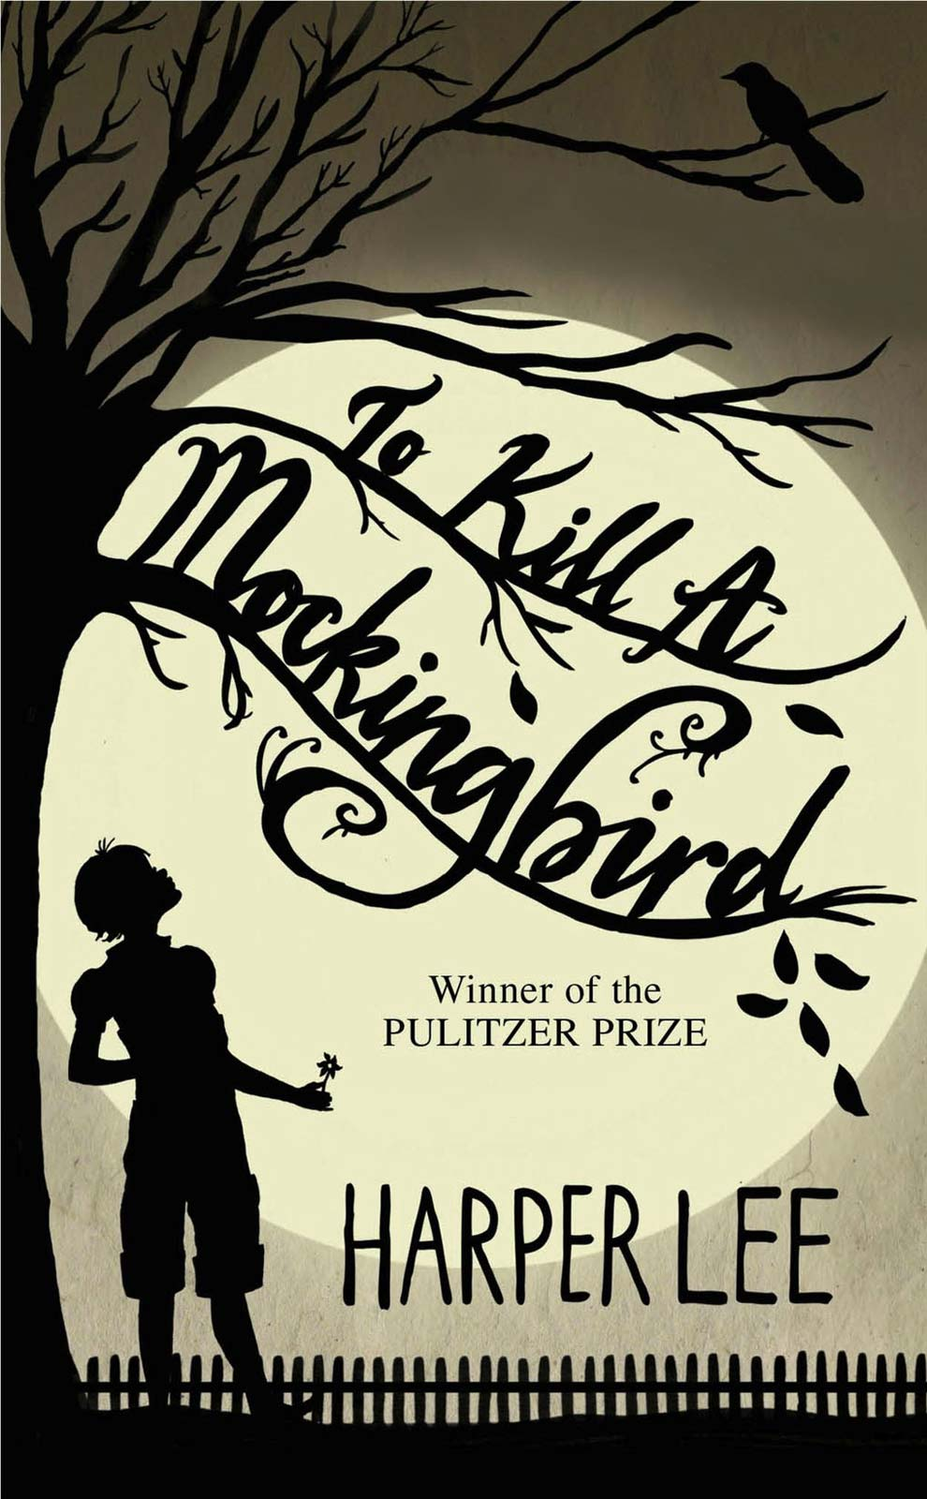
Raised in South Carolina and New York, Woodson always felt halfway home in each place. In vivid poems, she shares what it was like to grow up as an African American in the 1960s and 1970s, living with the remnants of Jim Crow and her growing awareness of the Civil Rights movement. Touching and powerful, each poem is both accessible and emotionally charged, each line a glimpse into a child’s soul as she searches for her place in the world. Click the link to listen to an excerpt read by the author
The unforgettable novel of a childhood in a sleepy Southern town and the crisis of conscience that rocked it. "To Kill A Mockingbird" became both an instant bestseller and a critical success when it was first published in 1960. It went on to win the Pulitzer Prize in 1961 and was later made into an Academy Award-winning film, also a classic. Click the link to see the original movie trailer.

Slide 5
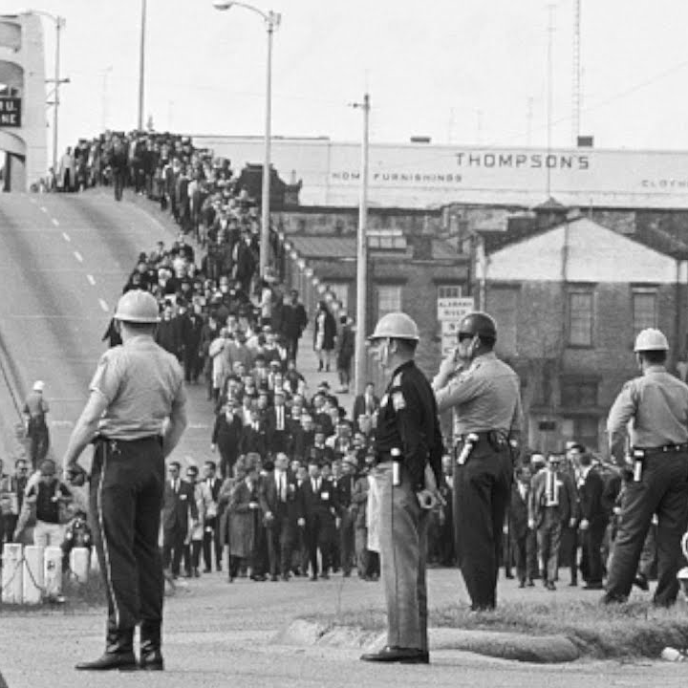
Non-Fiction Titles
The Selma to Montgomery marches were three protest marches, held in 1965, along the 54-mile (87 km) highway from Selma, Alabama, to the state capital of Montgomery. [Image from YouTube]

Slide 6
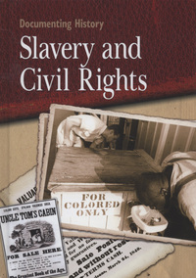
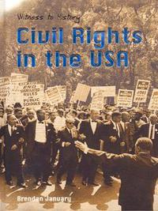
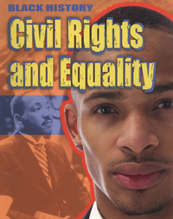
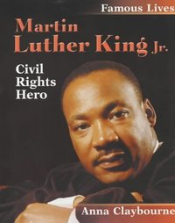
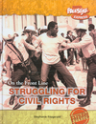

Slide 7
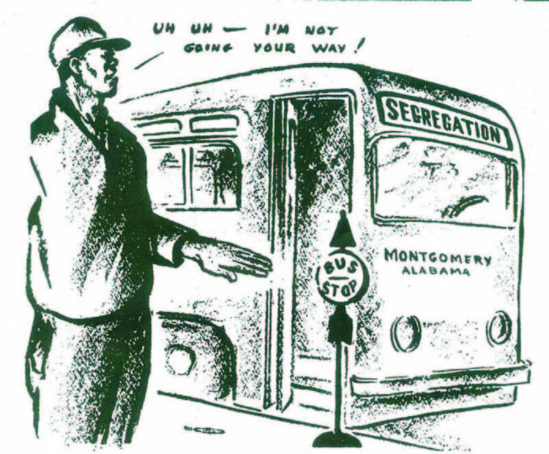
Graphic Novels
Cartoon of the Montgomery bus boycott 1955-56.

Slide 8
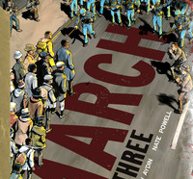
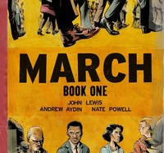
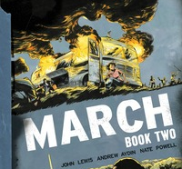
'March' is a vivid, first-hand account of John Lewis' lifelong struggle for civil and human rights (including his key roles in the historic 1963 March on Washington and the 1965 Selma-Montgomery March), meditating in the modern age on the distance travelled since the days of Jim Crow and segregation. John Robert Lewis (February 21, 1940 – July 17, 2020)
Fun Fact- John Lewis once “liked” a Tweet from Mrs. Baird about these very books!

Slide 9
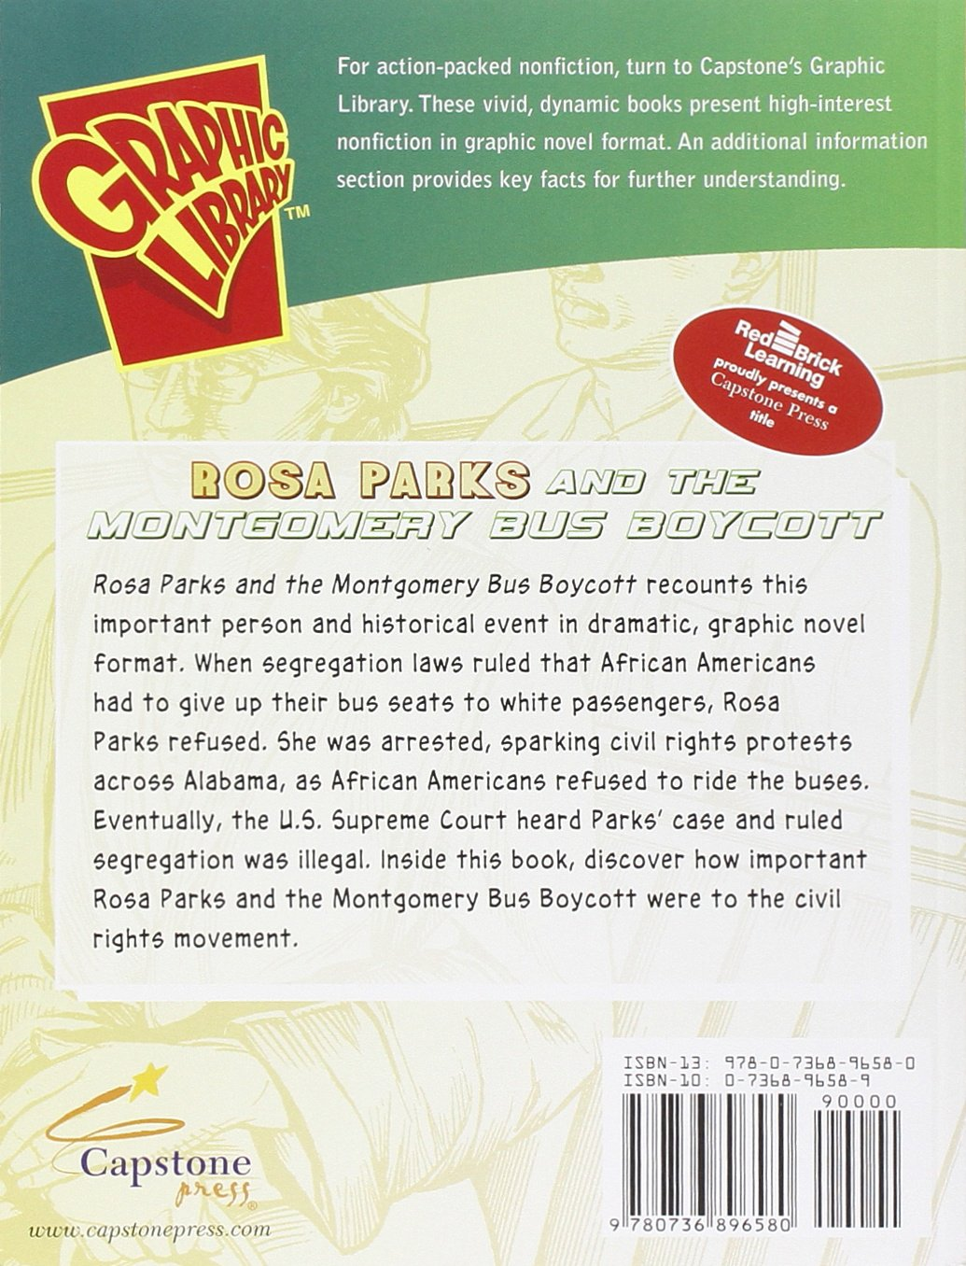
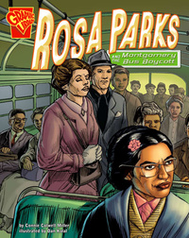
Nicely laid out and well-designed graphic novel telling the story of Rosa Parks and the Montgomery bus boycott.
If you want to know more you might like to watch the Dr Who episode- Rosa written by none other than the amazing Malorie Blackman. Available on BBC iPlayer Click the link.

Slide 11
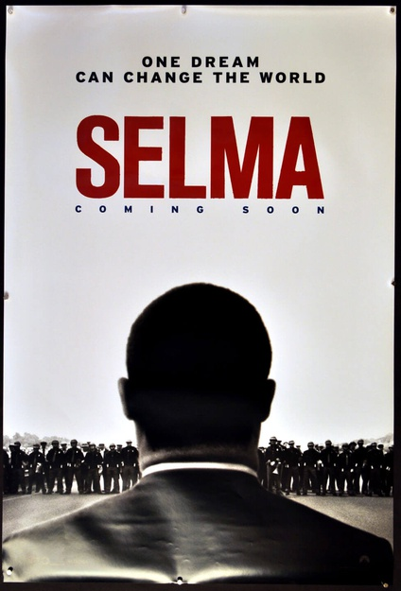
“Selma”
“Selma” (2014) is a chronicle of Dr. Martin Luther King, Jr.’s life and his pursuit for equal voting rights, centered on the historic 1965 march from Selma to Montgomery, Ala. The film, starring David Oyelow as the late Dr. King, follows the true story of the famous activist embarking on a dangerous three-month campaign to secure equal voting rights for African Americans, culminating in President Johnson signing the Voting Rights Act of 1965. This is a powerful film that you will be thinking about long after the credits roll. Amazing acting as well.

Slide 12
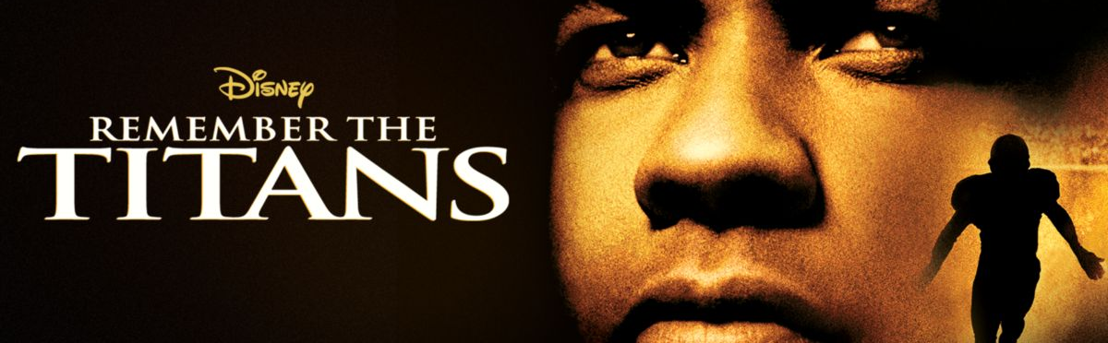
Denzel Washington stars in this iconic film about the 1971 court-mandated desegregation of Virginia high schools, portraying football coach Herman Boone. As the school’s first black coach, he faces the obstacles of prejudice and the challenge of uniting the team and leading them to victory. “Remember the Titans” (2000) remains one of the greatest sports films of all time that’s about so much more than just the game. And you know if Denzel is in it it’s going to be great.

Slide 13
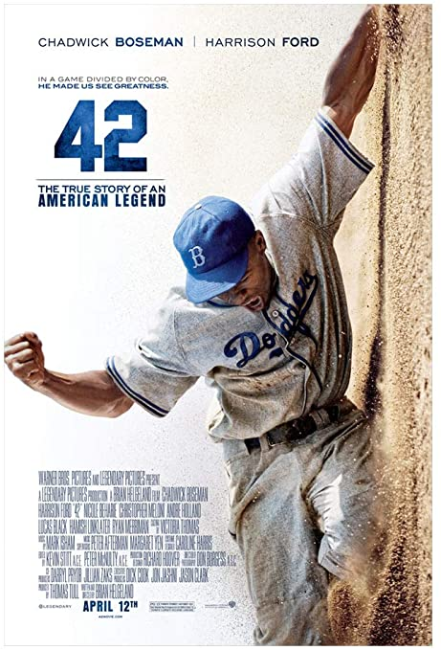
“42” (2013) – The story of Jackie Robinson from his signing with the Brooklyn Dodgers organization in 1945 to his historic 1947 rookie season when he broke the color barrier in Major League Baseball, including the hardships he faced from racist teammates, fans, and others. I saw this film recently and it was just fantastic. Be aware that there is some racist language.
The late Chadwick Boseman ( Black Panther) is utterly fantastic, and Harrison Ford is almost unrecognizable; a truly great film.

Slide 14
Other sources you might like to try
There are lots of songs from this era you might want to listen to – click on this link for some suggestions.
You might want to look at some of the resources from the Civil Rights Museum in Memphis. Yes, this is the actual hotel where Martin Luther King was shot.
Remember to use the library catalogue if you need it and use BorrowBox to download straight to your device. Any questions just get in with Mrs Baird contact.
Take care.

