Slide 1


Mearns Castle Cluster
Fractions, Decimals and Percentages
Early Level
First Level
Second Level
Third Level
Fourth Level

Slide 2
Fractions – Early Level
When learning about fractions your child will share out a group of items by making smaller groups and can split a whole object into
smaller parts.
Skills:
  Give out individual items from a set.
  Split a whole object into smaller parts
  Split a whole object into a specified number of parts
  Identify the importance of equal sharing when splitting a whole object into smaller parts
  Understand the concept of “half”

Slide 3
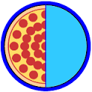
Early Level
  Understand the concept of ‘half’
A song about halves
http://www.bbc.co.uk/education/clips/z6bq6sg
Notes:
Introduction
Design to support
Facilitate

Slide 4
  Fractions – Early Level
Early Level
Use materials, cubes, draw out problem, act out
Calum and Lisa have 4 cupcakes to share between them. How many cup
cakes do they get each?
Sarah has 8 dolls. She has 2 doll houses, how many dolls go in each house?
David has 9 sweets. He wants to share these with his 3 friends. How many sweets does each friend get?
Megan has 15 cookies. She puts 3 cookies in each bag. How many bags can she fill?
Mrs Stewart has 20 pencils. She wants to put hem into 4 boxes so that each box has the same amount. How many pencils in each box?

Slide 5
Early Level
Notes:
Introduction
Design to support
Facilitate

Slide 6
First Level Fractions
and
Across First level your child will be exploring fractions by taking part in practical activities.
Your child will be able to show understanding of:
how a single item can be shared equally
the notation and vocabulary associated with fractions
where simple fractions lie on the number line.
They will then explore how groups of items can be shared equally, and will be able to find a fraction of an amount by applying knowledge of division.
Through taking part in practical activities including use of pictorial representations, your child will demonstrate understanding of simple fractions which are equivalent.

Slide 7
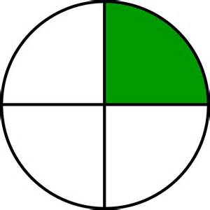
First Level
  Understand the concept of ‘quarter’
Your child will build on their knowledge of ‘half’ and the term ‘quarter’ is
introduced.
Fractions Song
Notes:
Introduction
Design to support
Facilitate

Slide 8
Your child will be able to show understanding of how a single item can be shared equally
First Level
Use materials, cubes, draw out problem, act out
Cara brought a pizza for lunch. She wanted to share the pizza equally with her friend. How much pizza did they each get?
Sam brought a large cake to a sleepover. There were 4 children altogether at the sleepover how much cake did each child get?

Slide 9
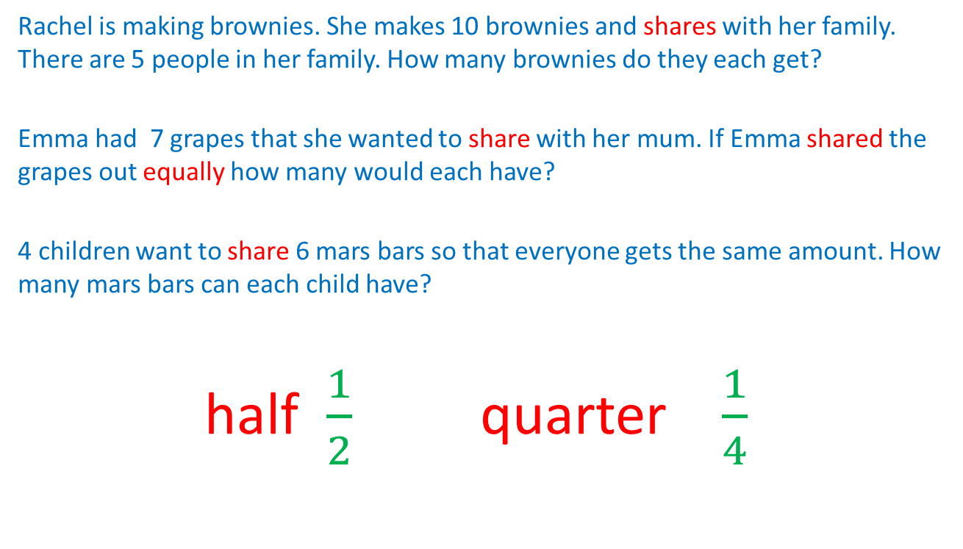
Your child will be able to show understanding of the notation and vocabulary associated with fractions
First Level
Rachel is making brownies. She makes 10 brownies and shares with her family. There are 5 people in her family. How many brownies do they each get?
Emma had 7 grapes that she wanted to share with her mum. If Emma shared the grapes out equally how many would each have?
4 children want to share 6 mars bars so that everyone gets the same amount. How many mars bars can each child have?
half $\frac{1}{2}$ quarter $\frac{1}{4}$

Slide 10
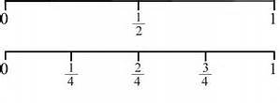
Your child will be able to show understanding of where simple fractions lie on the number line.
First Level

Slide 11
They will then explore how groups of items can be shared equally, and will be able to find a fraction of an amount by applying knowledge of division.
First Level
Rachel is making brownies. She makes 10 brownies and shares with her brother. How many brownies do they each get?
Emma had 8 grapes that she wanted to share with her mum. If Emma shared the grapes out equally how many would each have?

Slide 12
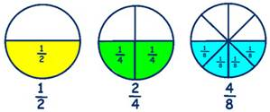
Through taking part in practical activities including use of pictorial representations, your child will demonstrate understanding of simple fractions which are equivalent.
First Level

Slide 13

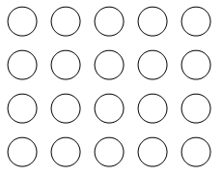
Finding a simple fraction of a single item
First Level
Further Examples

Slide 14
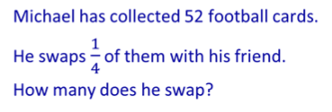
First Level
Further Examples - 2

Slide 15
First Level
Further Examples - 3
Copy this Flag in your jotter.
2/3 of the Nigeria flag is green
1/3 of the Nigeria flag is white.
Use colouring pens or pencils to
colour the flag of Nigeria.
Copy this flag into your jotter.
1/3 of the Italy flag is green.
1/3 is white and 1/3 is red.
Use colouring pens or pencils
to colour the flag of Italy.

Slide 16
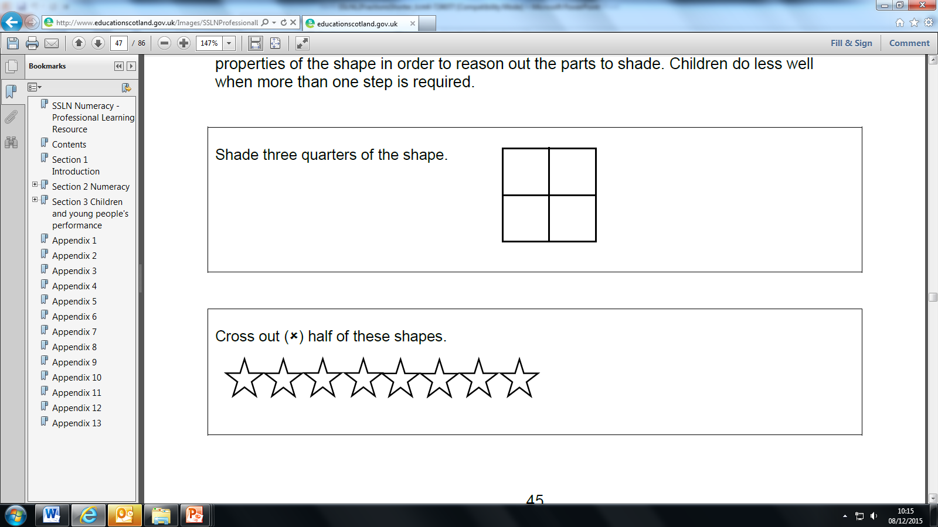
First Level
Further Examples - 4

Slide 17
Video Links
First Level
http://www.mathsisfun.com/numbers/fractions-match-frac-line.html
http://www.bbc.co.uk/learningzone/clips/ordering-fractions-on-a-number-line-signed/1662.html

Slide 18
Second Level
Your child will be able to investigate the everyday contexts in which simple fractions, percentages or decimal fractions are used and can carry out the necessary calculations to solve related problems.
Your child will be able to show the equivalent forms of simple fractions, decimal fractions and percentages and can choose their preferred form when solving a problem, explaining their choice of method.
They will also be able to investigate how a set of equivalent fractions can be created, understanding the meaning of simplest form, and can apply their knowledge to compare and order the most commonly used fractions.

Slide 19
Your child will be able to investigate the everyday contexts in which simple fractions, percentages or decimal fractions are used and can carry out the necessary calculations to solve related problems.
Second Level
Challenge Level - 1
There are 12 children who want to share 6 apple pies so that everyone gets an equal share. What fraction of the pie will each child get?
Challenge Level - 2
There are 12 children who want to share 3 apple pies so that everyone gets an equal share. What fraction of the pie will each child get?
Challenge Level - 3
There are 12 children who want to share 8 apple pies so that everyone gets an equal share. What fraction of the pie will each child get?

Slide 20
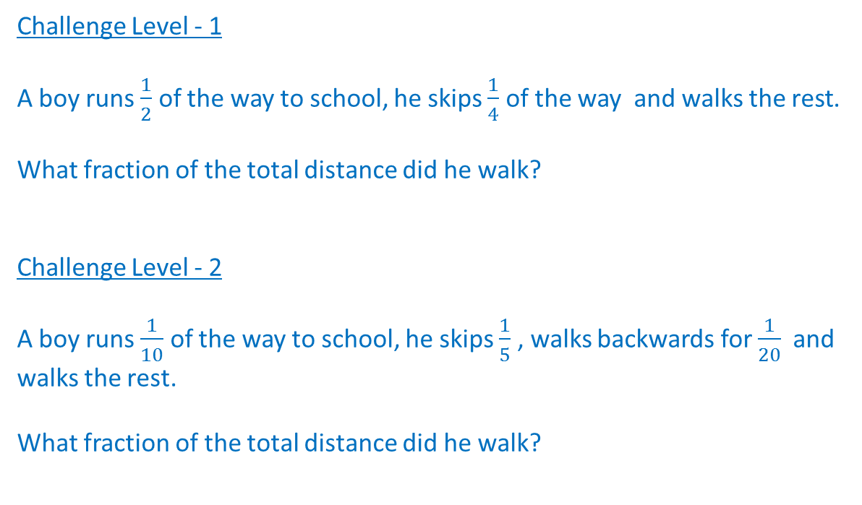
Your child will be able to show the equivalent forms of simple fractions, decimal fractions and percentages and can choose their preferred form when solving a problem, explaining their choice of method.
Second Level
Challenge Level - 1
A boy runs $\frac{1}{2}$ of the way to school, he skips $\frac{1}{4}$ of the way and walks the rest.
What fraction of the total distance did he walk?
Challenge Level - 2
A boy runs $\frac{1}{10}$ of the way to school, he skips $\frac{1}{5}$ , walks backwards for $\frac{1}{20}$and walks the rest.
What fraction of the total distance did he walk?

Slide 21
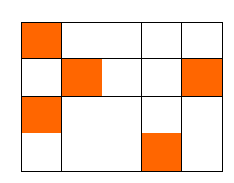

They will also be able to investigate how a set of equivalent fractions can be created, understanding the meaning of simplest form, and can apply their knowledge to compare and order the most commonly used fractions.
Second Level
Challenge Level - 1
Write this as a fraction in its simplest form?
Challenge Level – 2
A survey found that of the accidents that happen at home;
47/100 of them are falls
12/50 of them are electrical
3/20 of them are scalds or burns,
800 accidents were reported in the survey.
How many were:
a) Falls B) burns C) electrical
d) Which is bigger 12/50 or 3/20?

Slide 22
Second Level
Further Examples
Is the following statement true or false?
Explain your answer:
The larger the denominator the smaller
the value of the fraction

Slide 23
Link between Fractions and Decimals
Second Level
Understand the relationship between tenths and hundredths in common fraction and decimal fraction notation.
Convert tenths and hundredths to decimal notation.
Convert decimal fractions to common fractions.

Slide 24
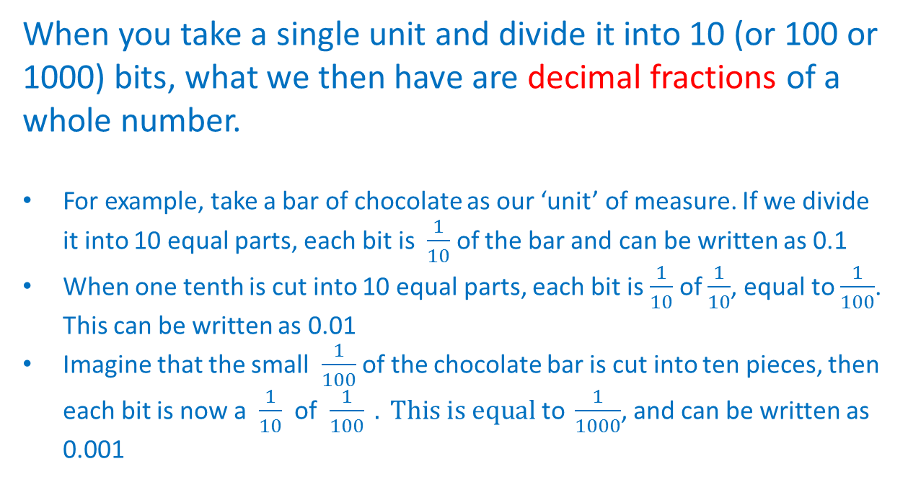
Second Level
Link between Fractions and Decimals
When you take a single unit and divide it into 10 (or 100 or 1000) bits, what we then have are decimal fractions of a whole number.
For example, take a bar of chocolate as our ‘unit’ of measure. If we divide it into 10 equal parts, each bit is $\frac{1}{10}$ of the bar and can be written as 0.1
When one tenth is cut into 10 equal parts, each bit is $\frac{1}{10}$ of $\frac{1}{10}$, equal to $\frac{1}{100}$. This can be written as 0.01
Imagine that the small $\frac{1}{100}$ of the chocolate bar is cut into ten pieces, then each bit is now a $\frac{1}{10}$ of $\frac{1}{100} . This is equal \text{to} \frac{1}{1000}$, and can be written as 0.001

Slide 25

Link between Fractions and Decimals
Second Level
If $\frac{6}{10}$as a decimal fraction is 0.6
Write the following as a decimal fraction:
    $\frac{3}{10}$
    $\frac{5}{10}$
    $\frac{9}{10}$

Slide 26
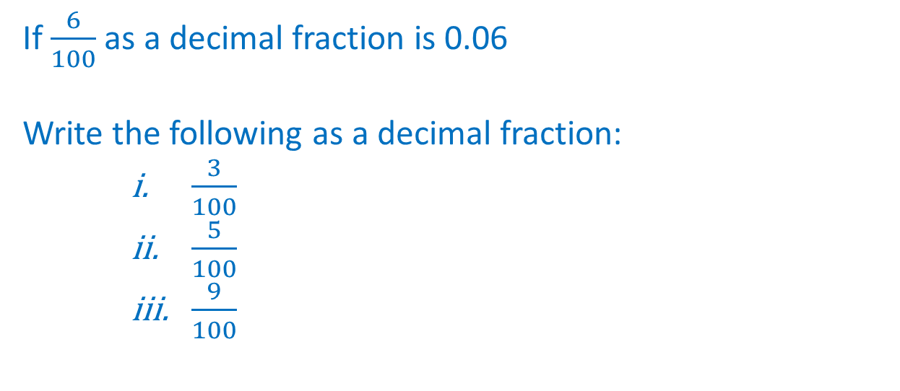
Link between Fractions and Decimals
Second Level
Second decimal place
If $\frac{6}{100}$as a decimal fraction is 0.06
Write the following as a decimal fraction:
    $\frac{3}{100}$
    $\frac{5}{100}$
    $\frac{9}{100}$

Slide 27
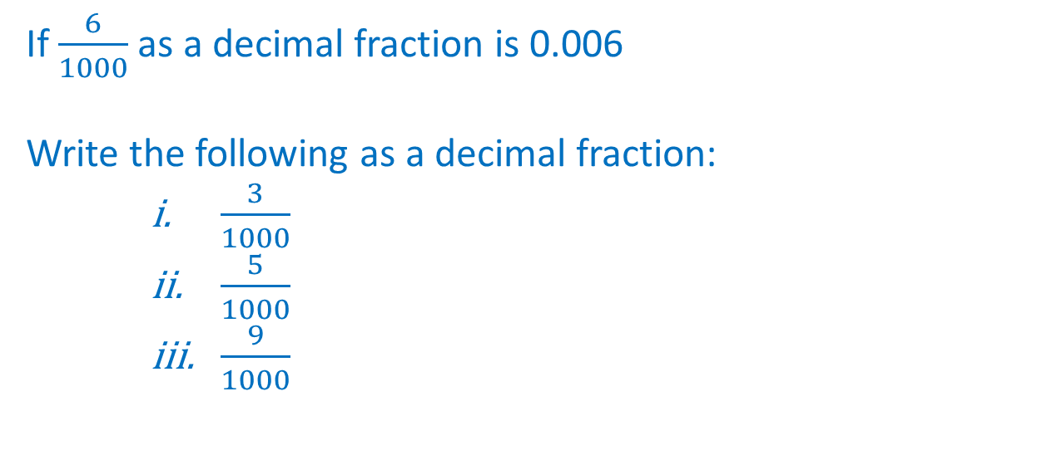
Link between Fractions and Decimals
Second Level
Third decimal place
If $\frac{6}{1000}$as a decimal fraction is 0.006
Write the following as a decimal fraction:
    $\frac{3}{1000}$
    $\frac{5}{1000}$
    $\frac{9}{1000}$

Slide 28
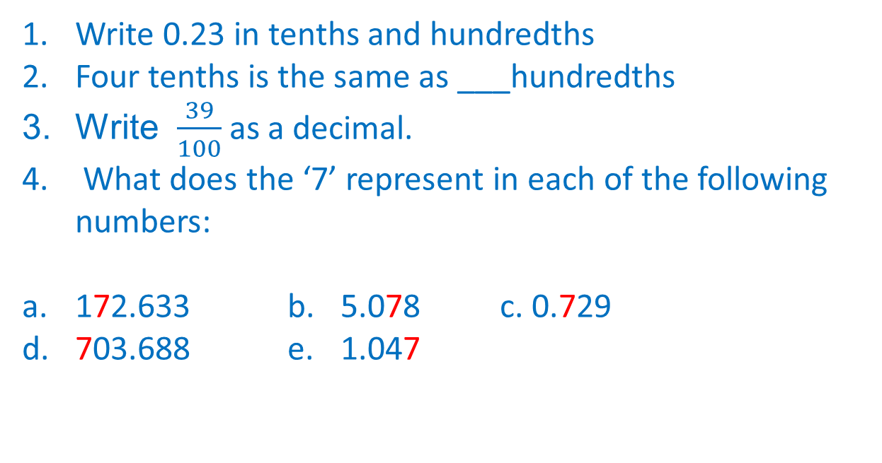
Link between Fractions and Decimals
Second Level
Mixed Examples
Write 0.23 in tenths and hundredths
Four tenths is the same as ___hundredths
Write $\frac{39}{100}$as a decimal.
What does the ‘7’ represent in each of the following numbers:
172.633 b. 5.078 c. 0.729
d. 703.688 e. 1.047

Slide 29
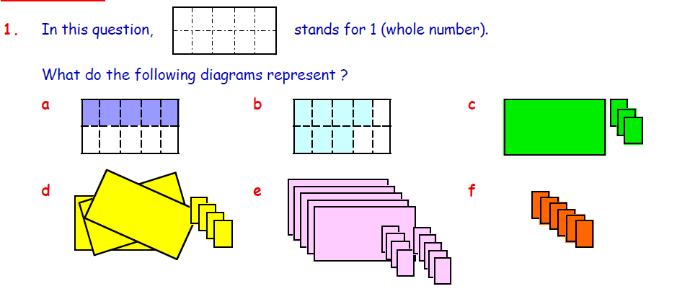
Link between Fractions and Decimals
Second Level

Slide 30
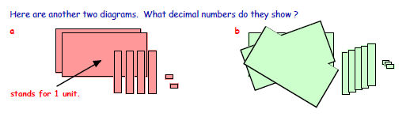
Link between Fractions and Decimals
Second Level

Slide 31
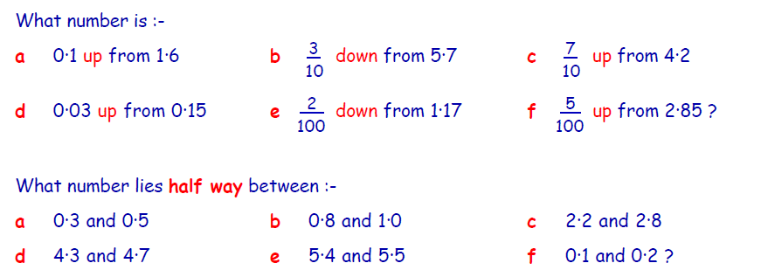
Link between Fractions and Decimals
Second Level
Mixed Examples
1.
2.

Slide 32

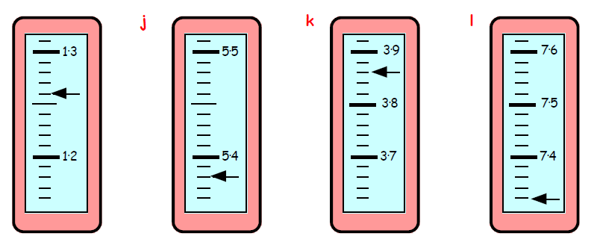
Link between Fractions and Decimals
Second Level
Decimals on a number line
To which numbers are the arrows pointing?
a
b.
1.
2.
a.
b.
c.
d.

Slide 33
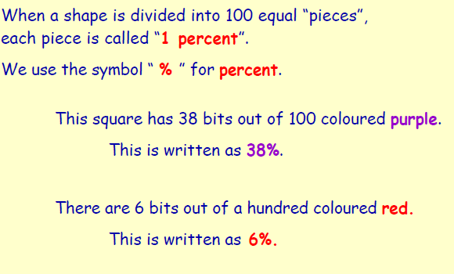
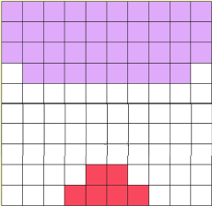
Link between Fractions, Decimals & Percentages
Second Level
What is a percentage?

Slide 34
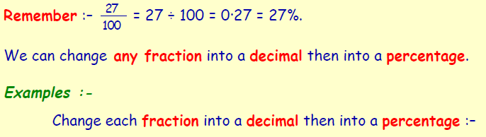

Link between Fractions, Decimals & Percentages
Second Level
(Note that a calculator may be used for these examples.)

Slide 35
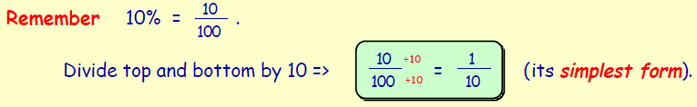
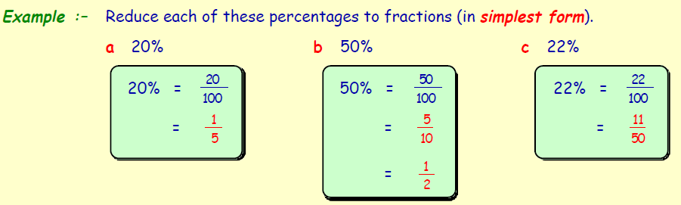
Link between Fractions, Decimals & Percentages
Second Level
Reducing a percentage to a fraction in its simplest form.

Slide 36
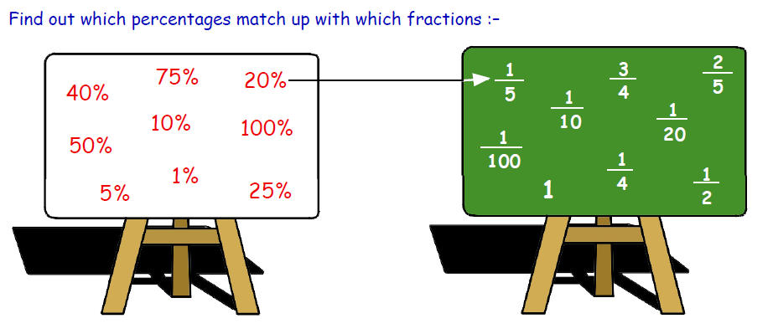
Link between Fractions, Decimals & Percentages
Second Level
Reducing a percentage to a fraction in its simplest form.

Slide 37
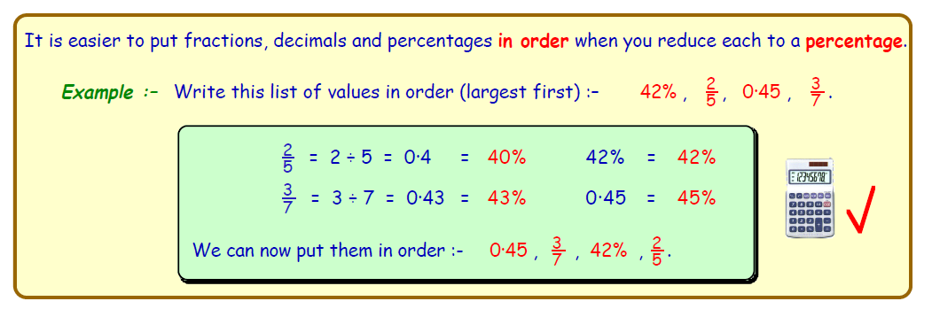
Link between Fractions, Decimals & Percentages
Second Level
Converting decimals and fractions to percentages.
(Note that a calculator may be used for these examples.)

Slide 38
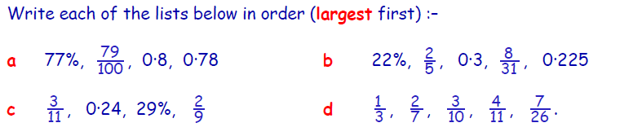
Link between Fractions, Decimals & Percentages
Second Level
Converting decimals and fractions to percentages.
(Note that a calculator may be used for these examples.)

Slide 39
Video Links
Second Level
http://www.iboard.co.uk/iwb/Fraction-Machine-Tool-377
http://www.topmarks.co.uk/Flash.aspx?b=maths/fractions
http://www.topmarks.co.uk/Flash.aspx?f=WhatFractionv3
http://www.topmarks.co.uk/Flash.aspx?a=activity08
http://www.topmarks.co.uk/Flash.aspx?f=DartboardFDP

Slide 40
Third Level
Third Level
Your child will be able to solve problems by carrying out calculations with a wide range of fractions, decimal fractions and percentages, using their answers to make comparisons and informed choices for real-life situations.
By applying my knowledge of equivalent fractions and common multiples, your child were be able to add and subtract commonly used fractions.
Having used practical, pictorial and written methods to develop my understanding, your child will be able to convert between whole or mixed numbers and fractions.
Your child will be able to show how quantities that are related can be increased or decreased proportionally and apply this to solve problems in everyday contexts.

Slide 41
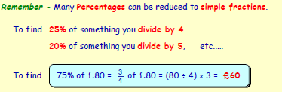
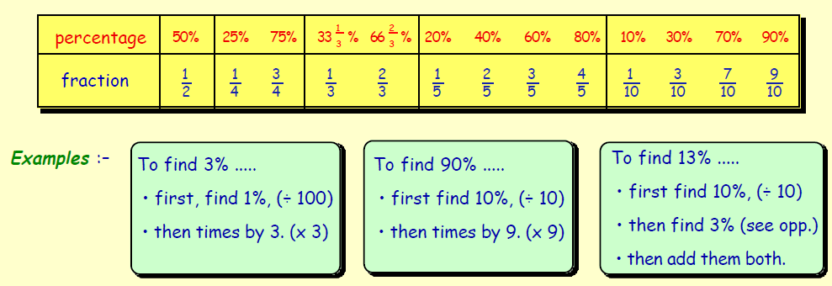
Finding a percentage without a calculator
Third Level

Slide 42
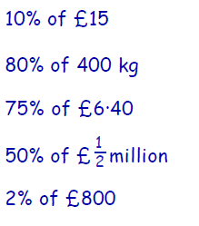
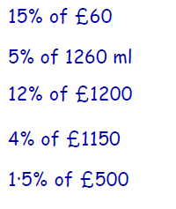
Finding a percentage without a calculator
Third Level
Challenge Level - 1
Challenge Level - 2

Slide 43
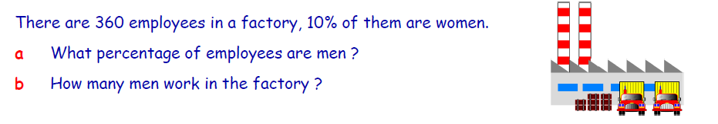
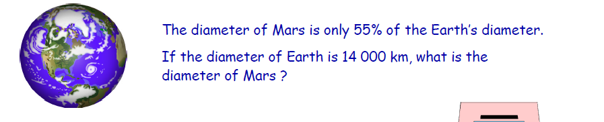
Finding a percentage without a calculator
Third Level
Challenge Level - 3
1.
2.

Slide 44

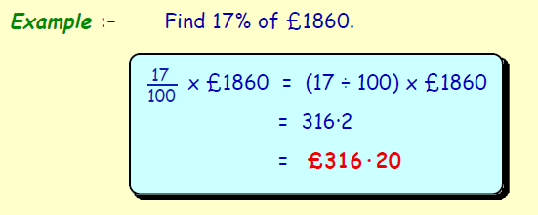
Finding a percentage with a calculator
Third Level

Slide 45
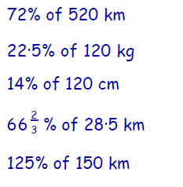
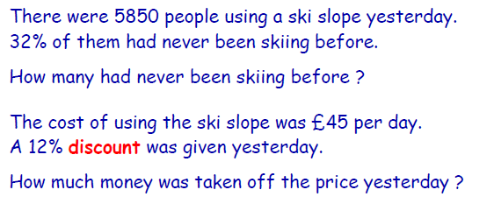
Finding a percentage with a calculator
Third Level
Challenge Level - 1
Challenge Level - 2
1.
2.

Slide 46

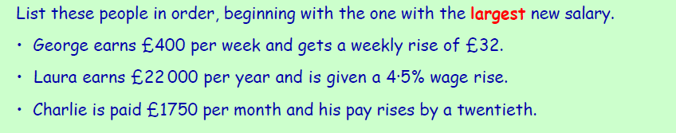
Finding a percentage without a calculator
Third Level
Challenge Level - 3
1.
2.

Slide 47
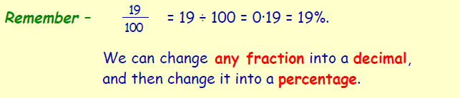
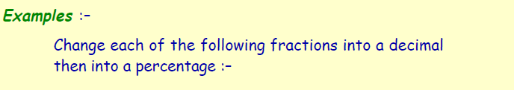
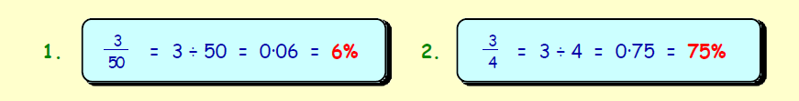
Linking fractions, decimals & percentages
Third Level

Slide 48
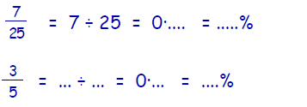
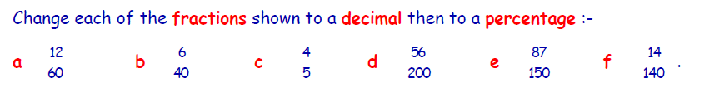
Linking fractions, decimals & percentages
Third Level
Challenge Level - 1
1.
2.
Challenge Level - 2
1.

Slide 49
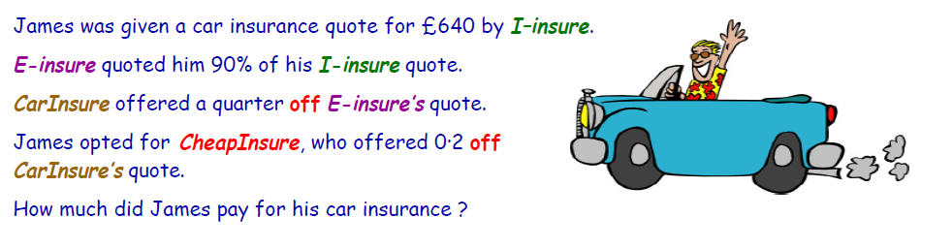
Finding a percentage without a calculator
Third Level
Challenge Level - 3

Slide 50
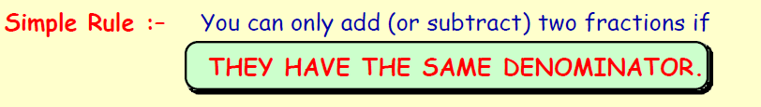
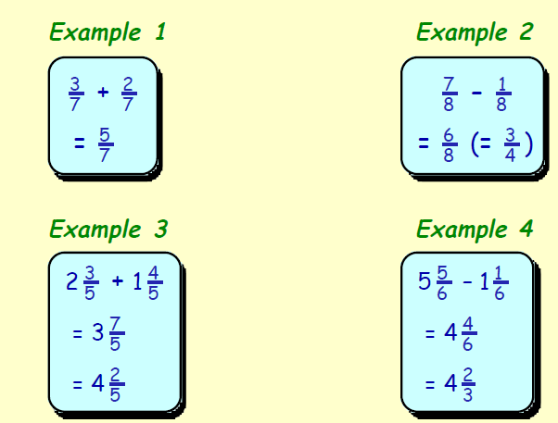
Adding & Subtracting Fractions
Third Level

Slide 51
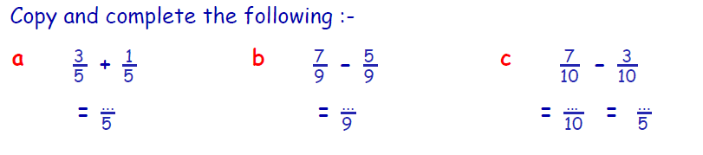
Adding & Subtracting Fractions
Third Level
Challenge Level - 1
Challenge Level - 2

Slide 52
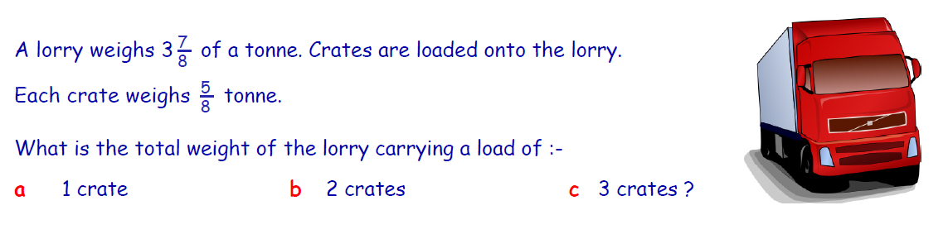
Adding & Subtracting Fractions
Third Level
Challenge Level - 3

Slide 53

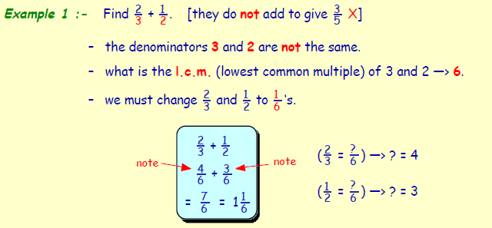
Adding & Subtracting Fractions
Third Level

Slide 54
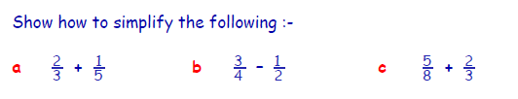

Adding & Subtracting Fractions
Third Level
Challenge Level - 1
Challenge Level - 2

Slide 55
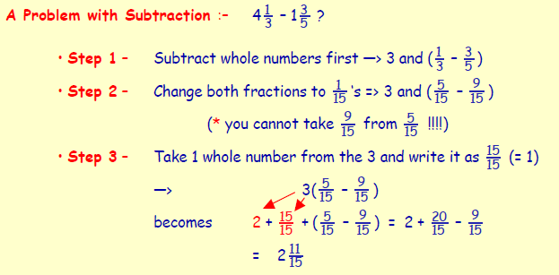
Adding & Subtracting Fractions
Third Level

Slide 56

Adding & Subtracting Fractions
Third Level
Challenge Level - 3

Slide 57

Adding & Subtracting Fractions
Third Level
Challenge Level - 4

Slide 58



Multiplying & Dividing Fractions
Third Level

Slide 59


Multiplying & Dividing Fractions
Third Level
Challenge Level - 1
Challenge Level - 2

Slide 60


Multiplying & Dividing Fractions
Third Level
Challenge Level - 3

Slide 61

Multiplying & Dividing Fractions
Third Level
Continued…

Slide 62

Multiplying & Dividing Fractions
Third Level

Slide 63


Multiplying & Dividing Fractions
Third Level
Challenge Level - 1
Challenge Level - 2

Slide 64

Multiplying & Dividing Fractions
Third Level

Slide 65


Multiplying & Dividing Fractions
Third Level
Challenge Level - 3
Challenge Level - 4

Slide 66


Understanding Ratio
Third Level

Slide 67



Understanding Ratio
Third Level
Challenge Level - 1
Challenge Level - 2

Slide 68

Understanding Ratio
Third Level
Challenge Level - 3

Slide 69

Simplifying Ratio
Third Level

Slide 70

Third Level
Simplifying Ratio
Challenge Level - 1
Challenge Level - 2

Slide 71

Understanding Ratio
Third Level
Challenge Level - 3

Slide 72
Video Links
Third Level
http://www.arcademics.com/games/ratio-blaster/ratio-blaster.html
http://games.cs.washington.edu/fv/rel/FAToy.swf
http://www.skoool.com.eg/english/skoool_bundle/content/primary/maths/add_sub_frac/index.html

Slide 73
Suggested Websites
http://www.bbc.co.uk/learningzone/clips/ordering-fractions-on-anumber-line/38.html
http://www.bbc.co.uk/learningzone/clips/ordering-fractions-on-anumber-
line-signed/1662.html
http://www.tes.co.uk/teachingresource/Teachers-TV-Problemsolving-
and-Other-Topics-6046026/

