Slide 1
Developing Reading Skills

Slide 2
Reading at Home
Research shows that children who are read to on a regular basis before they start school are most likely to succeed.
It is a key predictor in terms of educational success.
Pie Corbett, who acts as an educational adviser to the government, said too many children were left to watch TV instead of being read a bedtime story, often by busy middle-class parents.
"This isn't just an economic thing – it's not just people who come from poor backgrounds, it's across the whole of society. You get a lot of children coming from very privileged backgrounds who've spent a lot of time in front of the TV and not enough time snuggled up with a good book. The TV does the imagining for you – and it doesn't care whether you're listening or not.“
Being told stories boosts language and, by feeding the child's imagination, develops abstract thought.

Slide 3
Reading for Pleasure
Just because your child is learning to read, avoid turning storytime into an academic exercise by using it to test your child’s reading skills!
Be a good role model, if children see adults reading for pleasure they will be encouraged to read too.
It is important, particularly for boys, to have male role models as readers and to be read to by both males and females.
Find a quiet time to read in a comfortable space which suits you and your child so that it does not feel like a chore.
Find texts which interest your child and not just what you would like them to read.
It could be comics, non fiction books, joke books etc
Visit the library and let your child choose new books to share.
Talk about what you have read.
Children can have favourite books they like to read many times and can almost recite to you, let them do this, they are acting as a reader.
.

Slide 4
Rhyme and Alliteration
If children do not develop phonological awareness, (sound discrimination) they will find it very difficult to read. This is the foundation of building their reading skills and ability to blend letter sounds and hear words.
Share nursery rhymes and poems as part of your reading time , sing them and say them.
Make up rhymes together and change rhymes you know already.
Play games making the longest rhyming strings and sentences with alliterative words.

Slide 5
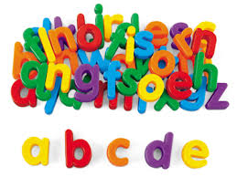
Letter Sounds and Letter Names
It is more important for your child to know the letter sound than the letter name but this does not mean there is any harm in knowing both.
Encourage awareness of print in everyday life; signs, adverts, food labels, menus, recipes etc
Look for letters and words you know they are learning at school that week
Play games e.g I spy (but with letter sounds rather than names) you sound a word and they guess it.
As they learn their sounds and begin to blend them to hear the words you can use a variety of materials to make reading and writing words fun.
Magnetic letters, playdough, shaving foam, painting, sand, pipe cleaners, chalk (you can do this outside as well), lego, collect natural materials and make words with them.
Write for a purpose; invitations, birthday cards, captions for a picture, make books and comic strips about what interests them (animal facts, dinosaurs, retelling favourite stories) Make a special box with them where they collect materials for writing.
As with your choice of reading books choose something which your child enjoys doing so it does not feel like school all over again. This will only put them off doing it!

Slide 6
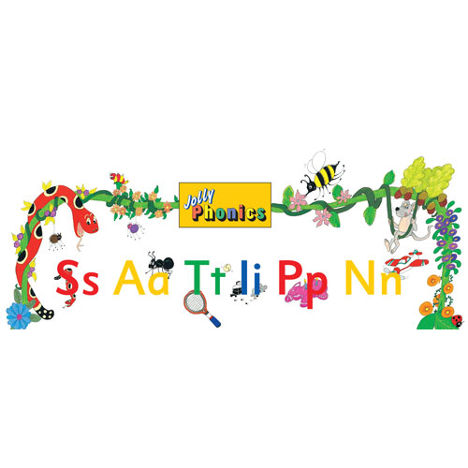
Reading Skills in School
Rhyme and alliteration
Jolly Phonics
Blending
Initial, medial and final sounds in words
Tricky words
Lowercase and uppercase letters
Alphabetic order (end of P1/P2)
Reading texts fiction and non fiction as a whole class
Reading in groups
COMPREHENSION

Slide 7
Reading and Phonics Homework
Don’t use the school reading book as a substitute for your reading time together.
Don’t let it become a battle. Negotiate with your child e.g. take turns to read a page, you read one night they read the next etc
Praise and encourage them for the words they can decode and if there are words they are really struggling to hear, you sound them and make it obvious what the word is !
Make up games with the words they are learning e.g. simple bingo, put the words round the house and send them on a word hunt.
Have the words on the fridge or in their room so they are seeing them all the time.
Remember that comprehension is as important as the reading so make sure you discuss the book during the reading and at the end of the book.

